Slide 1
IWA19 Capstone
Book Connect
CREATED BY: MICSIB179 - Michael Siboto ______________________ Coach: Sarah Francis

Slide 2
Objectives
User Stories
As a user, I want to view a list of book previews, by title and author, so that I can discover new books to read.
As a user, I want an image associated with all book previews so that I can recognize a book by the cover even if I forgot the name.
As a user, I want to have the option of reading a summary of the book so that I can decide whether I want to read it.
As a user, I want to have the option of seeing the date that a book was published so that I can determine how easy it is to obtain second-hand.
As a user, I want to find books based on specific text phrases so that I don’t need to remember the entire title of a book.
As a user, I want to filter books by author so that I can find books to read by authors that I enjoy.
As a user, I want to filter books by genre so that I can find books to read in genres that I enjoy.
As a user, I want to toggle between dark and light modes so that I can use the app comfortably at night.

Slide 3
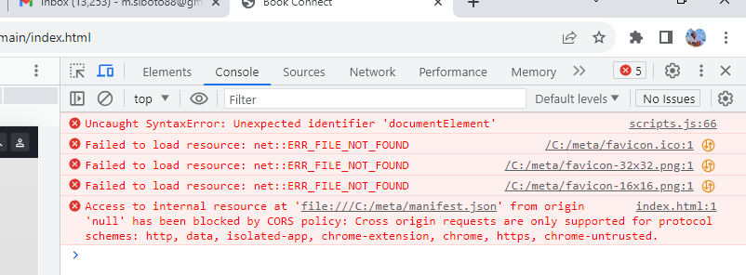
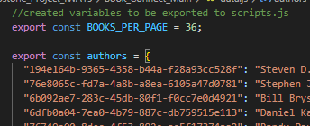
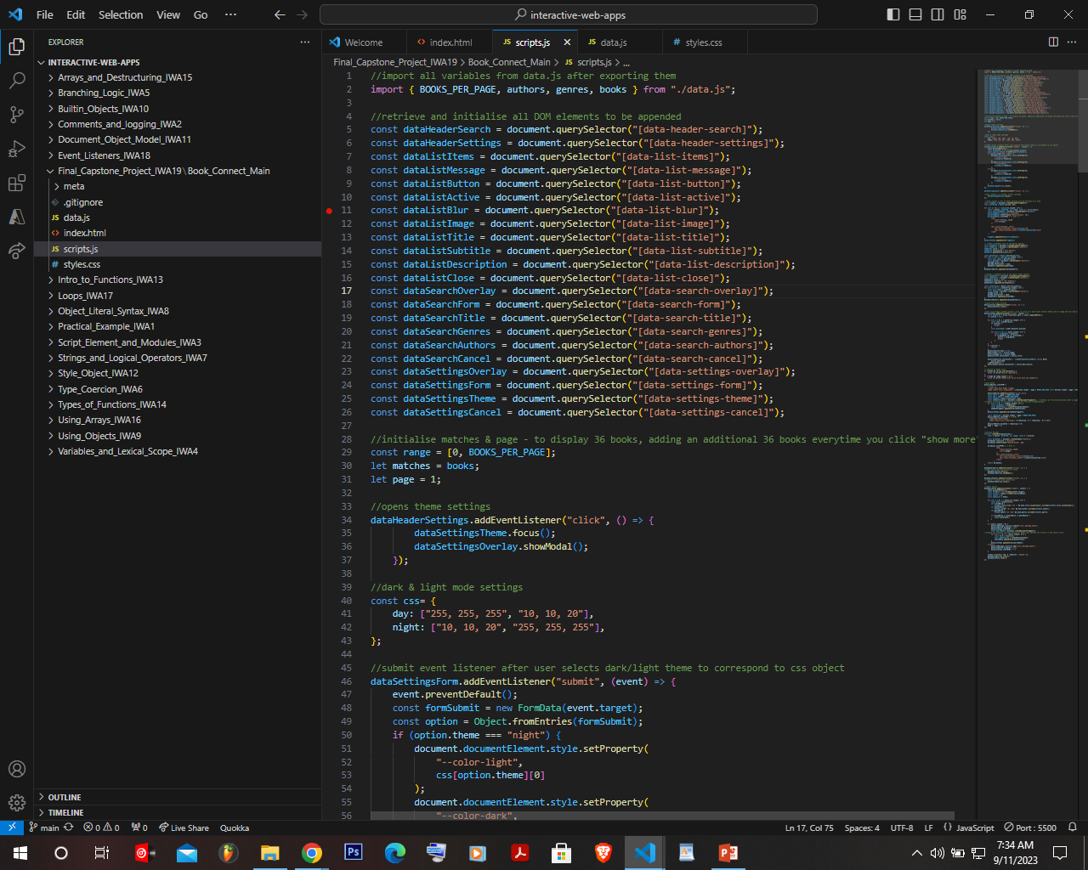
Resolutions
Inspected common erros/faults
Found the java scrips was not loading properly.
Corrected the scrips loading path by including defer type = “module”.
Removed the data.js by rather using inport/export method for information required from the file

Slide 4
Resolutions
Removed the data.js from html file and rather used import/export method for information extracted from file.

Slide 5

Resolutions
Created variables to retrieve and initialise all DOM elements to be appended in the code

Slide 6
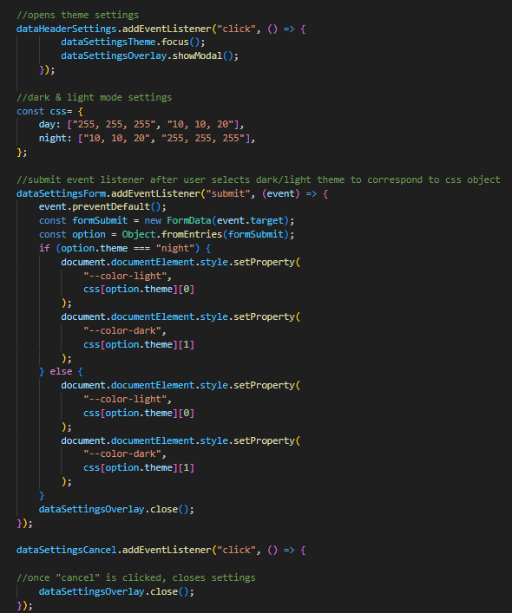
Resolutions
To set day/night mode, addEventListerner for when clicking on the header button to show popup window to chose options on the input box using focus and showModal functions
Created variable for day/night with different color options.
submit event listener after user selects dark/light theme to correspond to css object.
Utilised if else statements depending on user theme option.

Slide 7
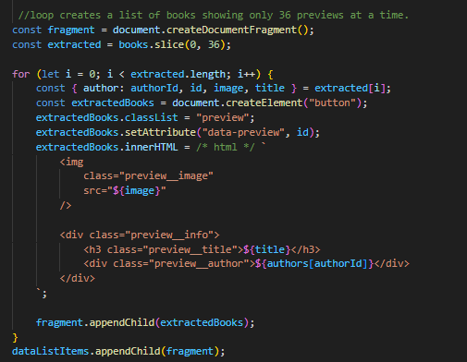
Resolutions
Created a fragment with a variable that selects the first 36 books
created a function that takes 'matches' variables (equal to the book obj) , and extracted all properties from each object
div element was created to contain HTML and added the class 'preview' to it in order to apply all styling
following that, HTML was created to be put on the DOM

Slide 8
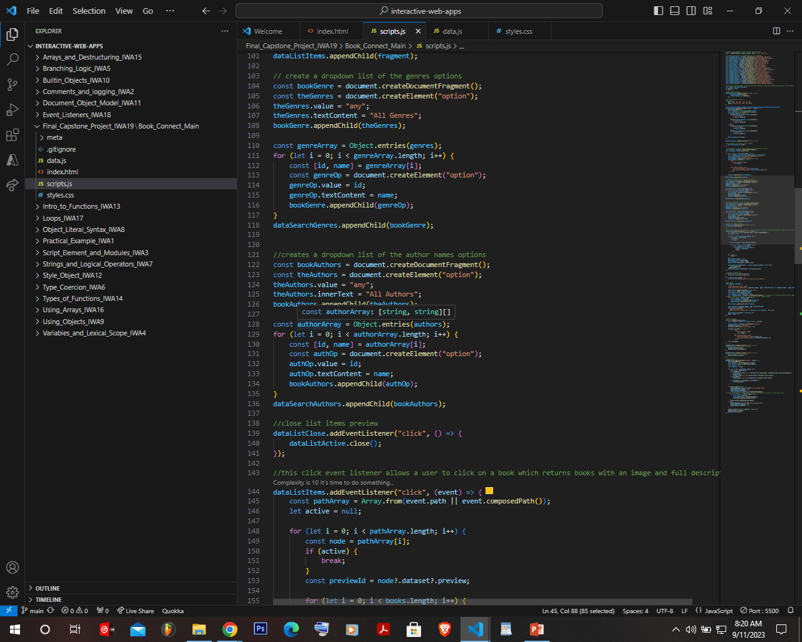
Resolutions
The created DOM elements were made to be displayed on html
the value and innerText of the created 'option' element are set to 'any' and 'All Genres' respectively until they are changed by the user when selected; the for loop displays this
the 'id' and 'name' properties are abstracted from each genre; each time the loop runs, a new 'option' element is created and its value and innerText (after the user has made their choice) changes to the matching 'id' and 'name' of that in 'genres'

Slide 9
Resolutions
Used the same logic for genre to display authors :
fragments are created to hold the content
its default values and innerText is set
the loop, creates a new 'option' element,
with each iteration through the 'authors' object, sets its value and innerText to the appropriate id and name

Slide 10
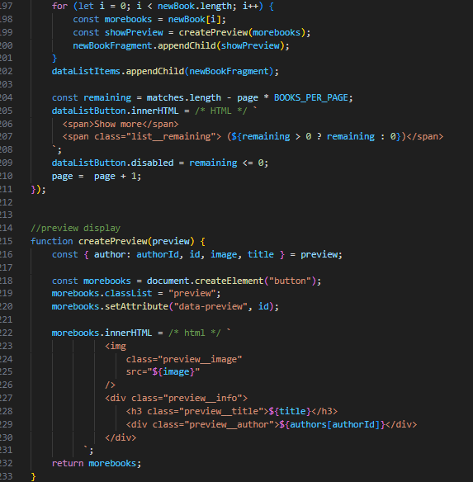
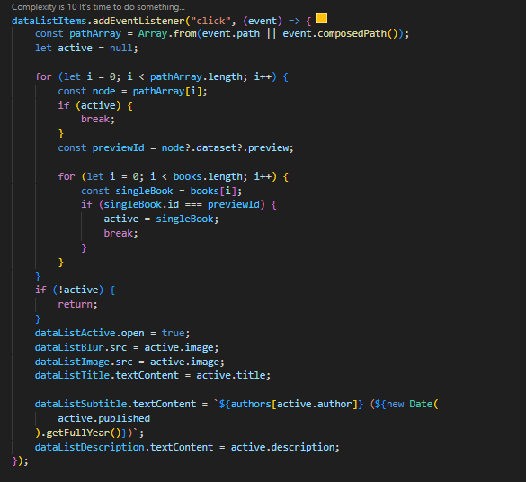
Resolutions
Included a click event listener that allows a user to click on a book which returns books with the following preview information: image, title, full description year published

Slide 11
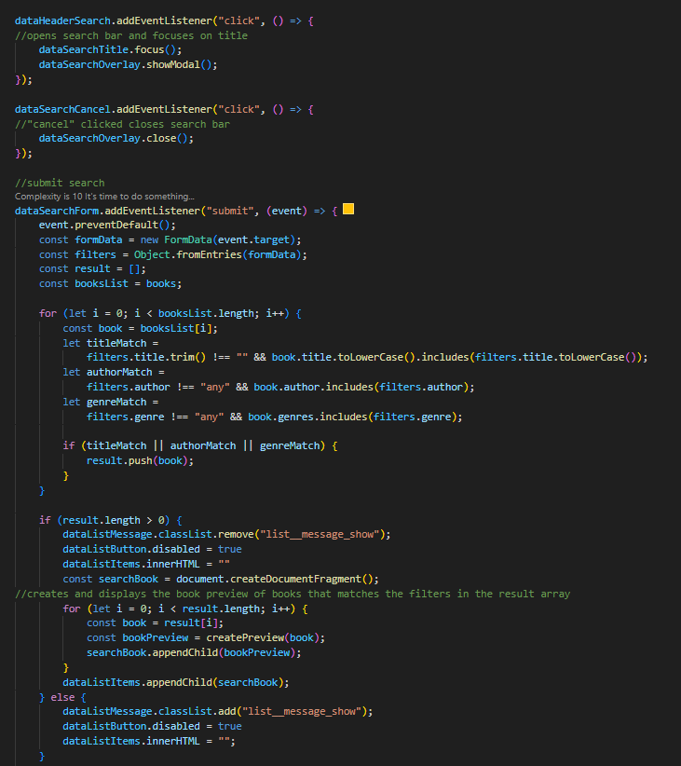
Resolutions
Lastly included an eventListerner that opens search bar
Search using title, author or genre.
creates and displays the book preview of books that matches the filters in the result array

