Slide 1
Global Terrorism
Berger Markus 1618005
Bognár Péter 1846044
Böröndy Ádam 1610133
Markus Sieder 1610682
188.995 Datenorientierte Programmierparadigmen 2019W

Slide 2
Content
Terrorism
Goals
Datasets
Data Preprocessing
Insights
Berger Markus,
Bognár Péter,
Böröndy Ádam,
Markus Sieder

Slide 3
Goals
Terrorism
Questions to be answered:
Does unemployment influence terrorism within a country?
Does GDP per capita influence terrorism within a country?
Which economical and social influences have an influence terrorism?
What data is necessary to predict terrorism for the next year?
Berger Markus,
Bognár Péter,
Böröndy Ádam,
Markus Sieder

Slide 4
Data
Terrorism
Global Terrorism Database (GTD) .csv
1970 – 2017 (missing 1993)
More than 180.000 terrorist attacks
More than 100 variables on location, perpetrators, targets and outcome
World Bank Data .xls
1960 – 2018
GDP (total, per capita, per capita growth)
Unemployment
Life expectancy at birth
Berger Markus,
Bognár Péter,
Böröndy Ádam,
Markus Sieder

Slide 5
Data Processing
Global Terrorism Database
Processing
Calculating casualties (killed + wounded)
Removing years before 1992 (before that: different countries, bad reporting, etc.)
Renaming countries to official UN names
Missing
Backwards interpolation for year 1993
Outliers
Removing terrorist attacks with 350 or more killed
Not reasonable for analysis
(You can’t predict 9/11!)
Berger Markus,
Bognár Péter,
Böröndy Ádam,
Markus Sieder

Slide 6
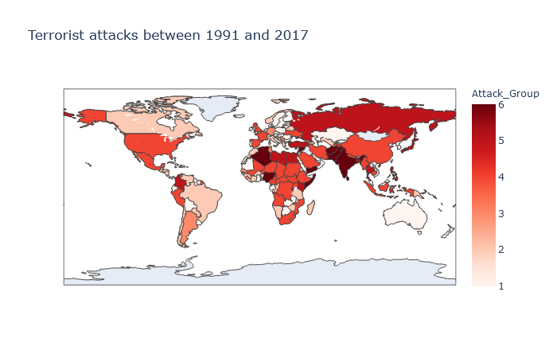
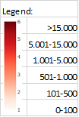
Data
Insights
Terrorism
Berger Markus,
Bognár Péter,
Böröndy Ádam,
Markus Sieder

Slide 7
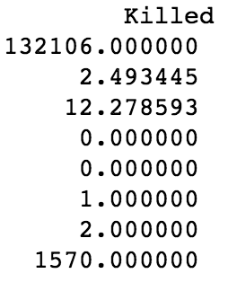
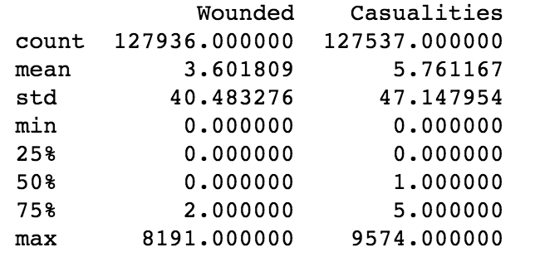
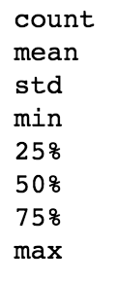
Data
Insights
Terrorism - Stats
Berger Markus,
Bognár Péter,
Böröndy Ádam,
Markus Sieder

Slide 8
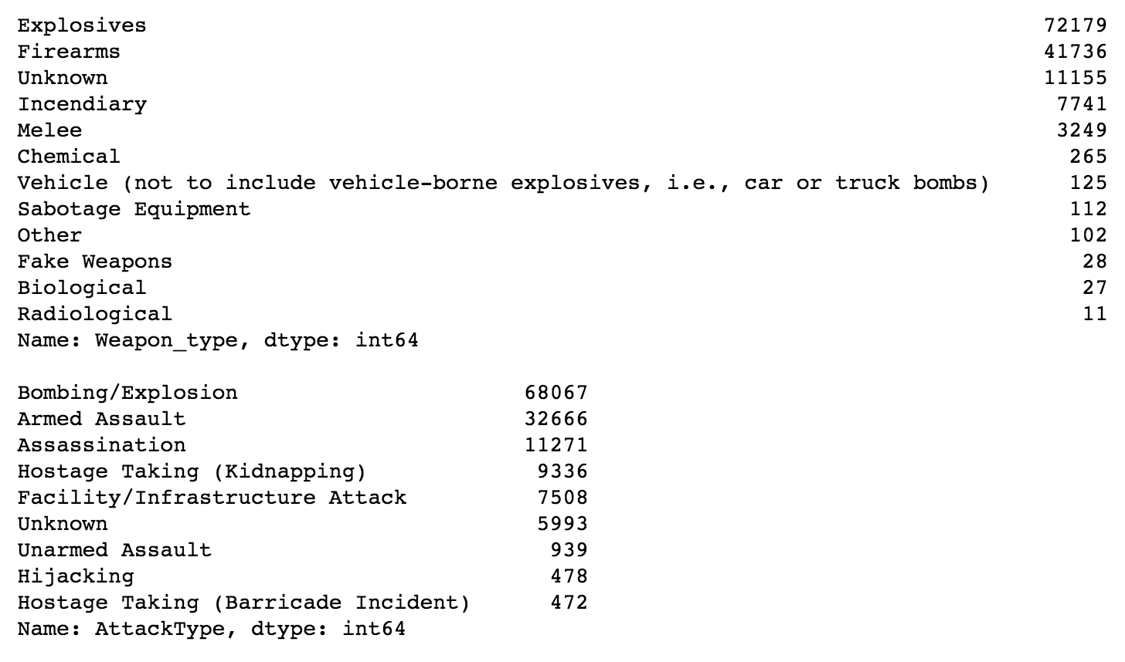
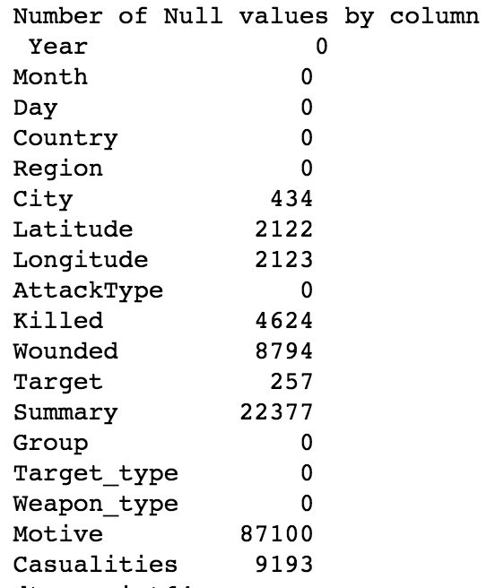
Data
Insights
Terrorism - Stats
Weapon Types
Attack Types
Berger Markus,
Bognár Péter,
Böröndy Ádam,
Markus Sieder

Slide 9
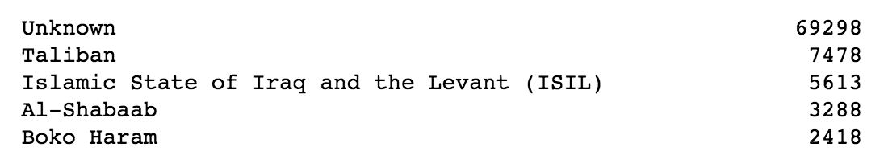
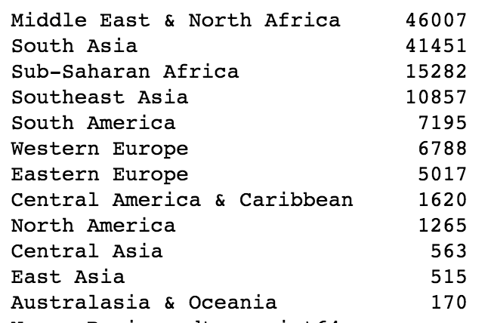
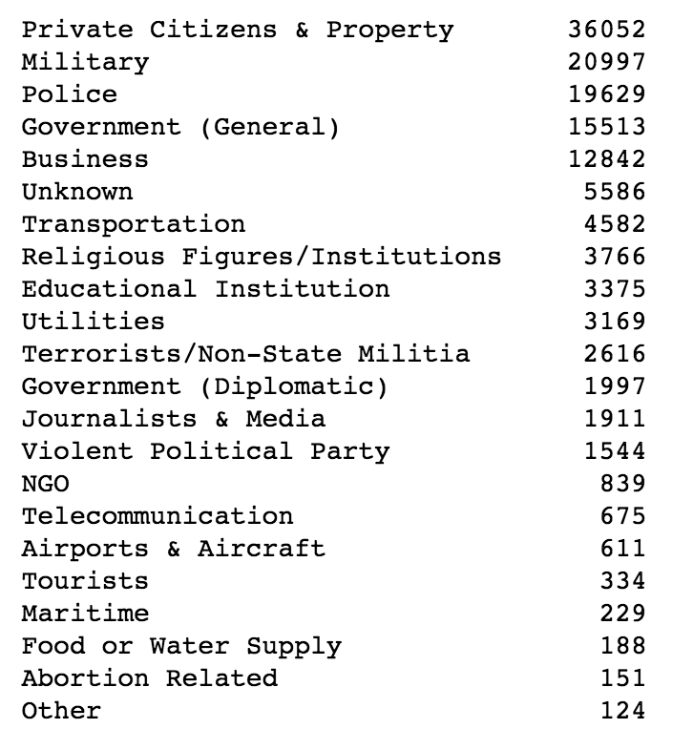
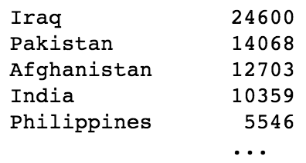
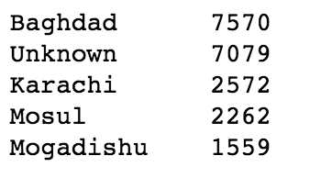
Data
Insights
Terrorism - Stats
Terrorist Organization
Region / Country / City
Targets of Attack
Berger Markus,
Bognár Péter,
Böröndy Ádam,
Markus Sieder

Slide 10
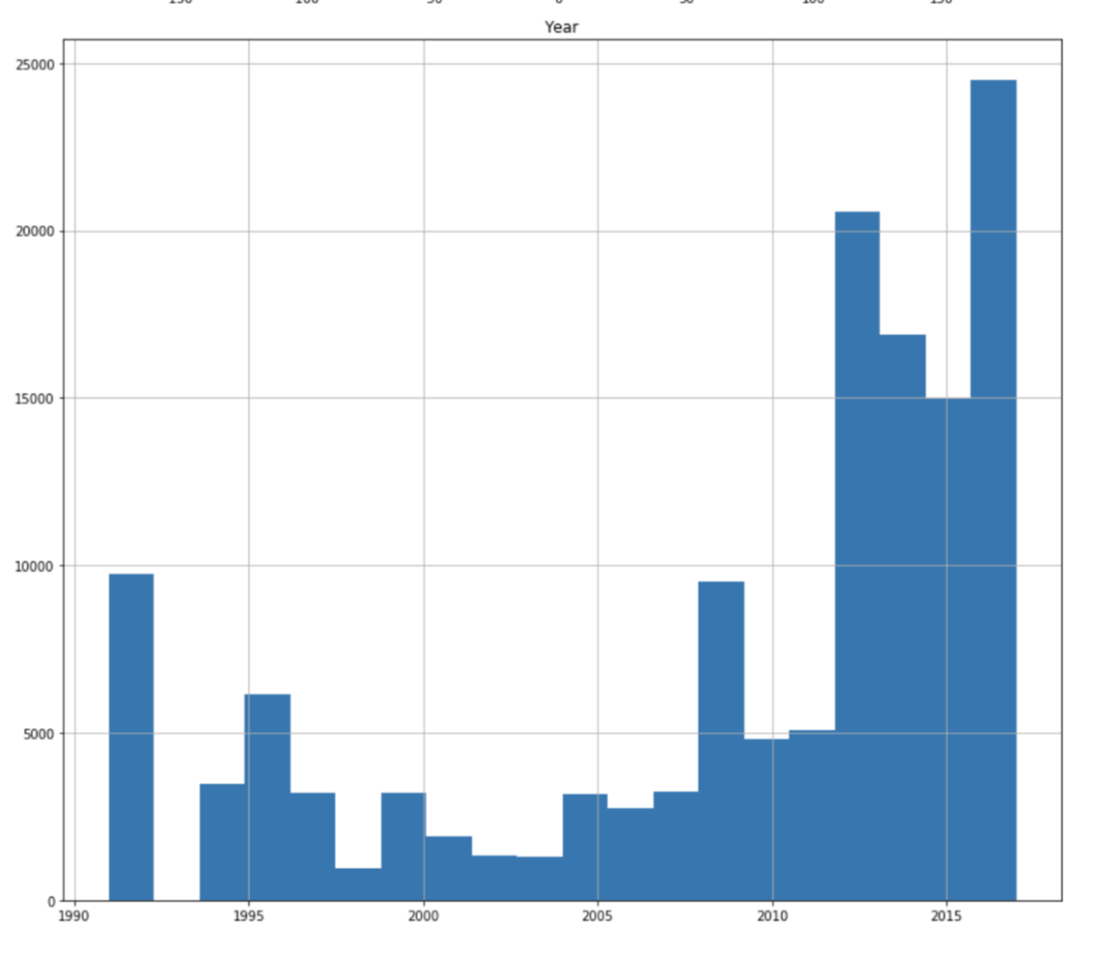
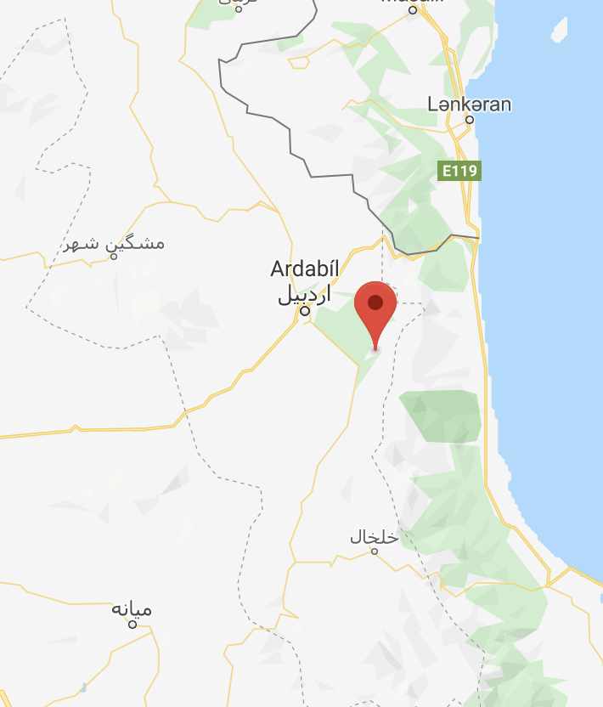
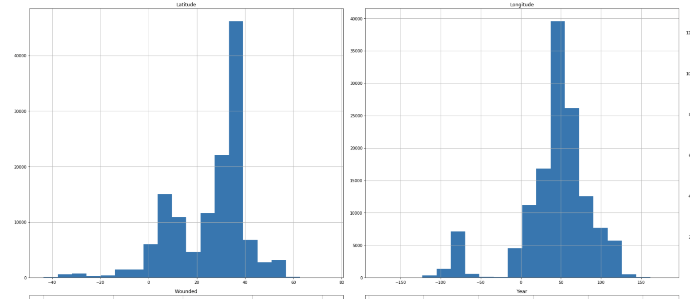
Data
Insights
Terrorism - Stats
Berger Markus,
Bognár Péter,
Böröndy Ádam,
Markus Sieder

Slide 11
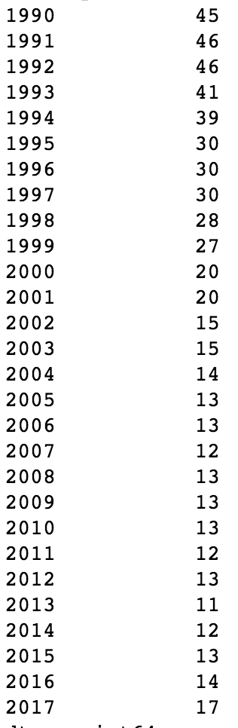
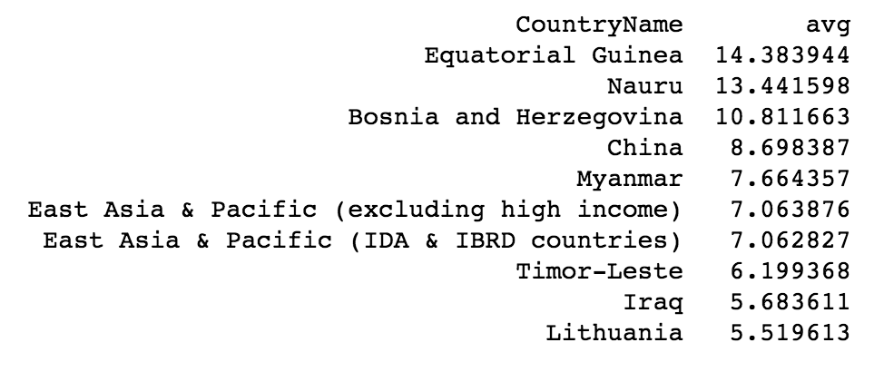
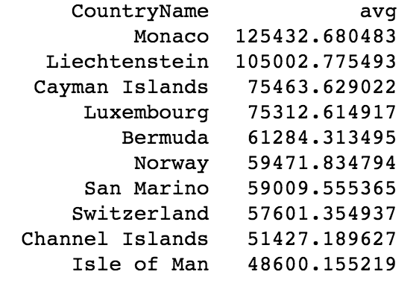
Data
Insights
GDP - Stats
GDP growth
GDP/capita
Berger Markus,
Bognár Péter,
Böröndy Ádam,
Markus Sieder

Slide 12
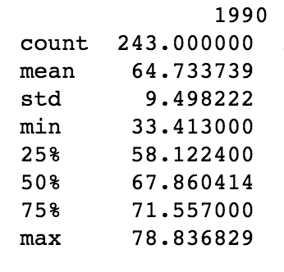
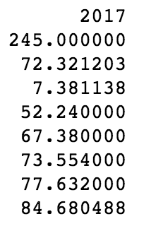
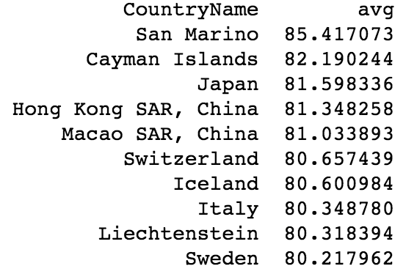
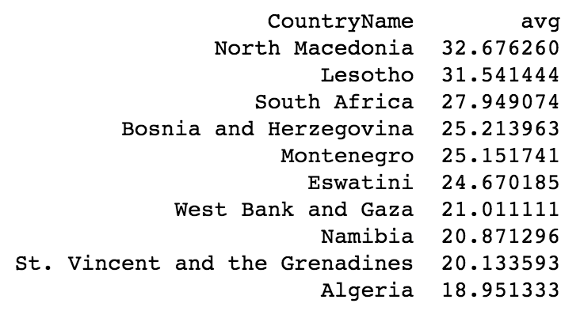
Data
Insights
Life & Unemployment - Stats
Avg lifetime TOP 10
Rate of Unemployment in %
Berger Markus,
Bognár Péter,
Böröndy Ádam,
Markus Sieder

Slide 13
Data Processing
World Bank Data
Processing
Removing years before 1992 and after 2017
Computing average values for visualization
Missing values
Interpolation by row (country)
Combining with GTD
Dropping countries with no attacks
Small country Boolean (25 % quantile)
GDP in different forms (log, normalized, change in %)
Attacks and casualties (last 1, 3 and 5 years)
Terrorism (low, medium, high)
Berger Markus,
Bognár Péter,
Böröndy Ádam,
Markus Sieder

Slide 14
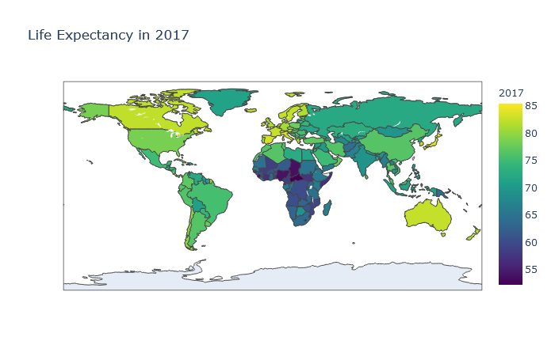
Data
Insights
Life Expectancy in 2017
Berger Markus,
Bognár Péter,
Böröndy Ádam,
Markus Sieder

Slide 15
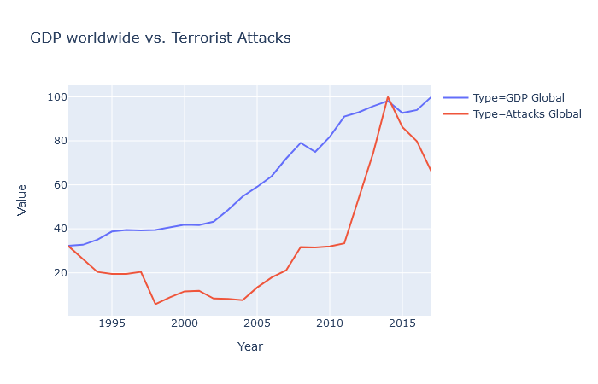
Data
Insights
Terrorism vs GDP
Berger Markus,
Bognár Péter,
Böröndy Ádam,
Markus Sieder

Slide 16
Data
Insights
Terrorism vs GDP
Rise throughout recent year
Heavy Increase in few countries
Correlation != Casualty
New Questions and Data
Berger Markus,
Bognár Péter,
Böröndy Ádam,
Markus Sieder

Slide 17
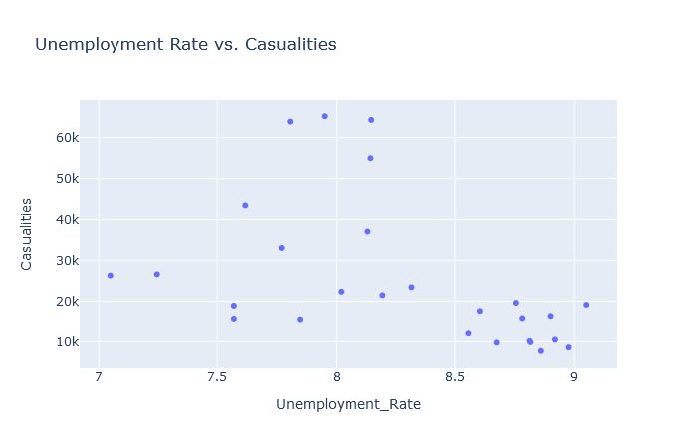

Question
Answering
Does unemployment influence terrorism within a country?
Correlation = -0.049
Discarded
Berger Markus,
Bognár Péter,
Böröndy Ádam,
Markus Sieder

Slide 18
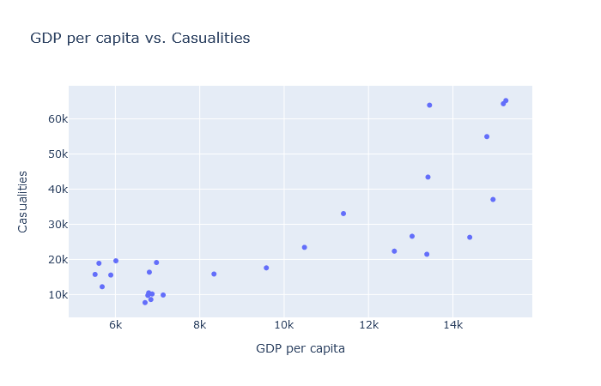
Question
Answering
Does GDP per capita influence terrorism within a country?
Correlation = -0.10
Discarded
Berger Markus,
Bognár Péter,
Böröndy Ádam,
Markus Sieder

Slide 19
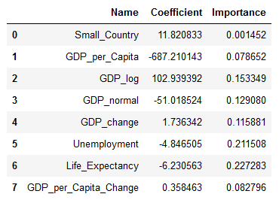
Question
Answering
Which economical and social influences have impact on terrorism?
Regression Coefficients (Ridge)
Random Forest Importance
MAE
86 (Random Forest)
398 (Ridge Regression)
RMSE
370 (Random Forest)
1330 (Ridge Regression)
Berger Markus,
Bognár Péter,
Böröndy Ádam,
Markus Sieder

Slide 20
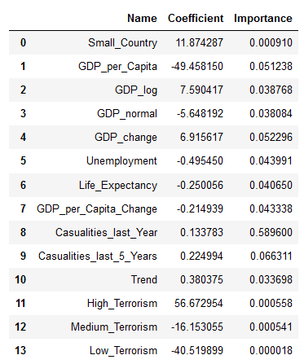
Question
Answering
What data is necessary to predict terrorism for the next year?
Idea to include past terrorism activity
Exclude outlier countries
Improved Model
MAE [RF=39; Ridge=43]
RMSE [RF=91;Ridge=96]
Berger Markus,
Bognár Péter,
Böröndy Ádam,
Markus Sieder

Slide 21
Any further Questions?
Thank you for your attention!

