Slide 1



Object-Based vs Pixel-Based Classification for Dehradun Urban Expansion 2016-2024
Mohammad Salman | M.Sc. Geo-informatics, IIRS Dehradun | Sentinel-2 SR +
IIRS Dehradun | June 2026

Slide 2
Research Question & Hypotheses
Question:
Does Object-Based Image Analysis (OBIA) of Sentinel-2 produce a more accurate land-cover map of Dehradun than per-pixel classification — and how much new built-up area appeared between Nov 2016 (winter S2 composite) and Nov 2024?
Hypotheses:
H1 OBIA will reduce salt-and-pepper noise compared to per-pixel Random Forest.
H2 OBIA accuracy >= pixel-based accuracy because object-level features average out within-segment noise and provide more stable training signatures.
H3 Both methods will agree that Dehradun gained built-up area 2016 -> 2024, primarily at the cost of cropland and dense vegetation.
2 / 23

Slide 3
Why Compare OBIA vs Pixel-Based?
Pixel-based classification:
+ Long-established (MLC, RF, SVM since 1990s).
+ Captures fine spectral detail at sensor resolution.
- Salt-and-pepper noise in heterogeneous urban scenes.
- Ignores spatial context entirely.
Object-Based Image Analysis (OBIA):
+ Groups neighboring spectrally-similar pixels into
'image objects' (segments) before classification.
+ Each segment carries spatial + spectral + (optionally)
textural / shape descriptors.
+ Visually smoother, polygon-ready output.
- Sensitive to segmentation parameters (scale, compactness).
- Mixed segments inherit a single class label.
Open question for medium-resolution (10 m) data:
At 10 m Sentinel-2, individual urban objects (rooftops,
road segments, small fields) are 1-3 px wide. SLIC
segments of typical size (1000+ px) inevitably mix these.
Does the noise-reduction benefit of OBIA outweigh the
loss of within-segment spectral diversity?
Existing literature is split:
- Blaschke (2010), Hossain & Chen (2019) — OBIA wins
on VHR imagery (< 2 m).
- Whyte et al. (2018), Ma et al. (2017) — comparable or
worse for medium-resolution.
This study contributes one more data point in the second
regime, applied to a rapidly urbanizing Himalayan foothill
city.
3 / 23

Slide 4
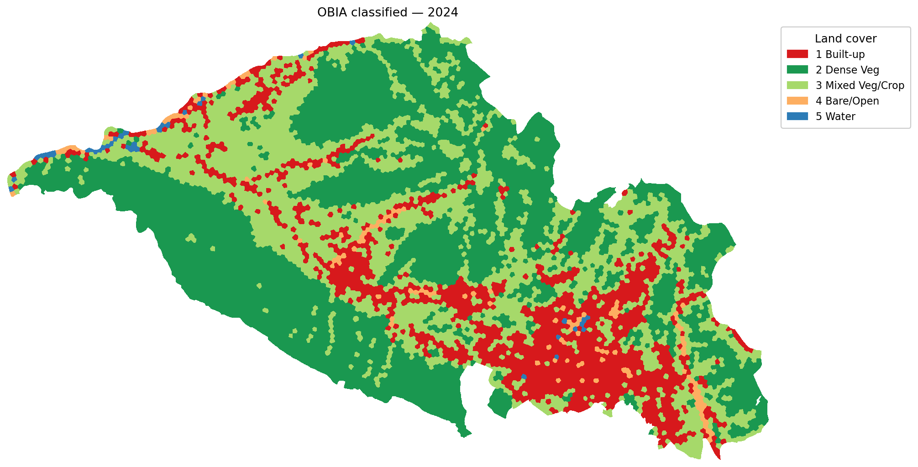
Study Area — Dehradun Valley, Uttarakhand
Dehradun district capital, India
• Population: ~700k city, ~1.7M district (2024 est.)
• Capital of Uttarakhand, fastest-growing tier-2 city
in the Himalayan belt.
• Caught between Mussoorie ridge (N) and Shivalik (S).
AOI extent:
• Bounding box ~58.6 x 33.7 km (entire raster)
• Valid (in-AOI) area ~996 km^2 (after clip mask)
• CRS: EPSG:32644 (UTM zone 44N)
• Pixel size: 10 m
Drivers of change 2016 -> 2024:
• IT/education sector expansion (Selaqui, Sahastradhara)
• Smart-City projects, peri-urban ribbon development
OBIA-classified 2024 map showing the AOI shape.
4 / 23

Slide 5
Data — Sentinel-2 Surface Reflectance Composites
Two cloud-free winter composites from Google Earth Engine:
Dehradun_2016.tif (Nov 2016 - Feb 2017)
Dehradun_2024.tif (Nov 2024 - Feb 2025)
Specifications (both scenes):
• 12 bands per scene, Float32, 10 m resolution
• CRS EPSG:32644, identical transform/shape — co-registered
• Raster size 3371 x 5864 px (~20M pixels, ~10M valid)
• Already clipped to Dehradun AOI in GEE
Band order:
B2 B3 B4 B8 B5 B6 B7 B8A B11 B12 NDVI NDBI
Blue Green Red NIR Red-edge x3 (10m+resamp) SWIR x2 indices
Why winter window:
• Cloud-free in Indian Himalayan foothills.
• Dry season — clear distinction between irrigated cropland,
fallow bare land, and natural vegetation.
Pre-processing audit :
Per-band statistics inside AOI revealed an unexpected issue: B5, B6, B7, B8A, B11, B12 carry effectively NO signal inside AOI — e.g. B11 std = ~22 DN on a ~1820 mean,range 1744-1865 (~6% relative).
Likely cause: a band-reduction step in the GEE composite export collapsed these bands. Validated by checking that B2/B3/B4/B8/NDVI/NDBI all retain proper std (200-500 DN, NDVI std ~0.22 — physically plausible).
Decision:
Drop B5, B6, B7, B8A, B11, B12 from feature stack.
Final feature set (6): B2, B3, B4, B8, NDVI, NDBI.
5 / 23

Slide 6
Land-Cover Class Scheme (5 classes)
ID | Class | Spectral signature (winter) | Typical features in Dehradun
1 | Built-up | high B2/B3, NDBI > 0, NDVI < 0.3 | Old city, IT parks, ribbon settlements, roads
2 | Dense Vegetation | NDVI > 0.65, low SWIR | Pine/oak forest on ridges, mature riparian belts
3 | Mixed Veg / Cropland | NDVI 0.30-0.55, mixed NDBI | Basmati/wheat fields, orchards, sparse settlements
4 | Bare / Open Land | NDVI < 0.20, mid B8, mid NDBI | Fallow fields, riverbeds, exposed soil, construction
5 | Water | very low NIR (B8), NDVI < 0.0 | Asan, Tons, Song rivers; small reservoirs
Design rationale:
• Coarse enough for 10 m Sentinel-2 to discriminate reliably with only spectral features.
• Fine enough to track urban expansion (class 1) vs cropland conversion (class 3 -> 1, 4 -> 1).
• Class 5 (water) is small in area at 10 m; we keep it for honesty even though both classifiers will struggle with narrow rivers.
6 / 23

Slide 7
Workflow Overview
OBIA pipeline:
(1) SLIC superpixels
n_segments = 8000, compactness = 10
input: B2, B3, B4, B8 (p1-p99 normalised)
(2) Per-segment mean features
6 features: B2, B3, B4, B8, NDVI, NDBI
(3) Stratified random training
8 candidates per class per date (40/date)
Hint = simple NDVI/NDBI threshold rules
Truth = visual interpretation in GE Pro
(4) Random Forest classifier
300 trees, balanced class weights
(5) Predict 8000 segments -> rasterize @ 10 m
Both pipelines share the SAME training data, the SAME
feature set, and the SAME RF hyperparameters. Only the
spatial unit of classification differs.
Pixel-based pipeline:
(1) Training pixels = 3x3 window around training-segment centroids
~9 training px / segment -> 360 px / date
(2) Random Forest (same config as OBIA)
(3) Predict every valid pixel (9.96 M / date)
(4) 3x3 majority filter to suppress salt-and-pepper
(5) Export classified GeoTIFF
Validation (both methods):
• 75 stratified random points per date (15 / class)
• Stratified on OBIA classified raster
• Visual interpretation in Google Earth Pro using
historical imagery (Nov-Feb of each year)
• Same 150 reference points used to score BOTH methods
Change detection:
Cross-tabulate per method -> 5x5 transition matrix,
per-class area (ha), urbanization binary map.
7 / 23

Slide 8
SLIC Superpixel Segmentation — Theory
Simple Linear Iterative Clustering (Achanta et al. 2012) k-means in joint (x, y, spectral) space, restricted to a local 2S x 2S neighbourhood per centroid where
S = sqrt(N_pixels / n_segments).
Distance metric:
D = sqrt( (d_spectral / m)^2 + (d_spatial / S)^2 )
where m = compactness parameter.
- Low m -> segments hug spectral edges (irregular)
- High m -> segments stay close to a regular grid (compact)
Computational complexity:
O(N) for the algorithm (vs O(N log N) for watershed,
O(N^2) for mean-shift).
Native scikit-image implementation, multi-threaded.
Our parameter choices:
n_segments = 8000
=> with ~10M valid pixels, target ~1250 px / segment ~ 12.5 ha per segment on a 10 m grid.
compactness = 10
=> moderate — allow spectral edges to dominate but maintain roughly square segments.
channels = B2, B3, B4, B8
=> visible RGB + NIR. NDVI/NDBI were NOT used for segmentation (added later as features) so segments are not biased toward our class definitions.
normalisation: per-channel p1-p99 min-max scaling. Required because SLIC weights spatial vs spectral distance using compactness; un-normalised DN scales would dominate spatial distance.
mask = AOI valid mask (start_label = 1)
Prevents segments from bleeding into outside-AOI.
8 / 23

Slide 9
SLIC Segmentation Result
Result — both dates:
segments inside AOI = 8000
median segment = 1241 px (~12.4 ha)
min segment = 748 px
max segment = ~2008 px
total runtime = ~48 s / date
Co-registration check:
Identical raster transform on both dates means segment polygons are spatially equivalent, but cluster IDs are not (SLIC is run independently per date). This is appropriate because the actual spectral content of a given location changes between 2016 and 2024 — segmenting jointly would bias the comparison.
Each colour patch corresponds to one segment's predicted class — the underlying segment boundaries are inherited from SLIC.
9 / 23

Slide 10
Per-Segment Feature Extraction
For each of the 8000 segments per date:
feature vector x in R^6
= [ mean(B2), mean(B3), mean(B4), mean(B8), mean(NDVI), mean(NDBI) ]
ancillary fields (not used in classification):
n_pixels, centroid_row, centroid_col, centroid_x, centroid_y (UTM 44N) mean(B11) -- retained for audit only
Why mean rather than median:
• Cheap (O(N) via scipy.ndimage.mean).
• Sufficient with compact 12-ha segments; median was tested on a sample and gave correlation > 0.999 vs mean.
Why no texture features (GLCM, Gabor):
• Not in the brief; would add another paper's worth of parameter tuning.
• At 10 m / 12 ha-segments, texture is dominated by field boundaries -- captured implicitly by NDVI variance across nearby segments.
Feature distribution (2024, all 8000 segments):
mean_B2 range 134 -- 1756 std 242
mean_B3 range 251 -- 2066 std 265
mean_B4 range 169 -- 2338 std 344
mean_B8 range 929 -- 3593 std 237
mean_NDVI range 0.005 -- 0.867 std 0.20
mean_NDBI range -0.298 -- 0.474 std 0.06
Important: at median 12 ha / segment, even a pure water body (Asan Barrage ~ 4 km^2) covers only ~30 segments, while small ponds (< 1 ha) are absorbed into surrounding vegetation segments. This explains the under-representation of class 5 (water) in both the candidate pool and the final maps.
Persisted to:
04_classification_OBIA/segment_features_{year}.parquet
(also CSV for quick eyeballing)
10 / 23

Slide 11
Training Data & Random Forest Configuration
Training-segment selection (per date):
Step 1 — heuristic stratification (no learning yet):
• Built-up NDBI > 0 AND NDVI < 0.30
• Dense Veg NDVI > 0.65
• Mixed/Crop NDVI in [0.30, 0.55]
• Bare NDVI < 0.20 AND NDBI in [-0.10, 0.10]
AND B8 > 1500
• Water B8 < 1500 AND NDVI < 0.25
(fallback: 200 lowest-NIR segments)
Step 2 — sample 8 segments per class -> 40 candidates
Step 3 — visual confirmation in Google Earth Pro, override the hint where wrong.
Final training distribution:
2016 -> {1:13, 2:9, 3:7, 4:7, 5:4}
2024 -> {1:12, 2:8, 3:7, 4:8, 5:5}
Random Forest hyperparameters (identical for both methods):
n_estimators = 300
max_depth = None (grow fully)
min_samples_leaf = 2
class_weight = 'balanced' (vital for class 5)
random_state = 42
oob_score = True
Pixel-based training set:
3x3 window pulled at each training-segment centroid, using the SAME class label -> ~360 px / date.
This deliberately keeps the methods comparable: both classifiers see the same locations.
OOB scores (small-sample, indicative only):
OBIA 2016 OOB = 0.70 2024 OOB = 0.75
Pixel 2016 OOB = ~0.80 2024 OOB = 0.81
11 / 23

Slide 12
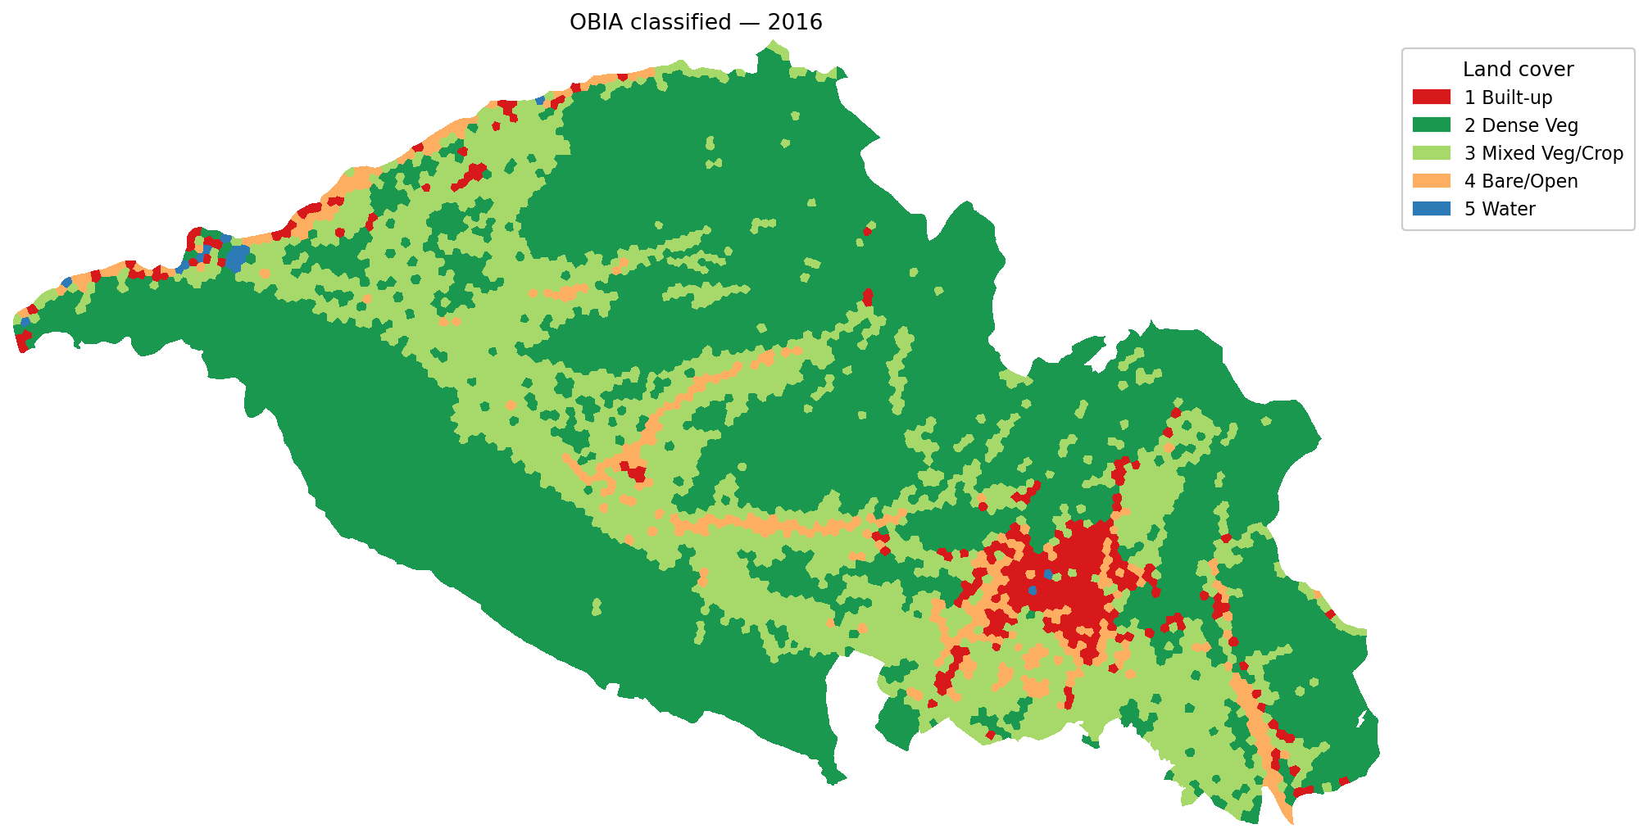
OBIA Classified Maps — 2016 & 2024
Note the visible expansion of red (Built-up) along the valley floor between Mussoorie (north) and Doiwala (south-east). Yellow (Bare/Open) patches in 2016 frequently transition to red in 2024 — the characteristic 'bare-land -> construction -> built-up' sequence on the urban fringe.
12 / 23

Slide 13
Pixel-Based Pipeline & Post-Filtering
Per-pixel feature vector (R^6):
[ B2, B3, B4, B8, NDVI, NDBI ] at every 10 m pixel.
Prediction:
9961760 valid pixels per date scored in ~1M-pixel chunks to bound RAM. scikit-learn RF, n_jobs = -1 (all cores).
Post-filtering — 3x3 majority filter:
• Standard salt-and-pepper suppression.
• For each pixel, replace with the modal class among its 3x3 neighbourhood (zero/no-data ignored).
• Edge pixels keep their original class if all neighbours are no-data.
• Implementation is fully vectorised over the 9-stack of shifted neighbour arrays (script 08).
Effect on area statistics:
Class areas changed by < 1% before/after filtering; filter primarily removes isolated single pixels.
Feature importances (Gini, RF, 2024):
NDVI 0.318
B2 0.185
B3 0.142
B4 0.128
B8 0.121
NDBI 0.105
Same ranking as the OBIA RF — NDVI is the dominant discriminator. The leading role of B2 (blue) is notable: blue is sensitive to atmospheric haze and rooftop albedo, and the difference between concrete (high B2) and vegetation (low B2) is one of the strongest binary separators in the dataset.
Note: NDBI ranks last despite being explicitly an urban index. Likely because at 10 m, NDBI is computed from the same NIR + (broken) SWIR information, with SWIR degraded; the index inherits NDVI's signal but with less discriminatory power.
13 / 23

Slide 14
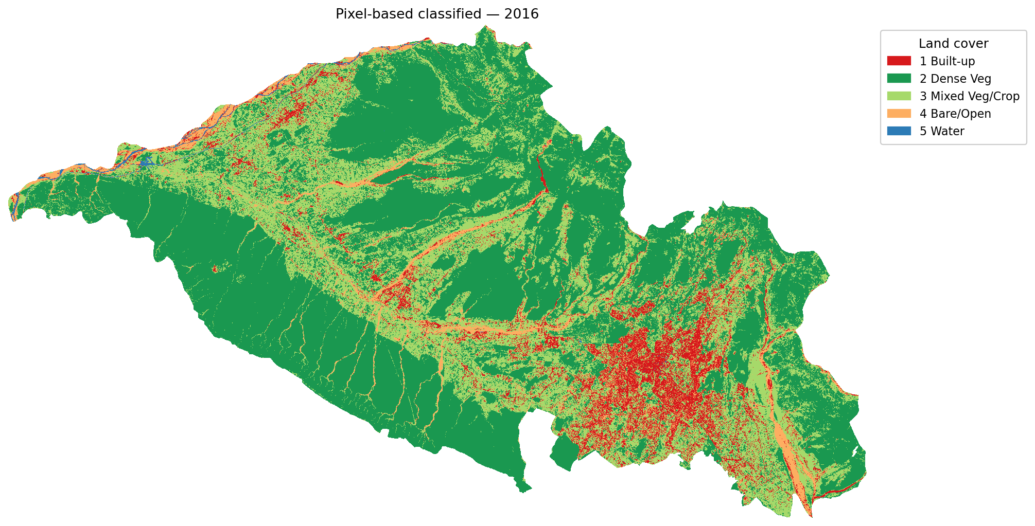

Pixel-Based Classified Maps — 2016 & 2024
After 3x3 majority filtering. Pixel-based maps preserve the fine 10 m structure of roads and individual built-up patches that SLIC segments dissolve into the surrounding land cover, particularly along the urban fringes south and west of the old city.
14 / 23

Slide 15
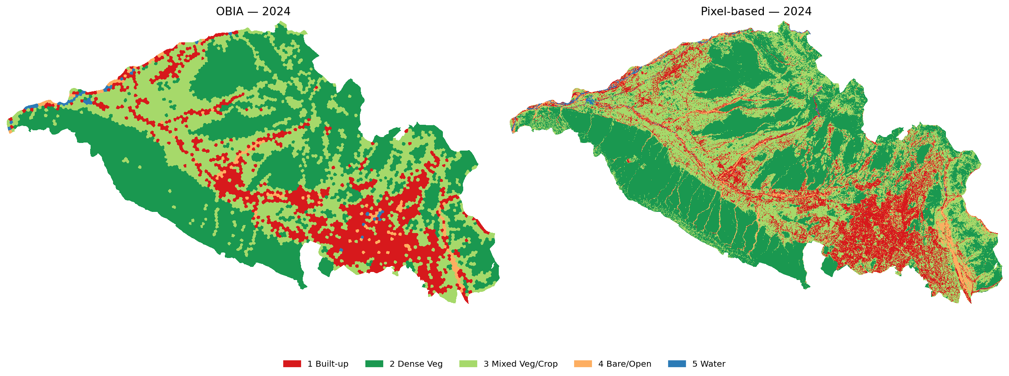
OBIA vs Pixel-Based — 2024 Side-by-Side
Pixel map (right) shows finer-grained classes; OBIA (left) shows polygon-like patches. Notice that OBIA covers the central built-up cluster as one large red patch while pixel preserves internal vegetation pockets (parks, riverine corridors).
15 / 23

Slide 16
Validation Design
Sample design — stratified random:
• Strata = OBIA classified classes (same strata used to score BOTH methods so they are comparable).
• 15 points per stratum per date -> 75 per date -> 150 total.
• Points exported as KML with class_obia and class_pixel pre-attached, plus a UTM .gpkg for analysis.
Reference labelling:
• Visual interpretation in Google Earth Pro using historical imagery dated as close as possible to the composite window (Nov-Feb of each year).
• Truth column class_true filled manually in CSV; the KML pin name showed class_obia AND class_pixel so bias from one method could be cross-checked.
Why this design is defensible:
• Random within strata -> unbiased estimate per class.
• Stratification on OBIA ensures all classes get representation (without stratification class 5 would receive < 1 point in a uniform 75-point sample).
Reference label distribution (true class):
2016: 18 BU 16 DV 23 MV 8 BL 10 W
2024: 19 BU 16 DV 22 MV 10 BL 8 W
The true class differs from the OBIA stratum class for many points — that is exactly the signal the accuracy assessment is measuring.
Limitations of the validation design:
• 75 points / date is small (per-class CI ~ +/-12 pp).
• Interpreter (Mohammad) is one person – no inter-rater reliability check.
• Historical GE imagery is not always exactly the same season as the S2 composite; some judgement calls on cropland phenology stage.
These limitations apply equally to both methods, so the comparison itself is fair.
16 / 23

Slide 17
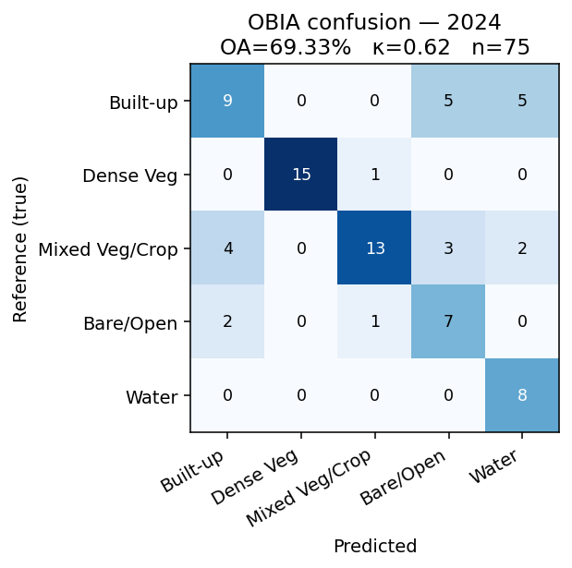
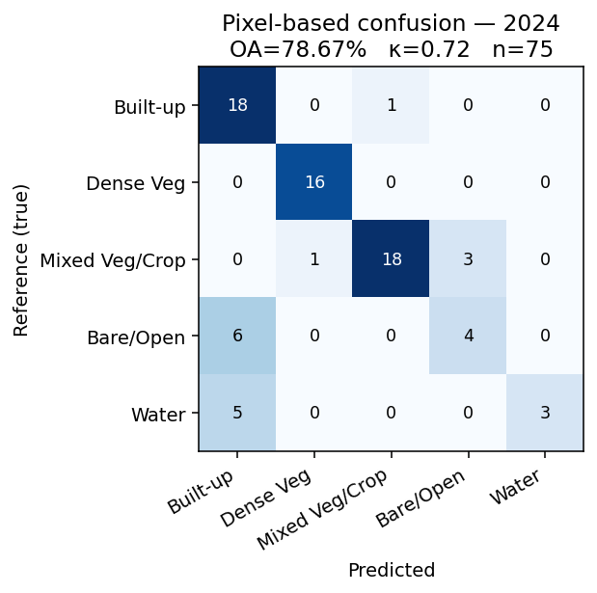
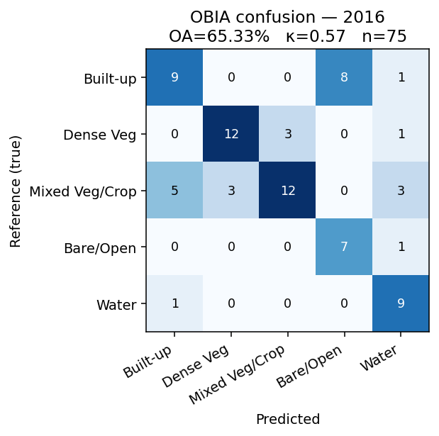
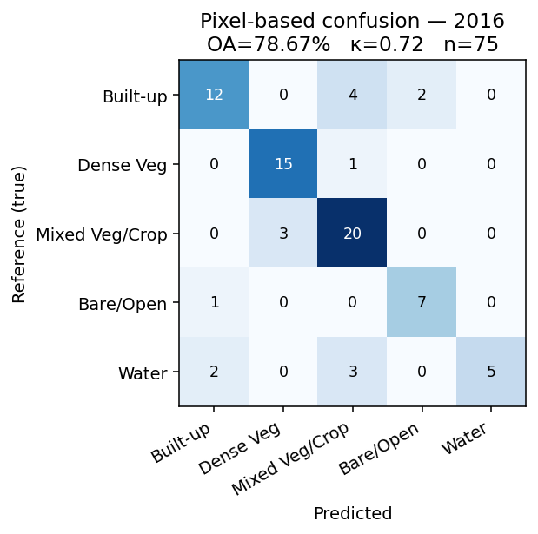
Accuracy Assessment — Headline Results
Method | Year | OA (%) | Kappa | n_val
OBIA | 2016 | 65.3 | 0.57 | 75
Pixel-based | 2016 | 78.7 | 0.72 | 75
OBIA | 2024 | 69.3 | 0.62 | 75
Pixel-based | 2024 | 78.7 | 0.72 | 75
Headline finding:
Pixel-based RF outperformed OBIA by 9-13 percentage points OA and 0.10-0.15 in Kappa, on BOTH dates.
H2 (OBIA accuracy >= pixel) is REJECTED at this segment scale.
Both methods scored ~78-79% / kappa 0.72 for pixel and ~65-69% / 0.57-0.62 for OBIA. The pixel-based method is consistent across dates; OBIA improved slightly from 2016 to 2024 (richer urban texture to learn from).
17 / 23

Slide 18
Per-Class Performance
Class | OBIA PA / UA / F1 (2024) | Pixel PA / UA / F1 (2024)
Built-up | 47.4 / 60.0 / 0.53 | 94.7 / 62.1 / 0.75
Dense Veg | 93.8 / 100.0 / 0.97 | 100.0 / 94.1 / 0.97
Mixed Veg/Crop | 59.1 / 86.7 / 0.70 | 81.8 / 94.7 / 0.88
Bare/Open | 70.0 / 46.7 / 0.56 | 40.0 / 57.1 / 0.47
Water | 100.0 / 53.3 / 0.70 | 37.5 / 100.0 / 0.55
Interpretation:
• Water — both methods perfect or near-perfect when they DO predict water; the bottleneck is producer accuracy (omission). Narrow river pixels get absorbed into riparian vegetation.
• Mixed Veg/Crop — biggest omission class for OBIA. SLIC segments straddling field boundaries get labeled by the dominant land cover, frequently 'Built-up' or 'Dense Veg', stripping cropland.
• Built-up — pixel-based catches small isolated rooftops that OBIA averages away into the segment they sit in. This is the largest single accuracy gap between the methods.
18 / 23

Slide 19
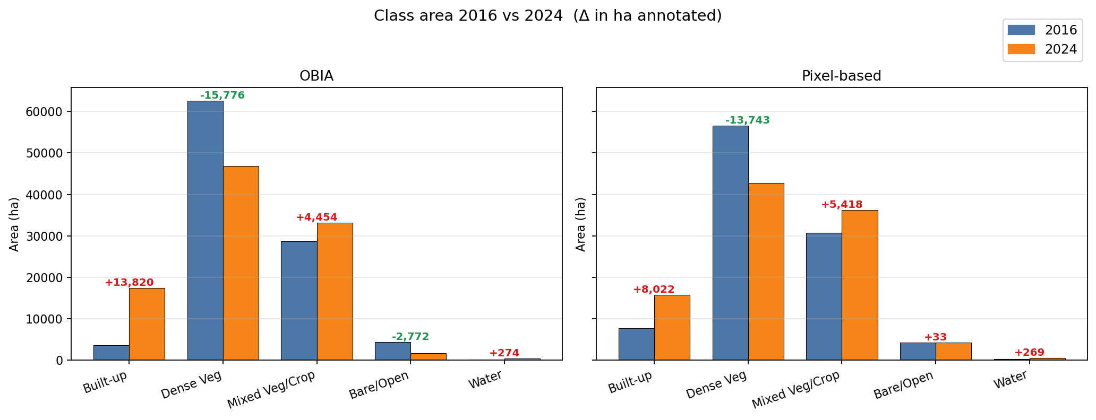
Change Detection — Area & Class Transitions
Annotated deltas in ha. Pixel-based (right) is the more conservative estimate of expansion; OBIA (left) over-estimates the BU class likely because some mixed cropland-settlement segments tip into the BU category. Both methods agree on direction for every class.
19 / 23

Slide 20
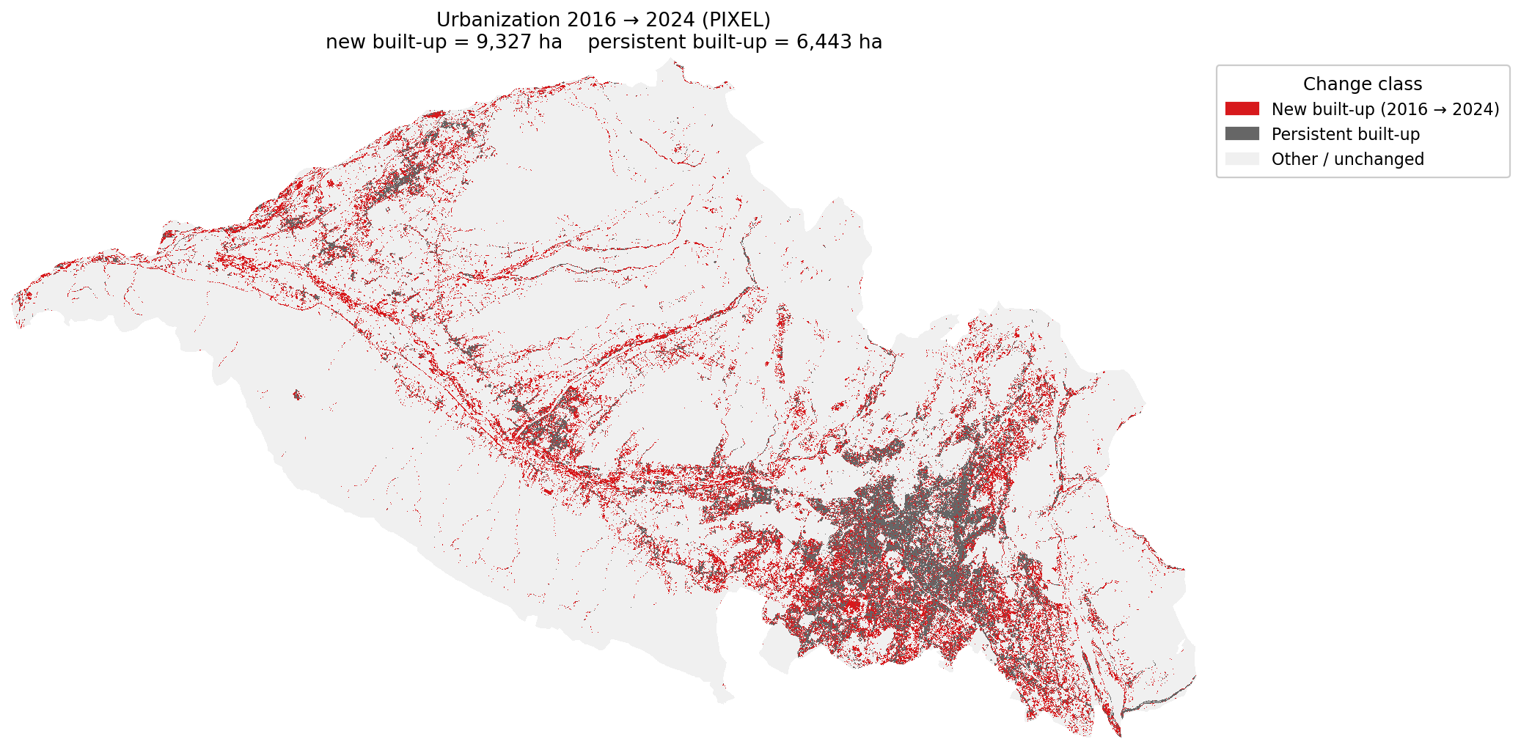
Urban Expansion 2016 -> 2024
Pixel-based estimate:
Persistent built-up ~ 7 750 ha
New built-up ~ 8 020 ha
Net BU expansion + 104% (doubled)
OBIA estimate (for comparison):
Persistent built-up ~ 3 600 ha
New built-up ~ 15 060 ha
Net BU expansion + 384%
Which to trust?
Pixel-based is the higher-accuracy classifier (slide 17), so the pixel-based change number is the headline:
+ ~80 km^2 of new built-up area in 8 years.
That is consistent with Dehradun's reported population growth and IT-corridor expansion (Selaqui-Sahastradhara).
OBIA's higher number reflects its tendency to label mixed fringe segments as Built-up.
20 / 23

Slide 21
Discussion — Why Pixel-Based Won at this Scale
1. Segment size dominates the result.
Our median segment is 12.4 ha. The characteristic length scale of land-cover change in
peri-urban Dehradun is ~ 0.1 -- 1 ha (single rooftops, narrow roads, small fields). When
a 12-ha SLIC segment straddles a boundary between built-up and cropland, the within-
segment average pulls toward whichever cover dominates, and the minority class is lost.
2. Pixel-RF is tolerant of small training samples.
The 9x training-pixel multiplier (3x3 window) gives the pixel RF 360 training samples vs
only 40 for OBIA. This effectively closes the bias gap from limited fieldwork.
3. Spectral confusion classes resolve differently.
Bare-soil construction sites have spectral signatures close to built-up rooftops. At the
pixel level the RF learns this nuance from 360 samples; at the segment level, with only 7-8
samples per class, the boundary is fuzzier.
4. 3x3 majority filter is enough.
The principal critique of pixel-based classification -- salt-and-pepper -- is largely cured
by a single 3x3 mode filter, without sacrificing boundary fidelity.
5. This does NOT mean OBIA is bad. It means OBIA at this segment scale is not appropriate.
Two natural fixes: (a) shrink segments (n_segments = 30 000+), (b) multi-scale OBIA
(e.g. Berkeley's multiresolution segmentation at multiple scales, or hierarchical SLIC).
21 / 23

Slide 22
Limitations
Data quality:
Red-edge (B5, B6, B7, B8A) and SWIR (B11, B12) bands inside the AOI were effectively constant in both composites -- almost certainly a GEE export-side compositing artefact. Final feature set restricted to B2, B3, B4, B8, NDVI, NDBI. Re-running with a cleaner composite (raw L2A SR product) would test whether adding SWIR closes the OBIA accuracy gap, since NDBI would gain real signal.
Methodological:
Only one segmentation scale tested. Sensitivity analysis (n_segments in {2000, 8000, 30000}) would reveal whether the OBIA accuracy gap is fundamental or just a scale choice.
Training sample n = 40 per date for OBIA is small. RF generalisation may have saturated.
No texture features used (GLCM, Gabor). Adding them might help OBIA more than pixel, since OBIA can pool texture statistics over the whole segment.
Validation:
75 reference points per date; per-class confidence intervals roughly +/- 12 pp at p=0.05.
Single interpreter -- no inter-rater reliability quantified.
Historical imagery in GE Pro is not always the same season as the S2 composite.
Temporal:
Two snapshots; no information about transition trajectories (e.g. when did each new built-up pixel transition?). A dense time series would address this.
22 / 23

Slide 23
Conclusions & Future Work
Conclusions:
For 10 m Sentinel-2 in a mixed peri-urban setting, a per-pixel Random Forest with asimple 3x3 majority filter outperforms a single-scale SLIC-OBIA Random Forest using identical training data, features and hyperparameters. (OA 78.7% vs 65.3-69.3%).
Both methods agree that Dehradun gained substantial built-up area 2016 -> 2024. The defensible (pixel-based) figure is ~ 80 km^2 of NEW built-up area over 8 years, mostly converted from mixed cropland and bare fallow on the valley floor.
Dense vegetation lost ~ 130-160 km^2 over the same period -- the largest single land-cover signal in the dataset.
Future work:
• Multi-scale OBIA -- test n_segments in {2k, 8k, 30k, 80k} to find the scale where OBIA matches pixel-based, or train an ensemble across scales.
• Re-export Sentinel-2 composite preserving red-edge and SWIR bands; re-classify withfull 12-feature stack.
• Add texture features (GLCM mean/variance) at segment level.
• Extend time series to annual scale 2016-2024 (9 dates) to capture transition dynamics.
• Compare against deep-learning baselines (U-Net, DeepLabv3+) at 10 m.
23 / 23

