Slide 1
STACK

Slide 2
Submitted to :
Rakib Hossen
Lecturer
Bangabandhu Sheikh Mujibur Rahman Digital University
Submitted By :
Md Jawad Labib [2002017]
Md Tazul Islam Rafi [2002018]
Farhana Yesmin Ety [2002034]
Tanziful Islam [2002036]
Md Abeer Hasan Sifat [2002041]
Md Saiful Islam [2002047]

Slide 3
Stack
A stack is a one of the most important and useful non-primitive linear data structure in computer science. A stack is a homogeneous collection of elements in which an element may be inserted or deleted only at one end, called the top of the stack.
It is a linear data structure consisting of list of items.
In stack, data elements are added or removed only at one end, called the top of the stack.

Slide 4
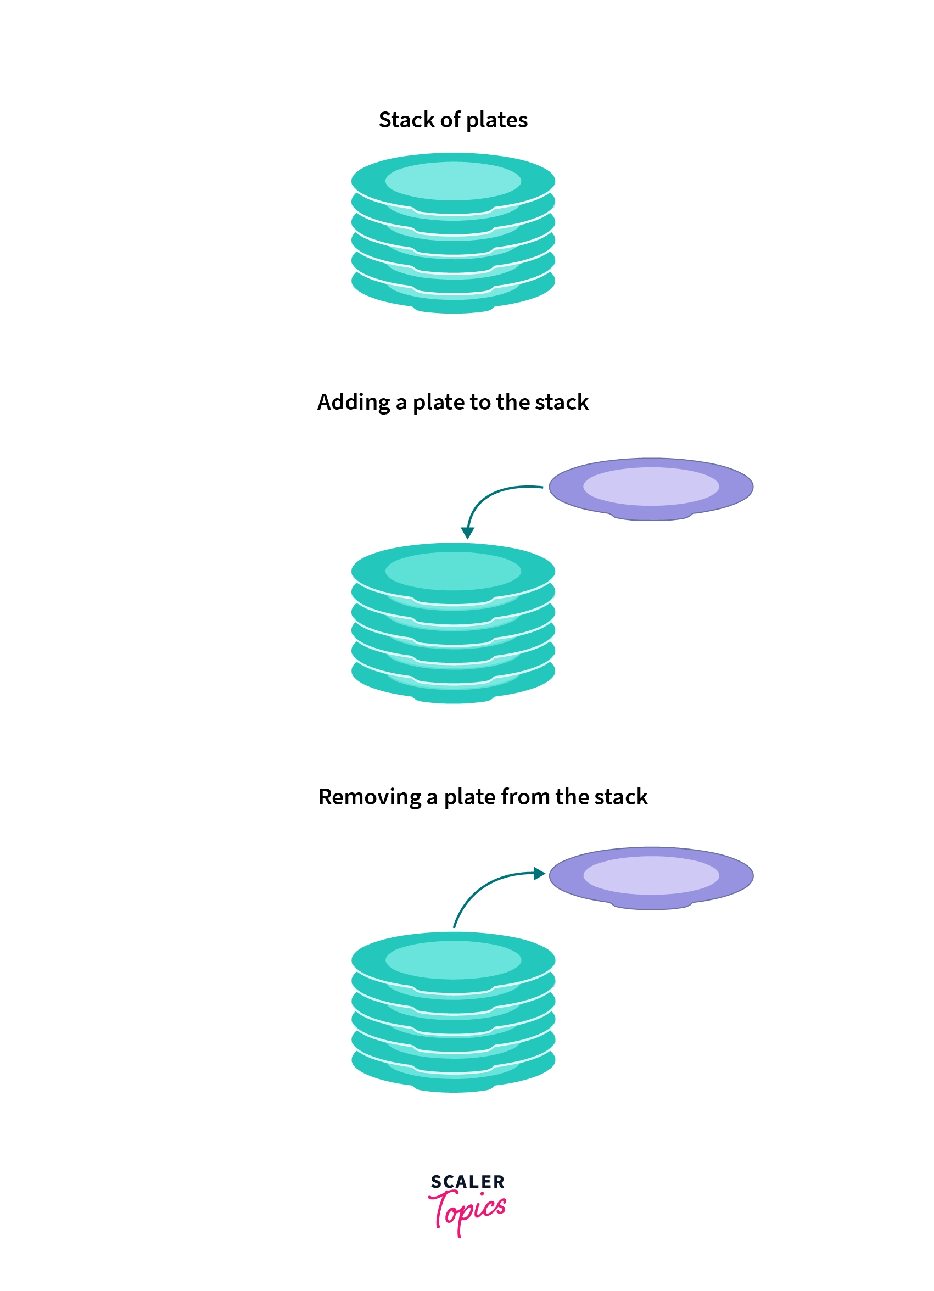
LIFO Principle of Stack
A stack follows the Last-In-First-Out (LIFO) principle, which means that the most recently added element is the first one to be removed. Its like a stack of plates where you can only add or remove plates from the top.

Slide 5
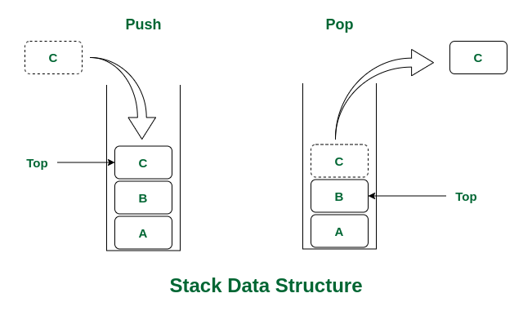
Stack Operations
Stack has two basic operations :
Push: This operation adds an element to the top of the stack.
Pop: This operation removes and returns the top element from the stack.

Slide 6
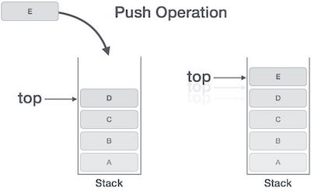
Push Operation
The push operation inserts an item at the top of the stack.
Algorithm :
If Top = MaxSTK then Print: Overflow and Return. /*…Stack already filled..*/
Set Top := Top +1
Set Stack[Top] := Item
Return.

Slide 7
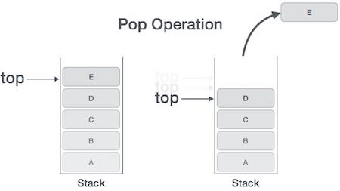
POP Operation
The pop operation deletes the item at the top of the stack.
Algorithm :
If Top = -1 then Print: Underflow and Return. /*…Stack already Empty..*/
Set Item := Stack[Top]
Set Top := Top - 1
Return.

Slide 8
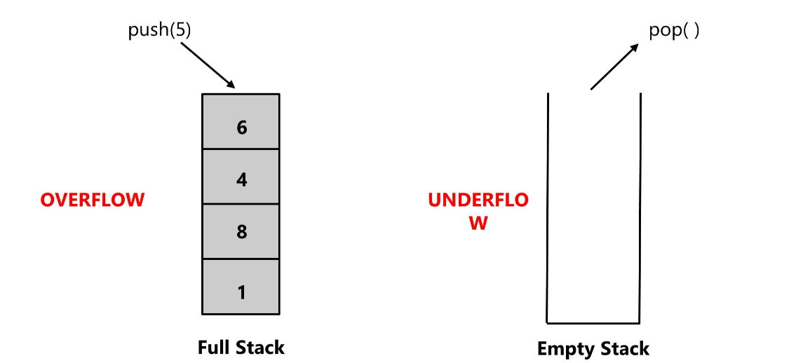
Stack Errors
There are two stack errors that can occur:
Stack Overflow: This error occurs when you try to push an element onto a stack that is already at its maximum capacity. It indicates that the stack is full, and no more elements can be added without first removing some.
Stack Underflow: This error occurs when you try to pop an element from an empty stack. It indicates that there are no elements left in the stack to be removed.

Slide 9
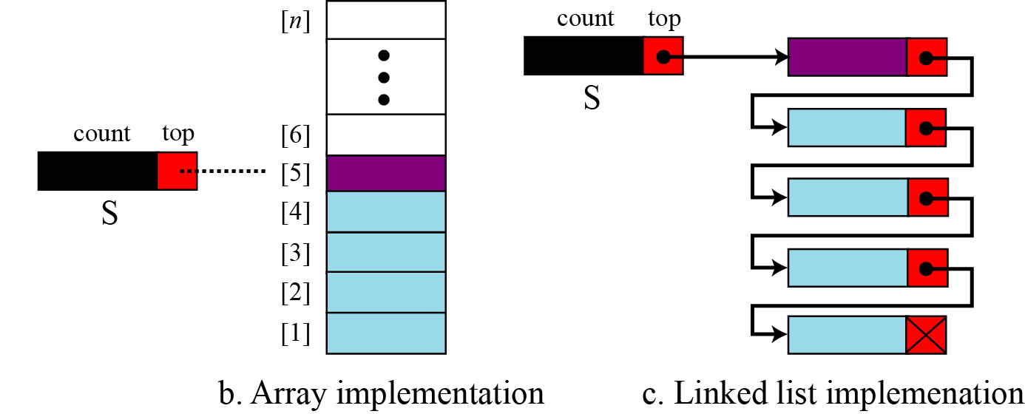
Implementation
Stack data structure can be implemented in two ways. They are as follows :
Using Array : When a stack is implemented using an array, that stack can organize an only limited number of elements.
Using Linked List :When a stack is implemented using a linked list, that stack can organize an unlimited number of elements.

Slide 10
Uses of Stack
Reversing a list
Parentheses checker
Conversion of an infix expression into a postfix expression & Evaluation of a postfix expression
Conversion of an infix expression into a prefix expression & Evaluation of a prefix expression
Recursion (Tower of Hanoi)
A very important application of stack is to implement recursive function call and processing of function calls such as passing arguments.

Slide 11
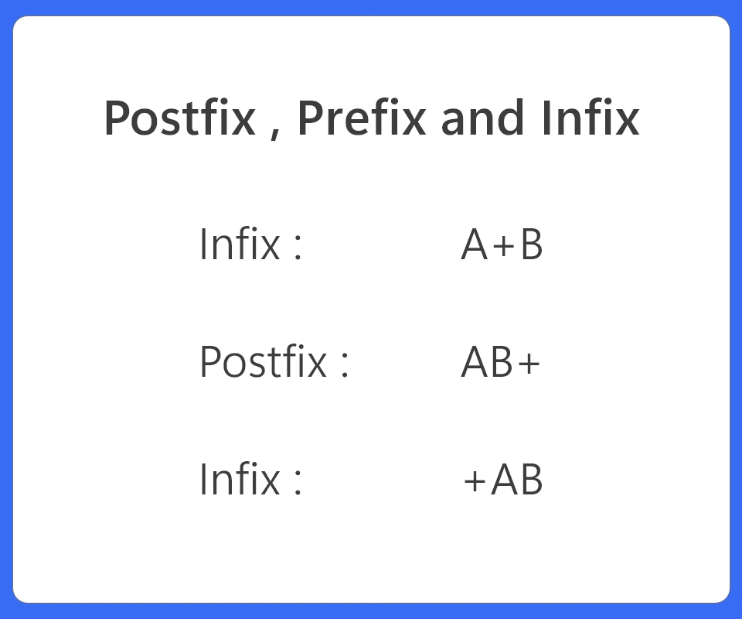
Notation
There are three types of notation. They are :
Infix : In this notation the operators '+' go in between the operands ('A' and 'B’).
Postfix/Reverse Polish Notation : In this notation the operators '+' go after the operands ('A' and 'B’).
Prefix/Polish Notation : In this notation the operators '+' go before the operands ('A' and 'B’).
The terms infix, prefix, and postfix tell us whether the operators go between, before, or after the operands.

Slide 12
Parentheses
Infix is the only notation that requires parentheses in order to change the order in which the operations are done. Let’s see some example…
Infix:
Evaluate 2+3*5.
+ First:
(2+3)*5 = 5*5 = 25
* First:
2+(3*5) = 2+15 = 17
So in Infix notation answer differs according to the use of parentheses.
Prefix :
+ 2 * 3 5 =
= + 2 * 3 5
= + 2 15 = 17
* + 2 3 5 =
= * + 2 3 5
= * 5 5 = 25
Postfix :
2 3 5 * + =
= 2 3 5 * +
= 2 15 + = 17
2 3 + 5 * =
= 2 3 + 5 *
= 5 5 * = 25

Slide 13
Fully Parenthesized Expression
A FPE has exactly one set of Parentheses enclosing each operator and its operands.
Which is fully parenthesized?
( A + B ) * C
( ( A + B) * C )
( ( A + B) * ( C ) )

Slide 14
Infix to Prefix Conversion
Move each operator to the left of its operands & remove the parentheses:
( ( A + B) * ( C + D ) )
( + A B * ( C + D ) )
* + A B ( C + D )
* + A B + C D
Order of operands does not change!

Slide 15
FPE Infix to Postfix
( ( ( A + B ) * ( C - E ) ) / ( F + G ) ))
Infix | Stack | Postfix
( ( ( A + B ) * ( C - E ) ) / ( F + G ) ))
( ( A + B ) * ( C - E ) ) / ( F + G ) )) | (
( A + B ) * ( C - E ) ) / ( F + G ) )) | ((
A + B ) * ( C - E ) ) / ( F + G ) )) | (((
+ B ) * ( C - E ) ) / ( F + G ) )) | ((( | A
B ) * ( C - E ) ) / ( F + G ) )) | (((+ | A
To be continue

Slide 16
FPE Infix to Postfix
( ( ( A + B ) * ( C - E ) ) / ( F + G ) ))
Infix | Stack | Postfix
) * ( C - E ) ) / ( F + G ) )) | (((+ | AB
* ( C - E ) ) / ( F + G ) )) | (( | AB+
( C - E ) ) / ( F + G ) )) | ((* | AB+
C - E ) ) / ( F + G ) )) | ((*( | AB+
- E ) ) / ( F + G ) )) | ((*( | AB+C
E ) ) / ( F + G ) )) | ((*(- | AB+C
To be continue

Slide 17
FPE Infix to Postfix
( ( ( A + B ) * ( C - E ) ) / ( F + G ) ))
Infix | Stack | Postfix
G ) )) | ((*(- | AB+CE
) / ( F + G ) )) | ((* | AB+CE-
/ ( F + G ) )) | ( | AB+CE-*
( F + G ) )) | (/ | AB+CE-*
F + G ) )) | (/( | AB+CE-*
+ G ) )) | ((*(- | AB+CE-*F
To be continue

Slide 18
FPE Infix to Postfix
( ( ( A + B ) * ( C - E ) ) / ( F + G ) ))
Infix | Stack | Postfix
G ) )) | (/(+ | AB+CE-*F
) )) | (/(+ | AB+CE-*FG
)) | (/ | AB+CE-*FG+
) |  | AB+CE-*FG+/

Slide 19
Importance
Stacks are a fundamental data structure in computer science and are used in various algorithms and applications due to their Last-In-First-Out (LIFO) nature. Here are some common uses of stacks in data structures and algorithms:
Function Call Stack: Stacks are crucial for managing function calls in programming languages.
Expression Evaluation: Stacks are used to evaluate expressions, such as arithmetic expressions and postfix expressions.
Backtracking Algorithms: Many backtracking algorithms, like Depth-First Search (DFS) and recursive algorithms, use stacks to keep track of the state of exploration.
Memory Management: In computer memory management, a stack is used for managing memory for function calls and local variables. This is often referred to as the call stack.
Algorithm Implementations: Stacks are used in various algorithm implementations, including algorithms for finding strongly connected components in a graph, topological sorting, and certain tree traversal algorithms.
Task Scheduling: In some operating systems, stacks are used for task scheduling and managing the execution of processes and threads.
Overall, stacks are a versatile data structure that plays a vital role in various aspects of computer science and programming, making them an essential concept to understand for anyone working in the field.

Slide 20
Advantages of Stack
Efficient LIFO Access: Stacks provide efficient access to the most recently added element (top of the stack) using the Last-In-First-Out (LIFO) order. This makes them suitable for scenarios where you need to access or manipulate the latest data or operations.
Simple and Fast Operations: Stack operations, such as push and pop, can be implemented with simple and fast algorithms, typically in constant time (O(1)). This makes stacks efficient for managing elements and executing operations on them.
Undo and Redo Functionality: Stacks are employed to implement undo and redo functionality in software applications.
Parsing and Syntax Checking: Stacks are used in parsing and syntax checking processes, such as checking balanced parentheses or validating the correctness of expressions.
Resource Tracking: Stacks can be used to track and manage resources, such as memory allocations or open files.

Slide 21
Disadvantages of Stack
Limited Access: Stacks provide access to only the top element, making it difficult to access or modify elements at other positions in the stack without popping off intervening elements.
Fixed Size (Array-Based Stacks): If you implement a stack using a fixed-size array, you may encounter the issue of stack overflow when the stack is full.
No Efficient Search: Stacks are not designed for efficient searching of elements.
Not Suitable for All Data Structures: Stacks are not suitable for all types of data and operations. For example, they are not ideal for maintaining a sorted collection of elements or for performing complex data manipulation operations.
Complex Nesting: When using stacks for complex data structures or algorithms, maintaining proper nesting and ensuring that elements are pushed and popped in the correct order can be error-prone and lead to bugs.
Stack Overflow: In recursive algorithms or deeply nested function calls, there is a risk of stack overflow if the call stack grows too large, which can result in program crashes. Some languages and environments have limited call stack sizes.

