Slide 1

Wolt Test Assignment Report: Predicting number of couriers
Mikhail Silaev

Slide 2

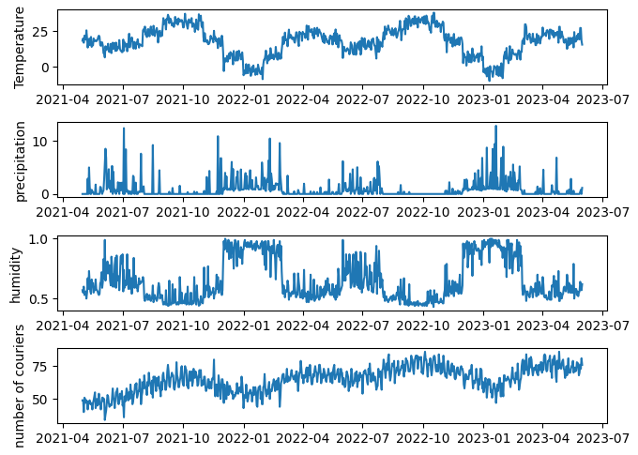



Introduction
The problem of predicting time series is crucial for the future activity planning. The dataset given contains daily courier number combined with the weather data.
Outlier-cleaned time series on this slide show visible correlations of courier number with temperature and precipitation
Is it possible to predict the number of couriers for next day or for several days ahead based on the historical data?

Slide 3
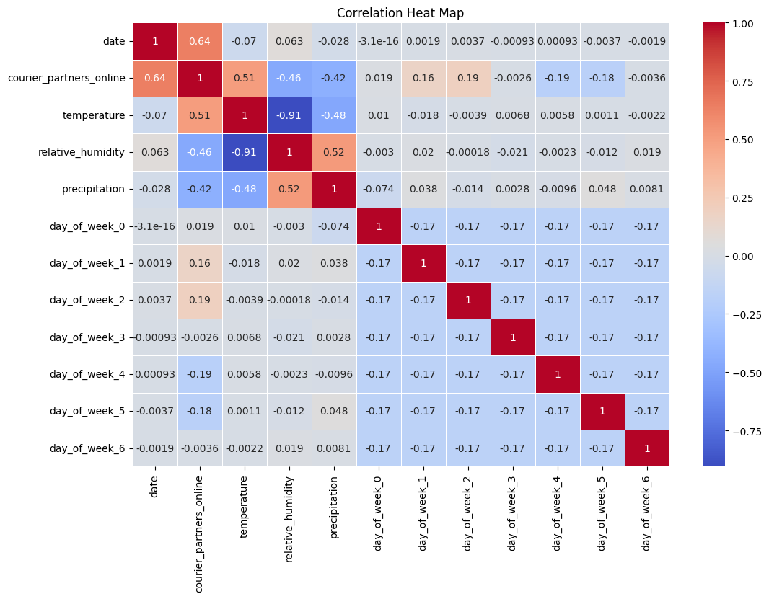

Exploratory Data Analysis
Let us have a look at the correlation matrix first. Besides weather characteristics we add also ‘day_of_week_i’ dummy variable with $i=0..6$. Here ‘day_of_week_0’ corresponds to Monday.
Largest correlation for ‘courier_partner_online’ is with ‘temperature’, and then with ‘precipitation’.
Correlation with ‘humidity’ is also large. However, ‘humidity’ is almost deterministically correlated with ‘precipitation’. It should not add new prediction power.

Slide 4
Prediction Tasks & Feature Engineering
Next-Day Task
Predicting the value of the y_{i+1} (representing ‘courier_partners_online’) for the next day based on the historical values available up to day i
Multiple-Day Task
Predicting the values of the variable y_{i+1}, y_{i+2}, …, y_{i+ n} for the next n days based on the historical values available up to day i
Feature selection
Features consist historical variables ‘courier_partner_online’ ‘temperature’, ‘precipitation’, ‘day_of_week_0’, … ‘day_of_week_6’ for the number of ‘train_days’ preceding days. In total there are 10 different variables. The number of preceding days (‘train_days’) can be different. We take it to be 40 days. It describes both small- and meso-time scales like season variability.
Since we use 10 feature and 40 preceding days, the total number of features is 400.

Slide 5

Models
Baseline - Linear Regression (LR) Model:
Parameters: Equal to the number of features (400)
Long Short-Term Memory (LSTM) Model:
Architecture:
Input: (timesteps, features)
Layers: 4 LSTM layers with varying units and dropout (30%, 10%, 20%, 30%)
Dense Layer: Output layer with n units, which can be 1 or e.g. 20
Total params: 138,271
Loss: MSE, Optimizer: Adam
We adopt the LSTM realization for stock prise prediction

Slide 6
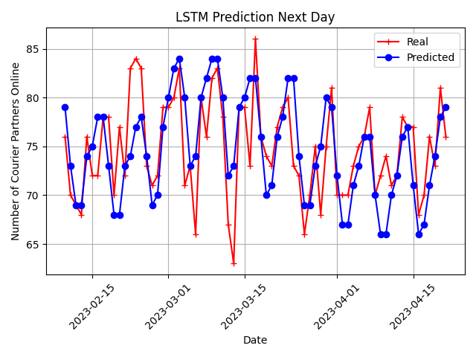
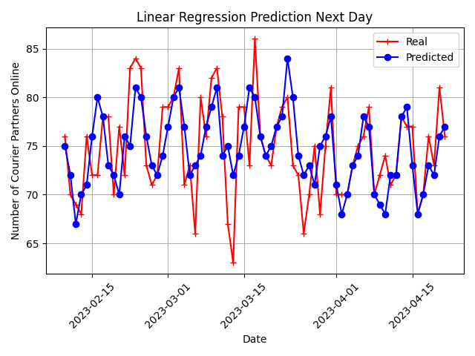
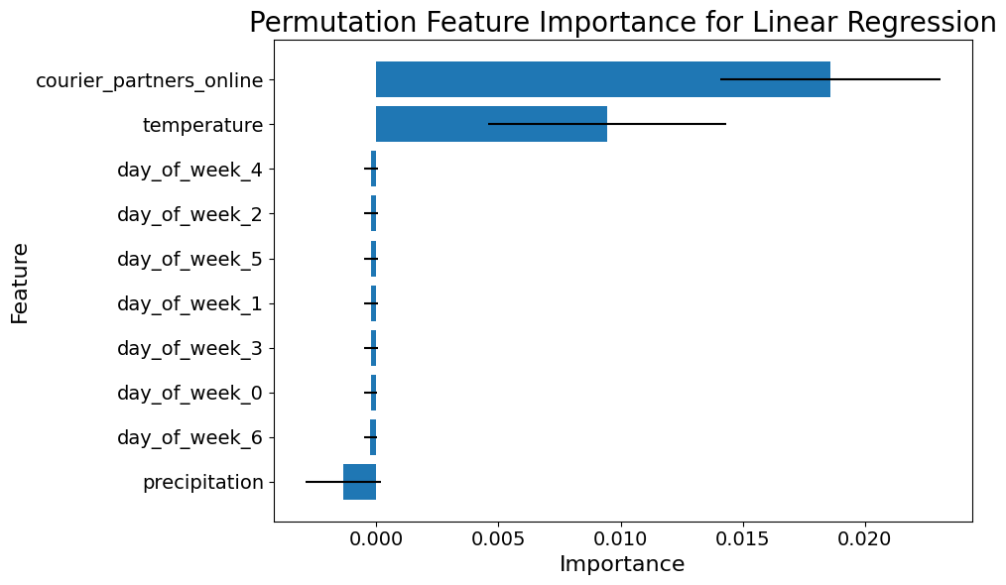
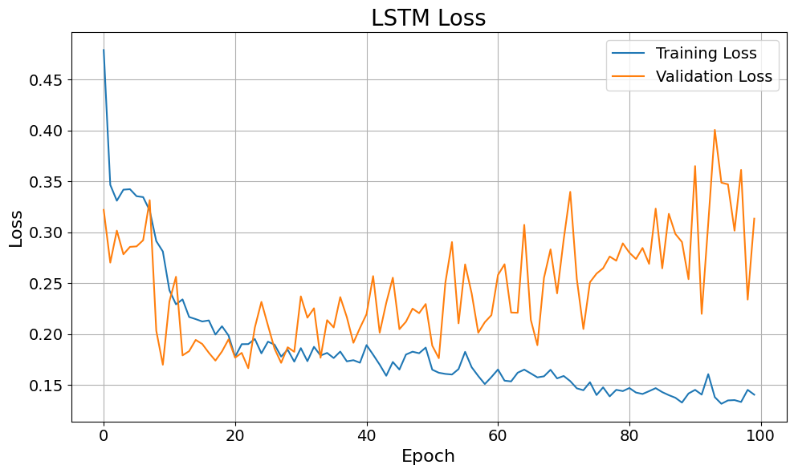
Results: Next-Day prediction
Learning curves (see in /notebooks)
Residual errors
Model | MAE | RMSE | SNR | R2
LSTM | 2.92 | 3.93 | 25.61 | 0.35
LR | 3.04 | 3.90 | 25.67 | 0.36
Linear Regression works a bit better than LSTM
Most important features: ‘courier_partner_online’, ‘temperature’
Optimal training stop is at 20 Epoch

Slide 7
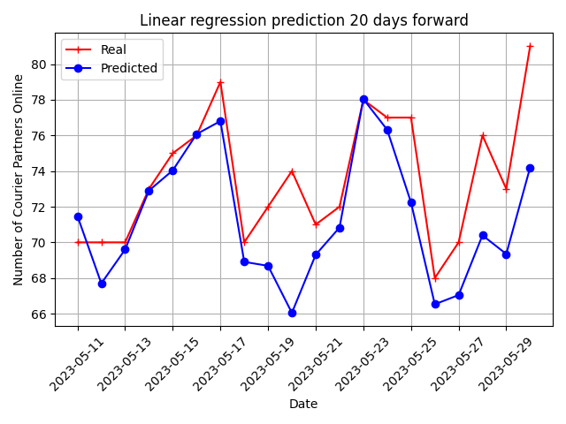
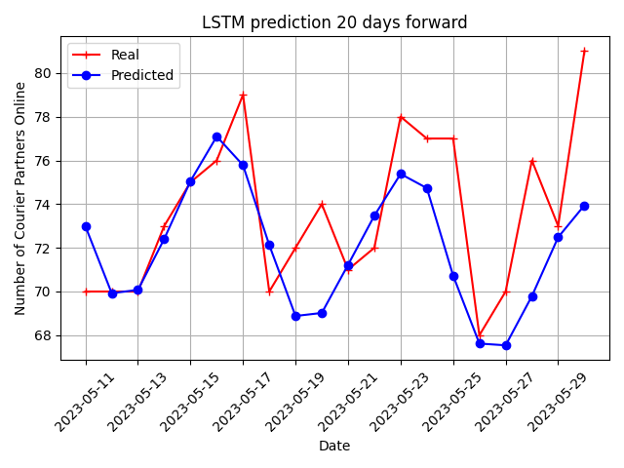
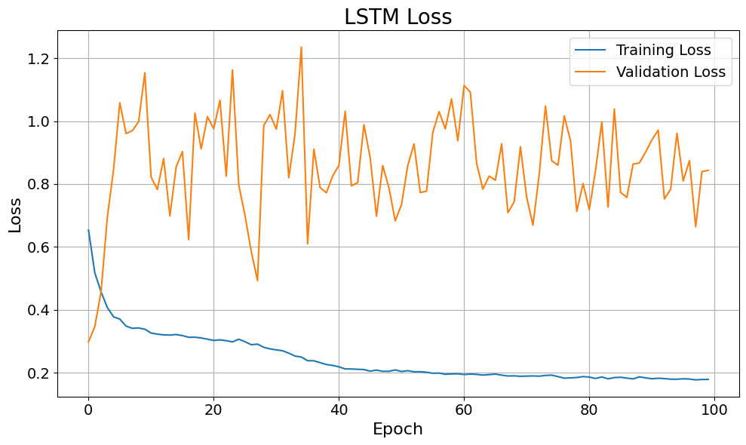
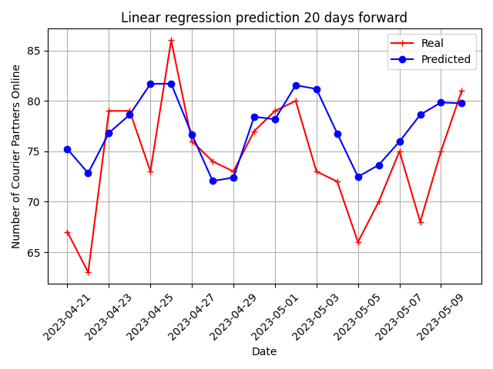
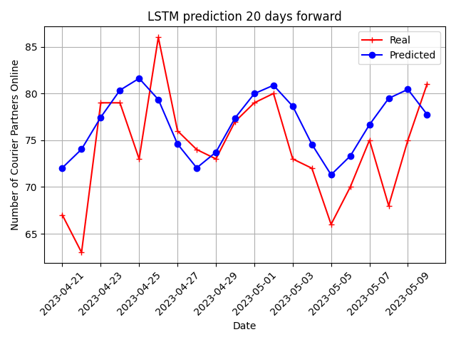
Results: Multiple-Day prediction for 20 ahead
Predictions for different 20-days terms
residual errors
Model | MAE | RMSE | SNR | R2
LSTM | 3.43 | 4.32 | 24.95 | 0.29
LR | 3.51 | 4.36 | 24.71 | 0.17
LSTM performs better than LR
However, LSTM overfits so that test and validation errors fluctuate

Slide 8
Conclusion
Both LSTM and Linear Regression models predict courier numbers for the next day and up to 20 days ahead, with RMSE, SNR, and R-squared metrics showing decent performance (R-squared ~0.2-0.3). For the Next-Day task, both models perform similarly, while LSTM slightly outperforms for the Multiple-Day task.
However, LSTM performance depends on hyperparameters like batch size. For Multiple-Day task LSTM model overfits. Future improvements can focus on hyperparameter optimization and expanding the time series dataset to further enhance performance.

