Slide 1

Wolt Test Assignment Report: Predicting number of couriers
Mikhail Silaev

Slide 2

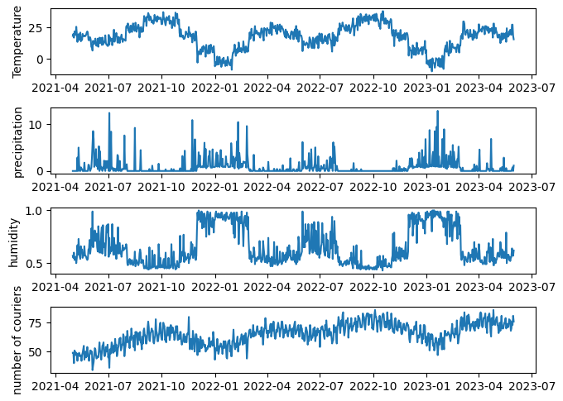



Introduction
The problem of predicting time series is crucial for the future activity planning. The dataset given contains daily courier number combined with the weather data.
Outlier-cleaned time series on this slide show visible correlations of courier number with temperature and precipitation
Is it possible to predict the number of couriers for next day or for several days ahead ?

Slide 3
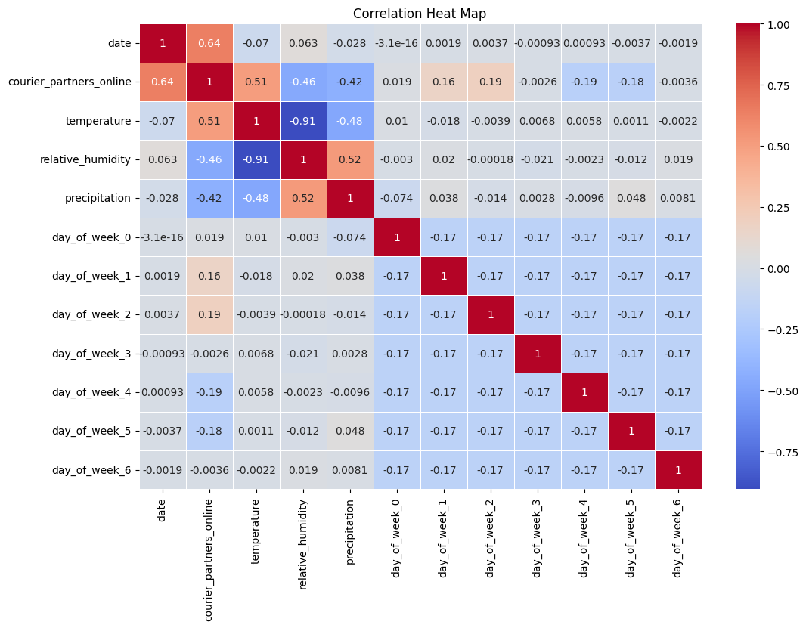

Exploratory Data Analysis
Let us have a look at the correlation matrix first. Besides weather characteristics we add also ‘day_of_week_i’ dummy variable with $i=0..6$. Here ‘day_of_week_0’ corresponds to Monday.
Largest correlation for ‘courier_partner_online’ is with ‘temperature’, and then with ‘precipitation’.
Correlation with ‘humidity’ is also large but at the same time ‘humidity’ itself is almost deterministically correlated with ‘precipitation’, so that it should not add new prediction power for the model.

Slide 4
Prediction Tasks & Feature Engineering
Next-Day Task
Predicting the value of the y_{i+1} (representing ‘courier_partners_online’) for the next day based on the historical values available up to day i
Multiple-Day Task
Predicting the values of the variable y_{i+1}, y_{i+2}, …, y_{i+ n} for the next n days based on the historical values available up to day i
Feature selection
Features consist historical variables ‘courier_partner_online’ ‘temperature’, ‘precipitation’, ‘day_of_week_0’, … ‘day_of_week_6’ for the number of ‘train_days’ preceding days. In total there are 10 different variables. The number of preceding days ‘train_days’ can be different. We take it to be 40.
Since we use 10 feature and 40 preceding days, the total number of features is 400.

Slide 5

Models
Baseline Linear Regression Model:.
Parameters: Equal to the number of features (400).
Long Short-Term Memory (LSTM) Model:
Architecture:
Input: (timesteps, features)
Layers: 4 LSTM layers with varying units and dropout (30%, 10%, 20%, 30%)
Dense Layer: Output layer with n units, which can be 1 or e.g. 20
Total params: 138,271
Loss: MSE, Optimizer: Adam
We adopt the LSTM realization for stock prise prediction https://blog.gopenai.com/

Slide 6
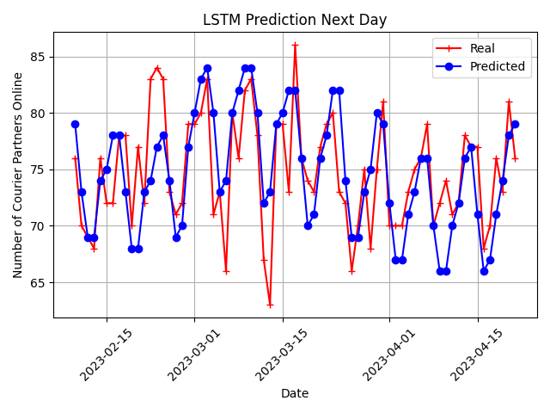
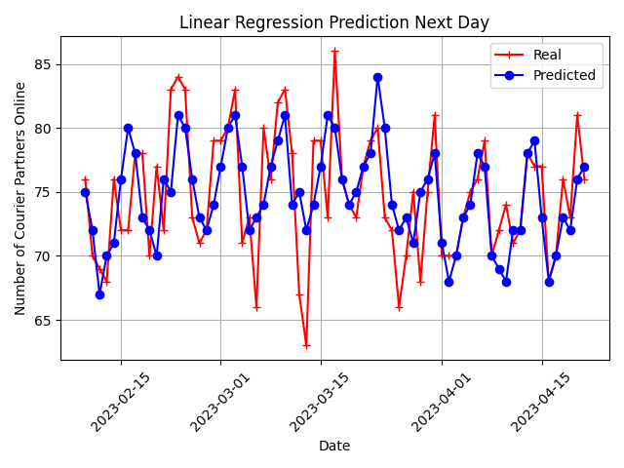
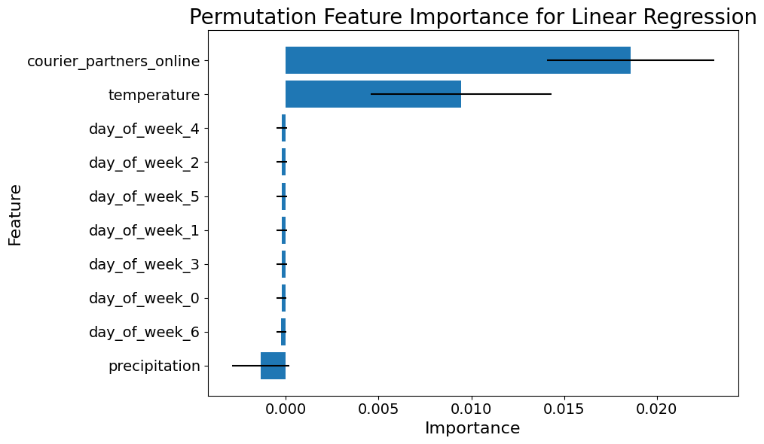
Results: Next Day prediction
residual errors
Linear Regression works a bit better than LSTM
‘courier_partner_online’ ‘temperature’ are most important features
Model | MAE | RMSE | SNR | R2
LSTM | 2.92 | 3.93 | 25.61 | 0.35
Linear Regression | 3.04 | 3.90 | 25.67 | 0.36

Slide 7
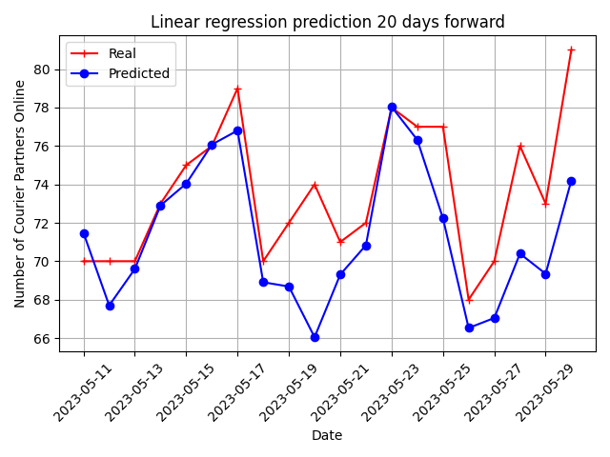
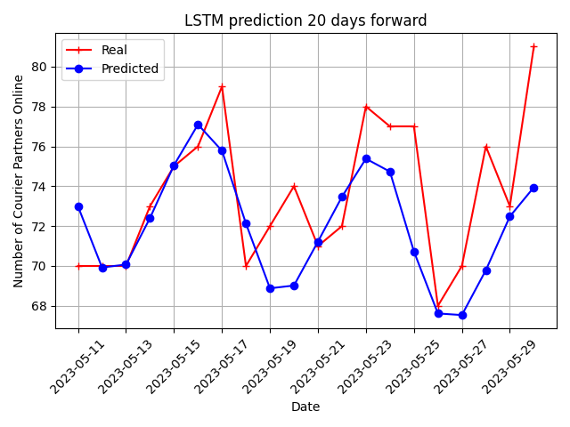
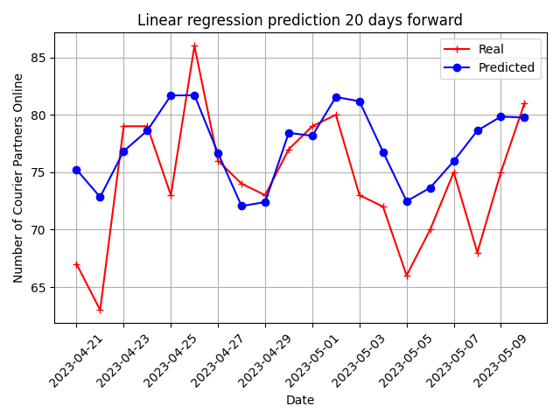
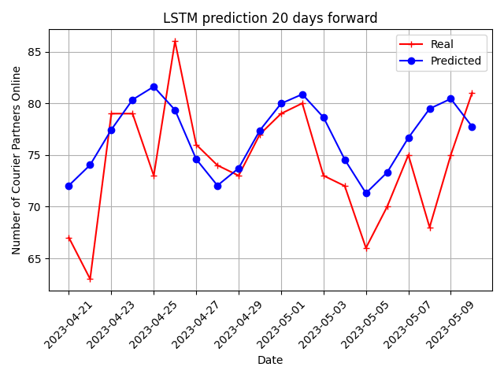
Results: Multiple (20) Day prediction
Predictions for different 20-days terms
residual errors
Model | MAE | RMSE | SNR | R2
LSTM | 3.43 | 4.32 | 24.95 | 0.29
Linear Regression | 3.51 | 4.36 | 24.71 | 0.17
LSTM performs better than baseline LR

Slide 8
Conclusion
Both LSTM and Linear Regression models predict courier numbers for the next day and up to 20 days ahead, with RMSE, SNR, and R-squared metrics showing decent performance (R-squared ~0.2-0.3). For the Next-Day task, both models perform similarly, while LSTM slightly outperforms for the Multiple-Day task. However, LSTM performance depends on hyperparameters like batch size. Future improvements can focus on hyperparameter optimization and expanding the time series dataset to further enhance performance.

