Slide 1

Wolt Test Assignment Report: Predicting number of couriers
Mikhail Silaev

Slide 2

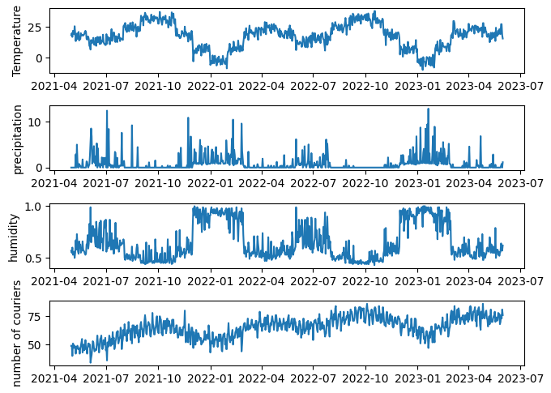



Introduction
The problem of predicting time series is crucial for the future activity planning. The dataset given contains daily courier number combined with the weather data.
Outlier-cleaned time series on this slide show visible correlations of “number of couriers” with temperature and precipitation. There is also a linear growing trend with time, probably due to the growing popularity of courier service.
Is it possible to predict the number of couriers for next day or for several days ahead based on the historical data?

Slide 3
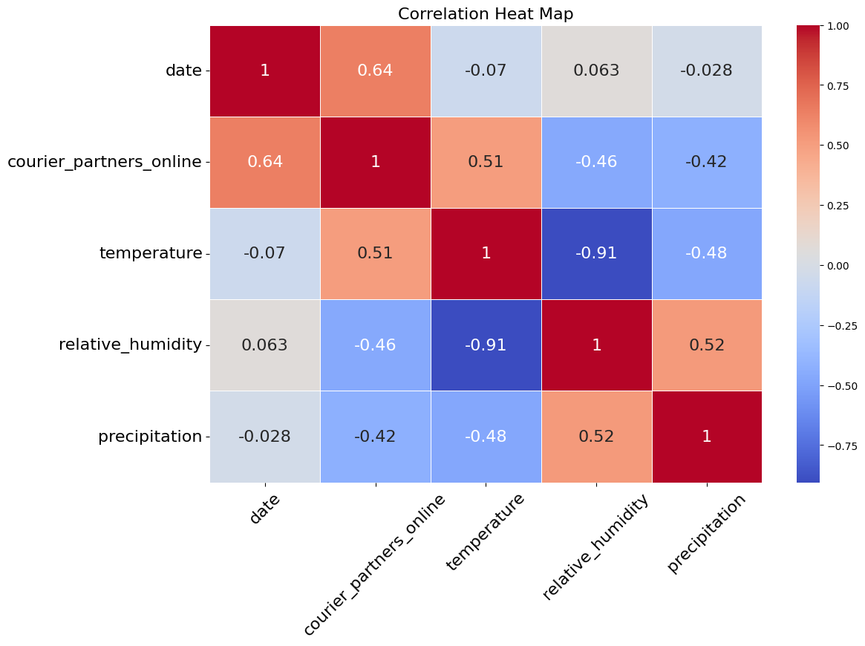

Exploratory Data Analysis
Let us have a look at the correlation matrix first. Besides weather characteristics we add also ‘day_of_week_i’ dummy variable with $i=0..6$. Here ‘day_of_week_0’ corresponds to Monday.
Largest correlation for ‘courier_partner_online’ is with ‘date’, ‘temperature’, and then with ‘precipitation’.
Correlation with ‘humidity’ is also large. However, ‘humidity’ is almost deterministically correlated with ‘temperature’. It should not add new prediction power.

Slide 4
Prediction Tasks & Feature Engineering
Next-Day Task
Predicting the value of the y_{i+1} (representing ‘courier_partners_online’) for the next day i+1 based on the historical values available up to day i.
Multiple-Day Task
Predicting the values of the variable y_{i+1}, y_{i+2}, …, y_{i+ n} for the next n days i+1, … i+n based on the historical values available up to day i.
Feature selection
Features consist historical variables ‘courier_partner_online’ ‘temperature’, ‘precipitation’, ‘day_of_week_0’, … ‘day_of_week_6’.
Look-back window size: ‘train_days’ parameter controls number of preceding days to be used as features. We take typically 40 days to describe both small- and meso-time scales like season variability.
With 10 feature and 40 preceding days, the total number of features is 400.
Additional features
In the notebooks you can experiment adding more features such as ‘date’, periodic ‘day_of_year’, ‘day_of_week’.

Slide 5

Models
Baseline - Linear Regression (LR) Model:
Parameters: Equal to the number of features (400)
Long Short-Term Memory (LSTM) Model:
Architecture:
Input: (timesteps, features)
Layers: 4 LSTM layers with varying units and dropout (30%, 10%, 20%, 30%)
Dense Layer: Output layer with n units, which can be 1 or e.g. 20
Total params: 138,271
Loss: MSE, Optimizer: Adam
We adopt the LSTM realization for stock prise prediction

Slide 6
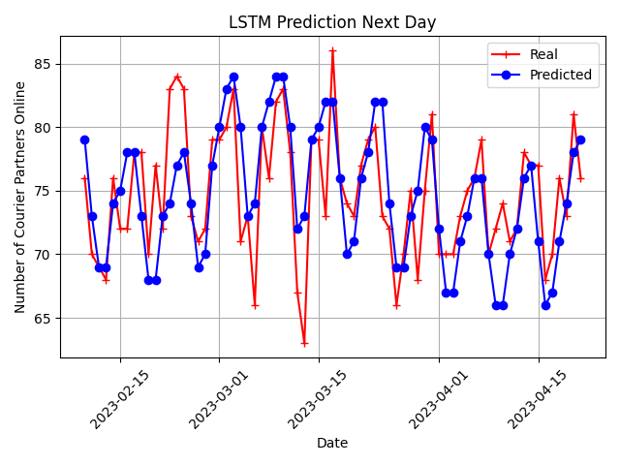
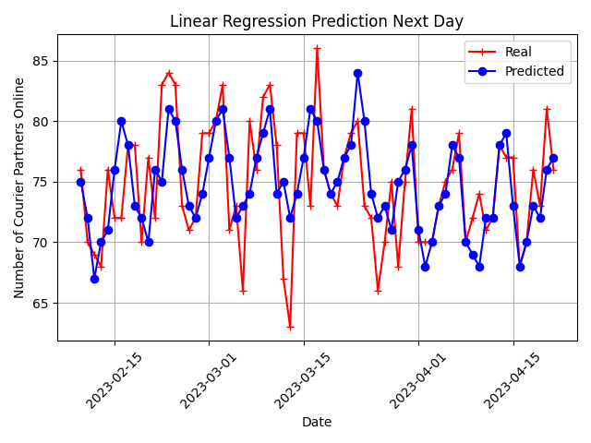
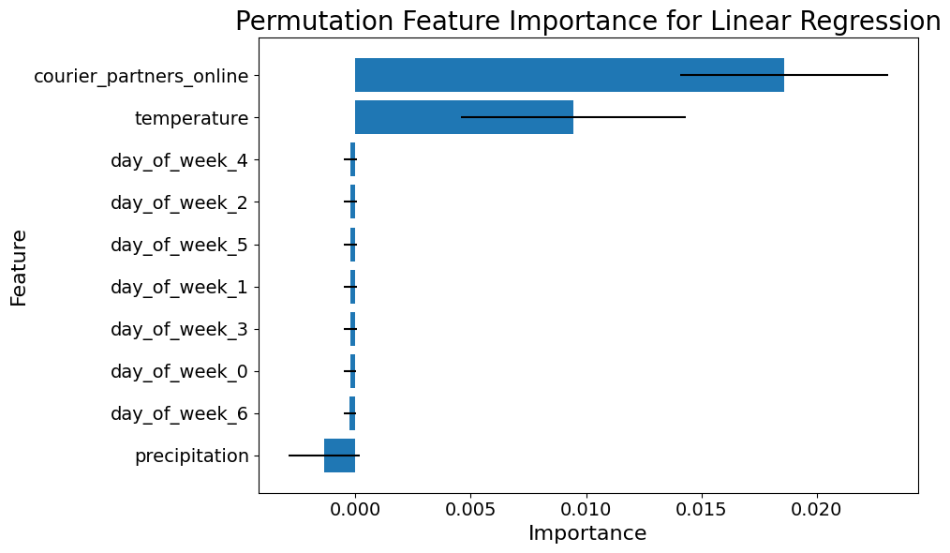
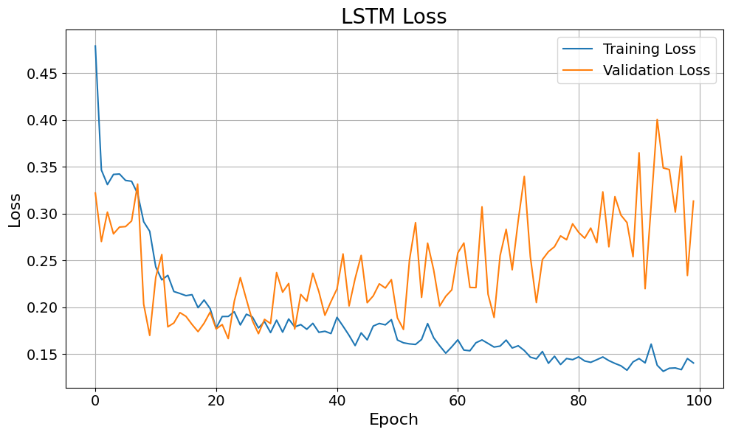
Results: Next-Day prediction
Learning curves (see in /notebooks)
Residual errors
Model | MAE | RMSE | SNR | R2
LSTM | 2.92 | 3.93 | 25.61 | 0.35
LR | 3.04 | 3.90 | 25.67 | 0.36
Linear Regression works a bit better than LSTM
Most important features: ‘courier_partner_online’, ‘temperature’
Optimal training stop is at 20 Epoch

Slide 7
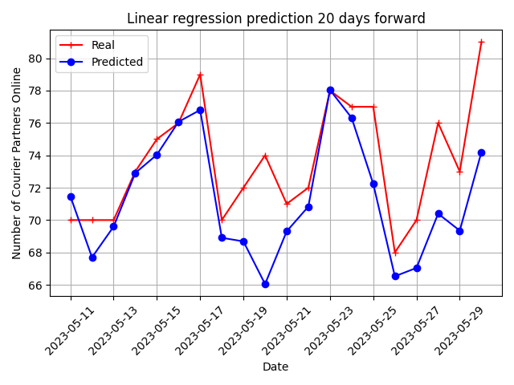
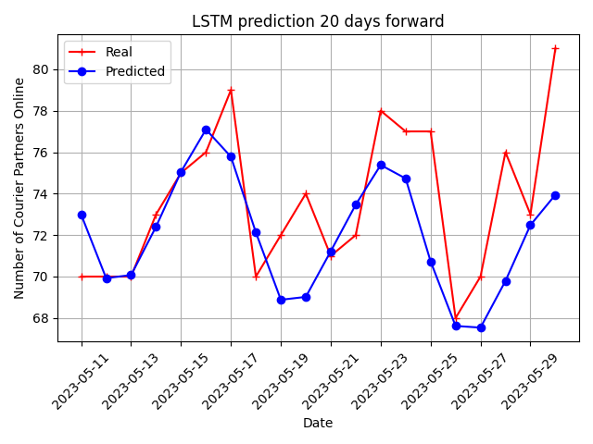
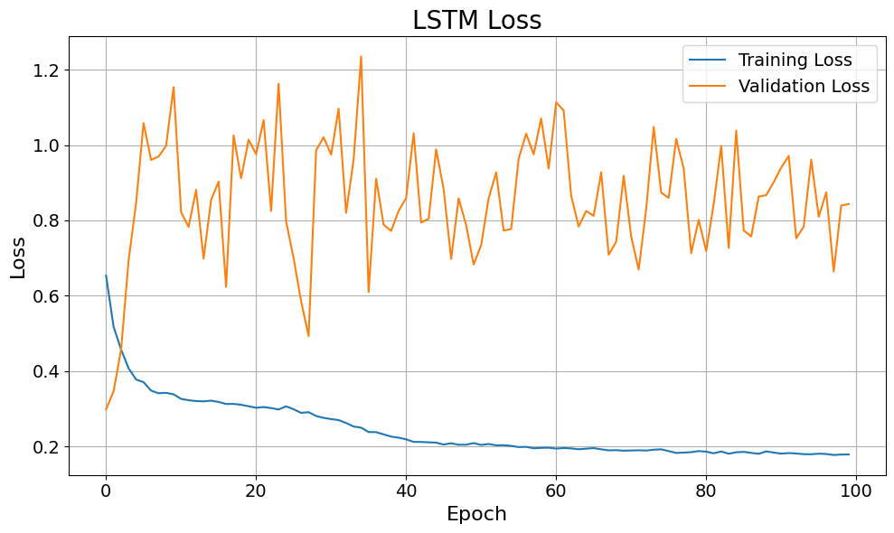
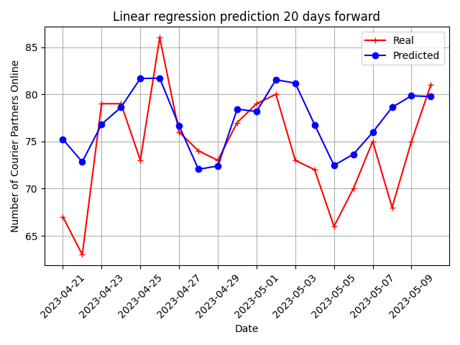
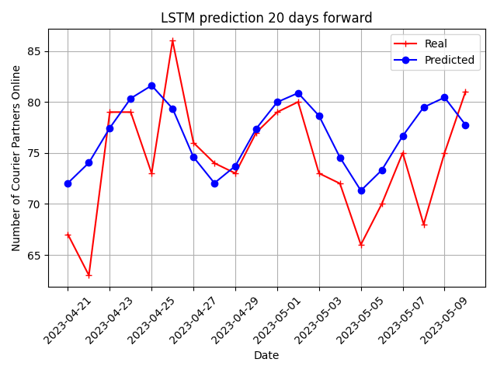
Results: Multiple-Day prediction for 20 ahead
Predictions for different 20-days terms
residual errors
Model | MAE | RMSE | SNR | R2
LSTM | 3.43 | 4.32 | 24.95 | 0.29
LR | 3.51 | 4.36 | 24.71 | 0.17
LSTM performs better than LR
However, LSTM overfits so that test and validation errors fluctuate. Metrics can vary from run to run

Slide 8
Conclusion
Both LSTM and Linear Regression models predict courier numbers for the Next Day and for Multiple Days ahead based on the historical features.
For both tasks metrics RMSE, SNR, and R-squared show decent performance (R-squared ~0.2-0.3). For the Next-Day task, both models perform similarly, while Linear Regression slightly outperforms for the Multiple-Day task.
LSTM performance depends on hyperparameters like batch size and early stopping. For Multiple-Day task LSTM model overfits. Future improvements can focus on hyperparameter optimization and expanding the time series dataset to further enhance performance.

