Slide 1

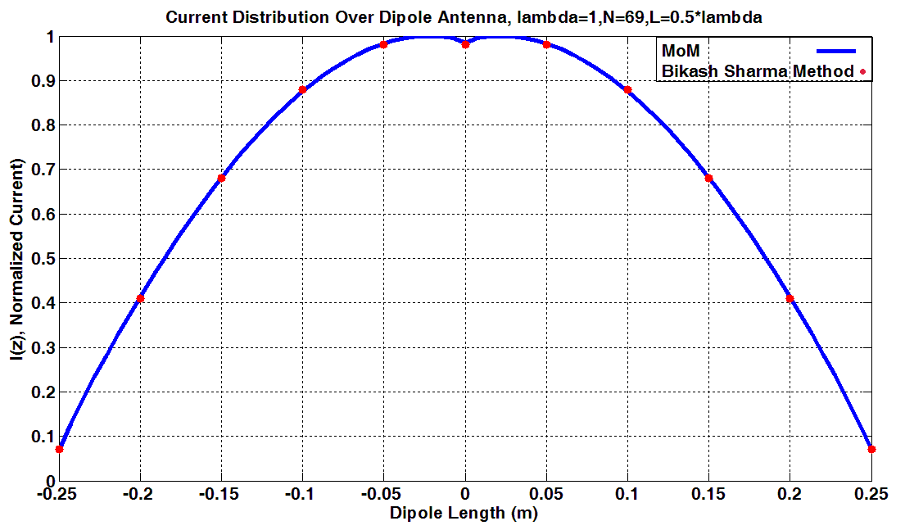
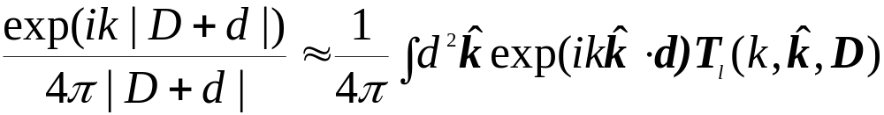
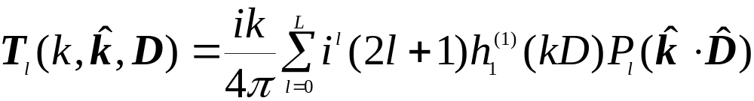
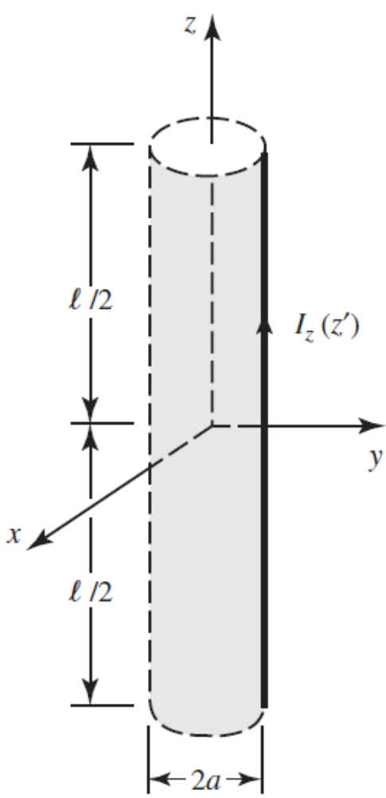
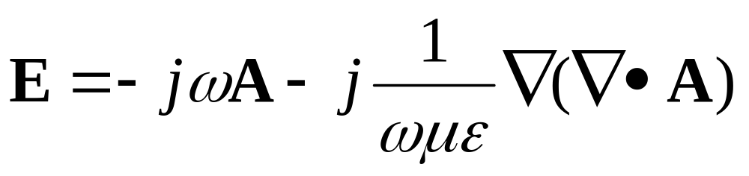
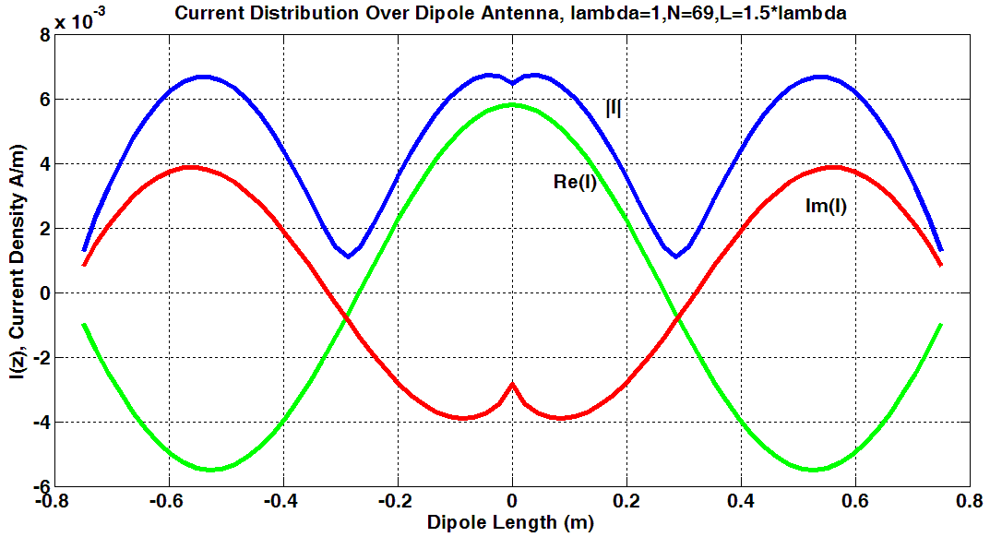
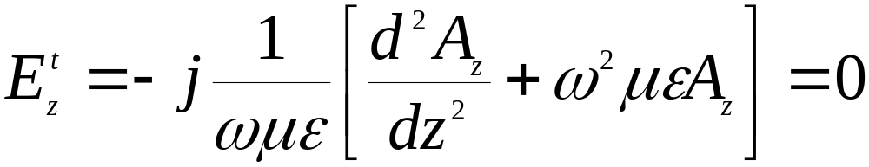
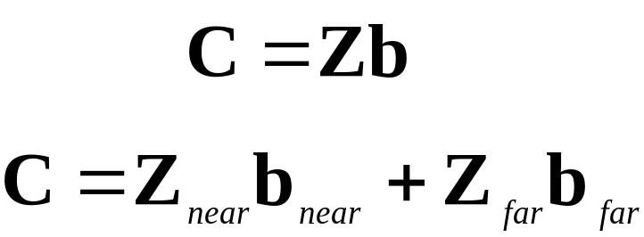
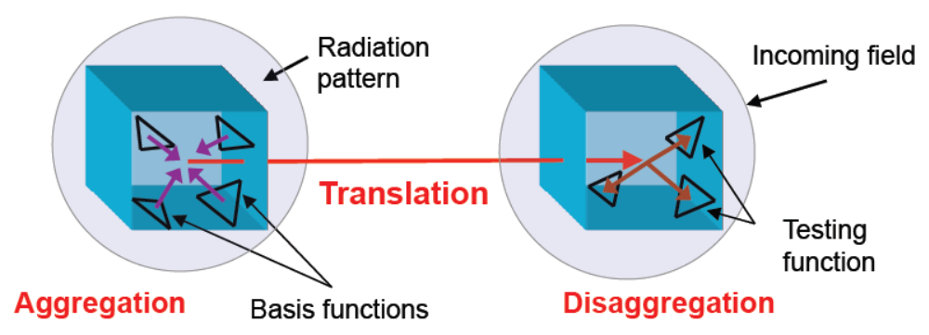
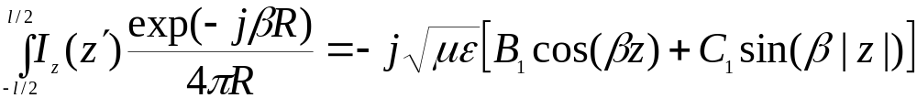
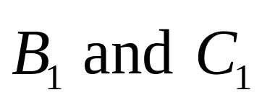
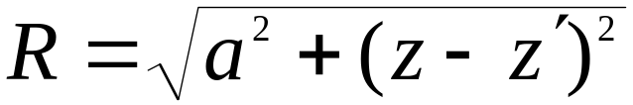
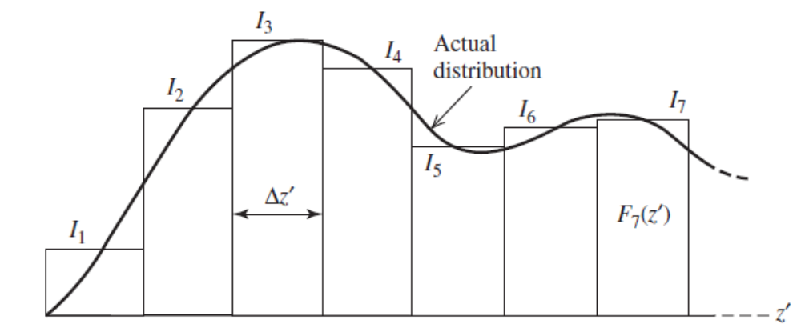
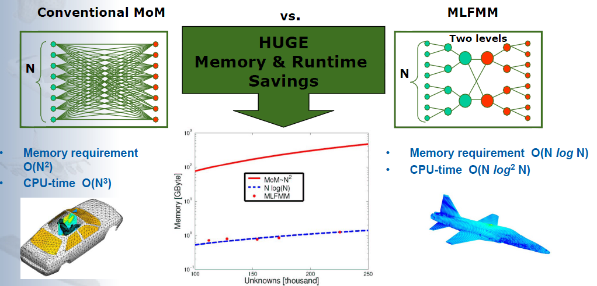

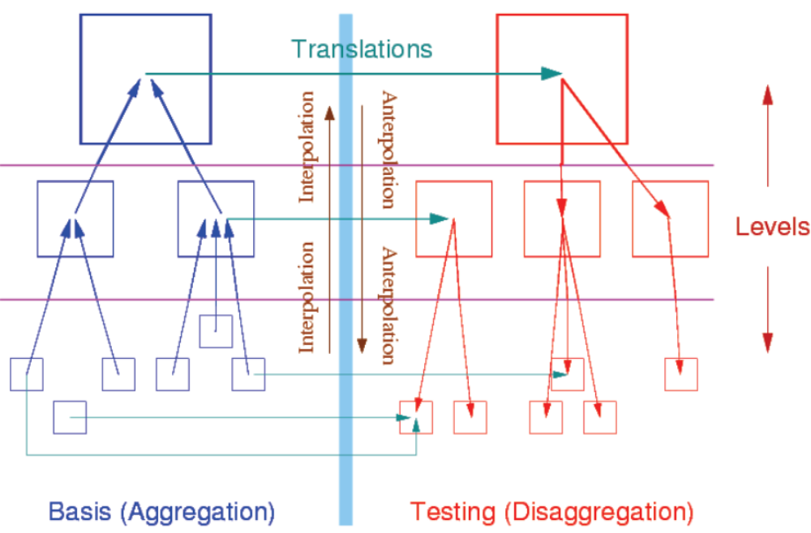
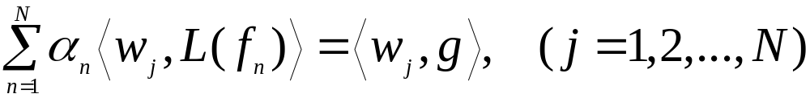
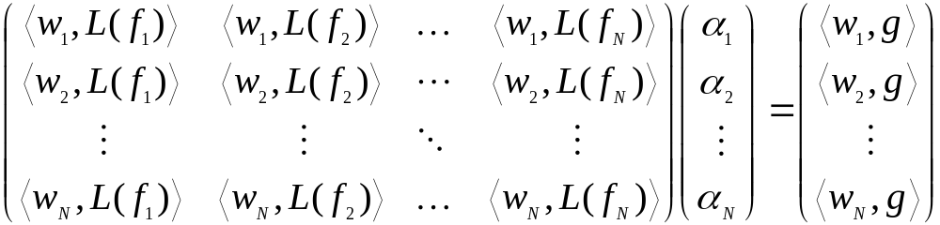
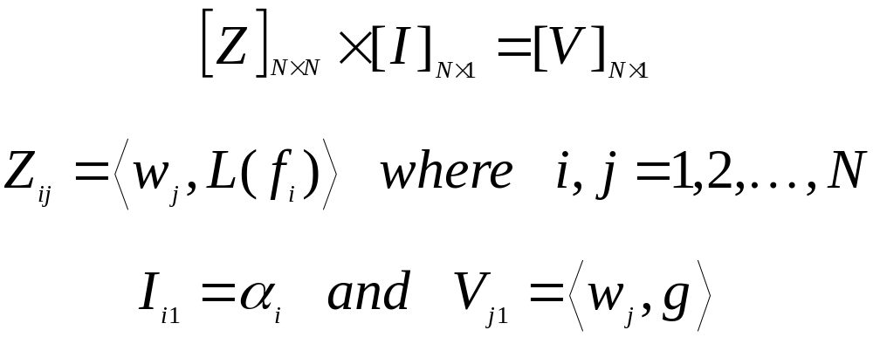

Wireless Communications and
Remote Sensing Lab
Electrical & Computer
Engineering
Class Schedule Generator through Matrix Manipulation
Murilo Silva
Department of Electrical & Computer Engineering
Abstract
Fast Multipole Method (FMM)
Results and Discussion
In the past few decades, computational simulation has become an accepted paradigm for scientific discovery, especially with the dramatic growth in fast computers and powerful software. Generally, simulations involve several million variables. Most large problems boil down to the solution of a linear system or performing a matrix-vector product. Regular product requires O(N×N) time and O(N×N) memory. The Fast Multipole Method (FMM), which has been acclaimed as one of the most efficient algorithms of the 20th century, dramatically reduces the complexity of matrix-vector multiplication involving a certain type of dense matrix, which can arise out of many physical systems. FMM achieves this product in O(N log N) time and memory. In electromagnetic applications, most problems of practical interest will generate a set of integral equations that is used to solve radiation and scattering problems. However, these equations generally cannot be solved analytically. The Method of Moments (MoM) is a powerful numerical technique used to convert these integral equations into a linear system that can be solved numerically using a computer. Hallen’s Integral Equation is a method for solving radiation from a dipole by casting the solution for the unknown current density, which is induced on the surface of the dipole, in the form of an integral equation, where the unknown induced current density is part of the integrand. In this poster, FMM is used to solve Hallen’s Integral Equation for dipole antennas. This requires the decoupling of the sources and the observation points using the addition theorem. The results are compared with the solution using MoM.
The Addition Theorem (factorization of Green’s function) states:
Using the plane-wave expansion
Using diagonalization
This yields a translation function:
Thus for many sources,
The MoM matrix Z represents the interactions between all basis functions in the system, and the right-hand side vector b represents the excitation of each basis function. When we compute the matrix-vector product,
FMM steps:
Multilevel FMM
Using Hallen’s IE, assuming an excitation of 1V and 2 ln( l /a)= 12.5, we determine the current distribution I(z) on a straight dipole. The figures show: (a) the normalized current distribution for l = λ/2, and (b) the magnitude of the current and the two phase components of the current for l = 1.5λ.
Case (a) –
Our numerical calculations are compared with the results from the analytical model developed by Bikash Sharma and the two sets agree very well.
Case (b) –
Because the current standing wave pattern of a dipole longer than λ (l > λ) undergoes 180 phase reversals between adjoining half cycles, the current in all parts of the dipole does not have the same phase.
Hallen’s Integral Equation
In the figure shown, the electric current density in the cylinder flows along the z-axis (J = az Jz ), then the vector potential is given by A = az Az (z), which for small radii is assumed to be only a function of z. Thus, the equation for electric field:
reduces to
since the total tangential electric field vanishes on the surface of the cylinder.
The solution of the above equation is given by
For a current-carrying wire, its potential is also given by
where are constants and , . This formulation is known as Hallen’s Integral Equation method.
Method of Moments (MoM)
Conclusions and Future Work
A general linear, inhomogeneous equation may be described in operator form as
where L is a linear operator which could be a differential, integral, or integro-differential operator; the function g is known and the corresponding solution f is to be determined.
The solution based on MoM is given by
References
Balanis, C. A. (2005). Anthenna Theory Analysis and Design (Third Edition ed.). New Jersey: John Wiley & Sons, Inc.
Gibson, W. C. (2008). The Method of Moments in Electromagnetics. New York, USA: Taylor & Francis Group.
Dr. Ulrich Jakobus and Dr. Markus Schick. Using FEKO for Electromagnetic Simulations in the Automotive Environment. EM Software & Systems GmbH, Germany. www.emss.de
In above equation, matrix Z is usually called MoM impedance matrix, while the vector I contains the unknown coefficients. If Z is an invertible matrix, we can find I using;

