Slide 1
Frequency Hopping Spread Spectrum
Murilo Silva
ECE571 Digital Communications

Slide 2
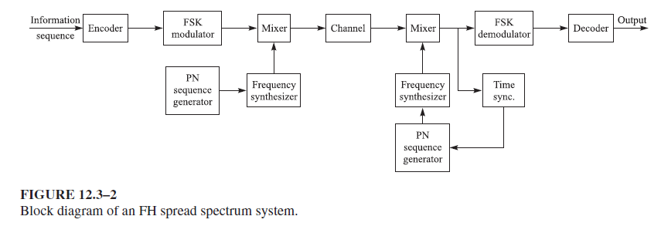
Overview

Slide 3
Frequency Hopping Spread Spectrum
Signal broadcast over seemingly pseudo random series of frequencies
Receiver and transmitter hops between frequencies in sync
Multi-user communication system
• Jamming on one frequency affects only a few bits*

Slide 4
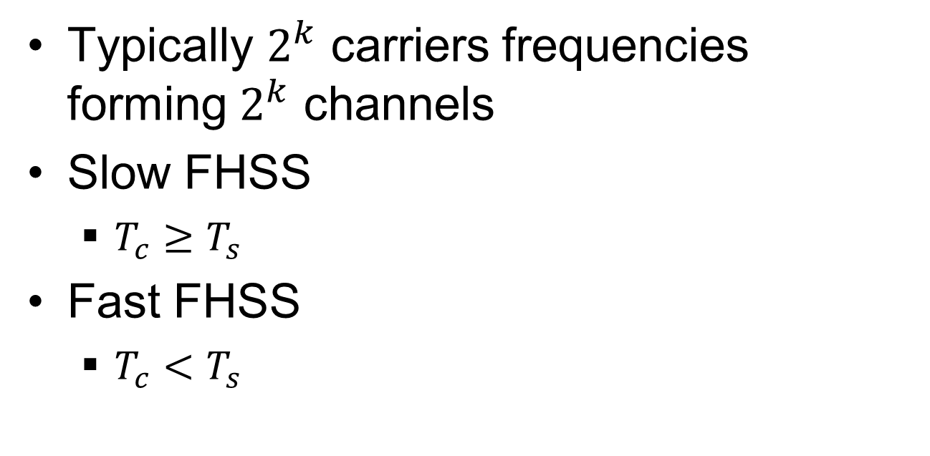
FHSS (cont’d)
Typically $2^{k}$ carriers frequencies forming $2^{k}$ channels
Slow FHSS
$T_{c}≥T_{s}$
Fast FHSS
$T_{c}<T_{s}$

Slide 5

FHSS and IEEE 802.11
ISM Band ($2.402GHz−2.48GHz$)
GFSK Modulated with BW = $1MHz$

Slide 6
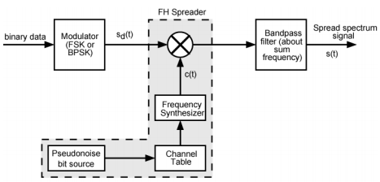
FHSS Modulator Revisited

Slide 7
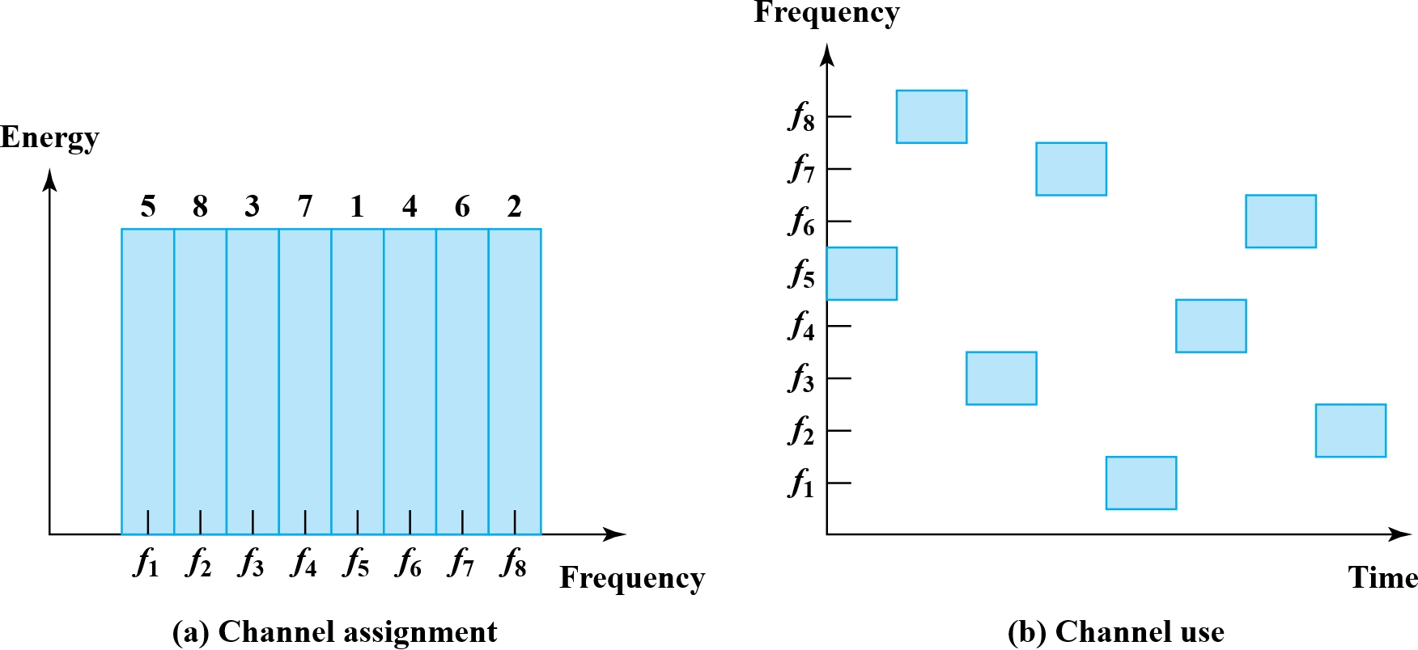
FHSS Frequency Assignment

Slide 8
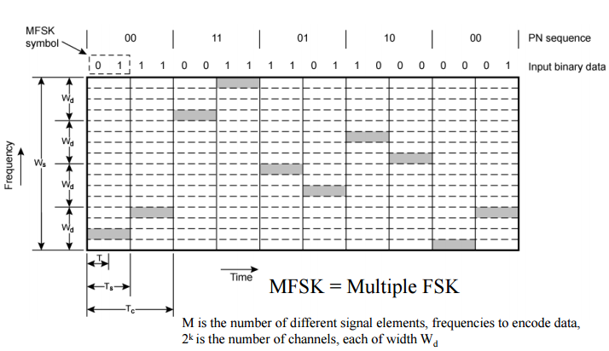
Slow FHSS

Slide 9
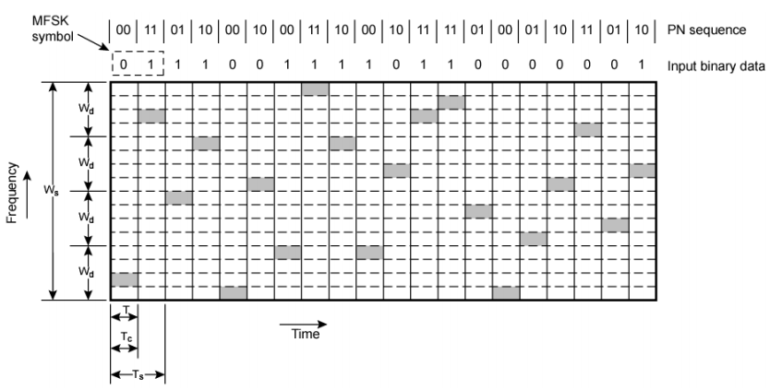
Fast FHSS

Slide 10
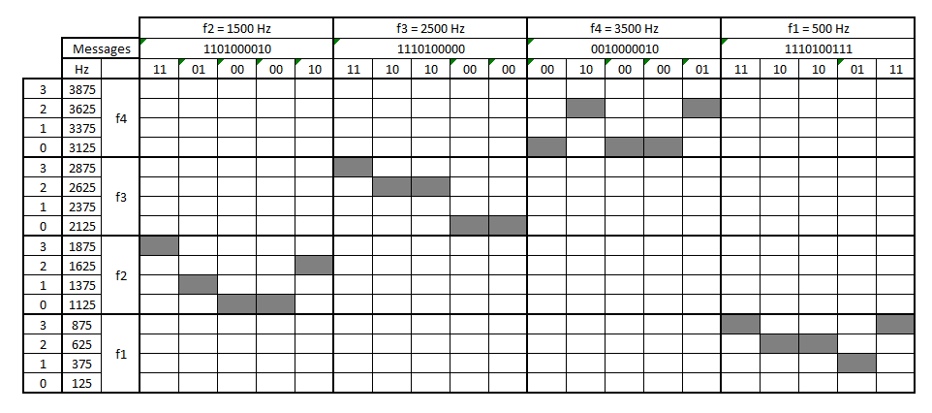
Slow FHSS Demo

Slide 11
Slow FHSS Demo (cont’d)

Slide 12
Slow FHSS Demo

Slide 13
Sources
Digital Communications 5th Edition, Proakis, Salehi. ISBN:9780072957167
https://www.tutorialspoint.com/digital_communication/digital_communication_frequency_shift_keying.htm
https://witestlab.poly.edu/blog/frequency-hopping-spread-spectrum/
http://www.rchelicopterfun.com/RC-Spread-Spectrum.html
http://www2.cs.uidaho.edu/~krings/CS420/Notes-F13/420-13-09.pdf
IEEE Standard for Information Technology: IEEE 802.11

