Slide 1
How the UN Sustainable Development Goals Have Changed Party Communication
Stefan Müller

Slide 2


Slide 3
Relevance
Evidence-Based Decision Making:
Quantify commitment to SDGs in existing policies
Identify gaps in SDG coverage across political discourse
Policy Evaluation and Improvement:
Track changes in SDG focus over time
Compare SDG alignment across different political entities
Enhanced Accountability:
Provide transparent metrics for public and stakeholders
Facilitate international comparisons and benchmarking

Slide 4
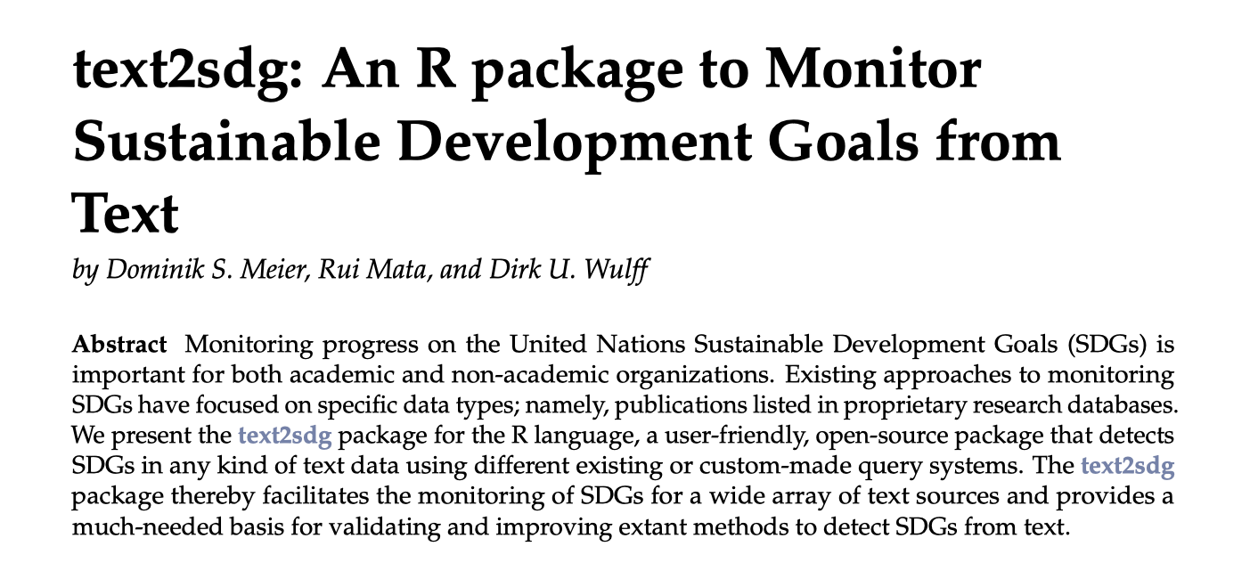
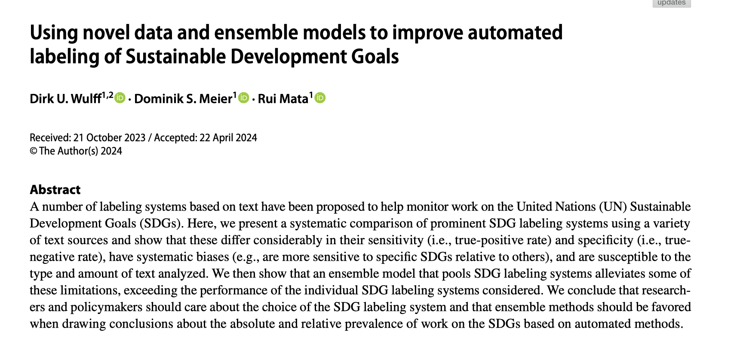
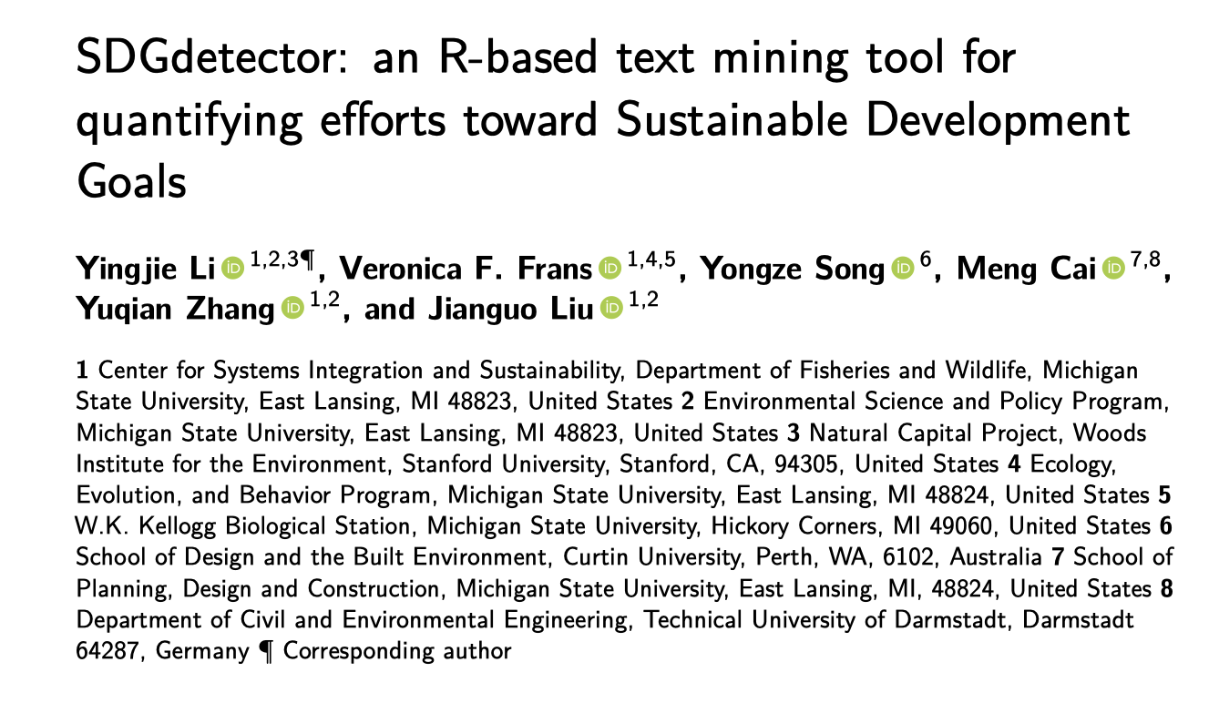

Slide 5


Slide 6
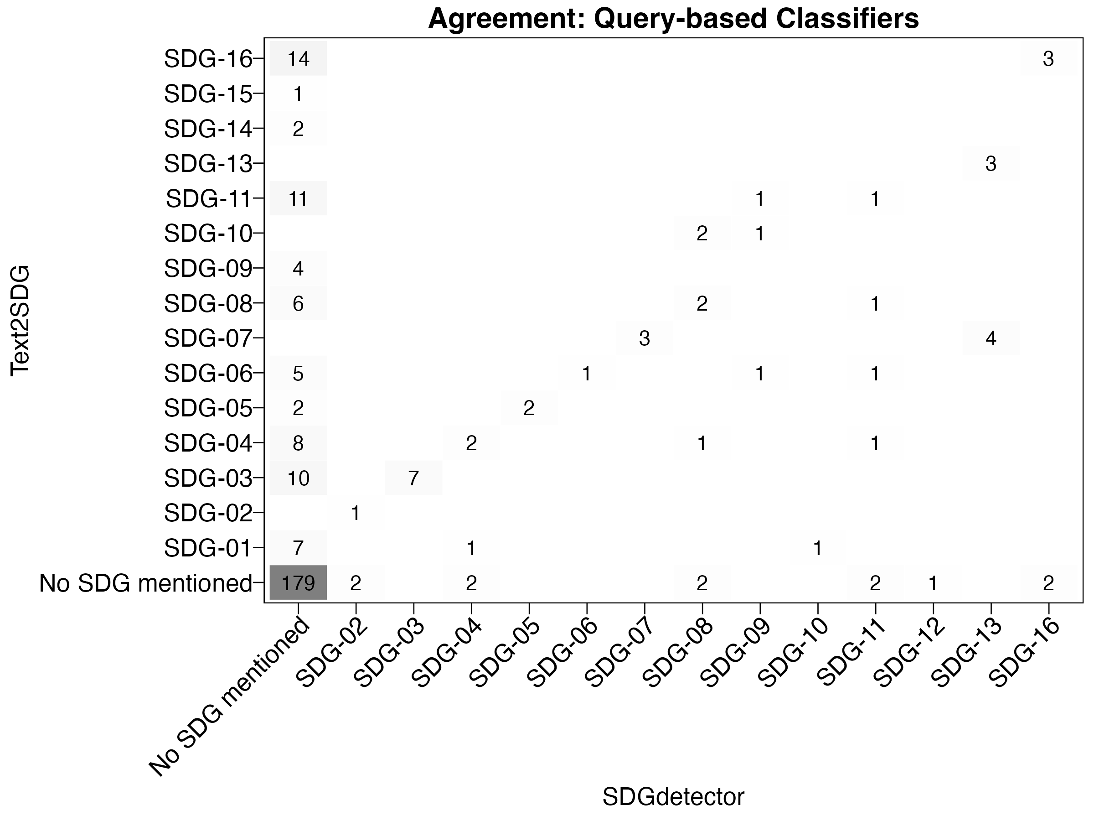
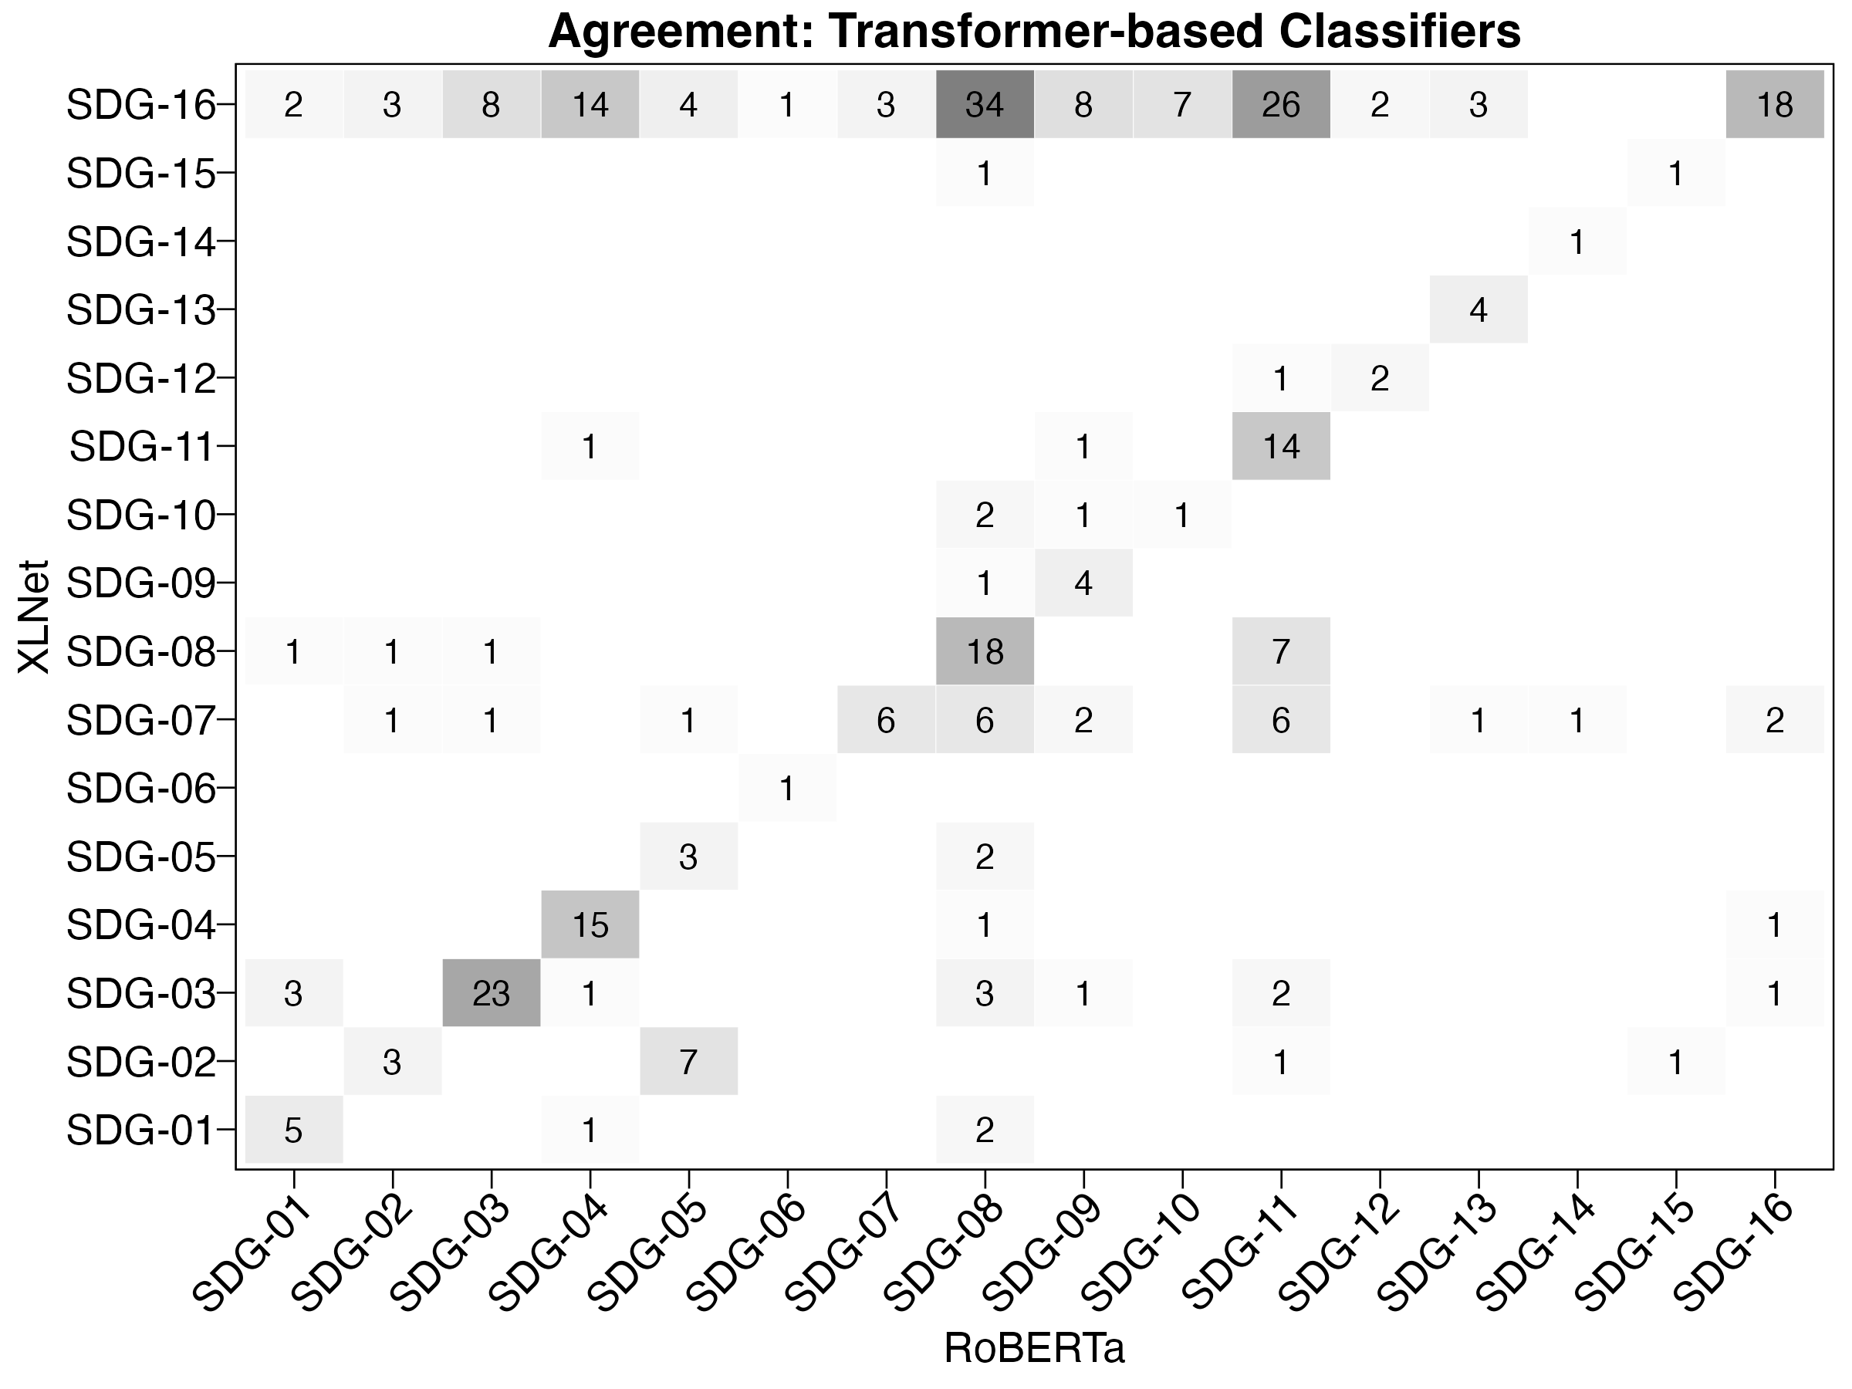

Slide 7
Goals and Applications
Improve existing classifiers using combination of approaches
Test Large Language Models
Apply to party manifestos and/or legislative speech

