Slide 1
qLearn Week 2
Intro to Quantum Information
Michael Silver ECE 2T6
UofT Quantum Computing Club

Slide 2


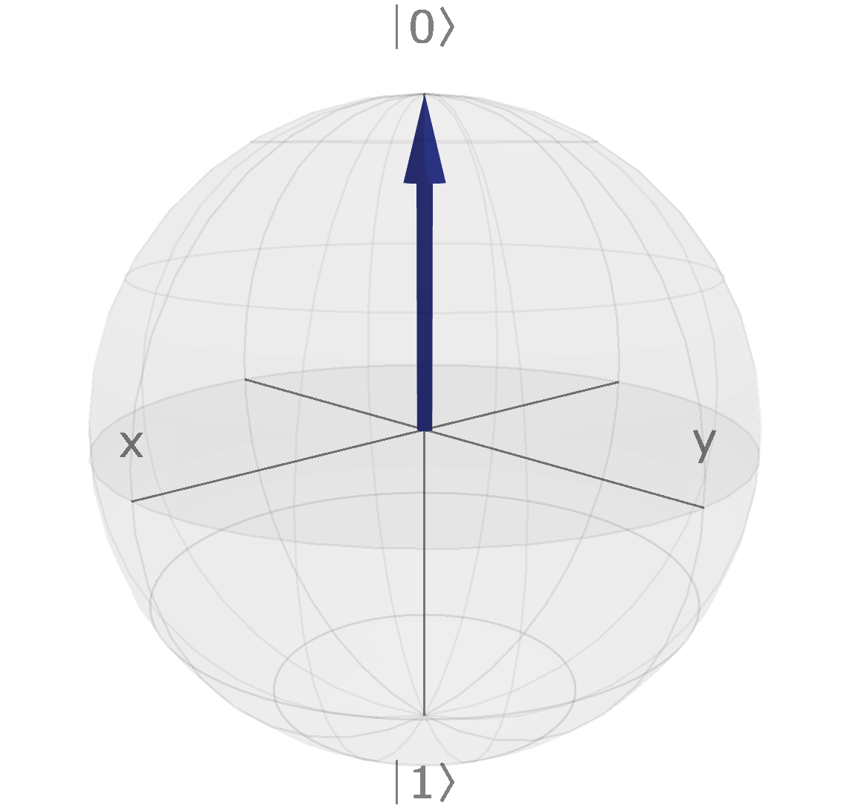
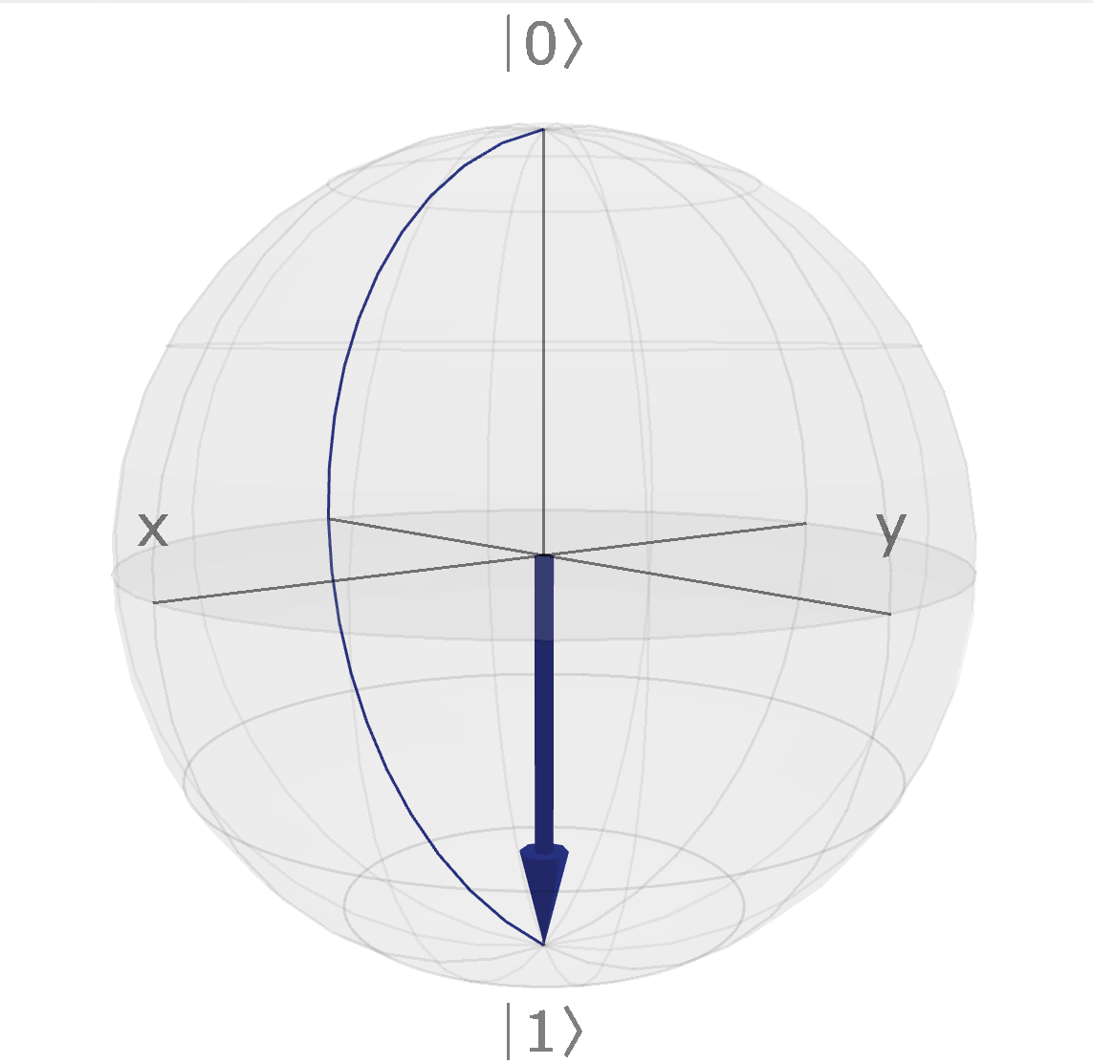
In Quantum Computers…
‘Bloch Sphere’

Slide 3


Using Simpler Terms… (Dirac/Braket Notation)

Slide 4
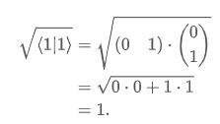
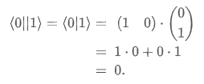
Computational (and other) Basis
‘Bra’, as opposed to ‘ket’
Calculating the length of a qubit state vector
Normalized (has length 1)
‘Braket’ Expression
orthogonal
When vectors (or states in our case) are orthogonal, they form a basis (any vector in the space can be expressed as a unique linear combination of the basis vectors)
This particular basis is called the computational basis, ie. the most commonly used
When a basis consists of two normalized, orthogonal vectors, is it called an orthonormal basis
All quantum bases will be orthonormal

Slide 5



Notation in Quantum Information
‘Probability amplitudes’: Carry information about the relative strengths of 0 and 1 in the state
Think about why they equal 1

Slide 6


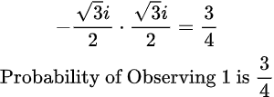
Example
We call i the ‘imaginary unit’, it creates complex numbers, just think of it as the square root of -1

Slide 7
Quantum Superposition

Slide 8
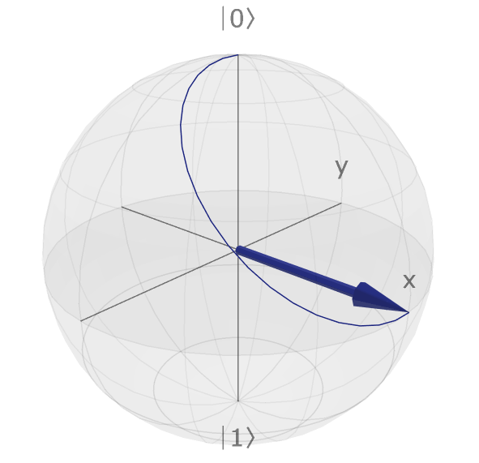
The Idea of Superposition

Slide 9
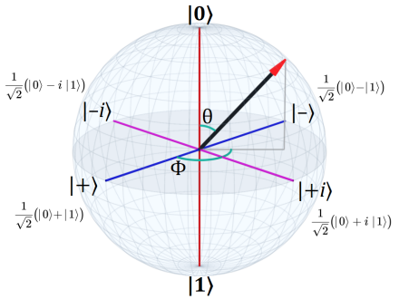


The ‘Superposition States’

Slide 10
Mom… It’s just a Phase!

Slide 11
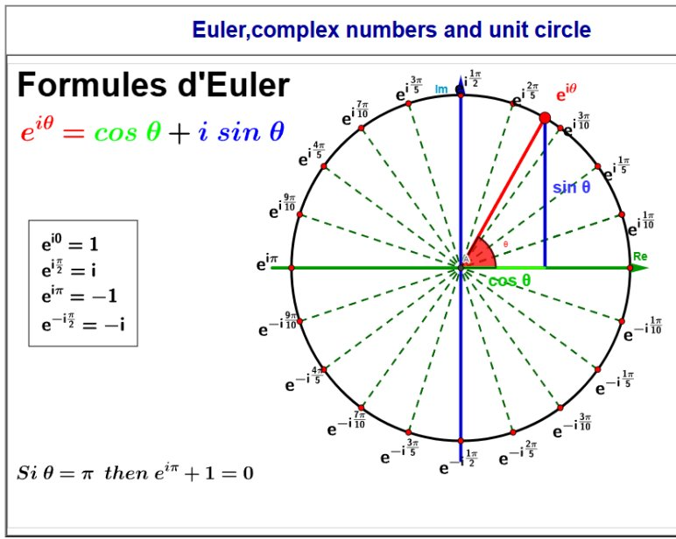
Using Phases in Quantum Computation
Quantum Amplitude Amplification (Board)

Slide 12
Quantum Computation

Slide 13

How do we Transform Vectors?
MATRICES!!!
What sends a 2D vector to another 2D vector?
Multiplication by a 2x2 Matrix, U
But remember, we need to preserve the length of the quantum state
Special class of matrices that preserves the length of vectors: unitary matrices
All quantum operations are unitary matrices

Slide 14
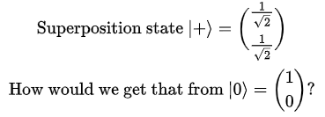


Exercise: Find the matrix to put a state into superposition
Hadamard Gate:
Our superposition operation; how we put a state into and out of superposition
(notice anything?)

Slide 15
See you Next Week!

