Slide 1
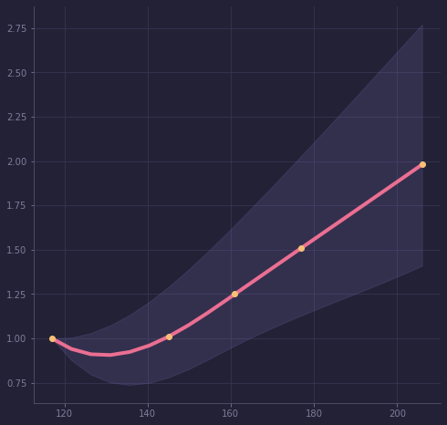
Refined Carbs Increase Your Glycemic Load & Cardiovascular Risk
person eating too many carbs
Risk of Cardiovascular Disease (CVD)
recommended daily
allowance
Carbohydrates Eaten Per Day
The Health Message Works!
1/3

Slide 2
Scientific Research - 2000
Glycemic Load means how quickly a food increases your blood sugar.
Refined carbs like added sugar, candy, white flour, white rice and breakfast meal and drinks with added sugar have a higher glycemic load than natural foods like fruits and whole foods.
Liu et al, 2000, American Journal of Clinical Nutrition, 71(6), 1455–1461.
The Health Message Works!
2/3

Slide 3
Ellen G. White - 1905
“Grains, fruits, nuts, and vegetables constitute the diet chosen for us by our Creator. These foods, prepared in as simple and natural a manner as possible, are the most healthful and nourishing.”
“They impart a strength, a power of endurance, and a vigor of intellect that are not afforded by a more complex and stimulating diet...”
The Ministry of Healing, 296, Ellen G. White
The Health Message Works!
3/3

