Slide 1
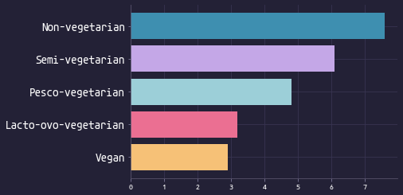
Consuming Animal Products Linked to Higher Prevalence of Type 2 Diabetes
🌿 🧀 🐟 🍖 🥩
🌿 🧀 🐟 🍖
🌿 🧀 🐟
🌿 🧀
🌿
Prevalence of Type 2 diabetes
The Health Message Works!
1/3

Slide 2
Scientific Research - 2014
Meat consumption is consistently associated with diabetes risk.
Recently published findings from the Chicago Western Electric Study indicated an association between animal protein intake and obesity. A diet eliminating meat was shown to... improve insulin sensitivity, compared with a more conventional diabetic diet
Barnard et al, Nutrients 2014, 6, 897-910
The Health Message Works!
2/3

Slide 3
Ellen G. White - 1905
When flesh is discarded, its place should be supplied with a variety of grains, nuts, vegetables, and fruits...
None should be urged to make the change abruptly...
....With care and skill, dishes may be prepared that will be both nutritious and appetizing...
The Ministry of Healing, 316, [1905]
The Health Message Works!
3/3

