Slide 1
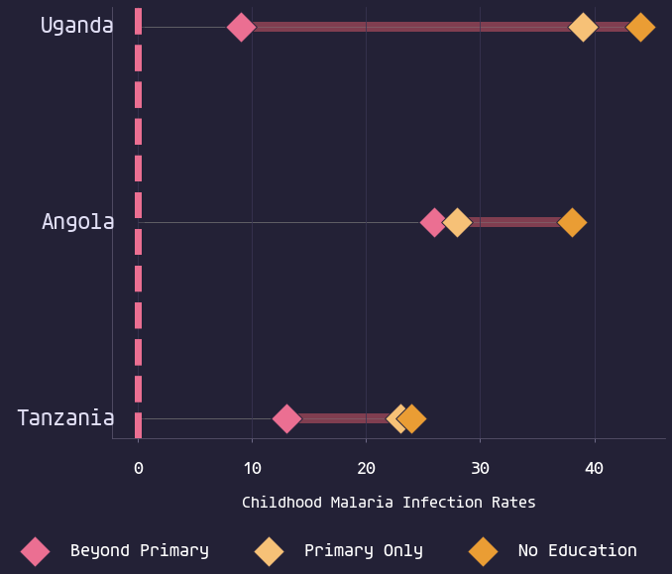
Educated Mothers Have Children with Lower Malaria Infection Rates
The Health Message Works!
1/3

Slide 2
Scientific Research - 2014
Children with mothers whose education level was beyond primary school were 4.7% less likely to be malaria-positive
Previous studies have documented that maternal education improves health-related knowledge and increases mothers’ receptiveness to
health messages...
Njau et al, Am. J. Trop. Med. Hyg., 91(3), 2014, pp. 509–519
The Health Message Works!
2/3

Slide 3
Ellen G. White - 1905
Hosea 4:6 “My people are destroyed for lack of knowledge”
...It is the duty of every person, for one's own sake, and for the sake of humanity, to inform himself or herself in regard to the laws of life
The Ministry of Healing, 128, [1905]
God holds mothers accountable for the diseases their children are compelled to suffer.
An Appeal to Mothers, Ellen G. White
The Health Message Works!
3/3

