Slide 1

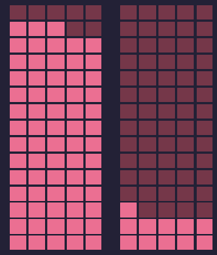
Eating 50-55% Carbs Per Meal is Healthier Than Either Extreme
moderate amount of Carbs
too many and too few Carbs
1.00
1.20
1.23
Risk of Mortality
The Health Message Works!
1/3

Slide 2
Scientific Research - 2010
Low carbohydrate diets that exchange carbohydrates for a greater intake of protein or fat have gained substantial popularity because of their ability to induce short-term weight loss
50–55% energy from carbohydrate had the lowest risk of mortality.
Both low (<40%) and high carbohydrate consumption (>70%) had greater mortality risk
Seidelmann et al, Lancet Public Health 2018;
The Health Message Works!
2/3

Slide 3
Ellen G. White - 1938
“There are two extremes, both of which we should avoid...”
You need not go into the water, or into the fire, but take the middle path, avoiding all extremes.. Have your food prepared in a healthful, tasteful manner;
...Do not have a starvation diet, but do not take a variety at one meal.
Counsels on Food and Diet, Ellen G. White, 1938
The Health Message Works!
3/3

