Slide 1
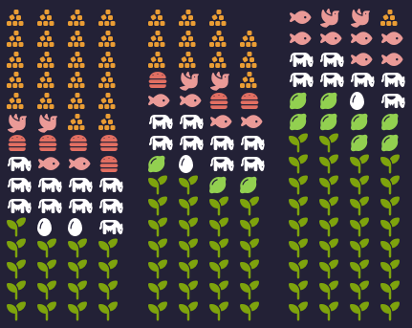
Changing Typical Western Diet Improves Life Expectancy By Over 10 Years
Typical
Better
Optimal
Refined Foods
Red & White Meats
Eggs & Milk
Legumes & Nuts
Whole Foods
0
6
12
Increase in Life Expectancy (Years)
The Health Message Works!
1/3

Slide 2
Scientific Research - 2022
The Western diet includes high intakes of pre-packaged foods, refined grains, red meat, processed meat, high-sugar drinks, candy and sweets, fried foods... other high-fat dairy products,
An optimal diet had substantially higher intake of whole grains, legumes, fish, fruits, vegetables, and included a handful of nuts
Estimating impact of food choices on life
expectancy: A modeling study. Fadnes, Lars T et al. PLoS Med 2022 Feb 8; 19(2)
The Health Message Works!
2/3

Slide 3
Ellen G. White - 1890
God has, with a lavish hand, provided us with rich and varied bounties for our sustenance and enjoyment...
...in order for us to enjoy the natural appetite, which will preserve health and prolong life, He restricts the appetite.
He says, Beware; restrain, deny, unnatural appetite.
Christian Temperance and Bible Hygiene, 150, 151
The Health Message Works!
3/3

