Slide 1
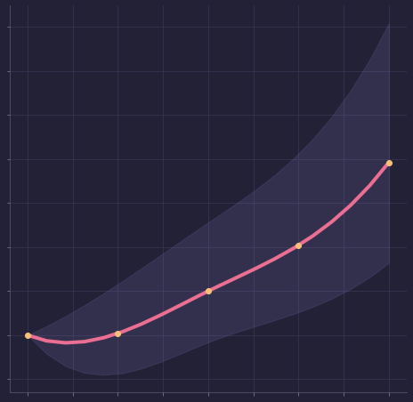
High Glycemic Loads Increase Cardiovascular Disease Risk
Liu et al, 2000, American Journal of Clinical Nutrition, 71(6), 1455–1461.
risk of a person eating close to twice the RDA
range of risk
Risk of Cardiovascular Disease
risk for a person taking the minimum Recommended Daily Allowance (RDA) i.e 130 g/day
Glycemic Load per day
Why Do I Get Sick?
1/3

Slide 2
High Glycemic Loads Increase Cardiovascular Disease Risk
Liu et al, 2000, American Journal of Clinical Nutrition, 71(6), 1455–1461.
Glycemic Load means how quickly a food increases your blood sugar.
Foods like added sugar, candy, white flour, white rice and breakfast meal and drinks with added sugar have a higher glycemic load than fruits and whole foods.
A glycemic load from refined foods like white rice increases the risk of CVD, independent of known coronary disease risk factors.
The risk of CVD when taking a higher glycemic load was higher in women with above average weights
Am I eating foods that are giving me a high glycemic load? How can I replace them with better foods that can protect me instead?
Why Do I Get Sick?
2/3

Slide 3
High Glycemic Loads Increase Cardiovascular Disease Risk
Liu et al, 2000, American Journal of Clinical Nutrition, 71(6), 1455–1461.
Proverbs 25:16 Have you found honey?
Eat as much as is sufficient for you,
lest you eat too much, and vomit it.
Far too much sugar is ordinarily used in food. Cakes, sweet puddings, pastries, jellies, jams,
“Sugar clogs the system. It hinders the working of the living machine. (2T 369, 370).
Fine-flour bread does not impart to the system the nourishment that is to be found in unbolted-wheat bread. Its common use will not keep the system in the best condition.
[Counsels on Food and Diet, Ellen G. White]
Why Do I Get Sick?
3/3

