Slide 1
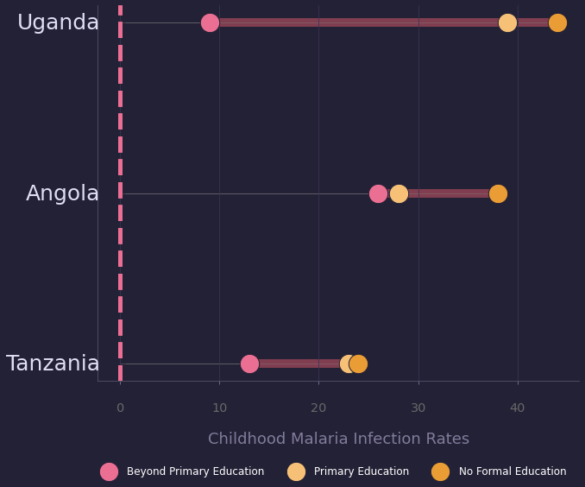
Educated Mothers and Rates of Childhood Malaria Infections
Njau et al, Am. J. Trop. Med. Hyg., 91(3), 2014, pp. 509–519
Infection rate of children whose mothers received education beyond the primary level
Counsels on Lifestyle
1/3

Slide 2
Educated Mothers and Rates of Childhood Malaria Infection
Njau et al, Am. J. Trop. Med. Hyg., 91(3), 2014, pp. 509–519
Children with mothers whose education level was beyond primary school were 4.7% less likely to be malaria-positive (P < 0.001).
Previous studies have documented that maternal education improves health-related knowledge and increases mothers’ receptiveness to
health messages... regardless of whether the specific health messages are covered in all school curricula...
Mothers with poor knowledge about the
causes of malaria are less likely to recognize malaria symptoms or take proper and prompt actions when their children became sick.
-Njau et al (2014)
Counsels on Lifestyle
2/3

Slide 3
Educated Mothers and Rates of Childhood Malaria Infection
Njau et al, Am. J. Trop. Med. Hyg., 91(3), 2014, pp. 509–519
Hosea 4:6 “My people are destroyed for lack of knowledge”
Too little attention is generally given to the preservation of health. It is far better to prevent disease than to know how to treat it
...It is the duty of every person, for one's own sake, and for the sake of humanity, to inform himself or herself in regard to the laws of life
—The Ministry of Healing, 128, [1905]
“Knowledge must be gained in regards to how to eat and drink and dress so as to preserve health.”
Parents are accountable in a great degree... God holds mothers accountable for the diseases their children are compelled to suffer.
-An Appeal to Mothers, Ellen G. White
Counsels on Lifestyle
3/3

