Slide 1

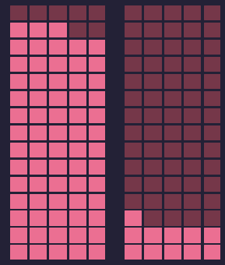
In the Long Run, Too Few Carbs Is as Unhealthy as Too Many
Seidelmann et al, Lancet Public Health 2018; 3: e419–28
person eating meals with moderate amount of Carbs
people eating meals with too many and very few Carbs
1.00
1.20
1.23
Risk of Mortality
Counsels on Lifestyle
1/3

Slide 2
In the Long Run, Too Few Carbs Is as Unhealthy as Too Many
Seidelmann et al, Lancet Public Health 2018; 3: e419–28
Low carbohydrate diets that exchange carbohydrates for a greater intake of protein or fat have gained substantial popularity because of their ability to induce short-term weight loss ...despite incomplete and conflicting data regarding their long-term effects on health outcomes
We studied a large prospective cohort, with a median follow-up of 25 years, to examine the association of carbohydrate intake with mortality in four US communities from diverse socioeconomic backgrounds
a percentage of 50–55% energy from carbohydrate was associated with the lowest risk of mortality.
Both low carbohydrate consumption (<40%) and high carbohydrate consumption (>70%) conferred greater mortality risk than did moderate intake,
Seidelmann et al (2018)
Counsels on Lifestyle
2/3

Slide 3
In the Long Run, Too Few Carbs Is as Unhealthy as Too Many
Seidelmann et al, Lancet Public Health 2018; 3: e419–28
“There are two extremes, both of which we should avoid. May the Lord help everyone connected with our medical institutions not to advocate a meager supply of food.”
It is really contrary to health reform to cut off the great variety of dishes, and then go to
the opposite extreme, taking no pains to understand that the living machinery must be fed in
order to work, and reducing the quantity and quality of the food to a low degree. Instead of health
reform, this is a health deform.”
You need not go into the water, or into the fire, but take the middle path, avoiding all extremes.. Have your food prepared in a healthful, tasteful manner;
...Do not have a starvation diet, but do not take a variety at one meal.
Counsels on Food and Diet, Ellen G. White [1938]
Counsels on Lifestyle
3/3

