Slide 1
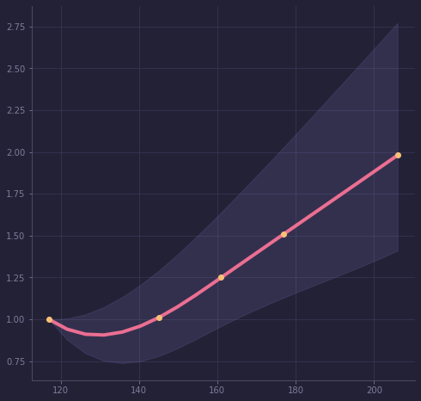
Lower Glycemic Loads Means Lower Cardiovascular Disease Risk
Liu et al, 2000, American Journal of Clinical Nutrition, 71(6), 1455–1461.
risk of a person eating more than twice the RDA
range of risk
Risk of Cardiovascular Disease
risk for a person taking the minimum Recommended Daily Allowance (RDA) i.e 130 g/day
Glycemic Load per day
Counsels on Lifestyle
1/3

Slide 2
Lower Glycemic Loads Means Lower Cardiovascular Disease Risk
Liu et al, 2000, American Journal of Clinical Nutrition, 71(6), 1455–1461.
Glycemic Load means how quickly a food increases your blood sugar.
Foods like added sugar, candy, white flour, white rice and breakfast meal and drinks with added sugar have a higher glycemic load than fruits and whole foods.
A glycemic load from refined carbs like white flour increases the risk of CVD, independent of known coronary disease risk factors.
The risk of CVD when taking a higher glycemic load was higher in women with above average weights
Am I eating foods that are giving me a high glycemic load? How can I replace them with better foods that can protect me instead?
Counsels on Lifestyle
2/3

Slide 3
Lower Glycemic Loads Means Lower Cardiovascular Disease Risk
Liu et al, 2000, American Journal of Clinical Nutrition, 71(6), 1455–1461.
Far too much sugar is ordinarily used in food. Cakes, sweet puddings, pastries, jellies, jams,
Fine-flour bread does not impart to the system the nourishment that is to be found in unbolted-wheat bread. Its common use will not keep the system in the best condition.
For use in bread-making, the superfine white flour is not the best. Its use is neither healthful nor economical. Fine-flour bread is lacking in nutritive elements to be found in bread made from the whole wheat. It is a frequent cause of constipation and other unhealthful conditions.
-Counsels on Food and Diet, Ellen G. White
Counsels on Lifestyle
3/3

