Slide 1
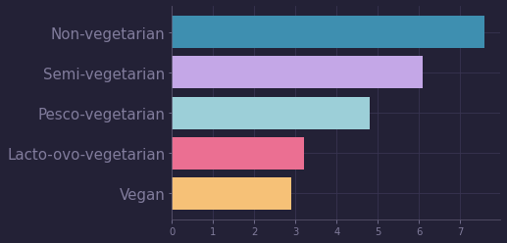
Animal Products and Type 2 Diabetes
Barnard et al, Nutrients 2014, 6, 897-910
——🌱🧀🐟🍖🥩—————————————————
——🌱🧀🐟🍖—————————————
——🌱🧀🐟————————————
those who consume mostly plant products have the lowest prevalence of type 2 diabetes
——🌱🧀——————
——🌱———————
Prevalence of Type 2 diabetes
Counsels on Lifestyle
1/3

Slide 2
Animal Products and Type 2 Diabetes
Barnard et al, Nutrients 2014, 6, 897-910
Meat consumption is consistently associated with diabetes risk.
Recently published findings from the Chicago
Western Electric Study indicated an association between animal protein intake and obesity. A diet eliminating meat was shown to reduce visceral fat
and improve insulin sensitivity, compared with a more conventional diabetic diet
Dietary habits are readily modifiable, but individuals and clinicians will consider dietary changes only if they are aware of the potential benefits of doing so.
What are the potential benefits that changing my diet might bring me? How can I slowly replace some foods with more nutritious ones if I do change my diet?
Counsels on Lifestyle
2/3

Slide 3
Animal Products and Type 2 Diabetes
Barnard et al, Nutrients 2014, 6, 897-910
When flesh is discarded, its place should be supplied with a variety of grains, nuts, vegetables, and fruits,
None should be urged to make the change abruptly...
Let the diet reform be progressive. Let the people be taught how to prepare food without the use of milk or butter. Tell them that the time will soon come when there will be no safety in using eggs, milk, cream, or butter,
—Testimonies for the Church, vol. 7, p. 135.
....With care and skill, dishes may be prepared
that will be both nutritious and appetizing... In all cases, educate the conscience, enlist the will, supply good, wholesome food, and the change will be readily made, and the demand for flesh will soon cease.
—The Ministry of Healing, 316, [1905]
Counsels on Lifestyle
3/3

