Slide 1
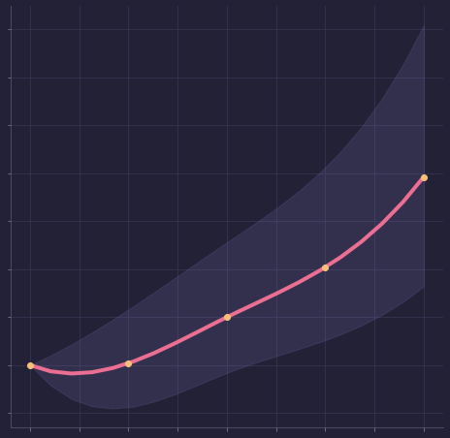
Eating Too Many Carbs Increases Cardiovascular Disease risk
Liu et al, 2000, American Journal of Clinical Nutrition, 71(6), 1455–1461.
risk of a person eating too many carbs in a day
Risk of Cardiovascular Disease
risk for a person not eating any carbs
Amount of carbohydrates
Why Do I Get Sick?
1/3

Slide 2
Plant Protein, Animal Protein and Cardio Vascular Disease
Bernstein et al, Circulation, Volume 122, Number 9, 2010.
Key Takeaways:
Plant and animal proteins affect Cardio Vascular Disease differently.
A high contribution of protein from meat increased risk of cardio vascular disease, whereas a high contribution of protein from nuts and seeds is protective.
These associations were not influenced by other characteristics of the diet, like being vegetarian
Why Do I Get Sick?
2/3

Slide 3
Plant Protein, Animal Protein and Cardio Vascular Disease
Bernstein et al, Circulation, Volume 122, Number 9, 2010.
From the Health Message
God gave our first parents the food He designed that the race should eat.The fruit of the trees in the garden, was the food man’s wants required. God gave man no permission to eat animal food until after the flood.
Everything had been destroyed upon which man could subsist... the Lord in their necessity gave Noah permission to eat of the clean animals which he had taken with him into the ark, but animal food was not the most healthful article of food for man.
Worldly physicians cannot account for the rapid increase of disease among the human family. But we know that much of this suffering is caused by the eating of dead flesh.—Letter 83, 1901
[Counsels on Food and Diet, Ellen G. White]
Why Do I Get Sick?
3/3

