Slide 1
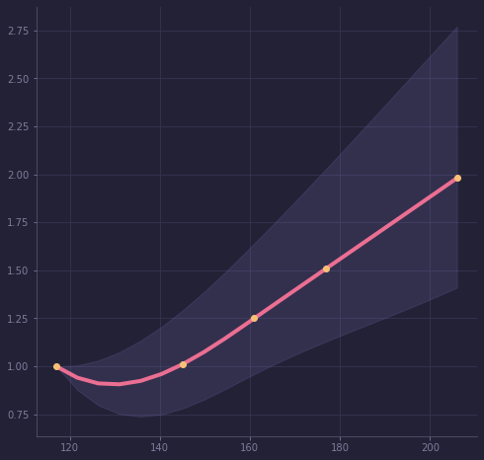
Refined Sugars means Higher Cardiovascular Disease Risk (CVD)
Liu et al, 2000, American Journal of Clinical Nutrition, 71(6), 1455–1461.
risk of a person eating more than twice the RDA
range of risk
Risk of Cardiovascular Disease (CVD)
risk for a person taking the minimum Recommended Daily Allowance (RDA) i.e 130 g/day
Glycemic Load per day
Counsels on Lifestyle
1/3

Slide 2
Refined Sugars means Higher Cardiovascular Disease Risk (CVD)
Liu et al, 2000, American Journal of Clinical Nutrition, 71(6), 1455–1461.
Glycemic Load means how quickly a food increases your blood sugar.
A glycemic load from refined carbs like white flour increases the risk of CVD, independent of known coronary disease risk factors.
Foods like added sugar, candy, white flour, white rice and breakfast meal and drinks with added sugar have a higher glycemic load than natural foods like fruits and whole foods.
The risk of CVD when taking a higher glycemic load was higher in women with above average weights
Am I eating foods that are giving me a high glycemic load? How can I replace them with better foods that can protect me instead?
Counsels on Lifestyle
2/3

Slide 3
Refined Sugars means Higher Cardiovascular Disease Risk (CVD)
Liu et al, 2000, American Journal of Clinical Nutrition, 71(6), 1455–1461.
Far too much sugar is ordinarily used in food. Cakes, sweet puddings, pastries, jellies, jams,
Fine-flour bread does not impart to the system the nourishment that is to be found in unbolted-wheat bread. Its common use will not keep the system in the best condition.
Grains, fruits, nuts, and vegetables constitute the diet chosen for us by our Creator. These foods, prepared in as simple and natural a manner as possible, are the most healthful and nourishing. They impart a strength, a power of endurance, and a vigor of intellect that are not afforded by a more complex and stimulating diet.
-Counsels on Food and Diet, Ellen G. White
Counsels on Lifestyle
3/3

