Slide 1
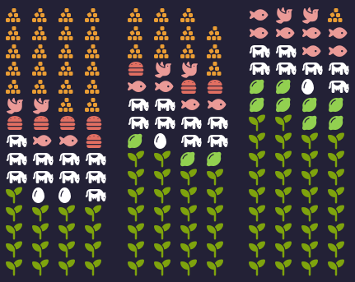
Life Expectancy (LE) and The Typical Western Diet
Fadnes, Lars T et al. PLoS Med 2022 Feb 8; 19(2)
Typical
Better
Optimal
Refined Foods
Red & White Meats
Eggs & Milk
Legumes & Nuts
Whole Foods
0
6
12
Increase in Life Expectancy (Years)
Counsels on Lifestyle
1/3

Slide 2
Life Expectancy and The Typical Western Diet
Fadnes, Lars T et al. PLoS Med 2022 Feb 8; 19(2)
The Western diet includes high intakes of pre-packaged foods, refined grains, red meat, processed meat, high-sugar drinks, candy and sweets, fried foods... other high-fat dairy products,
An optimal diet had substantially higher intake of whole grains, legumes, fish, fruits, vegetables, and included a handful of nuts, while reducing red and processed meats, sugar-sweetened beverages, and refined grains.
Change from a typical Western diet to the optimal diet from age 20 years would increase LE by more than a decade for women and men from the United States. Gains are predicted to be larger the earlier the dietary changes are initiated in life.
What does my current diet look like or the foods I’m giving my family? Is our diet helping to increase our lifespan? If not, what changes could we make?
Counsels on Lifestyle
2/3

Slide 3
Life Expectancy and The Typical Western Diet
Fadnes, Lars T et al. PLoS Med 2022 Feb 8; 19(2)
He who created man and who understands his needs appointed Adam his food. “Behold,” He said, “I have given you every herb yielding seed, … and every tree, in which is the fruit of a tree yielding seed; to you it shall be for food.”
Let the diet reform be progressive. Let the people be taught how to prepare food without the use of milk or butter. Tell them that the time will soon come when there will be no safety in using eggs, milk, cream, or butter, because disease in animals is increasing in proportion to the increase of wickedness among men... because of the iniquity of the fallen race, the whole animal creation will groan under the diseases that curse our earth.
God will give His people ability and tact to prepare wholesome food without these things. Let our people discard all unwholesome recipes.—Testimonies for the Church 7:135, 1902
Counsels on Lifestyle
3/3

