Slide 1
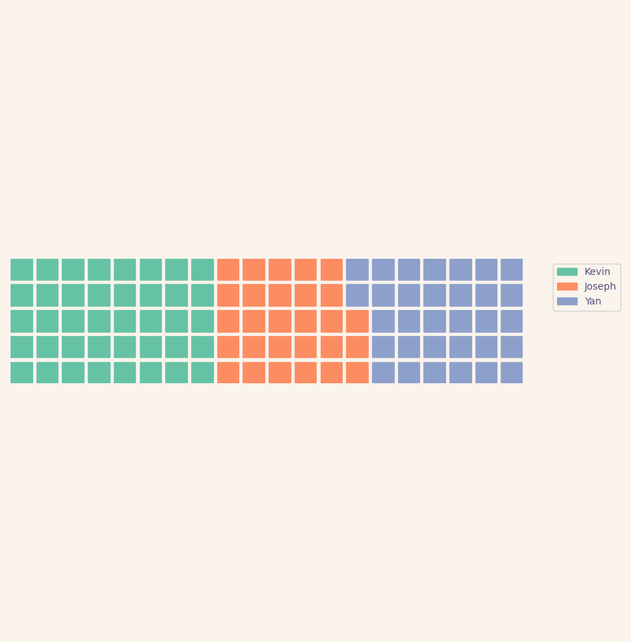

Story #1: Food is better with friends
12.01.2022

Slide 2

Plant Protein, Animal Protein and Cardio Vascular Disease
Bernstein et al, Circulation, Volume 122, Number 9, 2010.
Meat
age adjusted average risk of cardio-vascular disease for a person who takes 1 serving per day of meat as their primary protein source
Grains
baseline risk for a person who does not consume these foods
12.01.2022
Nuts & Seeds
Risk
0.6
0.8
1.0
1.2
1.4
1.6
whydoigetsick.com
1/3

Slide 3
Plant Protein, Animal Protein and Cardio Vascular Disease
Bernstein et al, Circulation, Volume 122, Number 9, 2010.
Key Takeaways:
Plant and animal proteins are associated with CVD mortality.
A high contribution of protein from meat increased risk of CVD mortality, whereas a high contribution of protein from nuts and seeds is protective.
These associations were not influenced by other characteristics of the diet, such as being vegetarian or nutrients related to CVD outcomes.
whydoigetsick.com
2/3

Slide 4
Plant Protein, Animal Protein and Cardio Vascular Disease
Bernstein et al, Circulation, Volume 122, Number 9, 2010.
From the Spirit of Prophecy
God gave our first parents the food He designed that the race should eat.The fruit of the trees in the garden, was the food man’s wants required. God gave man no permission to eat animal food until after the flood.
Everything had been destroyed upon which man could subsist... the Lord in their necessity gave Noah permission to eat of the clean animals which he had taken with him into the ark, but animal food was not the most healthful article of food for man.
Worldly physicians cannot account for the rapid increase of disease among the human family. But we know that much of this suffering is caused by the eating of dead flesh.—Letter 83, 1901
[Counsels on Food and Diet, Ellen G. White]
whydoigetsick.com
3/3

