Slide 1


Touro College Fall 2019 Class: MSIN- 636 Instructor: Alfred Rezk Thurs. 6:15pm- 9:15 Pm

Slide 2
Lecture 2: Angular Directives, Data Binding and Pipes

Slide 3

1. Data Binding

Slide 4
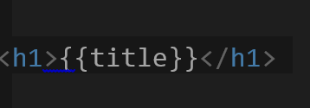
1. Data Binding
Data Binding means bind properties and methods between the template (HTML file)and the component class (typescript file).
Angular provide 4 types of Data Binding:
1. String Interpolation {{}}:
- Access any property or field value in component class in the template
- One direction binding component → template

Slide 5


1. Data Binding
2. Property Binding [ ]:
- Bind any property or field from the component class to template element property
- One direction binding component → template
3. Event Binding ( ) :
- Bind a template element event to a method in the component class
- One direction binding component ← template

Slide 6

1. Data Binding
4. Two- Way Binding [( )]:
- Bind any property or field in component class with a template element.
- If property value changed in the template it will be reflected in the component class.
- If property value changed in the component class it will be reflected in the template.
- One direction binding component ←→ template

Slide 7
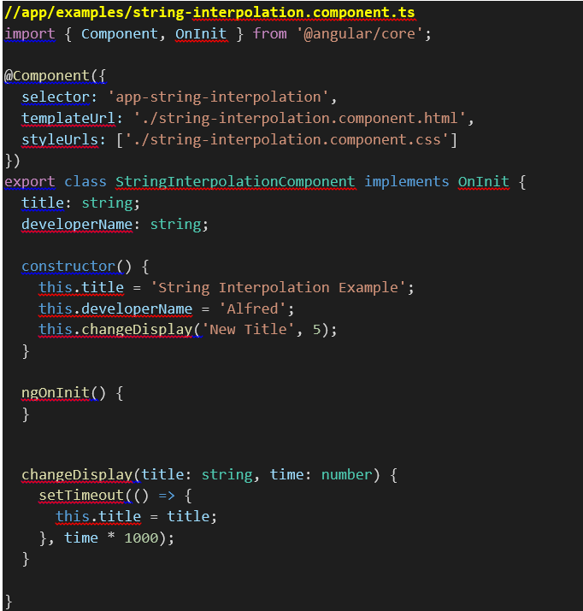
1.1 String Interpolation
Here is an example
In the component class we define two
properties title and developerName
Also we define one method changeDisplay()
The two properties assigned with string
values and changeDisplay() method
executed in the component constructor()
The changeDisplay() Method will change
title property value after a specific
amount of time using setTimeout().

Slide 8


1.1 String Interpolation
Now in the template we can access component class property values using string interpolation to display it in the browser as the following:
When you compile and run this script you will get the following result
After 5 seconds the screen will render the following results since title property value changed

Slide 9
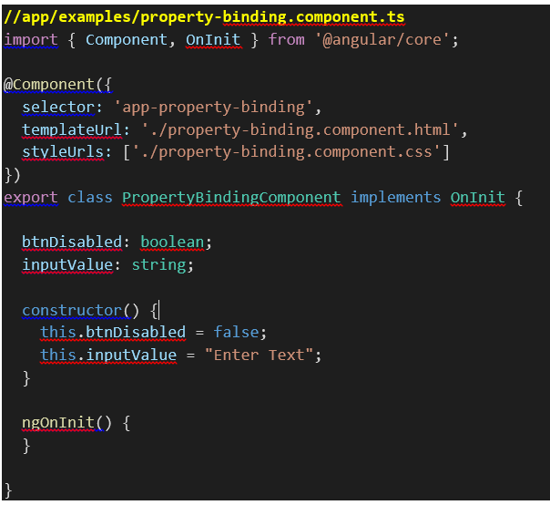
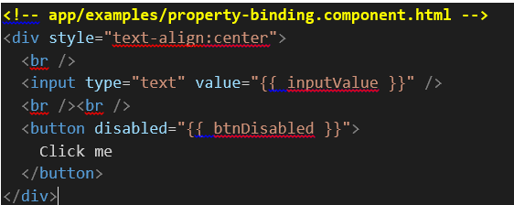

1.2 Property Binding
To illustrate the different between
String interpolation and property binding
try the following example:

Slide 10
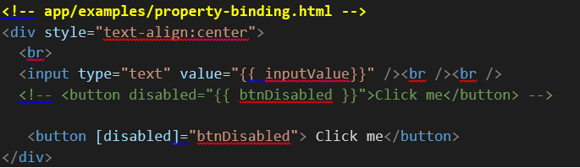
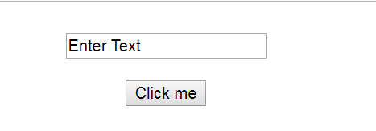
1.2 Property Binding
To be able to bind a Boolean property to HTML element property use property binding as the following:

Slide 11
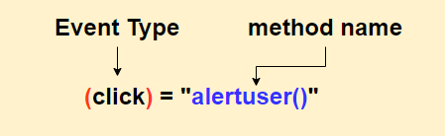
1.3 Event Binding
Event binding is used to bind a method in your typescript with a user interaction event.
Parentheses () can be used to register an event listener and define a data binding from the HTML to your component
Whenever we want to capture an event from the view we can wrap the event type by ( ) and assign it to a method that defined in component class.

Slide 12
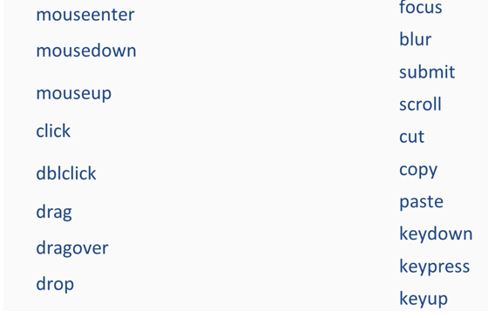
1.3 Event Binding
Here is a list of most events we can use

Slide 13
2.Angular Directives

Slide 14
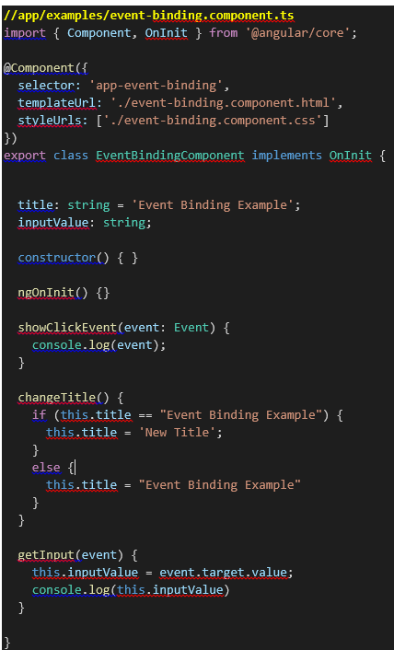
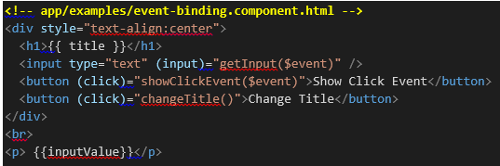
1.3 Event Binding
Here is an example:
The $event argument is a Angular special variable which
used to pass the event object as a method argument

Slide 15
2. Angular Directives
What is Angular Directives?
Directive is instructions that tells Angular to do something and it depend on the directive we want to use.
Types of directives
We have three types of directives
Component directives: Directives of their of own templates
Attribute directives: Change attribute behavior of element
Structural directives : Change DOM layout by adding or removing Dom element

Slide 16
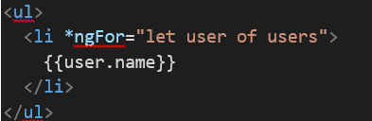
2.1 ngFor Directive
* ngFor is a structural directive, and start with * indicating it’s a structural directive
A loop to iterate through data model item.
Here is an example:
Now lets work in a bigger project example to understand ngIf directive

Slide 17
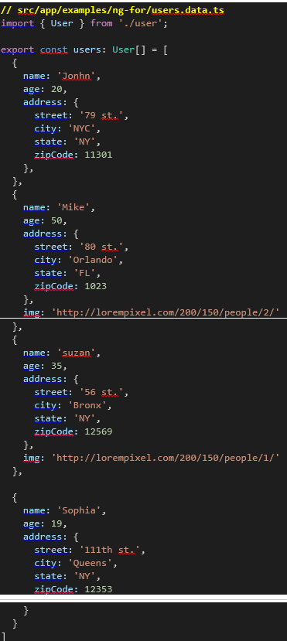
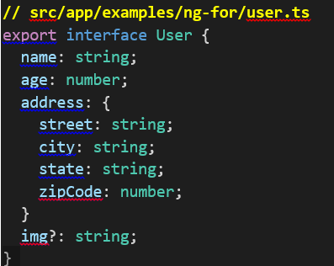
2.1 ngFor Directive
Create the following user interface.
Create a data file that will export an array of users information's

Slide 18
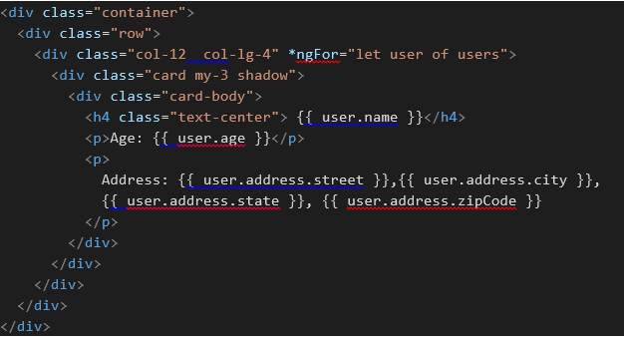
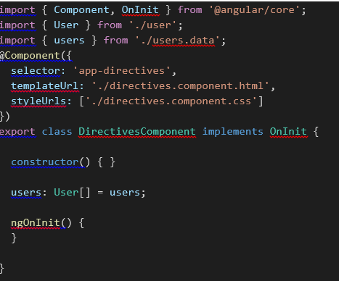
2.1 ngFor Directive
Import the user interface and users data inside your component typescript file.
To loop through the users in the template we will use ngIf directive

Slide 19
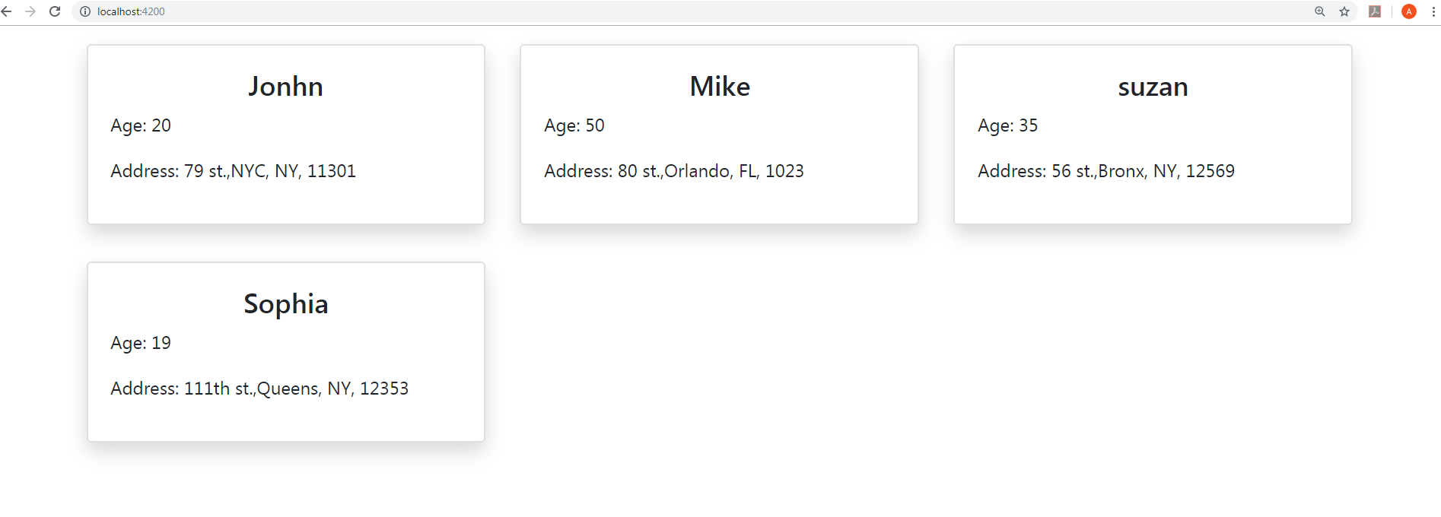
2.1 ngFor Directive
When you run the application you should get the following results

Slide 20
2.2 ngIf Directive
*ngIf is a structural Directive
It takes a Boolean expression and display or not the entire element based on if the expression is true or false.
We can update our pervious example, so we can use ngIf directive to check if the user has an image.
If the user has an image we will display it, if not we will not display any images.

Slide 21
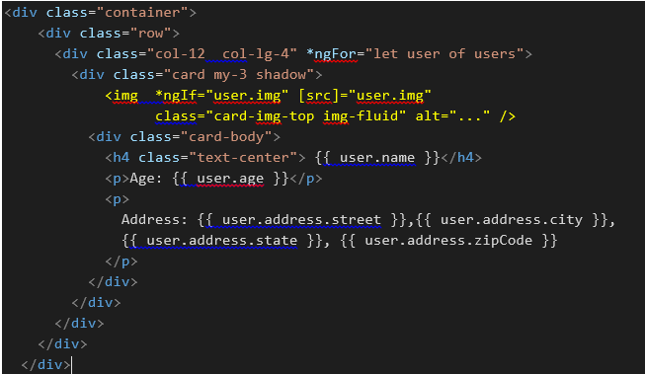
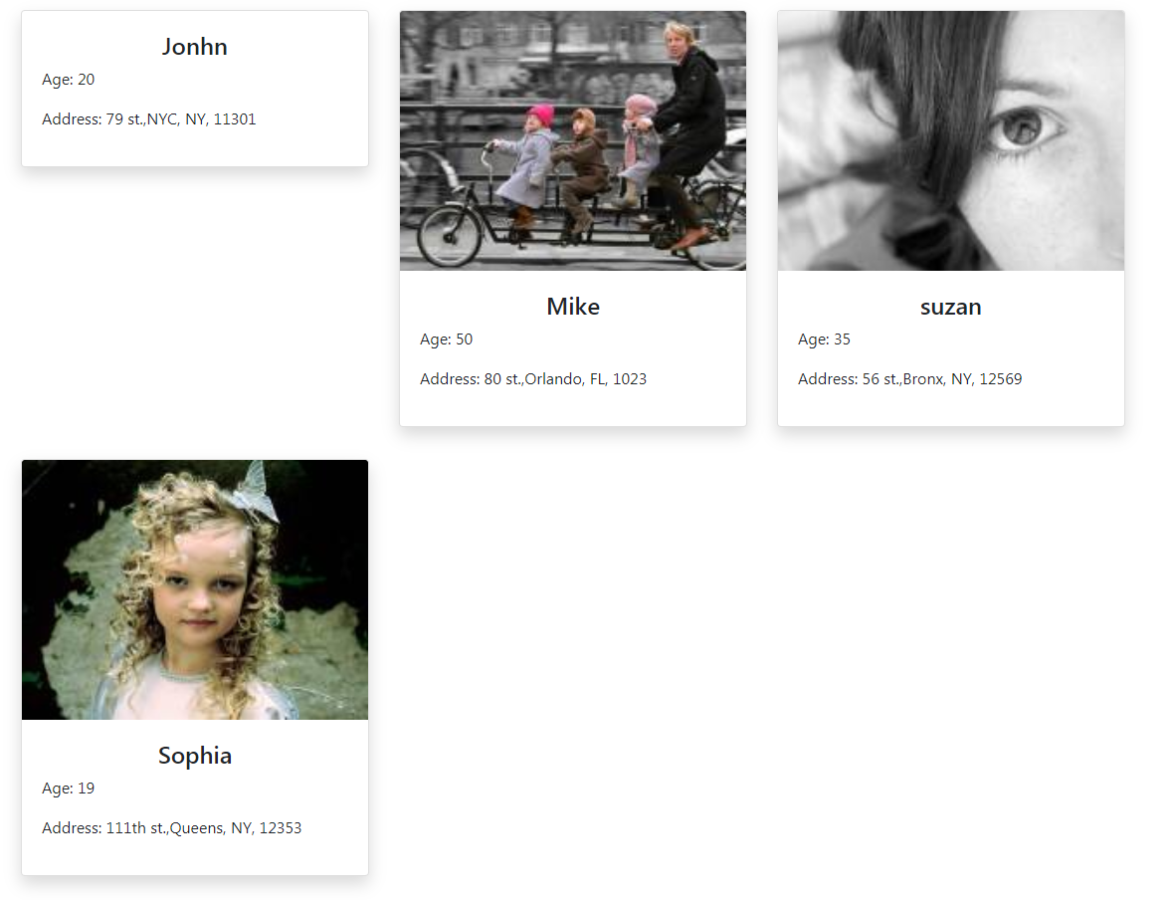
2.2 ngIf Directive

Slide 22
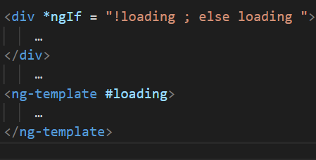
2.2 Doing IF-Else using ngIf
We can use <ng-template> element to create an else statement for ngIf directive.
We need to give the <ng-template> a local reference using the # key as the following
<ng-templete #elseStatment></ng-template>
Using ng-template local reference we use IF-else statement as in the following example

Slide 23
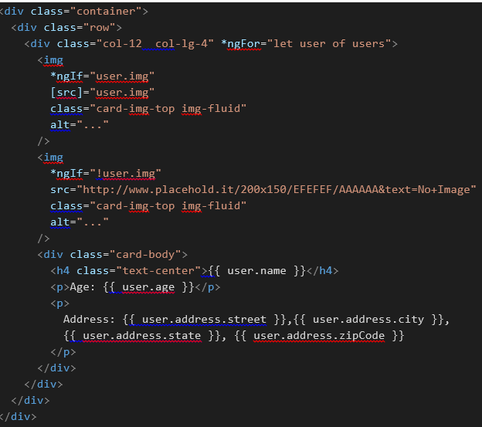
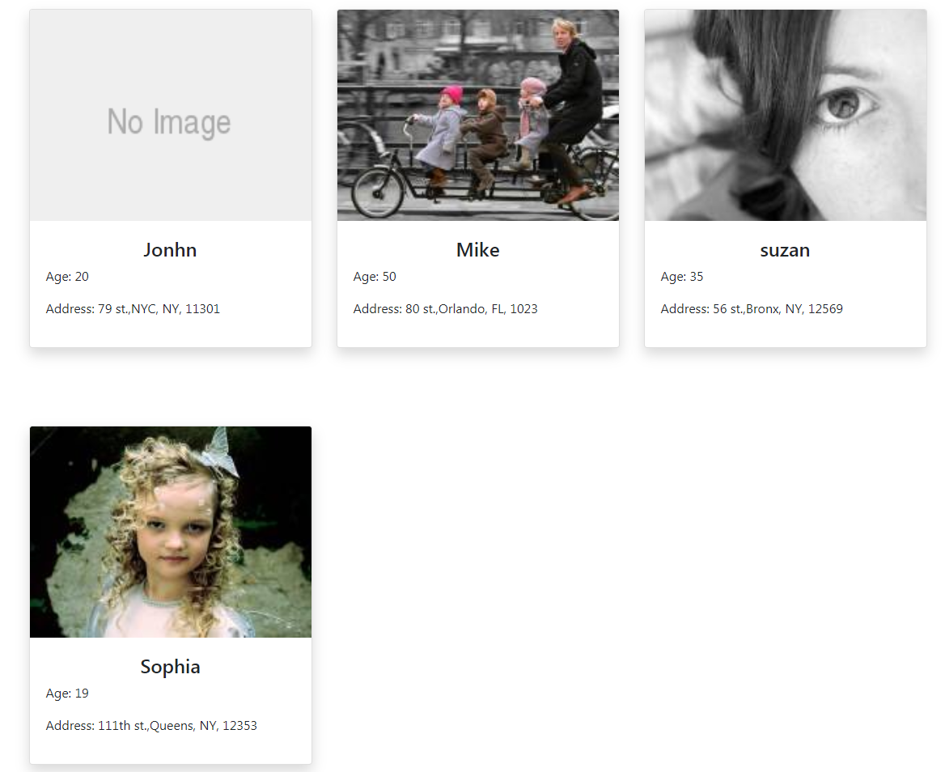
2.2 Doing IF-Else using ngIf
Another method is to use two or more ngIf directives.
For example we can update our users app by showing a default image if the user don’t have an image.

Slide 24
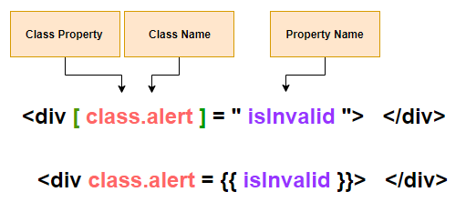
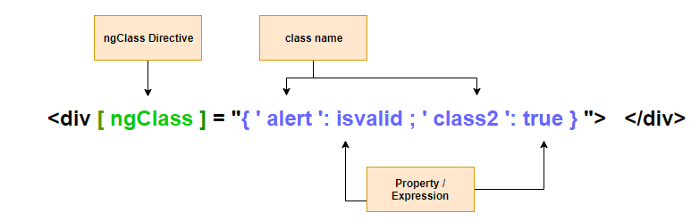
2.3 Class Binding and ngClass
Class binding is same as property binding with the difference that we need to prefix class name with class “.”
Class binding is limited for only one class can be assigned to the element.
If we want to assign more than one classes to the same element we can use multiple Class binding or use ngClass Directive.
ngClass is an Attribute Directive

Slide 25
2.4 Style Binding and ngStyle
Style binding is same as property binding with the difference that we need to prefix the CSS property name with class “.”
Style binding is limited for only one CSS property can be configured in the element.
If we want to assign style more than one CSS property we can use multiple style binding or use ngSlass Directive.
ngSlass is an Attribute Directive

Slide 26
2.4 Style Binding and ngStyle
We can set an element style base on condition using ternary operator as in the following example :

Slide 27
2.5 ngSwitch, ngSwitchCase and ngSwitchDefaut
ngSwitch is not a structural directive.
ngSwitch is an attribute directive which control the behavior of two directives ngSwitchCase and ngSwitchDefaut which are structure directives.
ngSwitch received the value and determine if any of switch cases are displayed.
ngSwitchCase displayes if the value matches the switch value.
If no matched of ngSwitchCase, the ngSwitchDefault will display the element.

Slide 28
3.Angular Pipes

Slide 29
3. Pipes
Pipes Allows Filtering and Funneling the outcome of the expression
Pipes Transform or better displays the data we are binding
It has simple syntax. Pipe name follows the expression separated by the pipe symbol
Pipes are chainable
Angular provides a wide range of pipe types
you can build customized pipes
Here is an example of string pipes you can use in your code

Slide 30
3.1 numbers Pipe
{{ value_expression | number [ : digitsInfo [ : locale ] ] }}

Slide 31
3.2 Currency Pipes
{{ value_expression | currency [ : currencyCode [ : display [ : digitsInfo [ : locale ] ] ] ] }}

Slide 32
4. In-Class Project

Slide 33
4. In-Class Project
We will start to practice what we have learned so far in a complete simple project.
The project is a class management system application, allow teachers to view their students information's like name, grades, assignments, etc..
The project is hosted and running online to see it live go to
https://msin636-practice1.web.app/

Slide 34
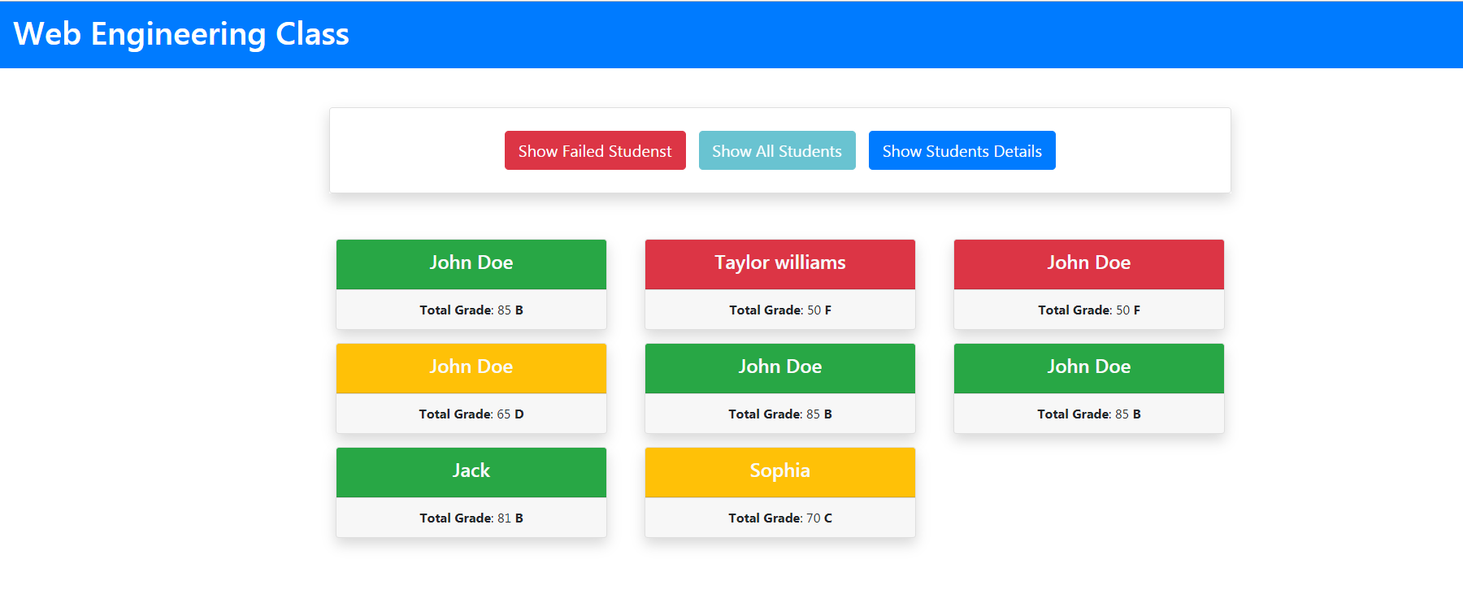
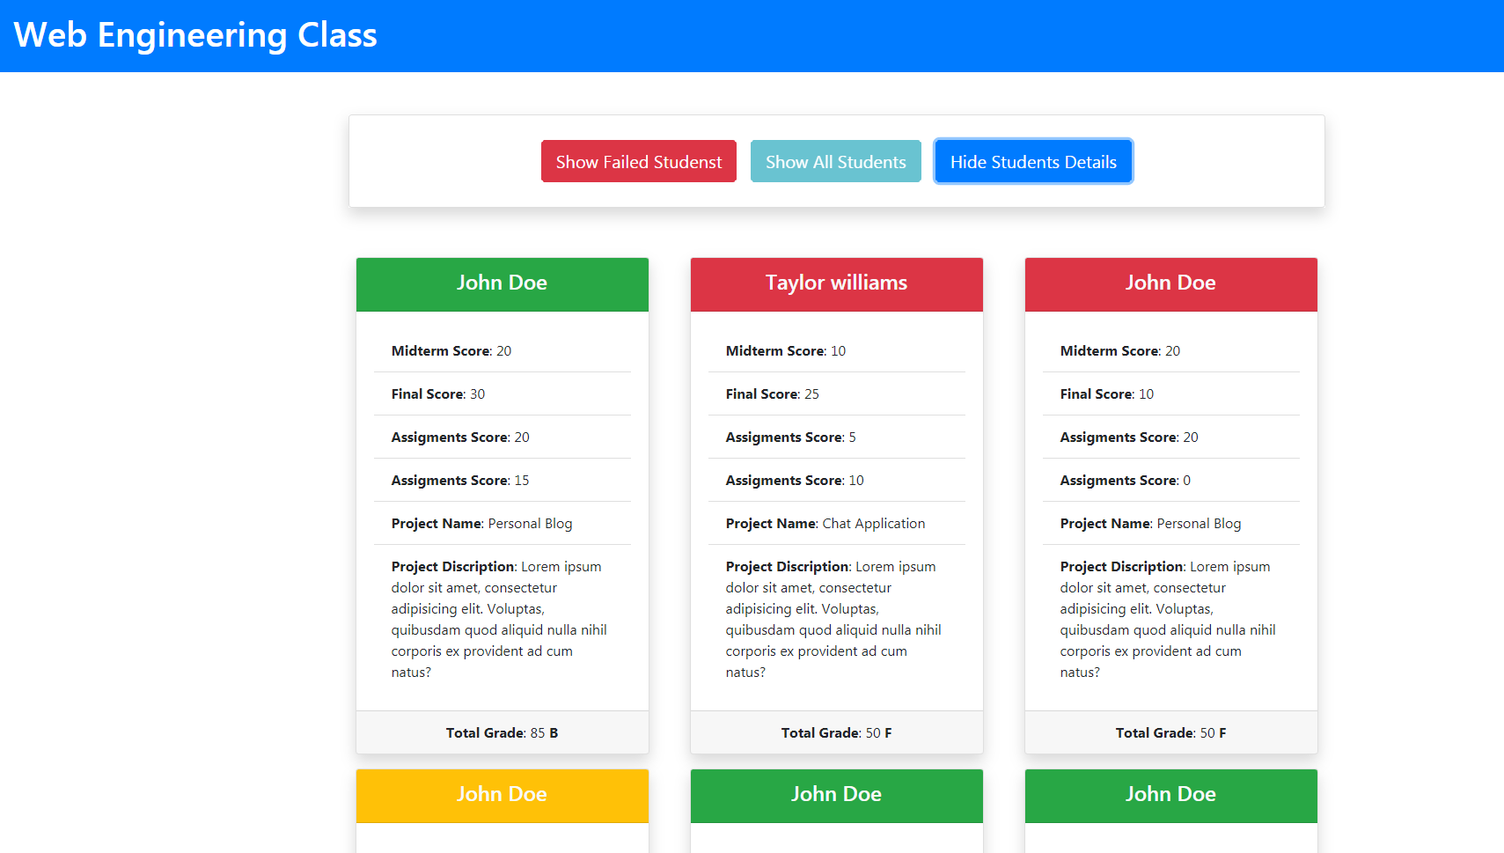
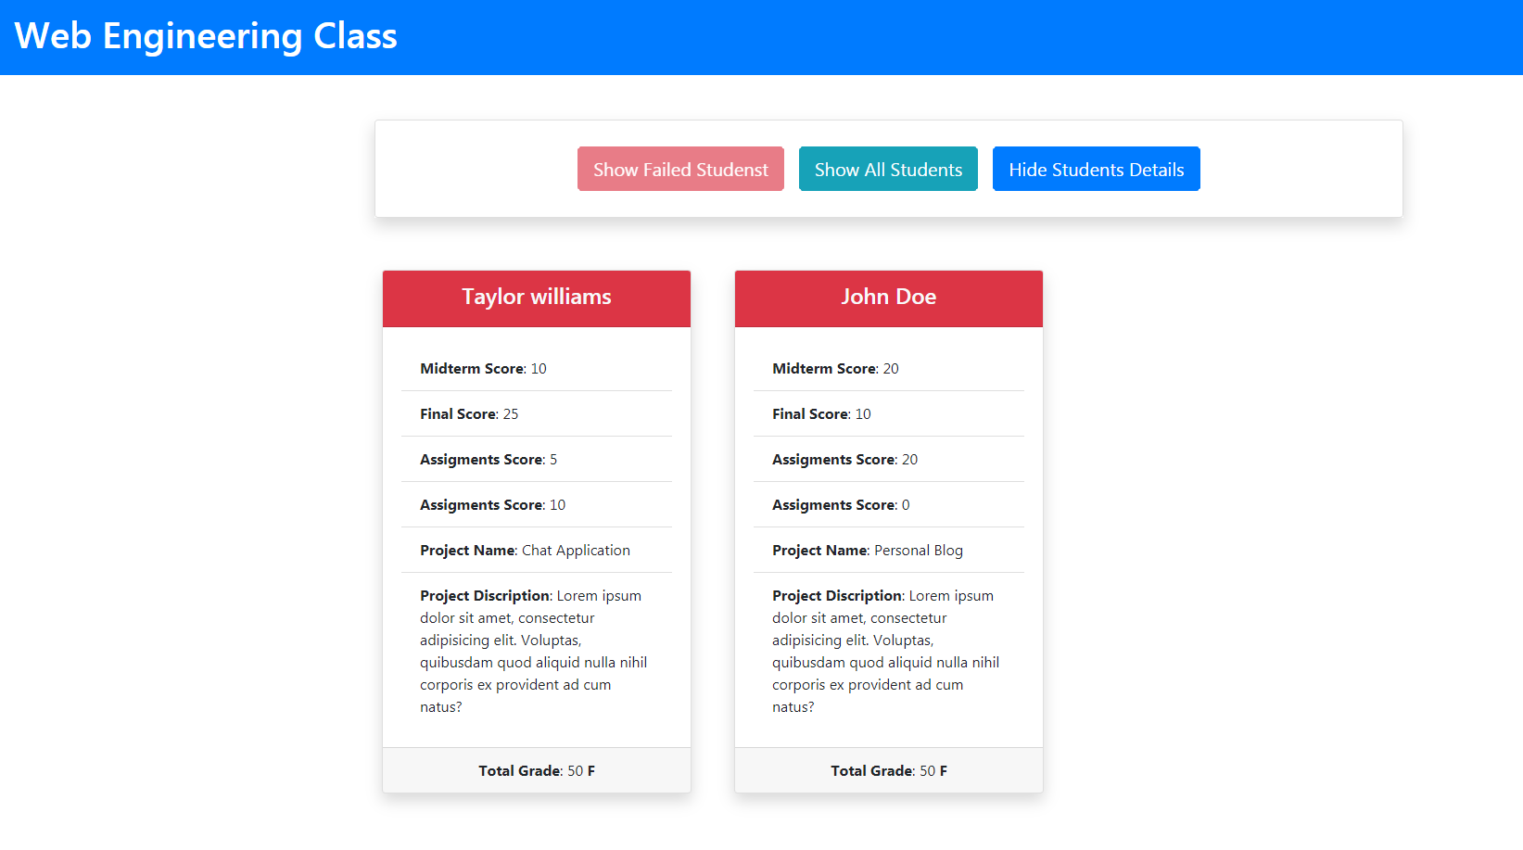
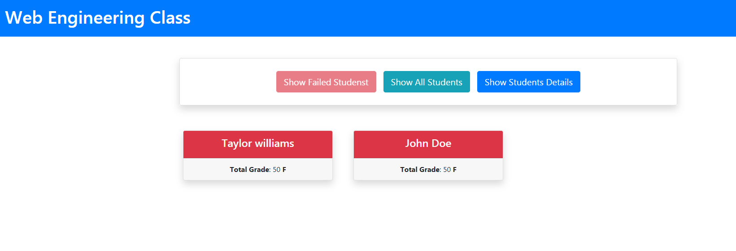
4. In-Class Project

