Slide 1
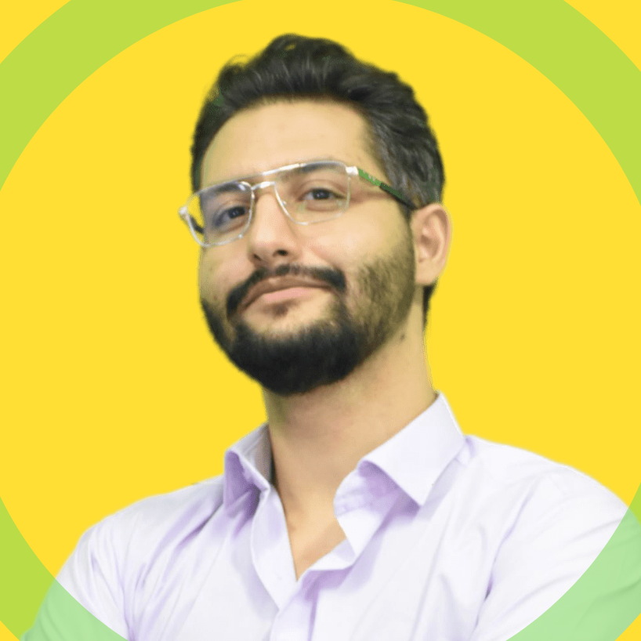














M. SINA
https://www.linkedin.com/in/msinamsina/
https://github.com/msinamsina
ALLAHKARAM
msinamsina@gmail.com
Computer Vision Expert
Full stack Programmer
Roboticists
09981075065
https://msina.me
As an expert Python programmer who has more than 6 years of experience working on various Computer Vision tasks and web /desktop applications development, Now I'm ready to utilize my experiences in your team and projects.
Python
Linux
C & C++
JavaScript
K. N. Toosi University of Technology
Master's degree
Django
Mechatronics, Engineering
2019-2023
K. N. Toosi University of Technology
Bachelor's degree:
Electrical and Electronics Engineering
2014-2019
ARAS-Farabi Experimental Framework for Skill Assessment in Capsulorhexis Surgery (Link)
Surgical Instrument Tracking for Capsulorhexis Eye Surgery Based on Siamese Networks (Link)
Closed-form Inverse kinematics Equations of a Robotic Finger Mechanism (Link)
RoboCup rescue 2017 team description paper KN2C (link)

Slide 2







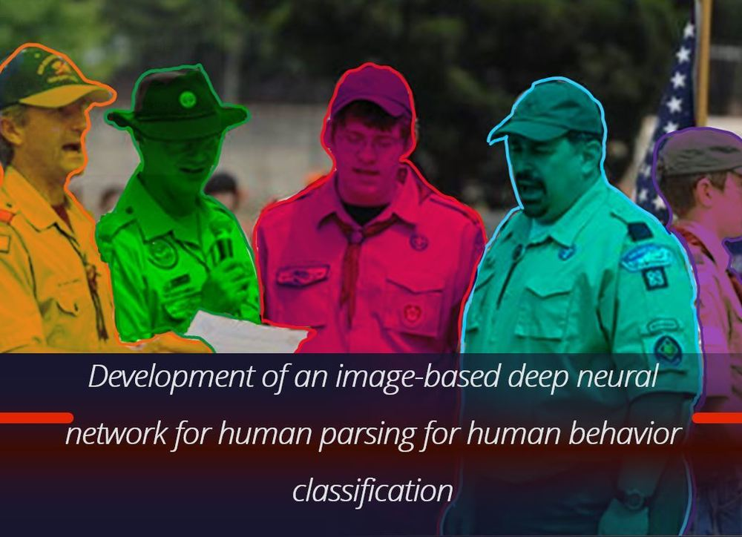


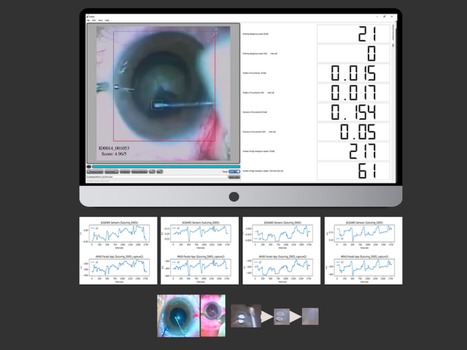

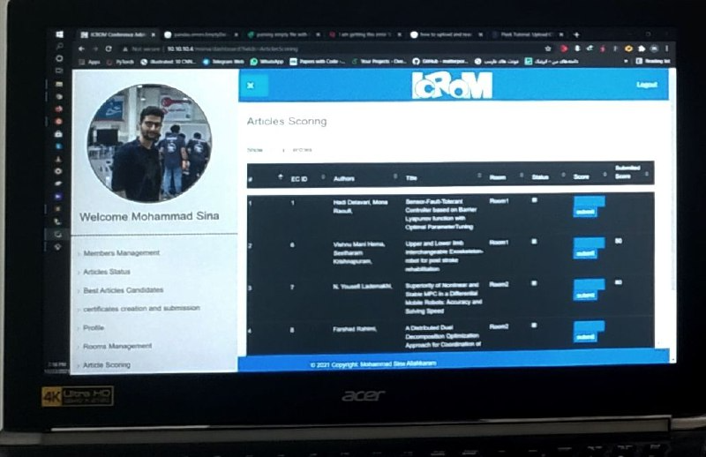
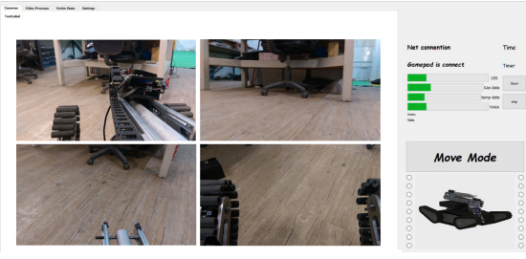


EXPERINCES
Computer Vision Researcher in ARAS Lab. (2018-2023)
Full Stack Developer in IT Team of ICRoM Conference (2018-2023)
COO and software-hardware designer in Rahbin Sanat Nasir Company (2022-2023)
hardware developer Ride-On company (2017-2018)
Team Leader, Software-Hardware developer in KN2C Robotic Team (2014-2018)
NOTABLE PROJECTS
Deep Learning Framework for Human Parsing Task
https://github.com/msinamsina/AdelaiDet-M
PyAutoMail: A Python Package For Large Scale Email Automation
https://github.com/msinamsina/pyautomail
https://pyautomail.readthedocs.io/en/latest/
ESEL: Eye Surgery Evaluation and Labelling
PCH: A Web Application For Evaluating the Papers in ICRoM Conference
Django
GUI For Tele-Operating of UGV Robot
ACHIVMENTS
TEACHING EXPERINCES
Third place in RoboCup Asia-pacific Rescue robot league 2018
Computer Vision And Deep Learning Course in ARAS Academy
Third place in Iran Open Rescue robot league 2017, 2018
Teacher Assistance in Robotics Course
Second place ICRoM Creative Exhibition 2016
Teacher Assistance in Micro Controller Course
Fifth place in RoboCup Rescue robot league 2017

