Slide 1
Git setup for a new repo on Ubuntu OS
-Manish Sharma

Slide 2
Initial email and user-name setup
git config --global user.email "you@example.com"
git config --global user.name "Your Name"
Remove “--global “ to set the email and name only for current repo

Slide 3
Setting a new folder as a git repo
Create the new folder
  mkdir -p ~workspace/melodic_ws/src
Go to the folder and command git init
  cd ~workspace/melodic_ws/src
  git init

Slide 4
Linking this newly created git repo with github
Create a new git repo using github.com
Link your local git repo with the created repo

Slide 5
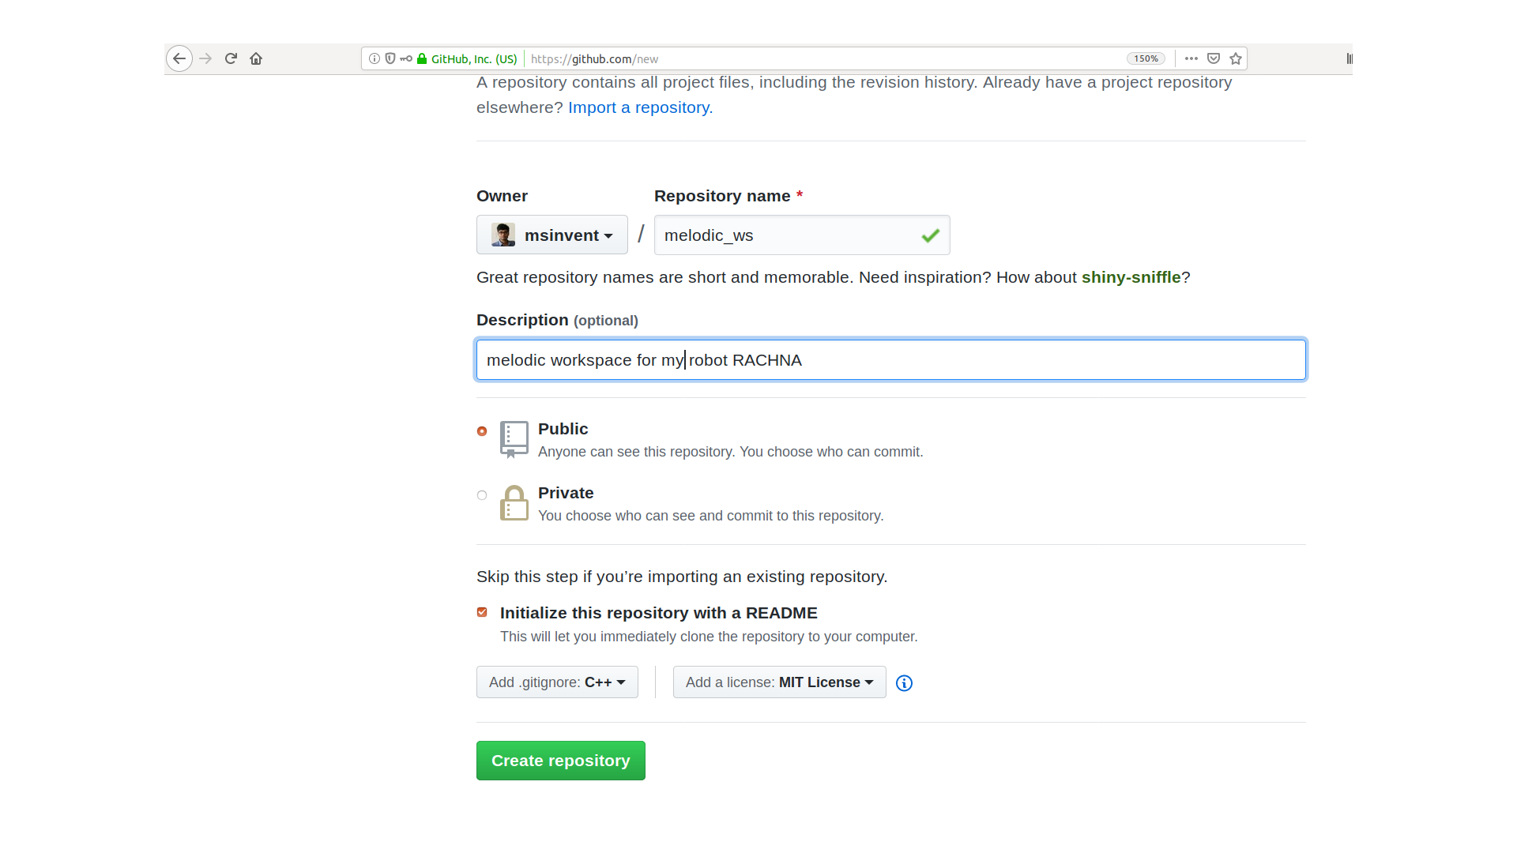
Create a git repo first

Slide 6
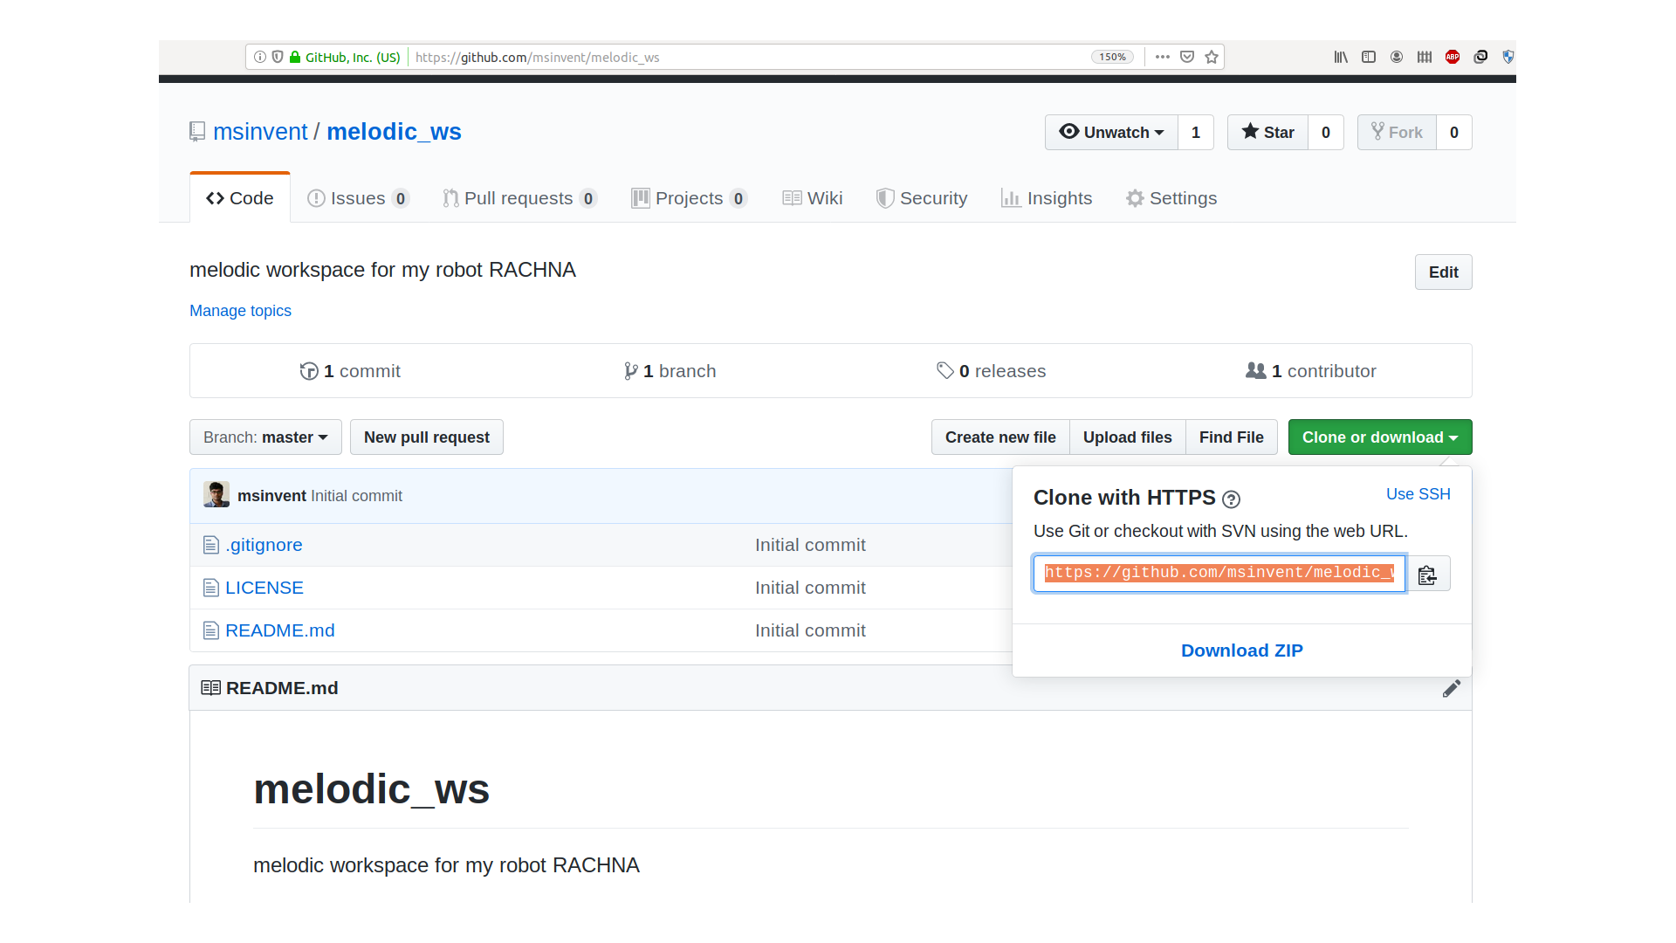
Created Repo

Slide 7
Attaching the local git repo with github repository created
git remote set-url origin
  Git remote set-url origin https://github.com/msinvent/melodic_ws.git
To check if the remote is added properly
  git config –get remote.origin
Fething the remote content (which includes README, .gitignore and licence file)
  git pull origin master

Slide 8
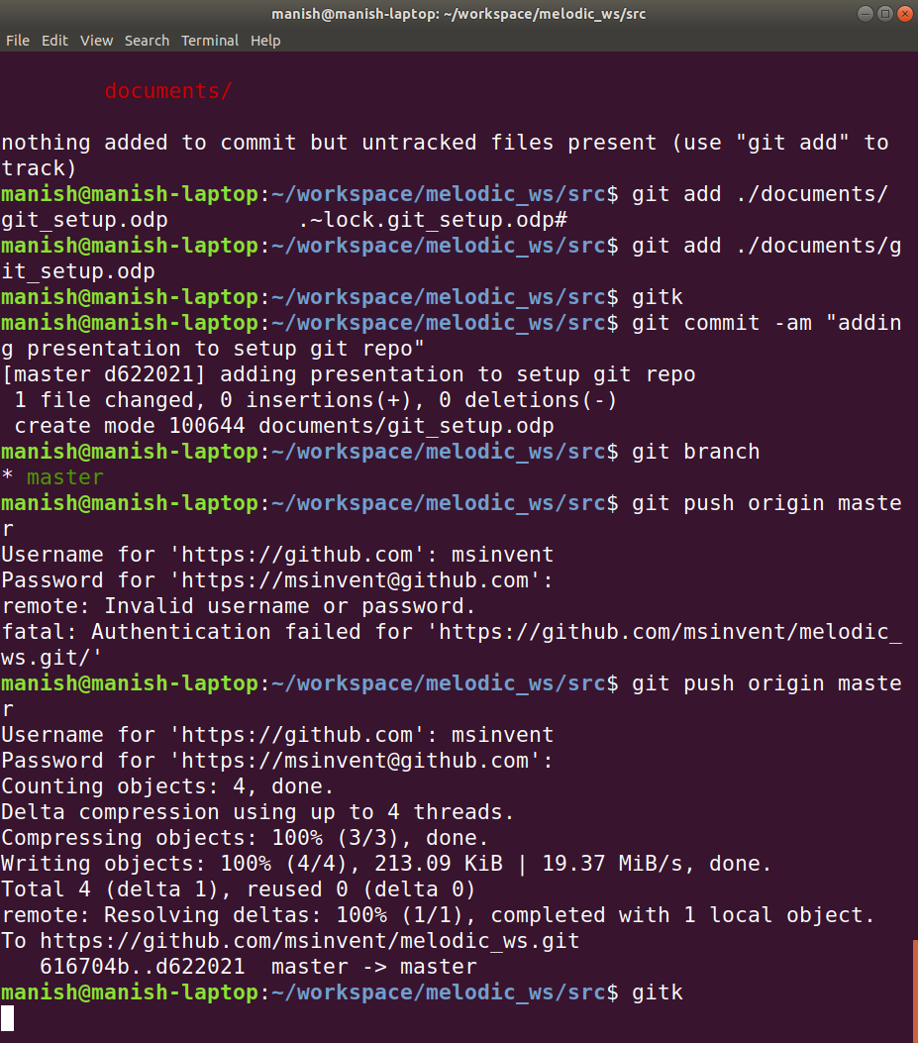
Adding this presentatino into the git

