Slide 1
Using Python in ArcGIS
Matthew L. Sisk
GIS Librarian
Center for Digital Scholarship
Hesburgh Library, University of Notre Dame
library.nd.edu/cds/

Slide 2
Data download
http://tinyurl.com/l6bm8k4
http://www3.nd.edu/~msisk1/PythonWorkshop_Data.zip
Both links are the same data
Extract to C:\Temp

Slide 3
What is GIS ?
In short: “computerized mapping software”
Formal definition
A Geographic Information System (GIS) is a computerized database management system for capture, storage, retrieval, manipulation, analysis and display of spatial (i.e. locationally defined) data

Slide 4
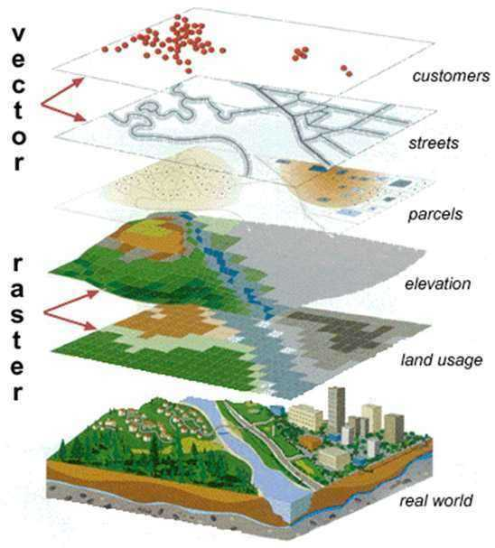
Layers
A GIS is composed of layers of spatial information
Can be different types of data
Everything is referenced to a coordinate system
e.g. latitude / longitude

Slide 5
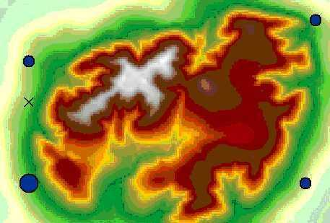

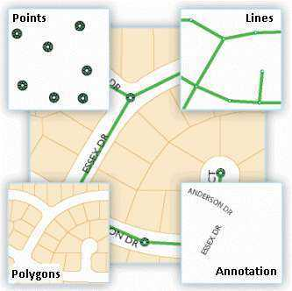
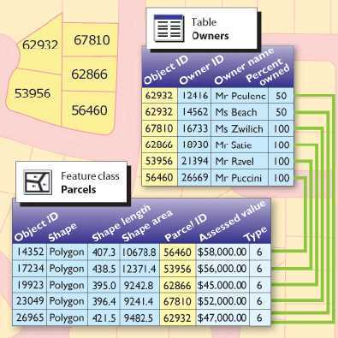
GIS digitally models the real world using:
Cells in an image
Three types of geometry
-Points
-Lines
-Areas
Data tables

Slide 6
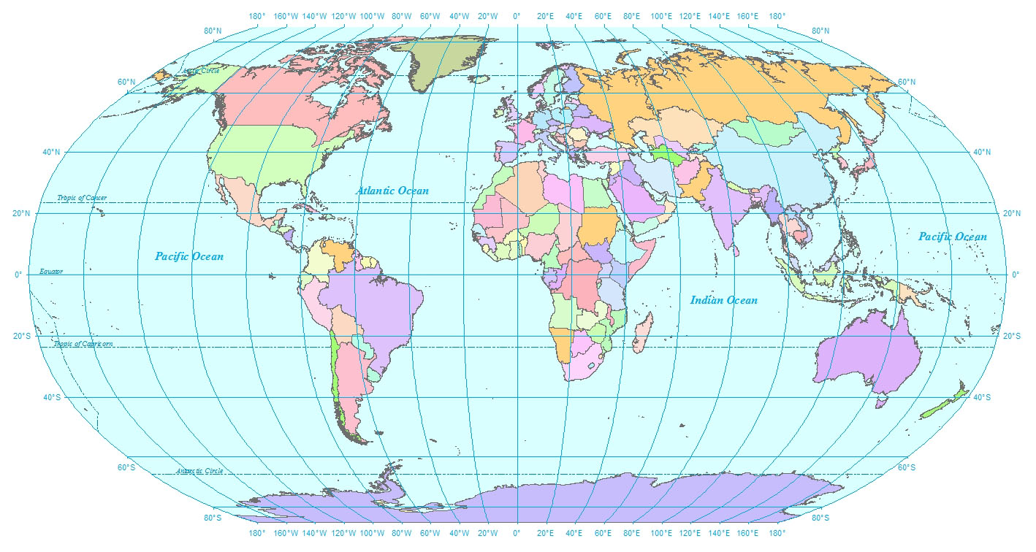
Attribute Data

Slide 7
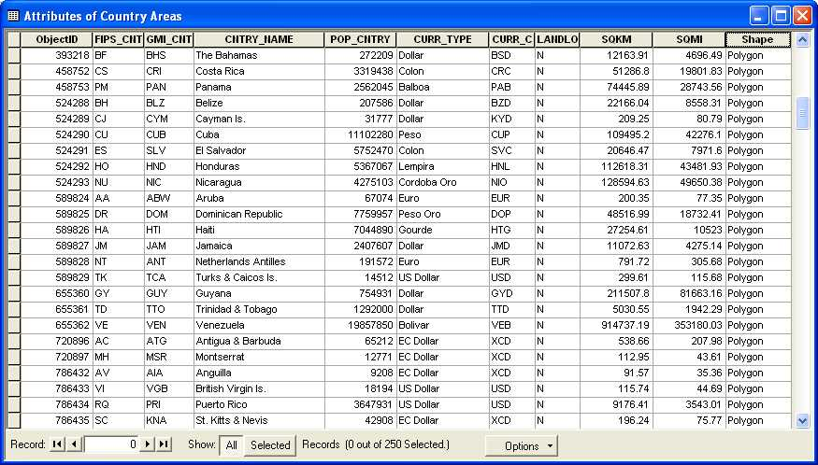
Attribute Data
Tabular data associated with each feature

Slide 8


What is Python?
“Python is an easy to learn, powerful language… (with) high-level data structures and a simple but effective approach to object-oriented programming. Python’s elegant syntax and dynamic typing…make it an ideal language for scripting…in many areas and on most platforms.”
–python.org
Scripting language of ArcGIS (and several other GIS packages)
Free, cross-platform, easy to learn

Slide 9
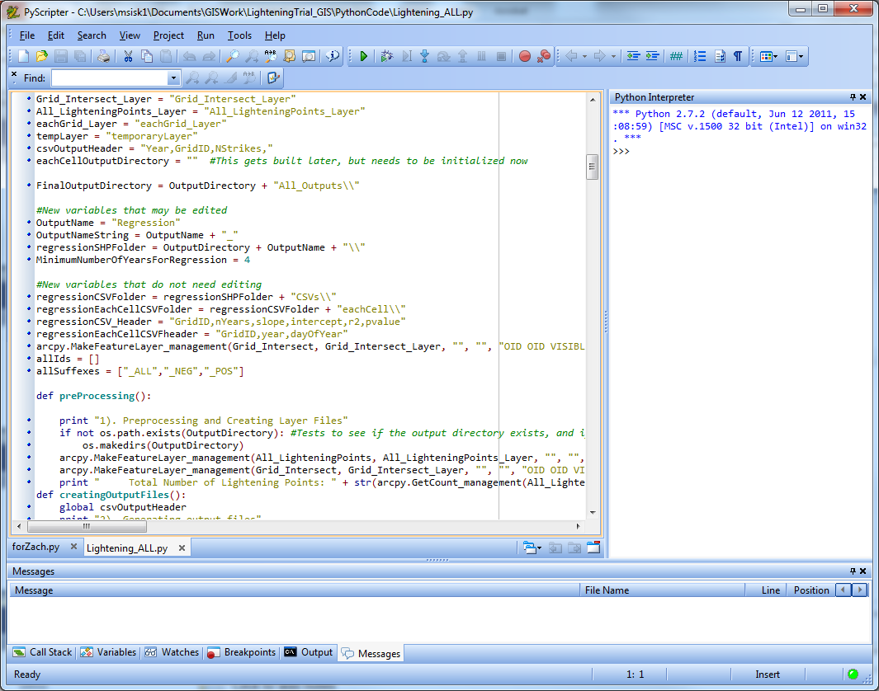
Why use Python scripting?
Multiple ways to run the same tool
Excellent way to document, share and automate workflows
GIS often has a metadata problem
Improves productivity
Increased modularity

Slide 10
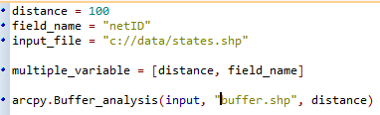
Python basics
Where do I write Python code?
IDE like IDLE
PythonWin or PyScripter
Python window in ArcGIS
How do I run a Python script?
Double-click or command prompt
Within IDE
As a tool in the ArcToolBox
What are variables?
A name that stores a value
Acts as a substitute for a real value
Assigned using =

Slide 11
Python basics
Python is a high-level computer language
Designed to be human readable
Indentation controls flow logic and code blocks
Python is also very forgiving
Strings can be defined using “ or ‘
Parentheticals are not always required
print (“Hello”) is the same as print “hello”
Comments can be defined multiple ways
#Comment
##Comment
‘’’Comment’’’
Most things are case-sensitive
Variables, functions, etc. are case sensitive
Print is not the same as print
Example 1

Slide 12
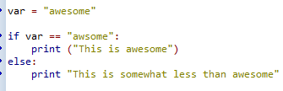
Python basics
Python has logic for testing conditions
if, else statement
Colon at end of each condition
Indentation determines what is executed
== tests equality; other operators like >, <, !=
Example 2

Slide 13
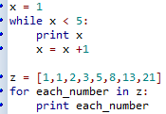
Python Basics
Techniques for iterating or looping
While loops
Continue to loop as long as a condition is met
for loops
Step through a predefined list of values
Colon at end of statement
Indentation determines what is executed
Example 3

Slide 14
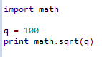
Python basics
Building blocks
Function: a defined piece of functionality that performs a specific task; requires arguments ()
Module: a Python file where functions live
Should be imported at the start of the script
Package: a collection of modules
math.sqrt(100) … 10.0
Python packages often have to be manually downloaded and installed
Not like r
Example 4

Slide 15
ArcPy Module
The access point to geoprocessing tools
A package of functions, classes and modules, all related to scripting in ArcGIS
Helper functions that enable workflows
ListFeatureClasses, Describe, SearchCursor, etc
Classes that can be used to create complex objects
SpatialReference, FieldMap objects
Modules that provide extended functionality
Mapping, SpatialAnalyst modules

Slide 16
ArcPy Module
Works with Python version 2.7x
Python 3.x is not currently compatible
Enhancement of arcgisscripting module (pre-10.0)
Older Python scripts will work
Every ArcGIS 10.x install also has Python 2.7
Typically in C:\Python27\ArcGIS10.5

Slide 17
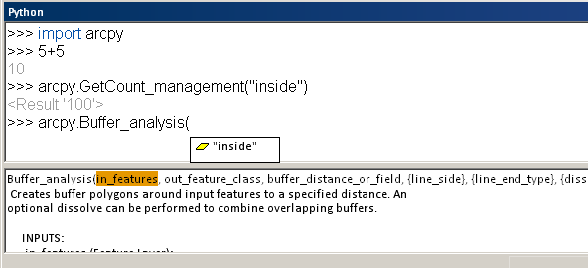
ArcGIS Python window
Embedded, interactive Python window within ArcGIS
Access to ArcPy and any Python functionality
Great for experimenting with Python and learning tool syntax
Help pane

Slide 18
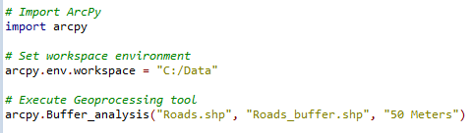
Executing tools in Python
ArcPy must be imported
General syntax: arcpy.toolname_toolboxalias()
Enter input and output parameters
Example 5

Slide 19
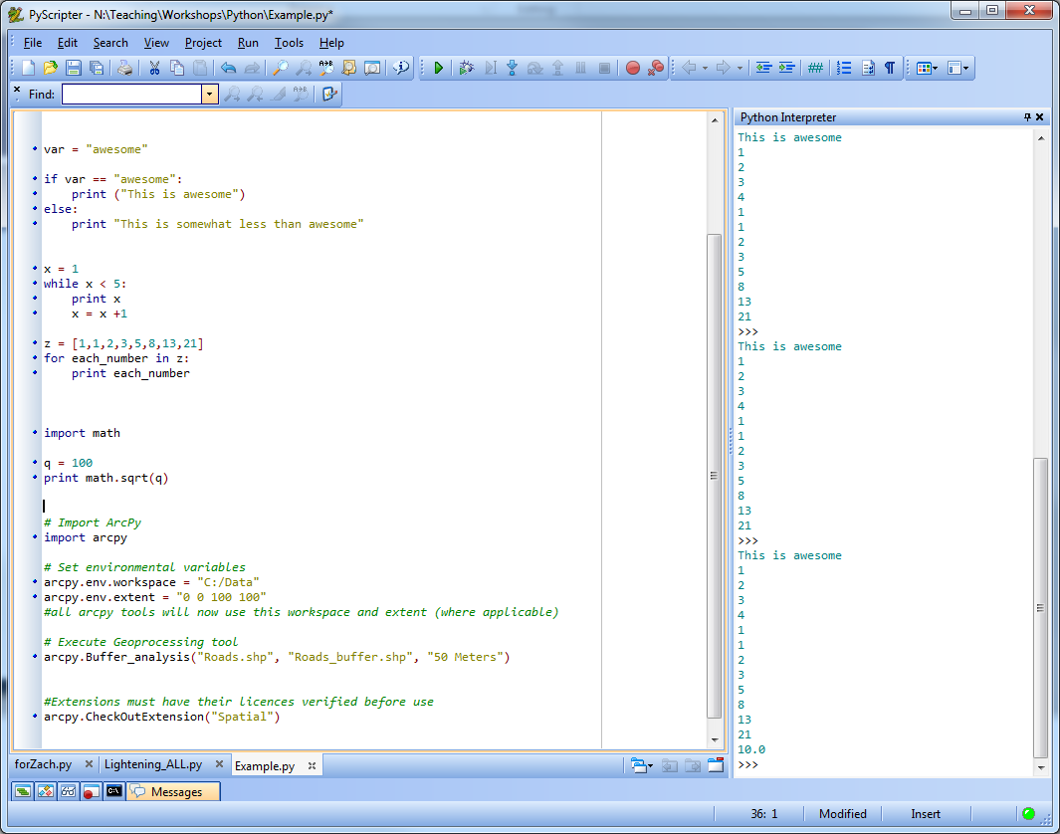
Executing tools in Python
Tools from extensions must have their license verified prior to running
Spatial analyst, 3D analyst, etc
Notre Dame’s site license includes most of these

Slide 20

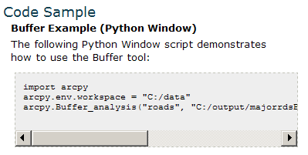
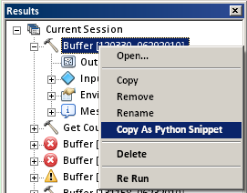
Getting tool syntax
Tool help page
Copy as Python Snippet
Export Model to Python script
Drag tool into Python window
help(“arcpy.Buffer_analysis”)

Slide 21
Setting environment variables
Accessed from arcpy.env
Workspace, coordinate system, extent, etc.
Global parameter
See tool help for honored environments
Provides finer control of tool execution
Makes scripting easier
Example 6

Slide 22
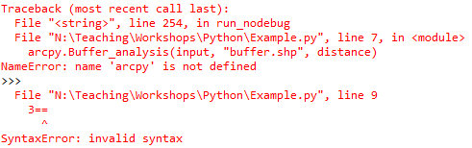
Error Handling
Why do errors occur?
Incorrect tool use
Typos
Syntax errors
What can I do if my script doesn't work?
View the geoprocessing messages
Use Python error handling
Debug the script in an IDE
Example 7

Slide 23
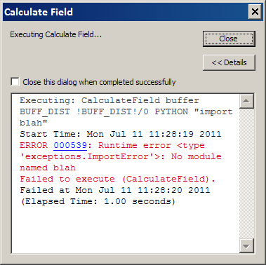
Geoprocessing messages
Three types of messages:
Informative messages
Warning messages
Error messages
Displayed in the Python window
arcpy.GetMessages()
(): All messages
(0): Only informative messages
(1): Only warning messages
(2): Only error messages

Slide 24
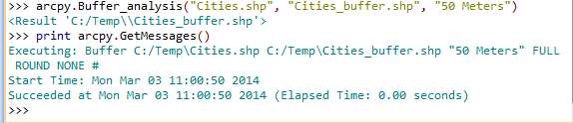
arcpy.GetMessages

Slide 25
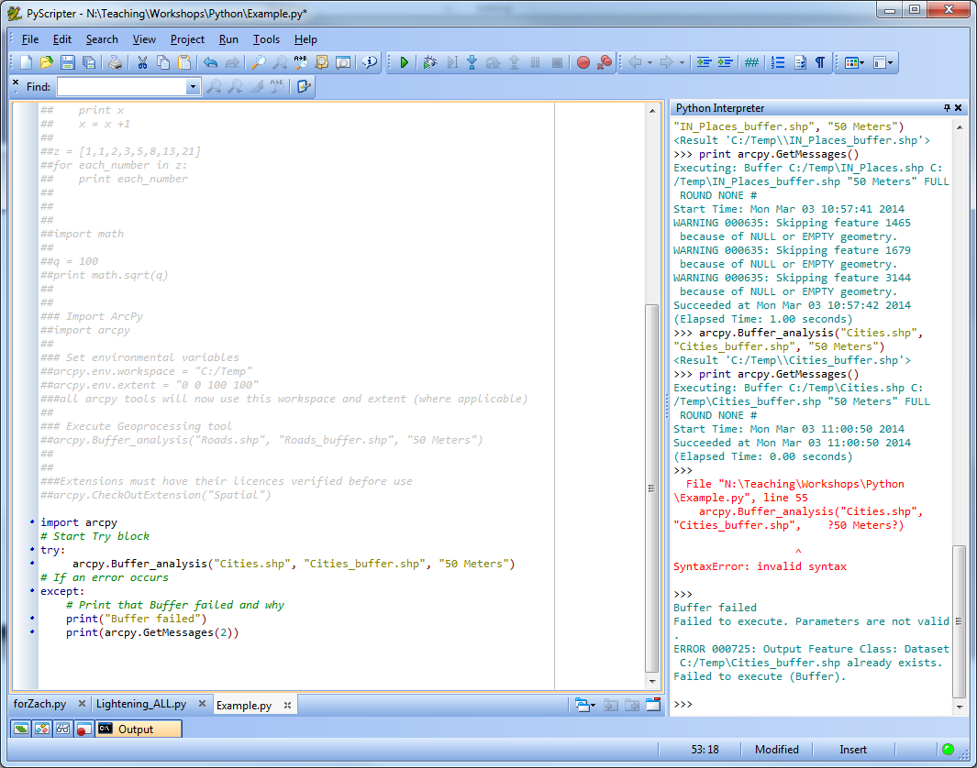
Python error handling
Try…Except…
Try to do something, and if an error occurs, do something else

Slide 26
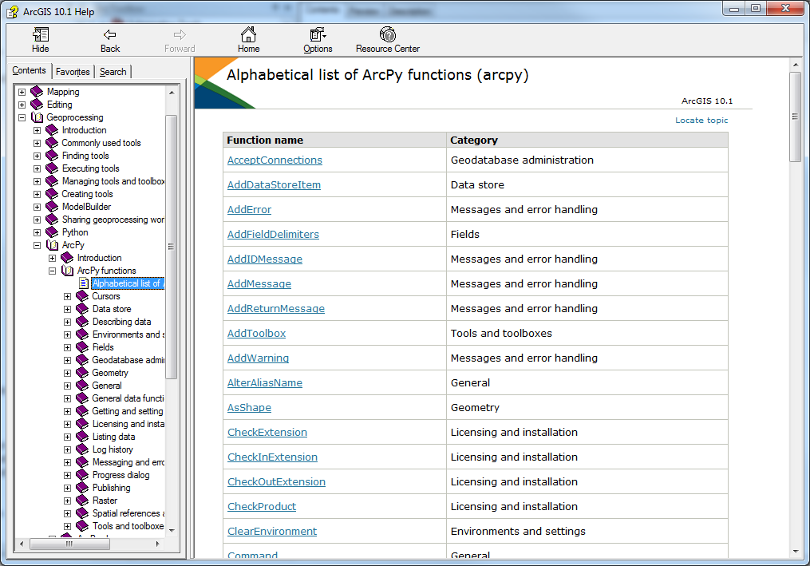
ArcPy Functions

Slide 27
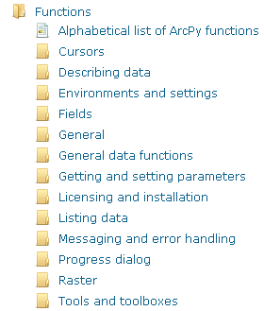
ArcPy functions
Helper functions
Perform useful scripting tasks
Print messages (GetMessages)
List data to perform batch processing (ListFeatureClasses, 12 total List functions)
Getting data properties (Describe)
Etc.
Supports automation of manual tasks

Slide 28
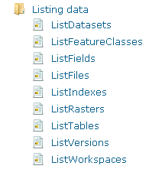
Batch processing
Run a geoprocessing operation multiple times with some automation
Clip every feature class in a geodatabase to a boundary
Calculate statistics for every raster in a folder
List functions used in Python to perform batch processing
One of the highest values in scripting
Example 8

Slide 29
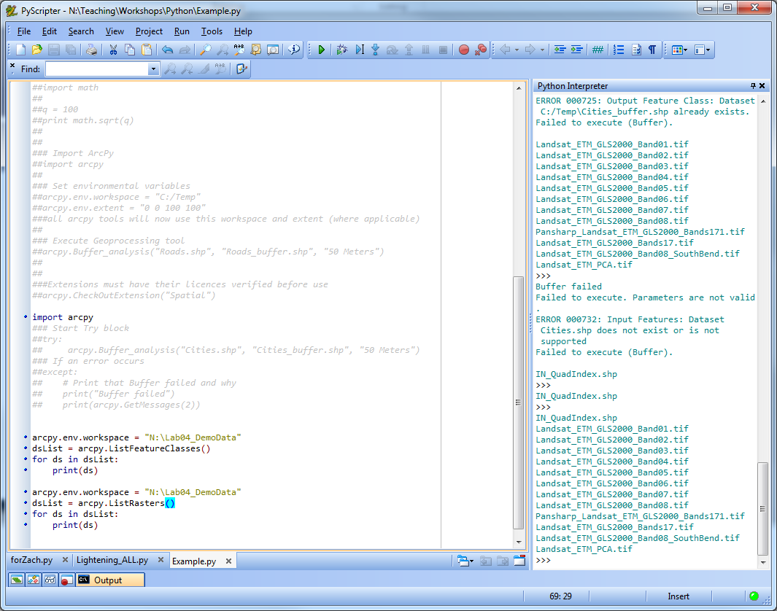
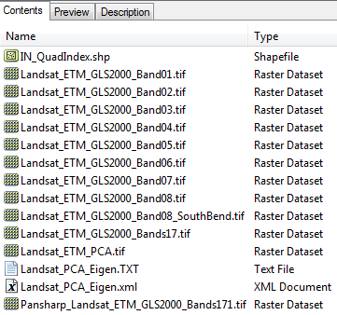
arcpy.ListFeatureClasses

Slide 30

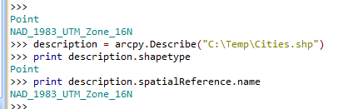
ArcPy functions -- Describe
Use the Describe function to read data properties
Returns an object with properties
Allows script to determine properties of data
Data type (shapefile, coverage, network dataset, etc.)
Shape type (point, polygon, line, etc.)
Spatial reference
Etc.

Slide 31
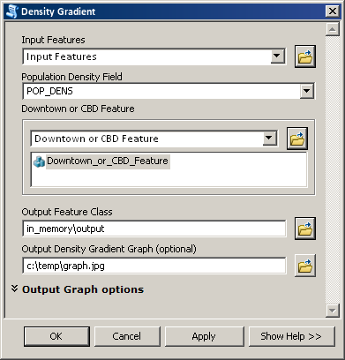
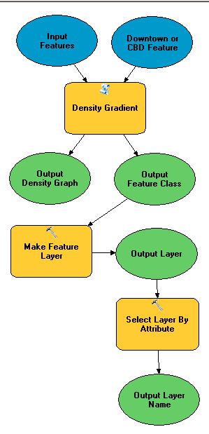
Python script tools
Connects Python to ArcGIS
Best way to create and share custom workflows
More accessible than stand-alone Python script
Extends ArcGIS
Integrated with geoprocessing framework
Inherits geoprocessing properties and environments from application
Can be used in ModelBuilder
Works with map layers

Slide 32
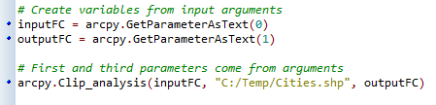
Receiving arguments
Arguments are user-defined inputs to a script
Values passed to script from user, instead of hard-coded
Use GetParameter or GetParameterAsText to read arguments
Example 9

Slide 33
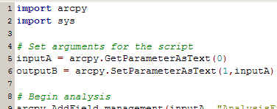
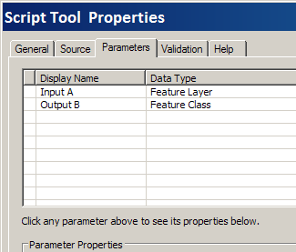
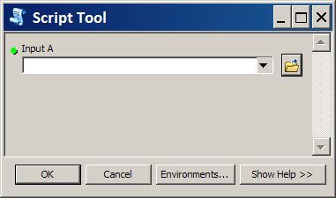
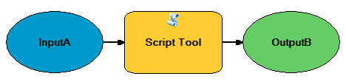
Connecting parameters

Slide 34
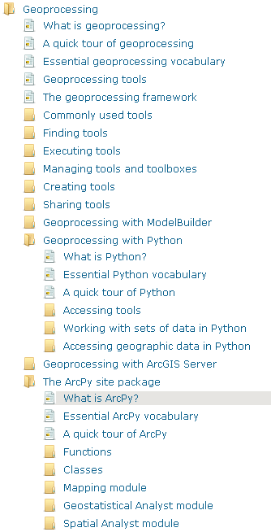
Python scripting resources
ArcGIS Resource Center
resources.arcgis.com
Online documentation
Geoprocessing: script gallery, blog, tutorials, presentations
Web Course (free)
Using Python in ArcGIS Desktop 10
Python Scripting for ArcGIS
PA Zandbergen
Python Resources
python.org
Learning Python by Lutz, et al.
The Python Standard Library by Example by Hellmann
diveintopython.org

