Slide 1
Project-1I Survey Generator
By
Harini Penta
Swathi Medisetty

Slide 2
Introduction:
The purpose of this application is to conduct Survey and after submitting it will provide the total Score.
User can enter his response by selecting the options provided to him
The interface allows user to participate in two different surveys :Funny Survey , Personality Test.

Slide 3
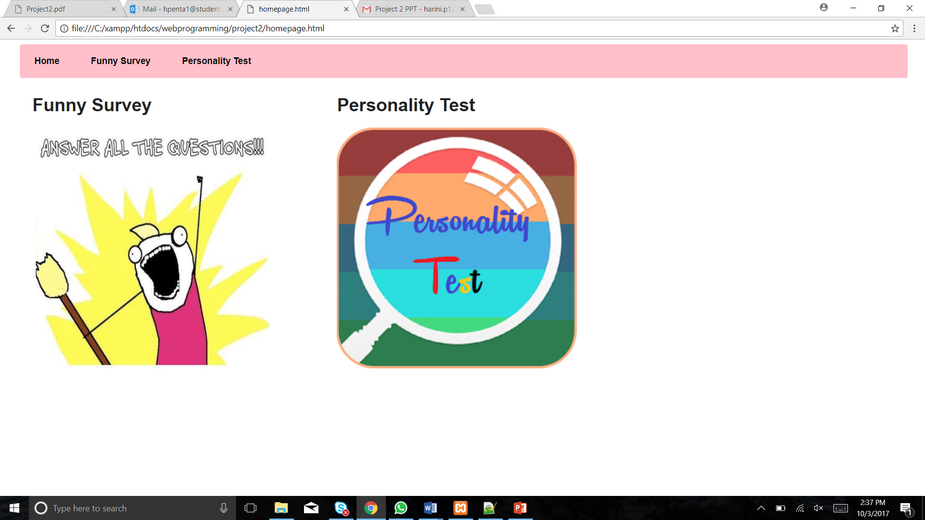
Demo Run

Slide 4
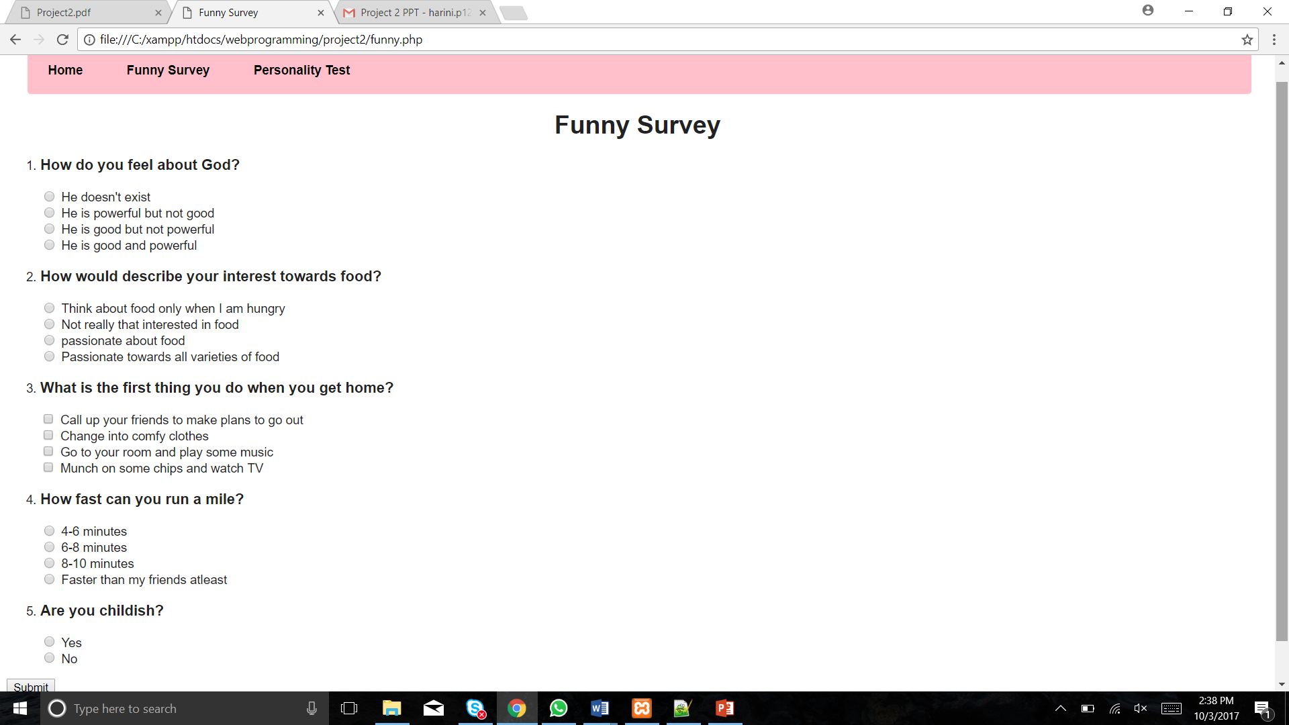
Demo Run

Slide 5
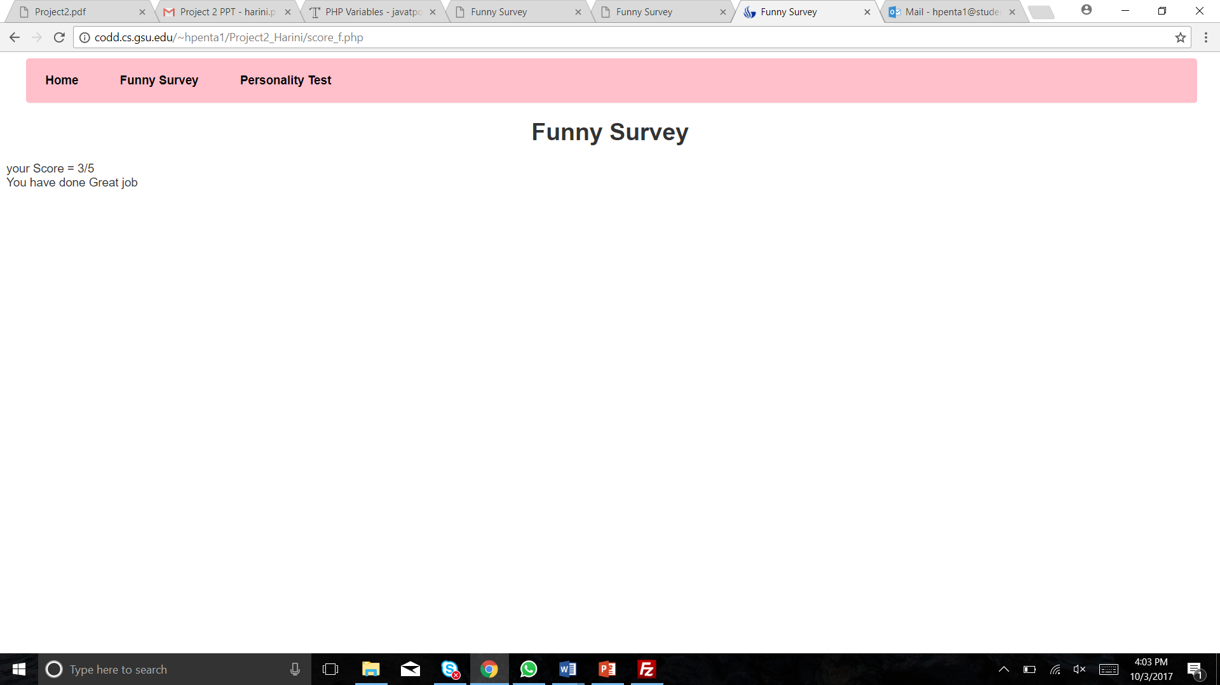
Funny Survey

Slide 6
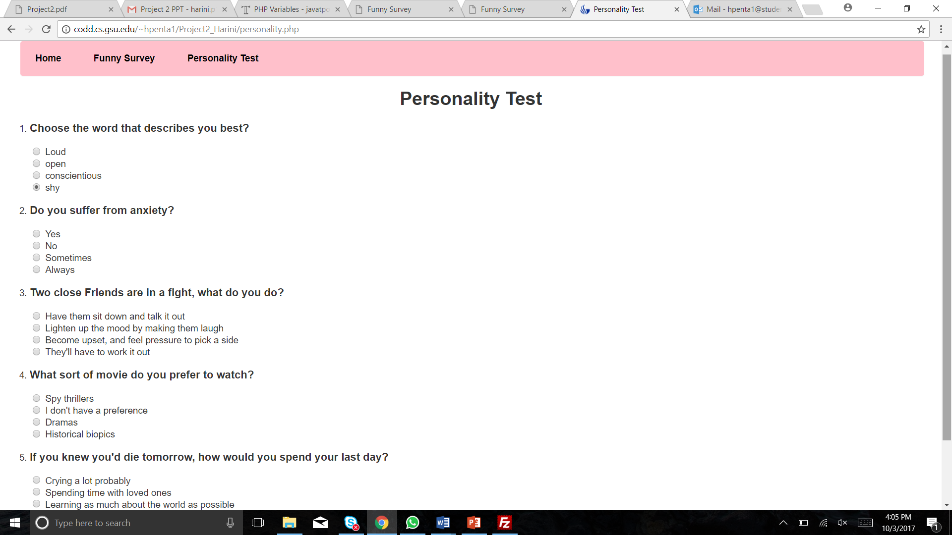
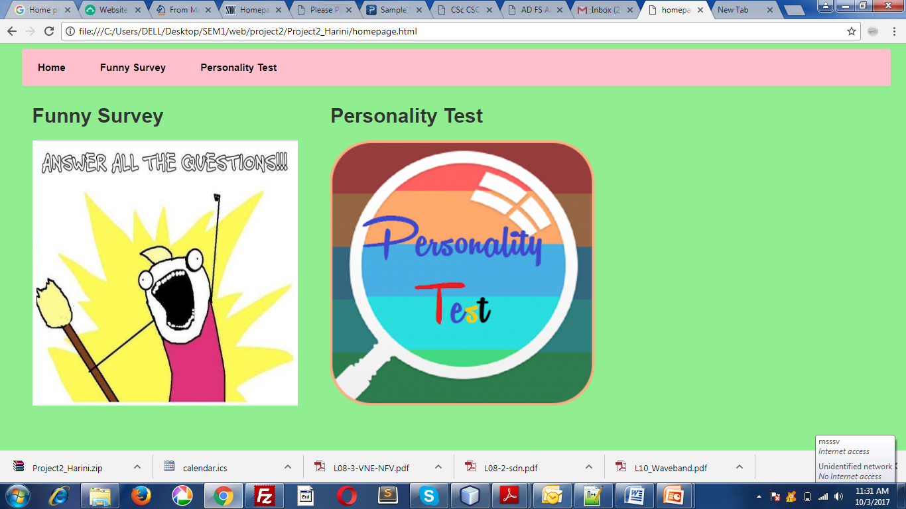
Personality Test

Slide 7
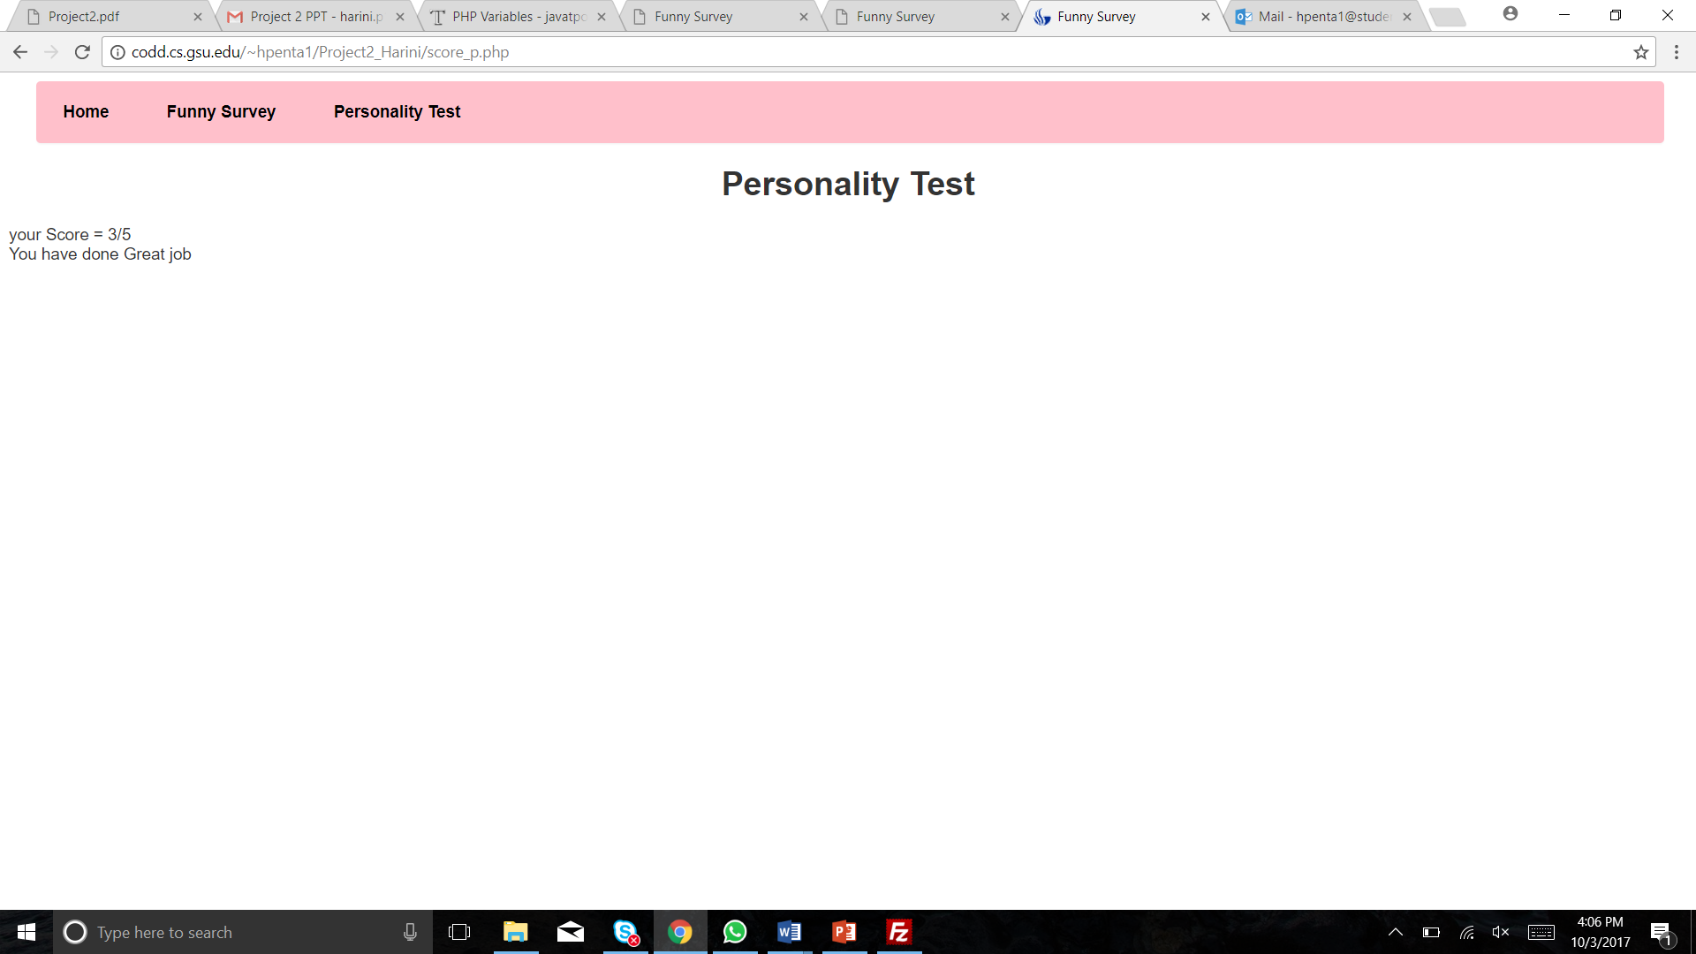
Personality Test

Slide 8
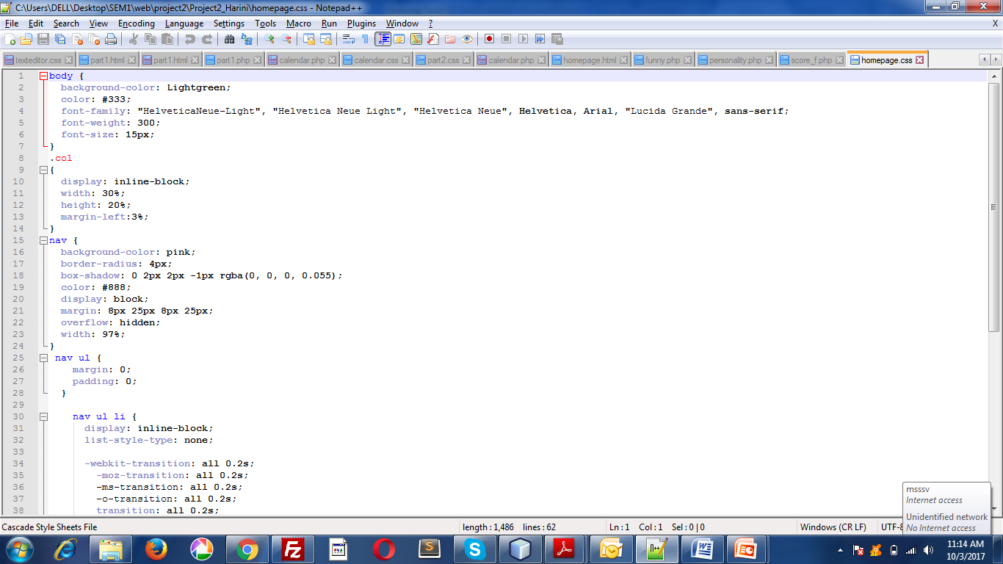
Code
CSS

Slide 9
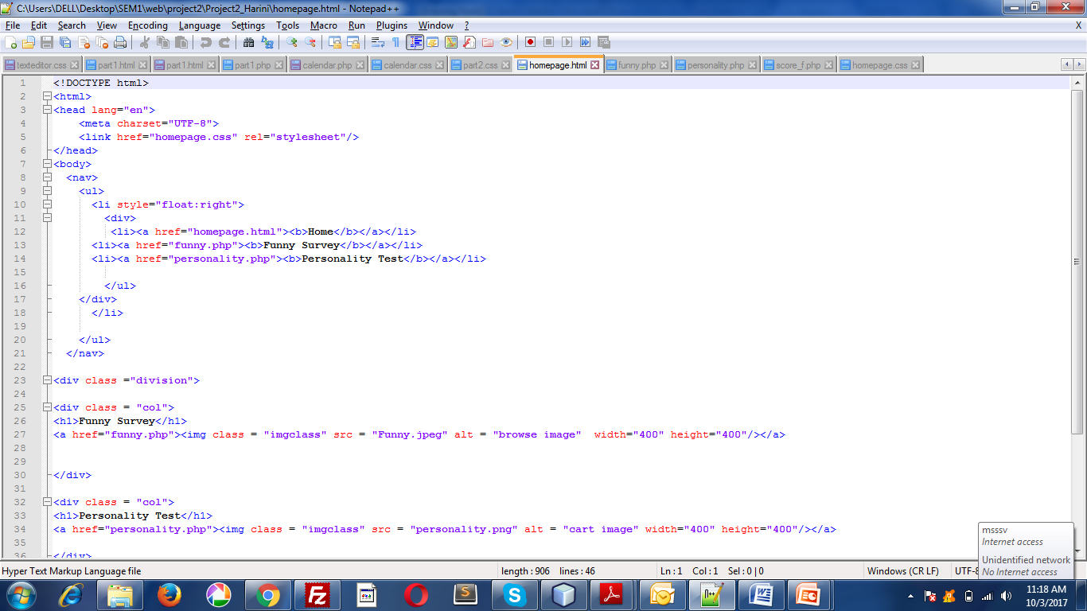
Code

Slide 10
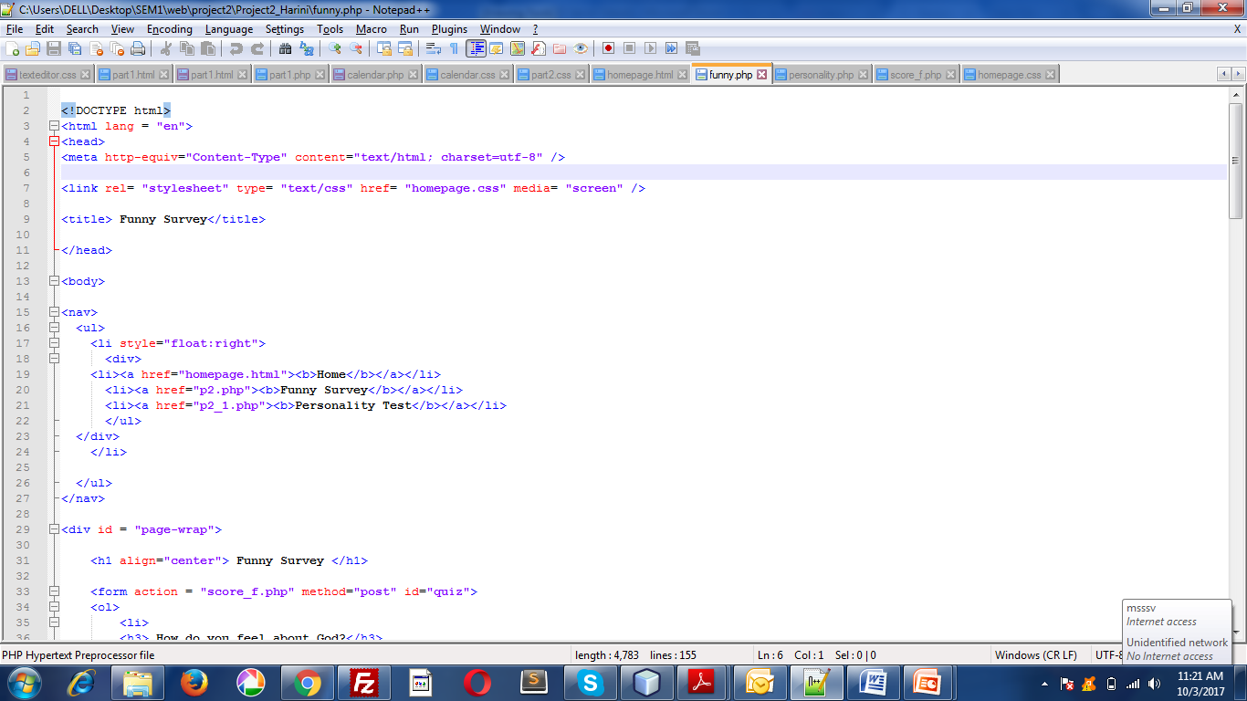
Code

Slide 11
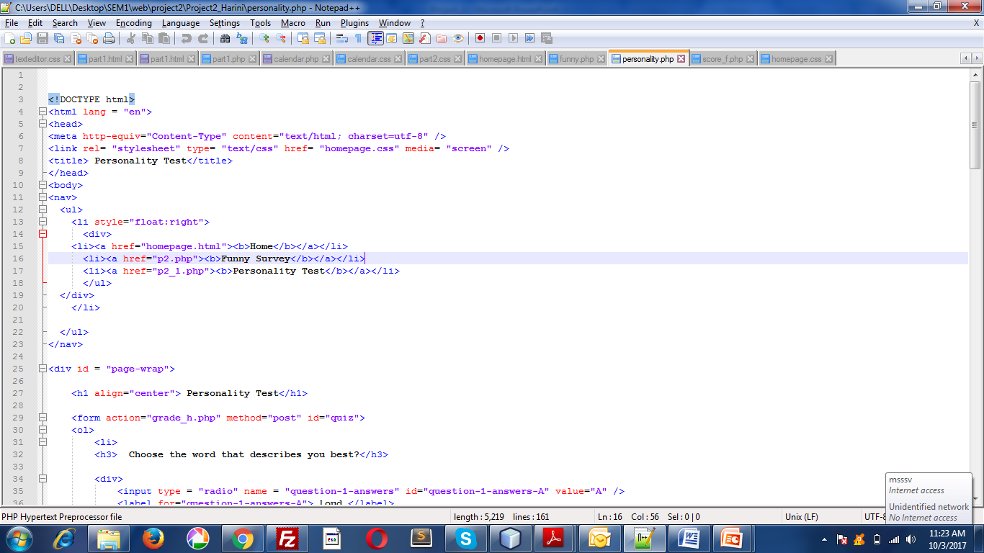
Code

Slide 12
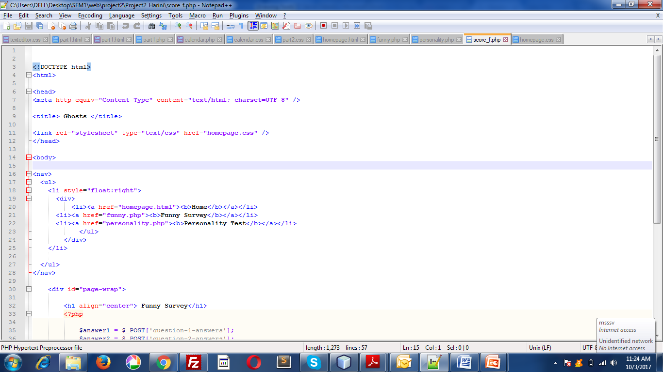
Code

Slide 13
Demo
http://codd.cs.gsu.edu/~smedisetty1/Project2/homepage.html

Slide 14
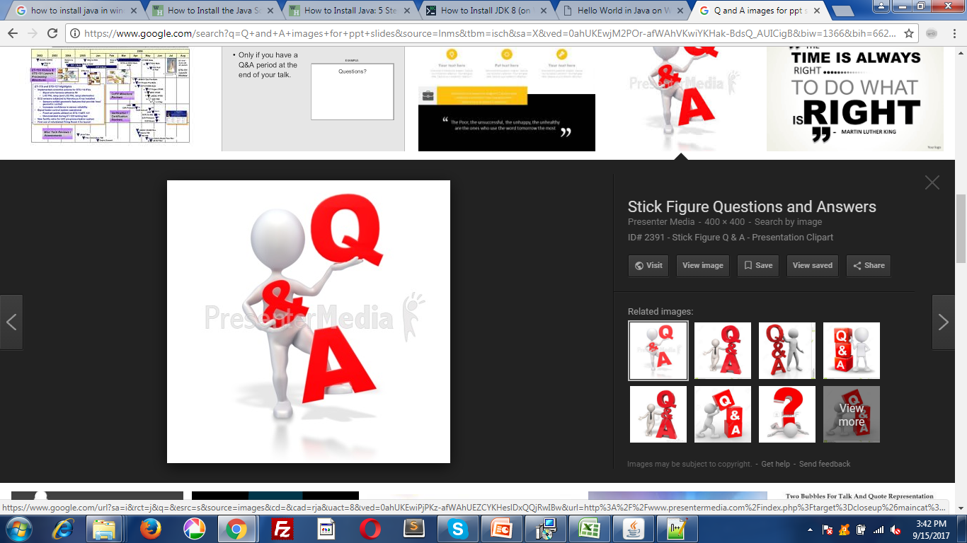
Q&A

Slide 15
Thank You

