Slide 1

Waheguru Ji Ka Khalsa
Waheguru Ji Ki Fateh
ਵਾਹਿਗੁਰੂ ਜੀ ਕਾ ਖਾਲਸਾ ॥
ਵਾਹਿਗੁਰੂ ਜੀ ਕੀ ਫ਼ਤਹ ॥

Slide 2
Coding Program
Updates and impact
Sanj Kaur Saini

Slide 3

Program Overview
Established: 2022 with support from Sikh Center Seattle Gurudwara Board
Vision: To introduce youth to coding at an early age, fostering STEM interest
Target Audience: Students from K-8

Slide 4

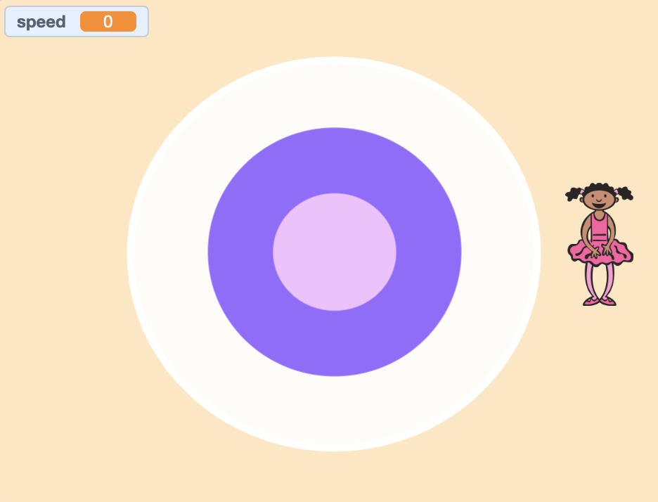
Progress: Year 1 [2022-23]
Started with 5 students, grew to 12
Introduced Coding Concepts
Completed 5 projects
Scratch - Block based coding

Slide 5

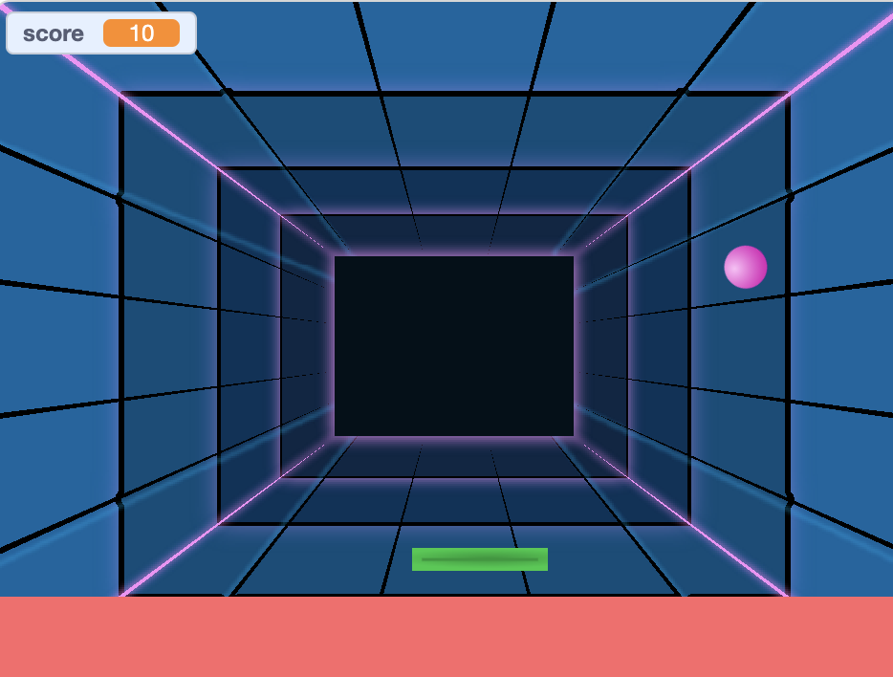
Progress: Year 2 [2023-24]
Expanded to 15 students in 2 classes (around 30 in all)
Beginner Scratch (K-4),
Advanced Scratch (5-8)
Programming Concepts
Completed 10 projects (Games, Animations)
Addition of 1 more teacher: Ronak Singh

Slide 6

Plans for Year 3 (2024-25)
Beginner Scratch (2-3rd Graders): Exploring the Scratch interface, creating animations, and designing simple games using loops, conditions, and events.
Advanced Scratch (4-5th Graders): Programming concepts like nested loops, custom blocks, variables, while also incorporating advanced user input
Beginner Python (5+ Graders): Introduces fundamental programming concepts such as variables, loops, and conditionals through engaging, hands-on projects

Slide 7
Beginner Scratch Program
Overview Designed for 2nd and 3rd graders, this course introduces students to the Scratch programming environment. They will explore the Scratch interface, learn to create animations, and design simple games using foundational concepts such as loops, conditions, and events through project-based learning.
Coding Type: Block-based coding, which is visual and simple, suitable for beginners.
Teacher: Amrit Singh, a junior at Bothell High School
Class Time: 9:30 AM - 10:15 AM every Sunday
Classroom: Portable in front of Gurudwara sahib
What to Bring: A fully charged laptop and a charger.

Slide 8
Advanced Scratch Program
Overview: Geared toward 4th and 5th graders, this advanced course delves deeper into programming concepts. Students will work with nested loops, custom blocks, variables, and advanced user inputs, empowering them to create more complex projects and games through project-based learning.
Coding Type: Block-based coding, which is visual and simple, suitable for young learners.
Teacher: Ronak Singh, a junior at North Creek High School
Class Time: 9:30 AM - 10:15 AM every Sunday
Classroom: Portable behind Gurudwara sahib
What to Bring: A fully charged laptop and a charger.

Slide 9
Python Beginner Program
Overview: Intended for 5th graders and above, this introductory Python course teaches essential programming concepts, including variables, loops, and conditionals. Through engaging, hands-on projects, students will gain a solid foundation in coding. Python is one of the most in-demand programming languages in the world. Coding Type: Text-based coding, which is more advanced and requires knowledge of programming concepts.
Teacher: Sanj Kaur Saini, a junior at Redmond High School
Class Time: 9:30 AM - 10:15 AM every Sunday
Classroom: Portable behind Gurudwara sahib
What to Bring: A fully charged laptop and a charger.

Slide 10
Thank You
We appreciate the support and resources provided by the Punjabi School Bothell and the Gurudwara Board.
Volunteers
We look forward to increased student attendance
Please contact us of you are interested to join the coding program
Sanj Kaur Saini
Program founder and Teacher
Ronak Singh
Teacher
Manish Tandon
Teacher Assistant
Gobinder Singh Saini
Coordinator and Teacher Assistant

Slide 11
Waheguru Ji Ka Khalsa
Waheguru Ji Ki Fateh
ਵਾਹਿਗੁਰੂ ਜੀ ਕਾ ਖਾਲਸਾ ॥
ਵਾਹਿਗੁਰੂ ਜੀ ਕੀ ਫ਼ਤਹ ॥

