Slide 1
Text Message Classification: Model to Determine Spam or Real Texts
Megan Jennings & John Figueroa
EE 6363 - Spring 2019
Milestone 2
3/18/ 2019

Slide 2
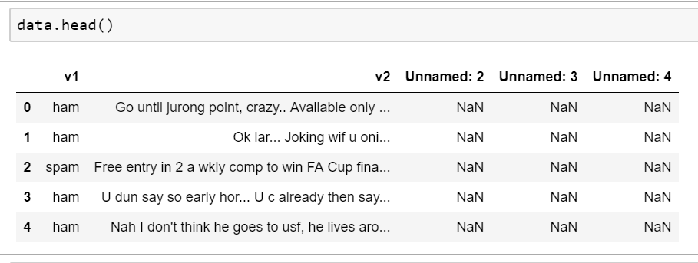
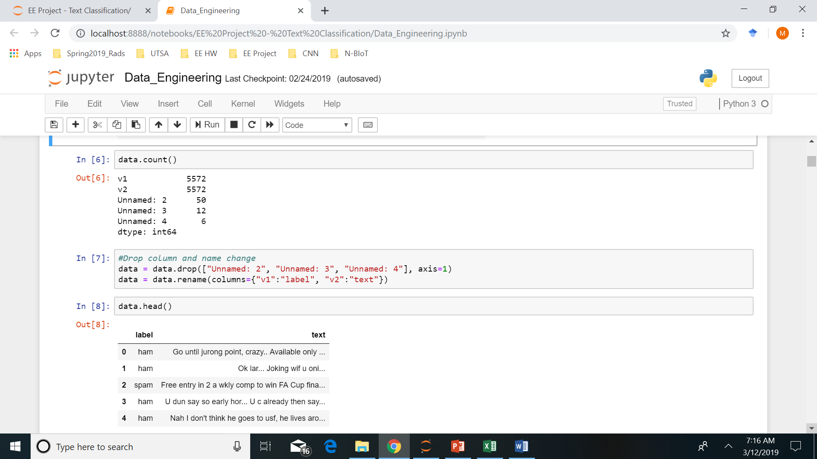
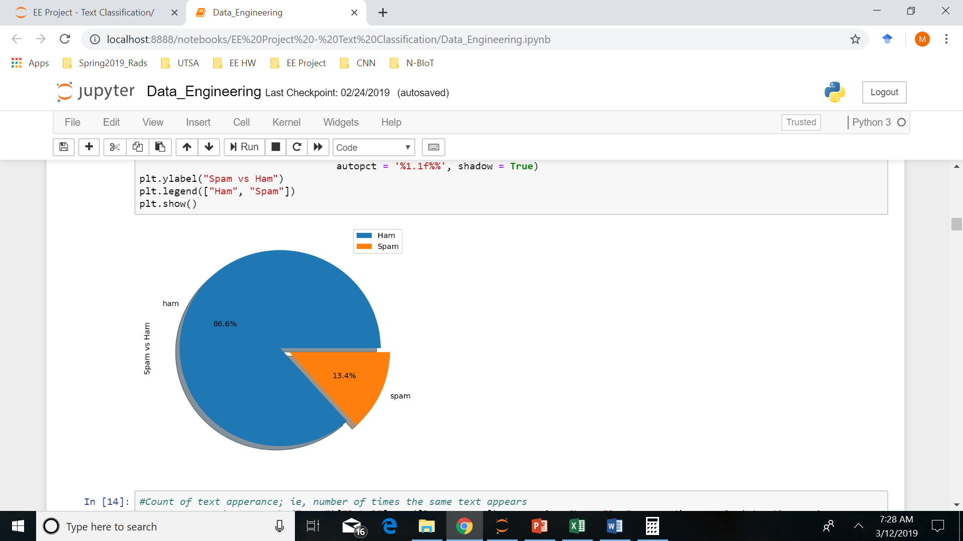
Cleaning the Data
# ham = 4825 (86.59%)
# spam = 747 (13.41%)
About 86% of our dataset consists of normal messages.
When we split our data set into train and test (or when we use cross validation), we will have to use stratified sampling, otherwise we have a chance of our training model being skewed towards normal messages.

Slide 3
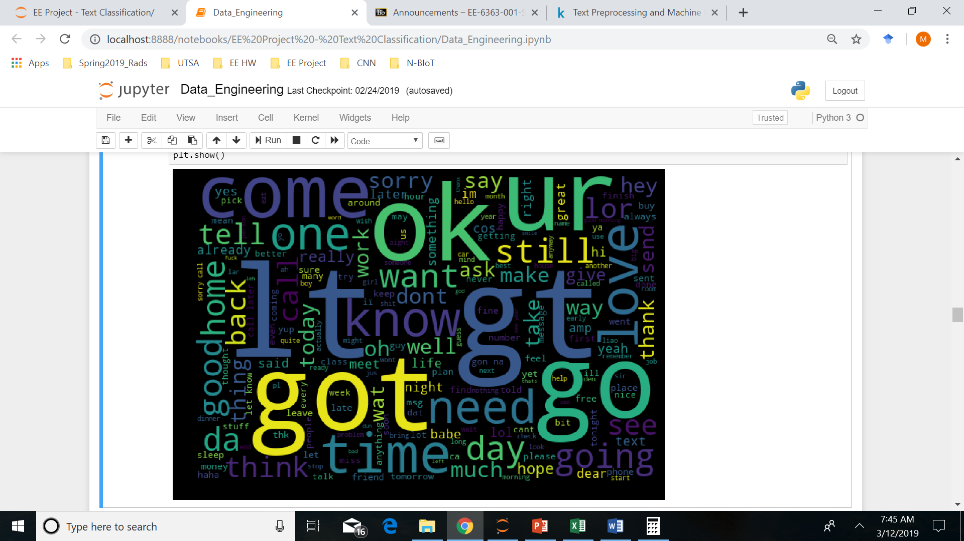
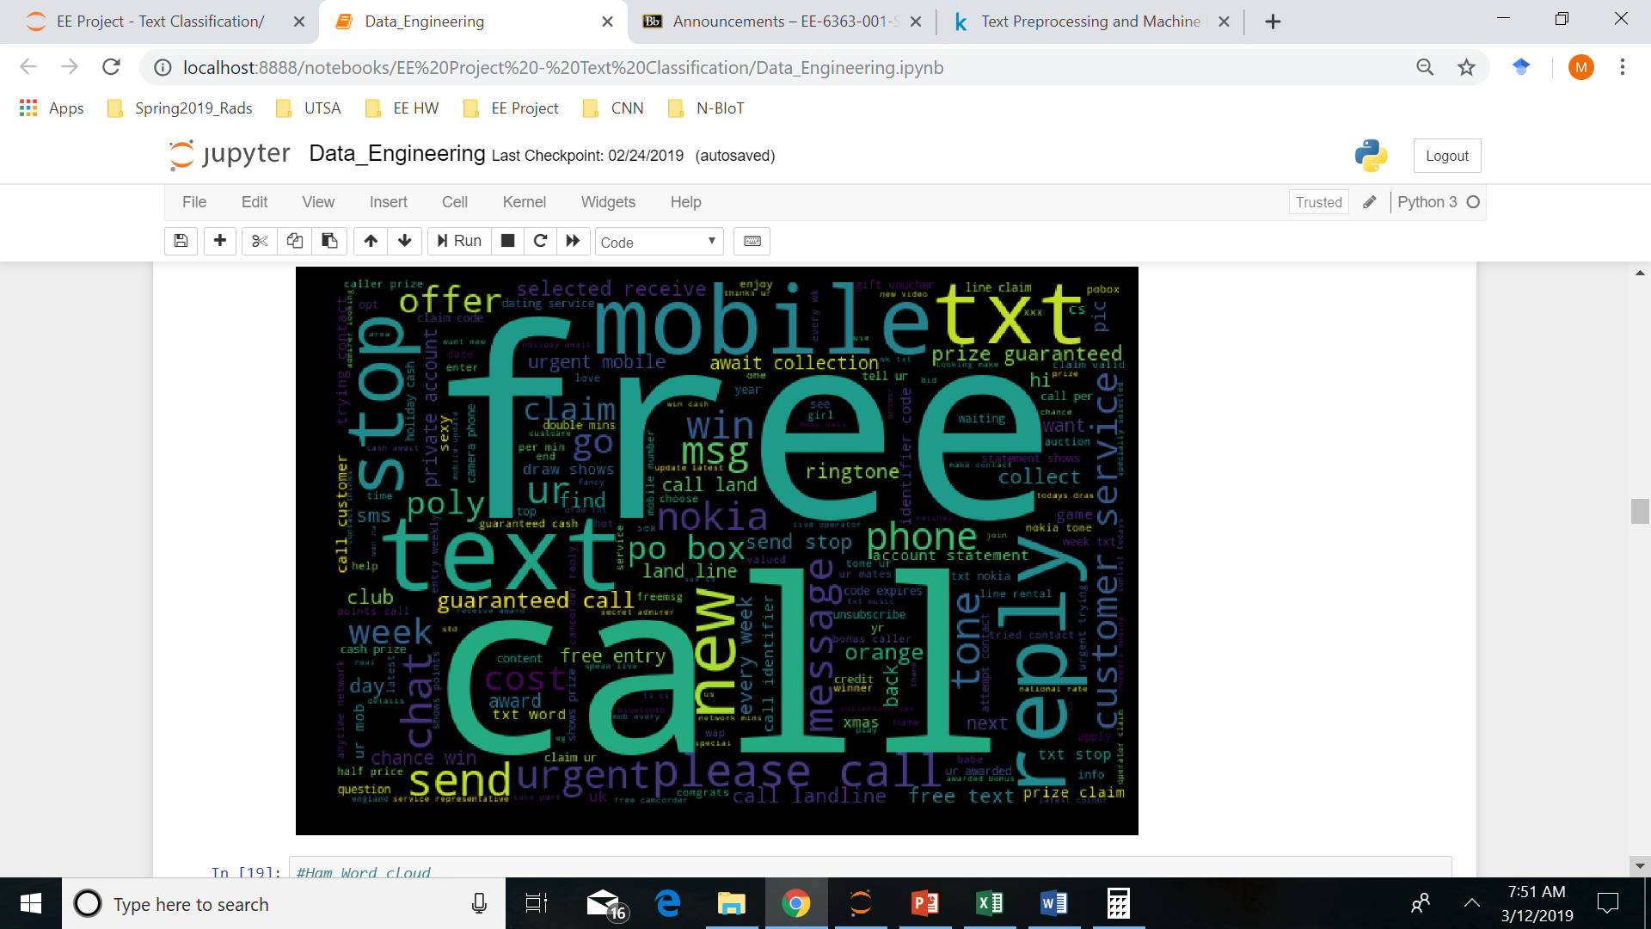
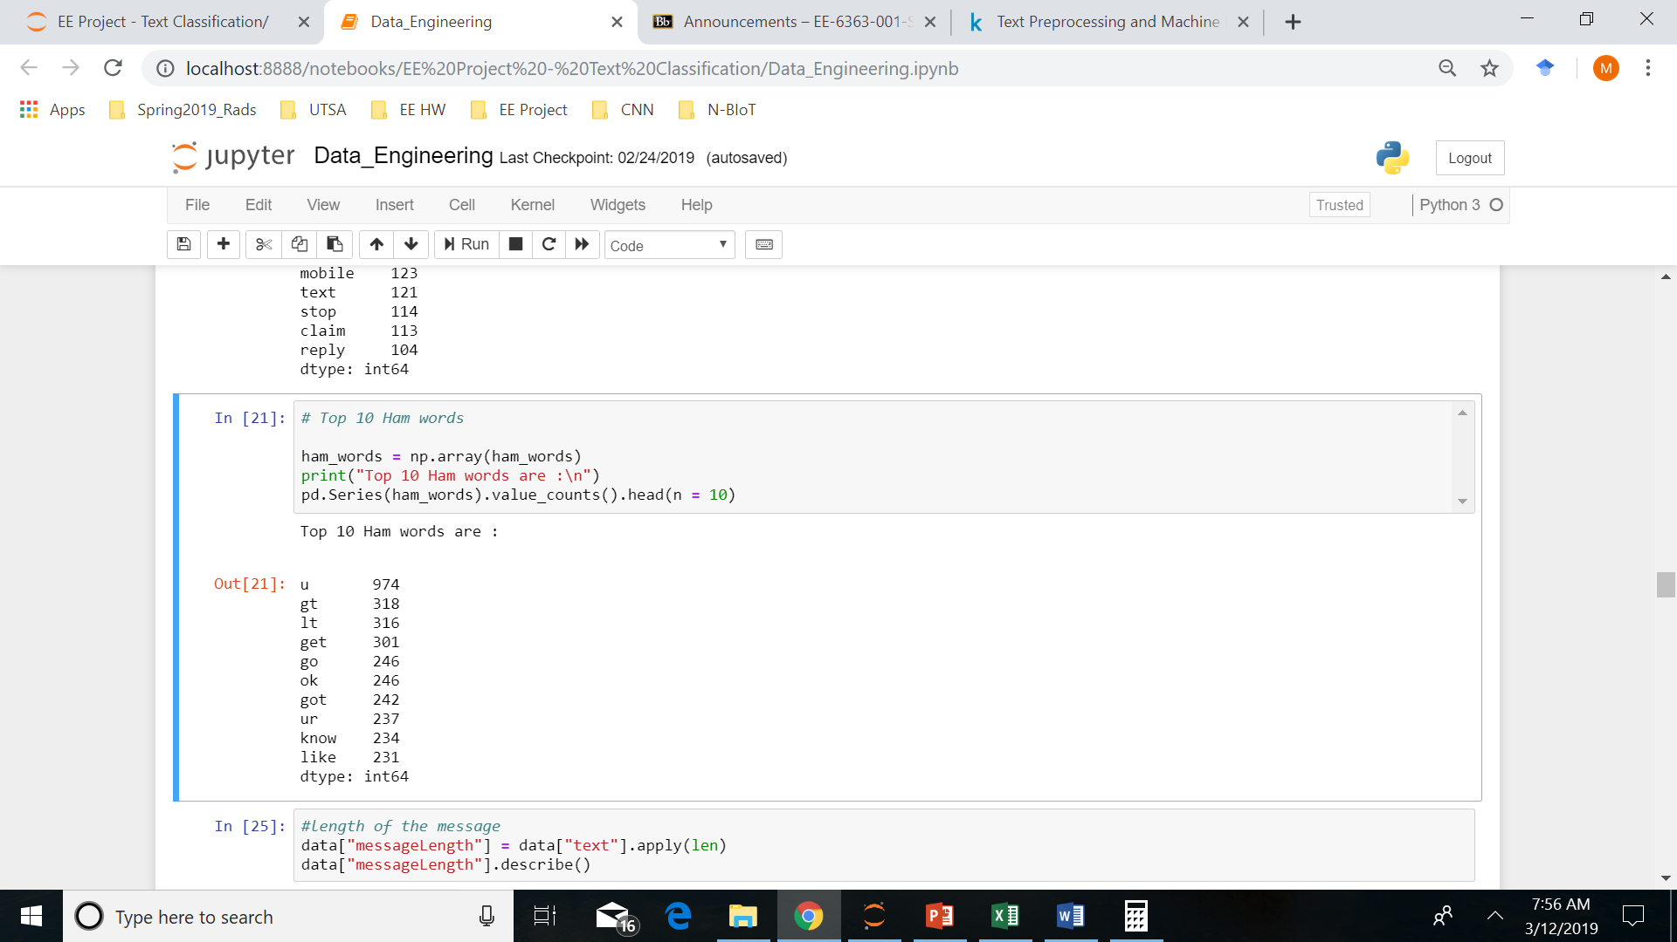
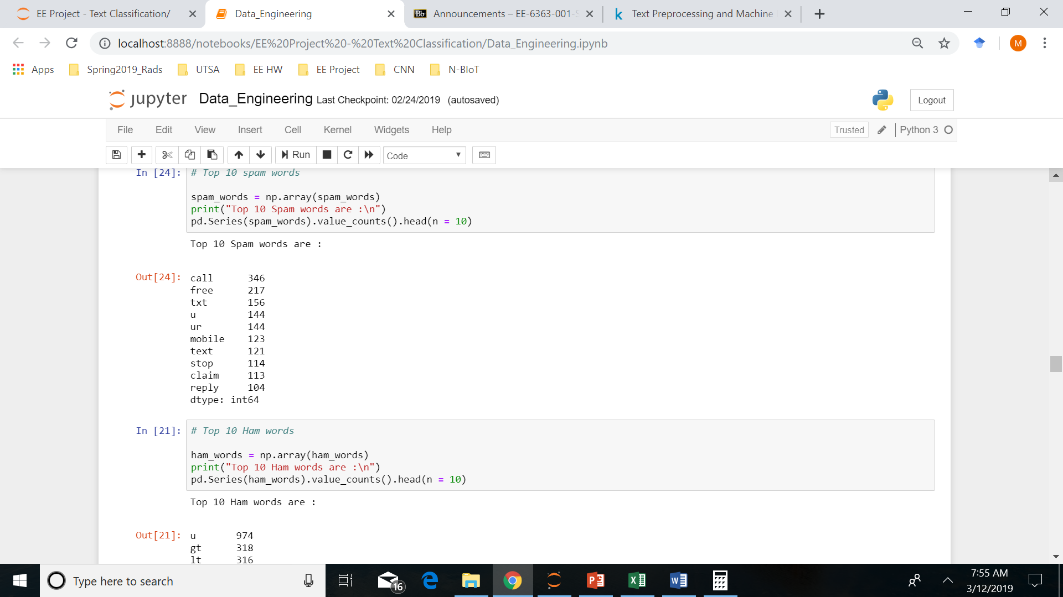
Ham Words (after word tokenize)
Spam Words (after word tokenize)

Slide 4
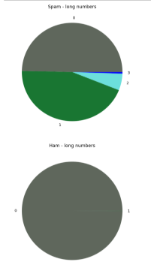
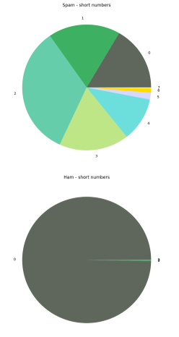
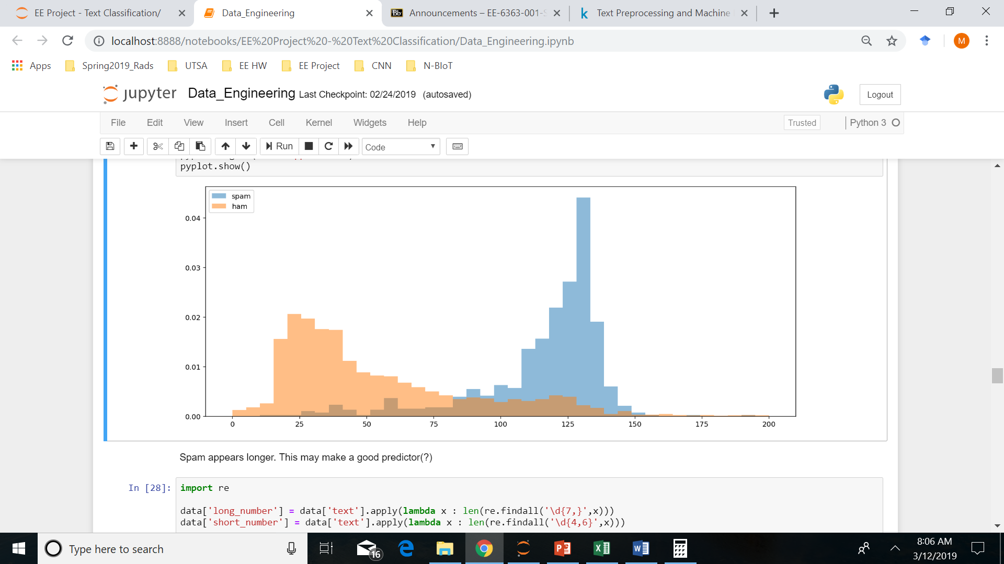
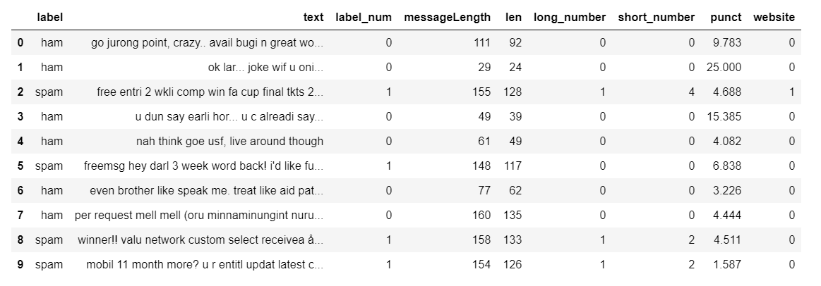
Feature Engineering
Notes:
Len is with spaces removed

Slide 5
Modeling
Test/ Train
80/ 20 with stratified sampling
Random Forest (all features)
Precision : 0.993 / Recall : 0.879 / fscore : 0.932 / Accuracy: 0.985
Multinomial Naive Bayes
Precision : 0.97 / Recall : 0.788 / fscore : 0.87 / Accuracy: 0.985
Logistic Regression
Precision : 0.979 / Recall : 0.848 / fscore : 0.909 / Accuracy: 0.985
Notes:
***We don't mind if we miss the odd spam message but we don't want to mark a ham message as spam i.e Precision is very important. Hence we will use fbeta score as our accuracy metric with inclination towards Precision
***Note: Recall is for ‘Spam’; values will change for ‘Ham’ see code for classification reporting

Slide 6
Proposed Timeline for Project
March & April
Classification reporting
Confusion Matrix
Deep dive on mis-classified messages
Fine tuning for better precision
4/29/2019
Results (Poster) Presentation
5/13/2019
Submit Final Report

