Slide 1
Corona Rescue Buddy
Prepared and Presented By – Sourav Adak

Slide 2
About the Project
This project is built keeping in mind the present COVID-19 Pandemic. This provides detailed information on what is COVID-19 pandemic, what are the safety / prevention mechanisms, relevant news articles and videos, worldwide statistics of the corona pandemic and helpdesk to end users whoever need from the comfort of their home. This web application is built using REACT JS, BOOTSTRAP, OPEN SOURCE APIs.

Slide 3
COVID-19 Alert !!
Coronavirus disease (COVID-19) is an infectious disease caused by a new virus. The disease causes respiratory illness (like the flu) with symptoms such as a cough, fever, and in more severe cases, difficulty breathing. You can protect yourself by washing your hands frequently, avoiding touching your face, and avoiding close contact (1 meter or 3 feet) with people who are unwell.
HOW IT SPREADS :
Coronavirus disease spreads primarily through contact with an infected person when they cough or sneeze. It also spreads when a person touches a surface or object that has the virus on it, then touches their eyes, nose, or mouth.

Slide 4
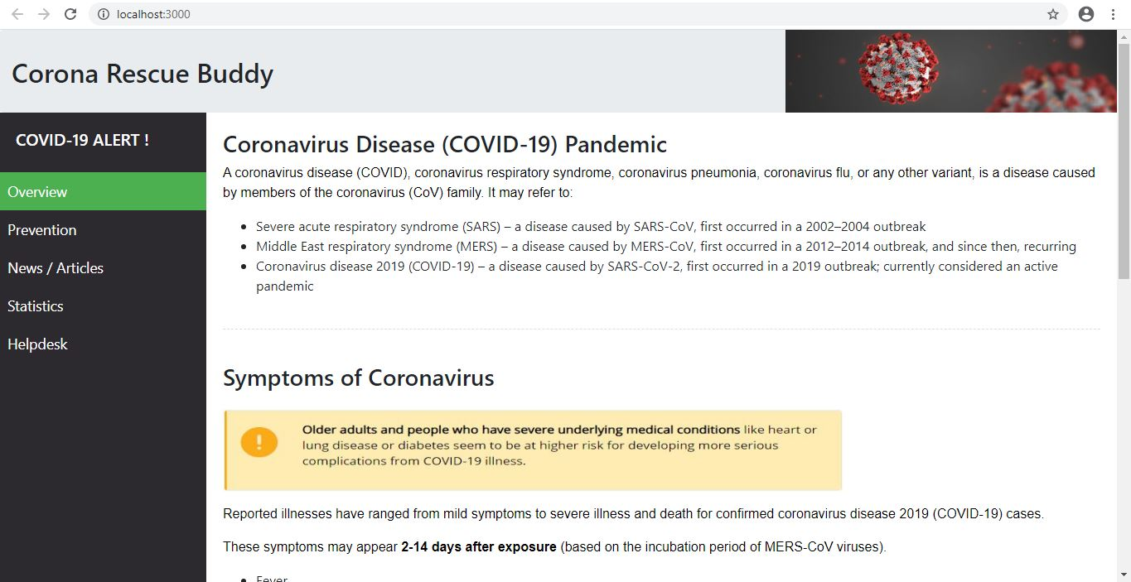

Slide 5
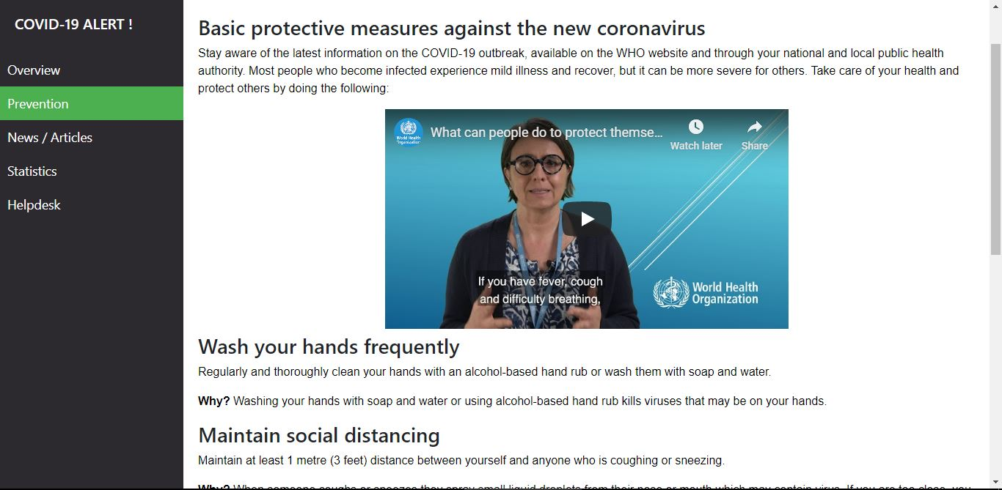

Slide 6
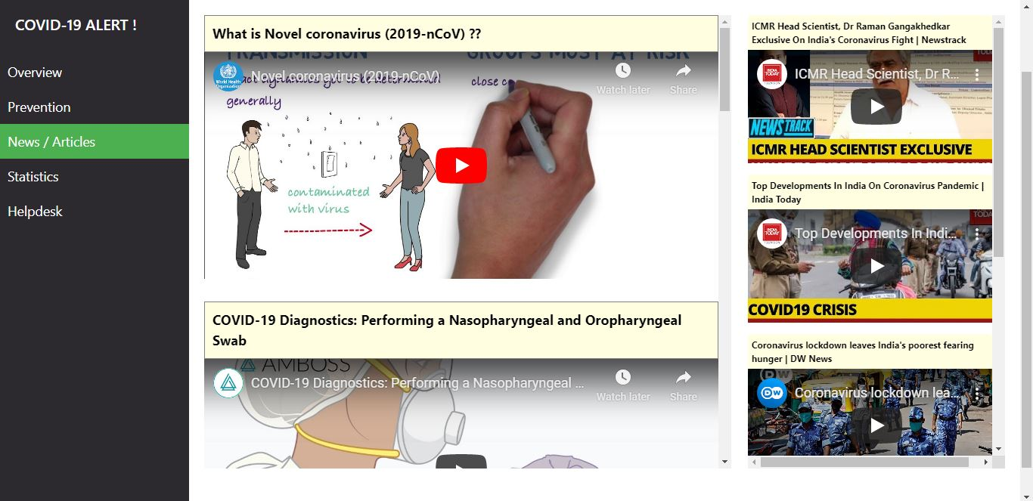

Slide 7
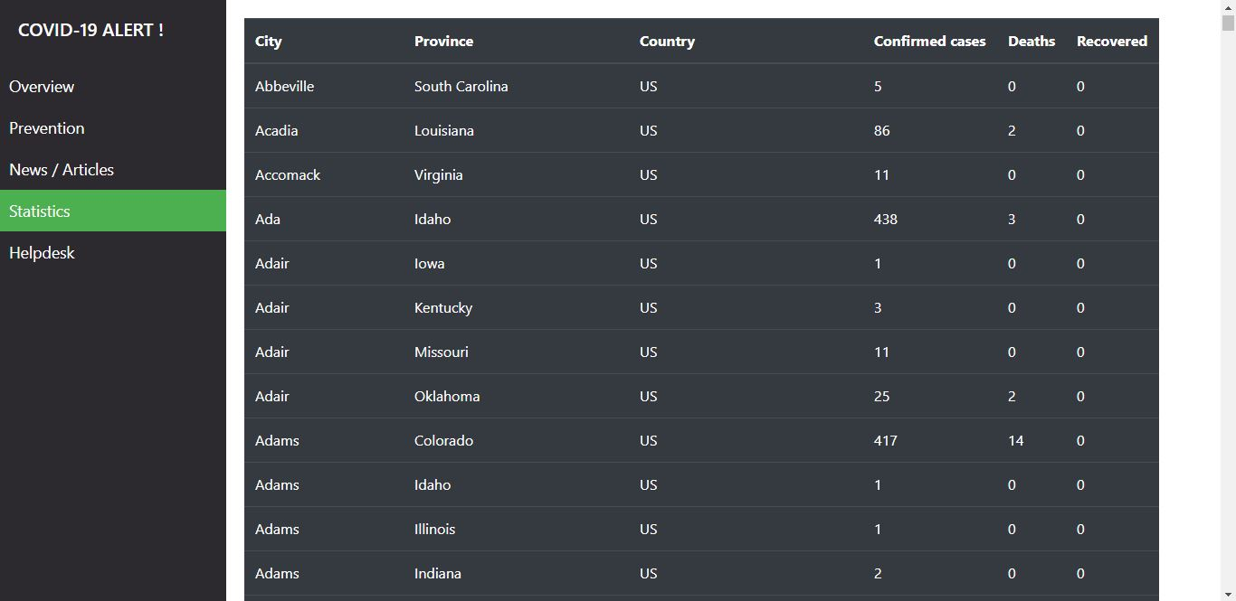

Slide 8
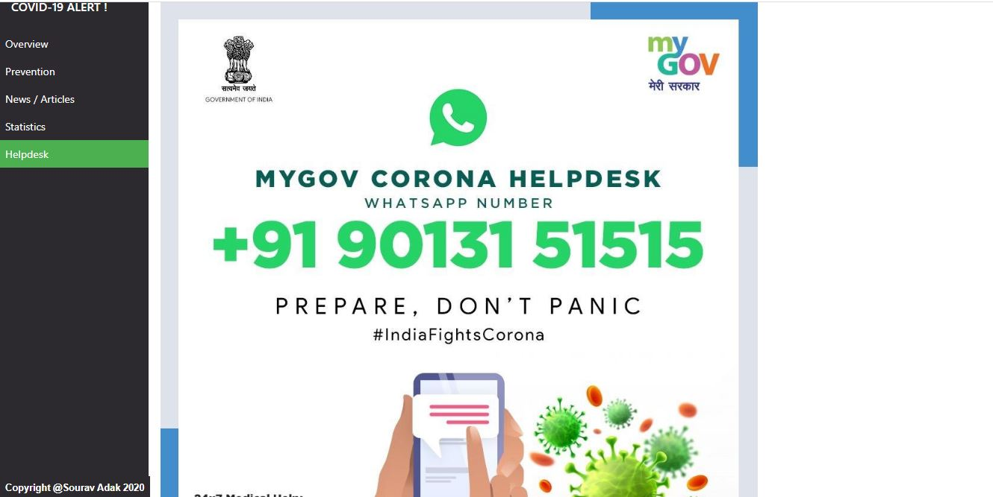

Slide 9


