Slide 1
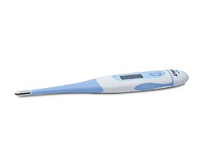

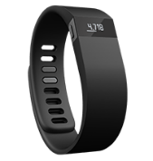
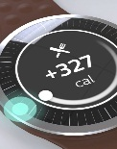





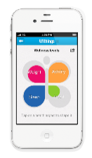
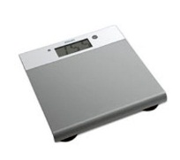


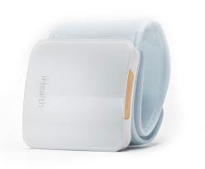
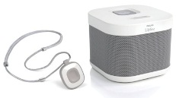

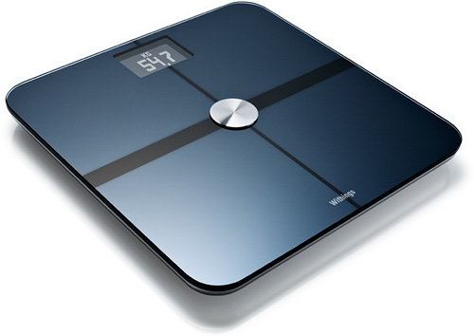
Note: mentioned devices and services are examples. Actual list of integrations can be obtained separately.
Vision
PHILIPS DEVICES
3rd PARTY DEVICES
Manual Input
Philips Thermometer
Fitbit
Jawbone
Moonshine
Data Lake
Sunshine
Philips BPM
Moves
Whitings
Scale
Validic
iHealth
Lifeline mPers
Whitings Scale

Slide 2



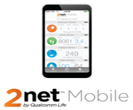
Customer
Step-2b Read API Write API
Customer Data Stream
Store Info
Data Lake
QCL
Archive Stream
Data Receiver (REST API)
Queue
ETL
Notes:
How does 2net platform associate a payload to a user?
Observations → device ID
Obs → user ID
Obs→Device ID
DeviceID→PatientID
Obs→PatientID
DDR: DeviceID, Device Attributes
SDR: DeviceID, Observations

Slide 3

Architecture
Connectivity
Provider
Data Receiver
Data Receiver
Queue
Transform
Map / Filter
Annotate
Data Adapter
Data Adapter
Data Lake
Analytics
Observation Store

Slide 4
Clickstream

Slide 5
Data Files | Validations
Browser | check it has two columns validate first column is a number
OS | check it has two columns validate first column is a number
ClickStream | check it has 13 columns Hit_timestamp is valid Referrer , if null replace with unknown Duration if null make it 0 Visit_num if null make it 0 Page_event if null make it 0

Slide 6
Queries
How many transactions occurred between September 25, 2013 and September 30, 2013 inclusive? Note: Each record in the file is one transaction. The hit_timestamp column contains the transaction date.
What is the average length in seconds of all the transactions that occurred between September 25, 2013 and September 30, 2013 inclusive?
How many unique visitors used the Chrome browser (any version)? Note: One visitor may have multiple transactions in the file.
What was the most used operating system & browser combination for all dates included in the clickstream data?
How many transactions were done using the Macintosh operating system? Note: Use only the data contained in the clickstream file in the query. The result of the query should be one row.
How many unique visitors had transactions per day per major browser? For example, for "Chrome 28.7”, the major browser would be "Chrome”.

Slide 7
Dimensions | Date Browser major browser operating system Referrer user agent
Measures | Transactions Duration visitors

Slide 8
Assumptions
report grain is days no time data has the PK type 1 dimension invalid data is rejected in click stream data is trans id is unique

Slide 9
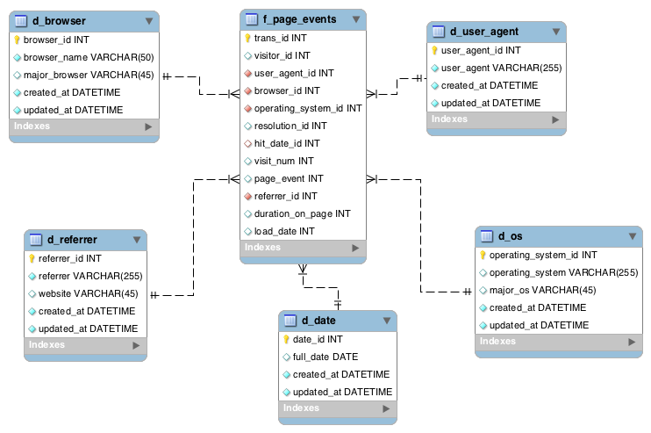
Model

Slide 10
Solution Implemented using two different options : Pentaho ETL tool, Python
Load Browser File
- Check number of Columns
- Extract Major Browser form browser
- Save browser record
-log metrics
Load Operating System File
- Check number of columns
- Get major os
- Save record
-log metrics
Load Clickstream File
- Change the format of time stamp to YYYYMMDD
- Replace null to unknown in referrer
- Replace duration with 0 when null
-Replace visit num with 0 when null ?
- Replace page event with 0 when null
- For each click stream
Create referrer, user agent, date
Insert row , ignore if already exists
Log metrics

Slide 11
Queries | SQL/result
How many transactions occurred between September 25, 2013 and September 30, 2013 inclusive? Note: Each record in the file is one transaction. The hit_timestamp column contains the transaction date. | select count(*)from mydb.f_page_eventswhere hit_date_id between 20130925 and 20130930 1487
What is the average length in seconds of all the transactions that occurred between September 25, 2013 and September 30, 2013 inclusive? | select avg(duration_on_page)from mydb.f_page_eventswhere hit_date_id between 20130925 and 20130930 48.8209
How many unique visitors used the Chrome browser (any version)? Note: One visitor may have multiple transactions in the file. | select count(distinct visitor_id)from mydb.f_page_events, mydb.d_browserwhere mydb.f_page_events.browser_id=mydb.d_browser.browser_idand mydb.d_browser.major_browser='Chrome’ 1972

Slide 12
Queries | SQL/result
What was the most used operating system & browser combination for all dates included in the clickstream data? | select mydb.d_browser.major_browser,mydb.d_os.major_os,count(*)from mydb.f_page_events, mydb.d_browser,mydb.d_oswhere mydb.f_page_events.browser_id=mydb.d_browser.browser_idand mydb.f_page_events.operating_system_id=mydb.d_os.operating_system_idgroup by mydb.d_browser.major_browser,mydb.d_os.major_osorder by 3 desc 'Chrome','Android','1784'
How many transactions were done using the Macintosh operating system? Note: Use only the data contained in the clickstream file in the query. The result of the query should be one row. | select count(*)from mydb.f_page_events,mydb.d_oswhere mydb.f_page_events.operating_system_id=mydb.d_os.operating_system_idand mydb.d_os.major_os='OS X’ 870

Slide 13
Queries
How many unique visitors had transactions per day per major browser? For example, for "Chrome 28.7”, the major browser would be "Chrome”. | select mydb.f_page_events.hit_date_id,mydb.d_browser.major_browser,count(distinct visitor_id)from mydb.f_page_events,mydb.d_browserwhere mydb.f_page_events.browser_id=mydb.d_browser.browser_idgroup by mydb.f_page_events.hit_date_id,mydb.d_browser.major_browser '20130916','Chrome','14 ''20130916','Firefox','10’ '20130916','Opera','22’ '20130917','Chrome','38’ '20130917','Firefox','11’ '20130917','Opera','34’ '20130918','Chrome','20’ '20130918','Edge','3'

