Slide 1
HSDP - Qualcomm 2net Integration Workshop #2 outcome
October 18th, 19th 2016, Hassan, Guy.

Slide 2
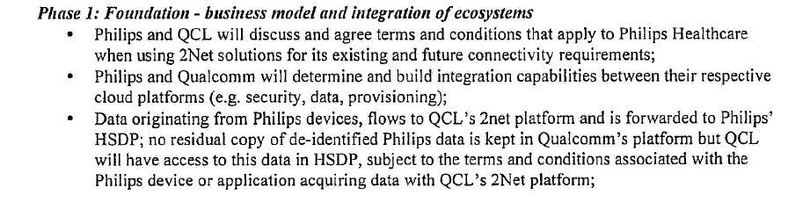
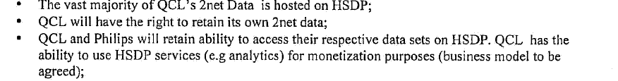
Phase 1: Qualcomm integration assignment
Statement in Letter of Intend:

Slide 3
Participants Workshop #2
Qualcomm QCL Participants:
Chris Fickle / Business Development lead for Philips
Jim Pyers / TAM for Philips
Audrey Salda / Program Manager for Philips
Vladimir Ivanov / 2net Gateway Product Manager
Anand Thomre / Cloud & Services Development lead
Jeremy Schroetter / Director of Engineering
Gabriel Perez / Cloud Architect (remote)
Vijay Sadagopan / Operations (remote)
Daphna Zeilingold / System Engineering (remote)
Philips HSDP participants:
Sergio Levi
Ad Dijkhoff
Rich Ridolfo (partly)
Hassan Mousaid
Allan Bugos
Tomas Russ
Guy Maris (remote)
Jurgen Heijmans (remote)
Jan Poesse (remote)

Slide 4
Qualcomm will use HSDP as Archive Store
The future solution will be using the HSDP PaaS building blocks. Two HSDP capabilities are used: the Device Profile Repository and the Observation Store. Initially this store will contain data from Philips propositions only.
HSDP will expose an API which QCL can use to send the data to. A different URI will be used to discriminate between the different QCL accounts/propositions.
Since the QLC data objects consist of both peripheral device identity and the observation data we will need to create a micro service to act as end-point for 2net which accepts incoming messages from 2net and split the data into a Device Profile and the Device Observation part.
For all peripherals a unique profile record will be created when a peripheral is seen for the first time. Updates will be done each time new data is arrived. All observations are stored in the observation store annotated with the unique peripheral ID.
The data ownership and access rights stay with Qualcomm.

Slide 5
Phase 1: Qualcomm will use HSDP as Archive Store
Step-1 → QCL in the lead.
What is it : Raw archive data store in HSDP managed Amazon S3 buckets
Business value : This allows for Qualcomm only to store and access to the data. , targeted for limited functionality.
- Data ingestion : Qualcomm to provide 2net – AWS integration
- Access the data : Qualcomm reading/accessing S3 API’s
Customers : Dedicated for Qualcomm
When available : Qualcomm timing
Actions:
2net OPS work with HSDP OPS to acquire HSDP S3 URL’s → Audrey/Hassan
2net OPS works with 2net OPS to investigate Lift&Shift of 2net to HSDP infra. Initial call within 2 weeks, decide on big/complex to simple/small → Rich/Audrey
Lift&Shift H2H and Respironics onto 2net instance on HSDP infra as a proof-point/first step Decision on viable path for L&S end of November. → Philips/QCL

Slide 6







Phase 1: Qualcomm will use HSDP as Archive Store
Step-1: AWS S3 bucket scenario by Qualcomm
Customer
Customer Data Stream
HSDP AWS IaaS
QCL
Archive Stream
Data Processor
Bucket
Notes:
How does 2net platform associate a payload to a user?
Observations → device ID
Obs → user ID
Obs→Device ID
DeviceID→PatientID
Obs→PatientID
DDR: DeviceID, Device Attributes
SDR: DeviceID, Observations

Slide 7
Phase 1: Qualcomm will use HSDP as Archive Store
Step-2 → Philips in the lead
What is it : Raw data store in HSDP Connect Data Stores SDR and DDR
Business value : Allows for data to be stored in HSDP and accessed through HSDP API’s
Device specifics need to be known, since raw data can have many device specific elements
Data ingestion : HSDP will configure an endpoint to receive Qualcomm 2net data (end-point per customer/account)
Access the data : Allows for data to be accessed through HSDP SDR and DDR API’s
Customers : Qualcomm: will have access to the Qualcomm data
Philips: This capability allows for Philips to have access to the Philips data
Other 2net and HSDP customers: This capability can be used by other customers as an end-point
When available : Q1 2017
Actions:
Develop pricing model for DDR/SDR store only compared to store and use the data. → Action Ad (mid Nov), decision Qualcomm end November.

Slide 8

Phase 1: Qualcomm will use HSDP as Archive Store
Step-2: Connect Data Store DDR/SDR scenario
Customer
Step-2b Read API Write API
Customer Data Stream
HSDP Connect
Store Device Profile Info
DDR
QCL
Archive Stream
Data Receiver (REST API)
Queue
Data Processor
SDR
Store Observation
The Qualcomm 2net data stream comprises the peripheral meta data and the observation.
A micro service (Data Receiver) splits this stream to separate the peripheral meta data (brand/type/SN ,status,…) and the observation.
With the peripheral meta data a Device Data Repository (DDR) record is created or updated. The DDR will contain all the unique peripheral records with meta data.
The Sensor Data Repository (SDR) will store all the observations under the unique peripheral ID.
Notes:
How does 2net platform associate a payload to a user?
Observations → device ID
Obs → user ID
Obs→Device ID
DeviceID→PatientID
Obs→PatientID
DDR: DeviceID, Device Attributes
SDR: DeviceID, Observations

Slide 9
Phase 1: Clarification by Qualcomm
A few clarifications to confirm a common understanding and slightly nuanced view of “Step-2a” and “Step-2b”:
For the purposes of simplicity, we are viewing “Step-2a” as the distribution (sending) of 2net sensor data to the HSDP platform in JSON format via HTTP POST. “Step-2b” would be the ability (via API) for 2net to read (send/receive) data from HSDP.
Step-2a.
2net to post sensor data from the Philips H2H and Philips Respironics (Trilogy) to the HSDP end point.
We will need these endpoints definition(s) from Philips to configure (URLs).
Note: we propose that Philips provide an HSDP test & prod endpoint for initial testing and then
production implementation. We also have a test environment for this purpose.
Note: There can be multiple endpoints (for example to DDR and SDR)
Note: Once 2net Philips data posts are configured to HSDP, the data posts from 2net will continue to
flow to current Philips BU defined end points.
Step-2b.
Audrey is working with engineering/ops teams to plan the steps for access the HSDP API’s for sending/receiving data from HSDP to the 2net platform. We will report back shortly on this
Based on your note below, I would say we are ready to complete Step-2a and/or Step-2b from the outbound perspective – however, that step won’t be implemented until we have configured the backend and tested the data post capabilities. This is a very straightforward process and is precipitated by a request to our ops team to update the configuration according to Philips request. (a matter of a days, not weeks – after testing)

Slide 10
QCL data format sent by 2net platform (1/2)
The qcl_json_data sent to HSDP via HTTP POST as a single name value pair consist of two integral aspects:
2net Properties - meta data available in 2net system that’s concatenated to the actual data uploaded by the biometric device. E.g 2net hub ID through which data gets uploaded, serial number of biometric device, time when data was received by 2net hub from biometric device etc…
Biometric data – All the information uploaded to 2net hub by the biometric device (includes the actual biometric measurement and any other meta data such as measurement time, battery level provided by the biometric device). This information varies per device model
2net Properties specified in section 4 of 80-KA083-1 document and json information in 80-KA213-x document shall be used together to understand what to expect in data post from 2net SP

Slide 11
QCL data format sent by 2net platform (2/2)
Device used by Philips H2H: A&D UA-767PBT Ci BP, Polymap GMA, Nonin 3230 pulse ox and Philips Motiva weight scale.
Polymap GMA is an Bluetooth dongle which one can connect various mass market glucometers.
Note: Although the 80-KA083-1 is the 2net REST API document, the data post has nothing to do with REST API.
HTTPS POST “www form URL encoded” form data with “qcl_json_data” name value pair.
2net SP supports 1-way or 2-way SSL controlled by your end point. 2-way SSL using Windows IIS one-to-one cert mapping feature. Basic or other types of authentication NOT supported by 2net system.
2net system will attempt to post data as and when it gets the data from the respective 2net hubs. Current H2H frequency is 600 measurements / day

Slide 12
Phase 2

Slide 13
Phase 2: Qualcomm will use HSDP as primary Data Store
Step-3
What is it : Normalized data store in HSDP SDR and DDR
Business value : This provides access to data in a standardized/normalized fashion though HSDP API’s
without the need to know device specifics.
Allows use of other HSDP technology stacks and platform services such as the HSDP Big Data
Analytics, HSDP Big Data Science platform and the HSDP rules engine.
Allows sharing of data with caregivers through the use of the HSDP Personal Health Record (PHR),
Clinical Data Repository (CDR) and the HSDP consent management framework
Allows to convert data from one protocol to another through the user of the HSDP transformation
service (i.e. transformation from a simple JSON object to a FHIR object)
Data ingestion : Qualcomm endpoint defined at HSDP Data Broker which will normalize and store data in DDR/SDR
Access the data : Allows for data to be accessed through HSDP SDR and DDR API’s
Customers : Qualcomm: will have access to the Qualcomm data
Philips: This capability allows for Philips to have access to the Philips data
Other 2net and HSDP customers: This capability can be used by other customers as an end-point
Action:
Product managers of 2net and HSDP work on this (Workshop in Ehv end Jan.?) → Vlad and Jurgen

Slide 14



Phase 2: Qualcomm 2net full HSDP integration
Customer
HSDP Store
CDR
HSDP Cloud
Store Device Profile Info
DDR
Data Receiver (REST API)
Receiving Queue
Data Processor
QCL
Customer Data
SDR
Store Observation
Mapping between device id and patient
- openIDM

Slide 15


Phase 3: Qualcomm will use HSDP DC3.0 as backend
Customer
HSDP Store
CDR
HSDP Connect
HSDP Cloud
Device Cloud 3.0
Store Device Profile Info
DDR
Data Processor
Connect
AWS IoT
SDR
Store Observation
Mapping between device id and patient
- openIDM

Slide 16
HSDP Connect – Device Cloud 3.0
AWS-based device management solution
HSDP Device Cloud
Messaging Services
Firmware Services
Discovery Service
Master Data Management
Data Broker Services
Device Data Repository
Provisioning Service
Reset Service
HSDP Foundation
HSDP IAM
HSDP Self Service Portal
HSDP Logging & Auditing
AWS Services
(S3) Simple Storage Service
Kinesis Streams
IoT
Tunneling Service
CloudFront
Cloud Trail
(SQS) Simple Queueing Service
(SNS) Simple Notification Service
Dynamo DB
Lambda
API Gateway
Route 53
Cloud Watch
AWS managed services newly to be created or adapted based on AWS/Philips device management requirements

Slide 17





HSDP Connect - future architecture
Connectivity
Provider
CPP DC1.0
HSDP DC3.0
Data Receiver
Data Receiver
Data Receiver
Data Receiver
HSDP Connect
DC 3.0 Broker
Queue
Transform
Map / Filter
Annotate
Data Adapter
Data Adapter
Data Adapter
HSDP Connect Data Store
DDR
SDR
CDR / PHR
Analytics
RIAK core
RIAK core
Device Profile Info
Observation Store
Connect
Store

Slide 18
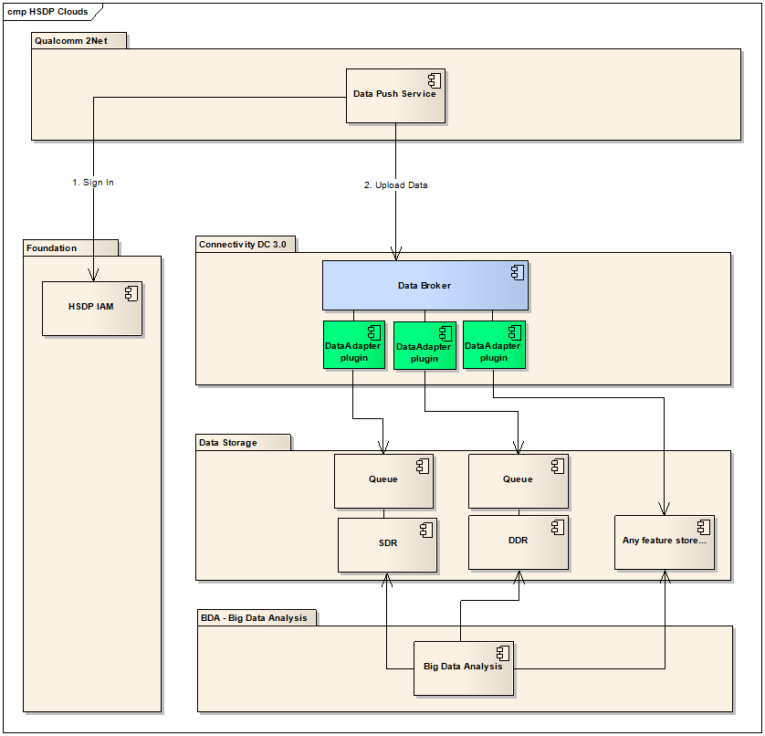

Slide 19
EOF

