Slide 1

Machine Learning for Intrusion Detection on IoT / IIoT Devices
COMP7710 Final Project
Muhammad (Sulaman) Khan

Slide 2
Introduction and Motivation
IIoT represents a critical part of industry today, often referred to as the next industrial revolution [1]
Currently, there are more than 8 billion IoT-connected devices, and the number is expected to reach 41 billion by 2027 [2]
The global IoT market size in 2021 was estimated to be over $380 billion, with the number expected to rise to $1.8 trillion by 2028 [2]
These devices must be secured appropriately, or there could be immense impacts on industry
This report will aim to use various machine learning techniques to develop an Intrusion Detection System (IDS) to categorise various attacks against IoT and IIoT environments
A variety of different models will be tested and evaluated for performance

Slide 3
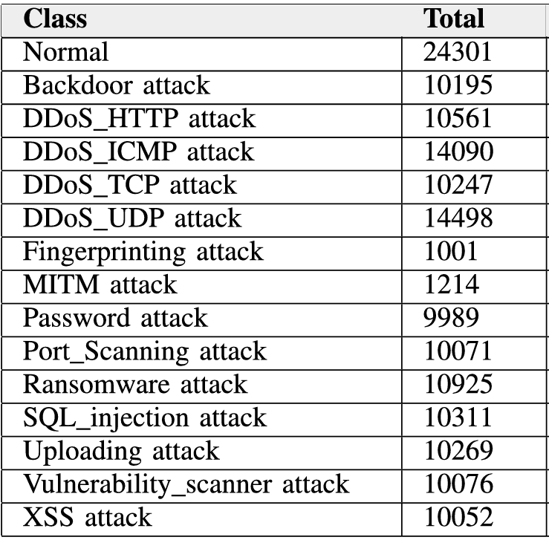
Chosen Dataset – Edge-IIoTset
EdgeIIoTset is a relatively new (2022) dataset which was developed by researchers by creating an IoT environment and capturing various activity through the different devices in the network
13 IoT devices were set up in a complete and realistic industrial IoT environment
14 different attack types were captured, covering various different DoS attacks, information gathering attacks, MitM attacks, injection attacks and malware attacks
63 features captured from network traffic, device resources, and device/alert logs [3]
Captured TCP, UDP, MQTT, ARP, HTTP, DNS info and more
Fig 1. Table showing the class distribution of dataset. Taken from [3].

Slide 4
Background Works
Recent surveys report that supervised ML classifiers (especially Decision Trees, Random Forests, KNN, SVM, etc.) often achieve very high detection rates (~99% accuracy) on IoT traffic data [4]
Other trends include ensemble methods and feature-selection: Alotaibi and Ilyas (2023) found that stacking/voting ensembles of RF, DT, KNN and LR improved IDS accuracy on the TON-IoT dataset [5]
In short, the field has largely focused on rich feature-engineering and powerful classifiers (often tree-based or neural) for signature-based detection, while exploring federated/edge architectures to address IoT constraints.
There isn’t a lot about unsupervised learning in these areas from what I could see

Slide 5
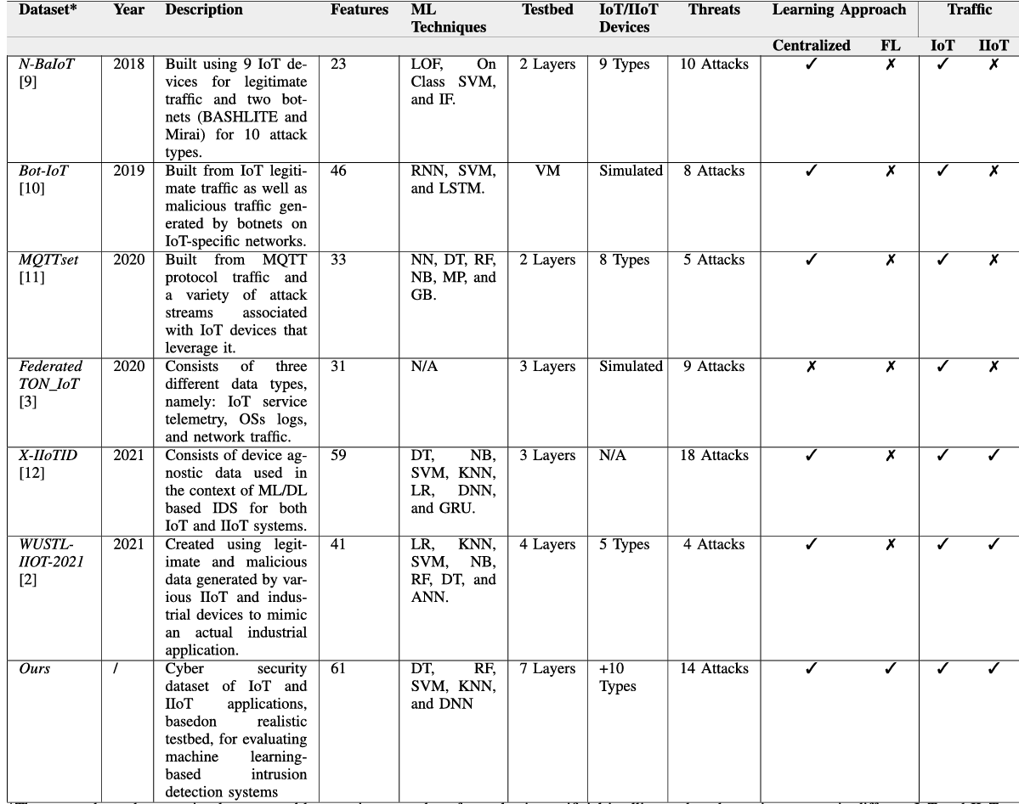
Older Similar Datasets
Fig 2. Table of older IoT datasets. Taken from [3].
Notes:
Problem with a lot of these is the class imbalance
Makes it harder to get realistic accuracy scores

Slide 6
This Project’s Focus
This project will cover some models that have already been used on other papers, and see if the results are similar on this new dataset
KNN, Decision Tree, Logistic Regression and MLP align well with the literature trends
In particular, KNN, DT and LR are among the standard supervised classifiers shown effective in IoT IDS studies
The project will also expand to try and assess the suitability of unsupervised techniques such as K-Means, GMM, Agglomerative Clustering
These techniques may prove useful as they, in theory, could generalise better to new attack types
These may be able to reveal new anomalous behaviours

Slide 7
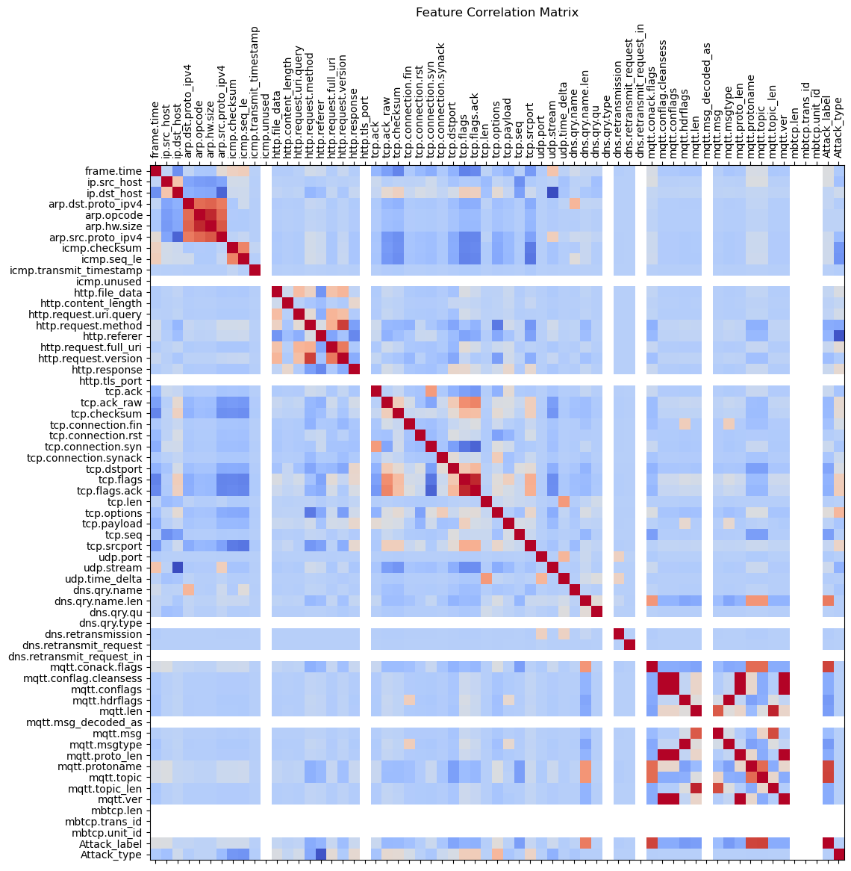
Preprocessing
The data was mostly already pre-processed, only needed to drop some columns that were redundant (as the paper specified)
Nothing really had ‘too-high’ correlation with the target labels, and so nothing additional was dropped

Slide 8
Supervised Models (well backed by literature)

Slide 9
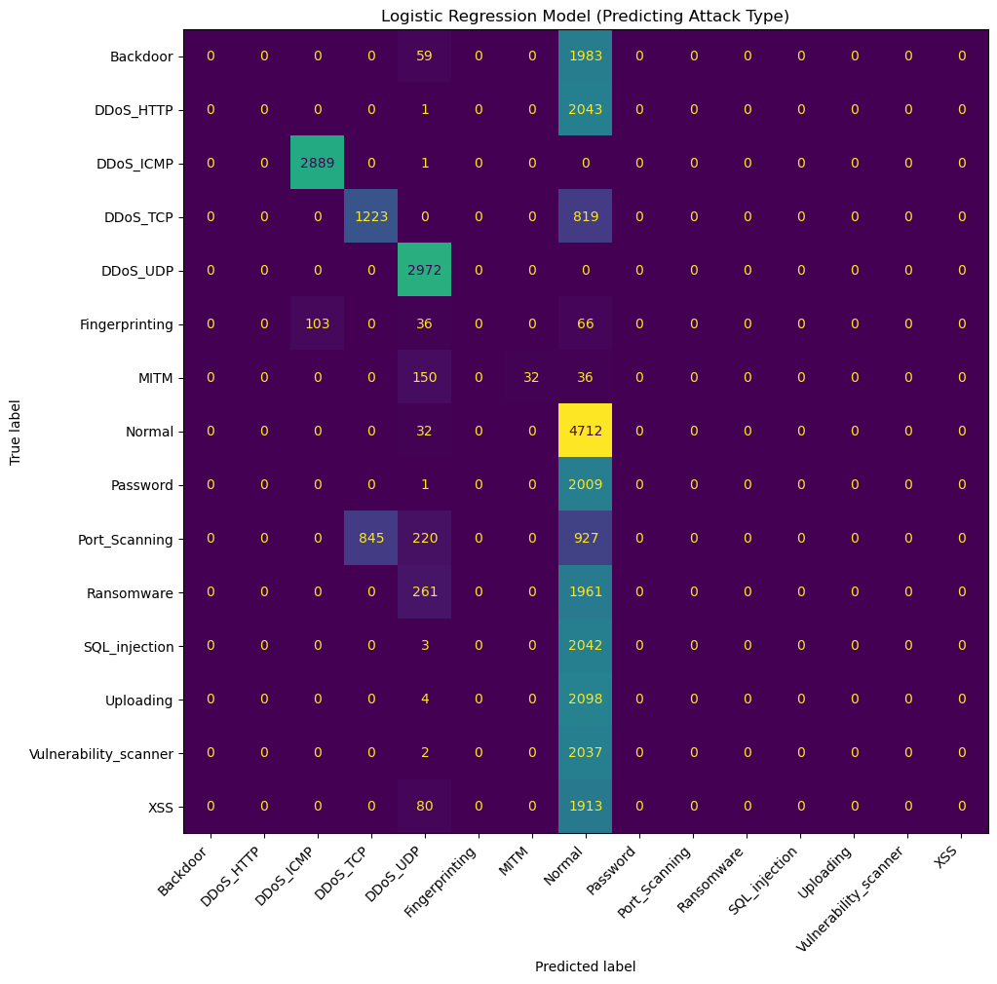
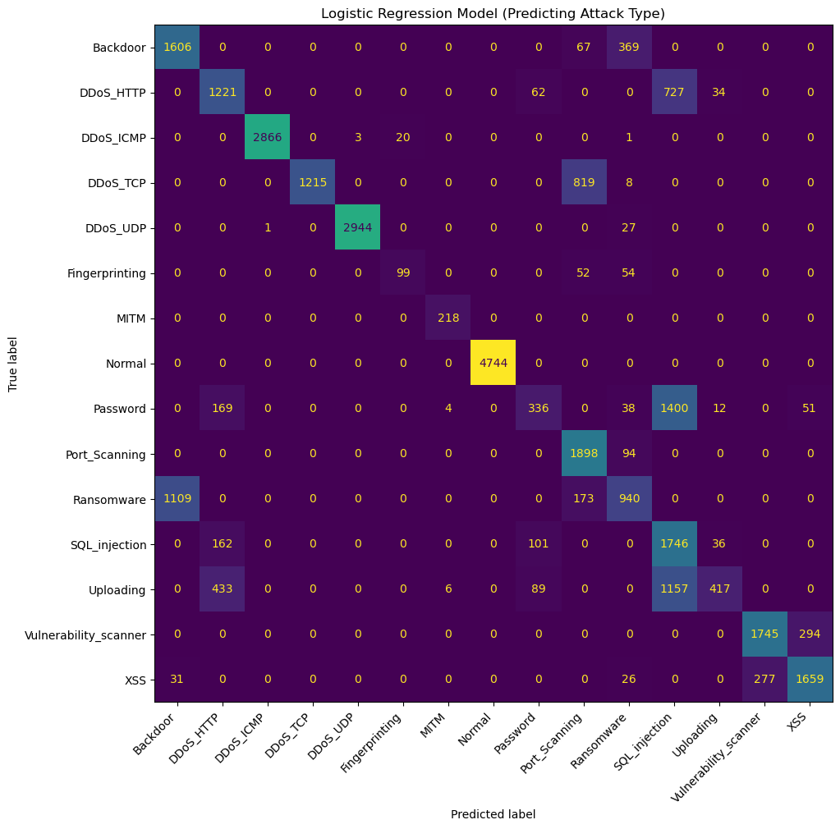
Logistic Regression
---- LR MODEL (NO SCALING) ---- Accuracy: 0.3748
---- LR MODEL (WITH SCALING) ---- Accuracy: 0.7495
Notes:
Tried changing a lot of settings had pretty much no effect
Added regularisation (L1 and L2), changed solver, changed C
Didn’t improve the model
Not exciting
Added Scaling with standard scaler, improved model massively

Slide 10
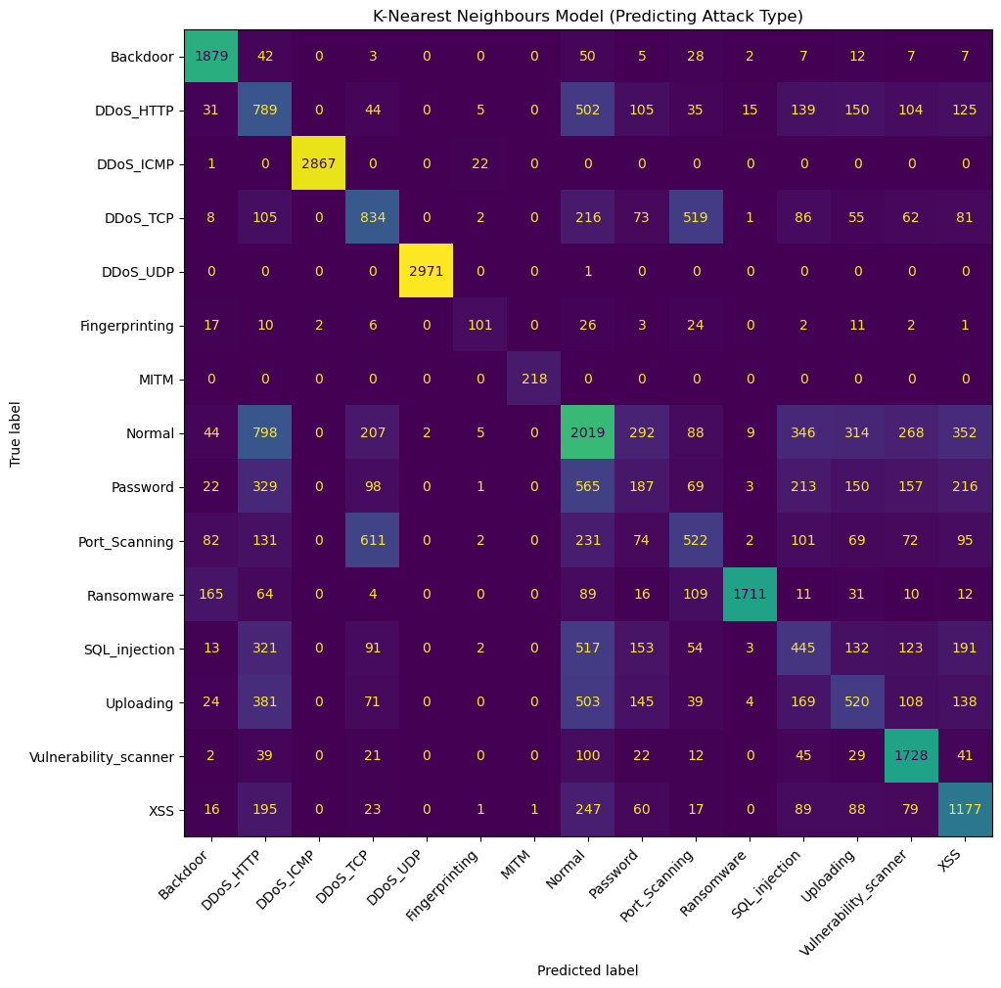
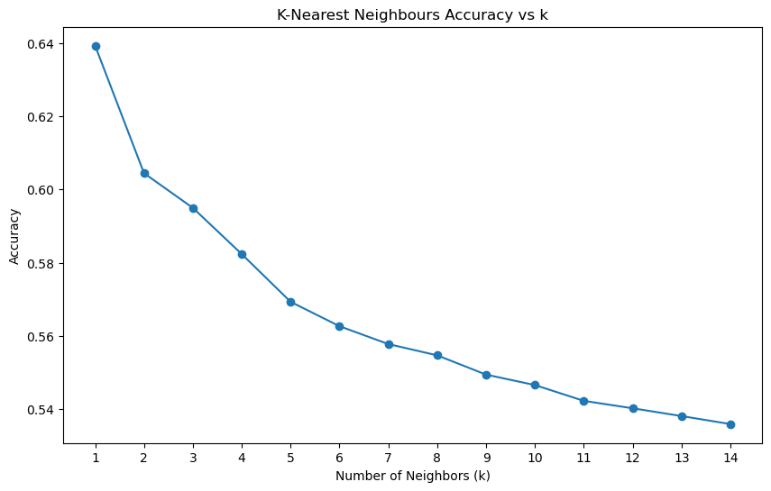
K-Nearest Neighbours (No Scaling)
---- KNN MODEL (NO SCALING) ---- Accuracy: 0.5693

Slide 11
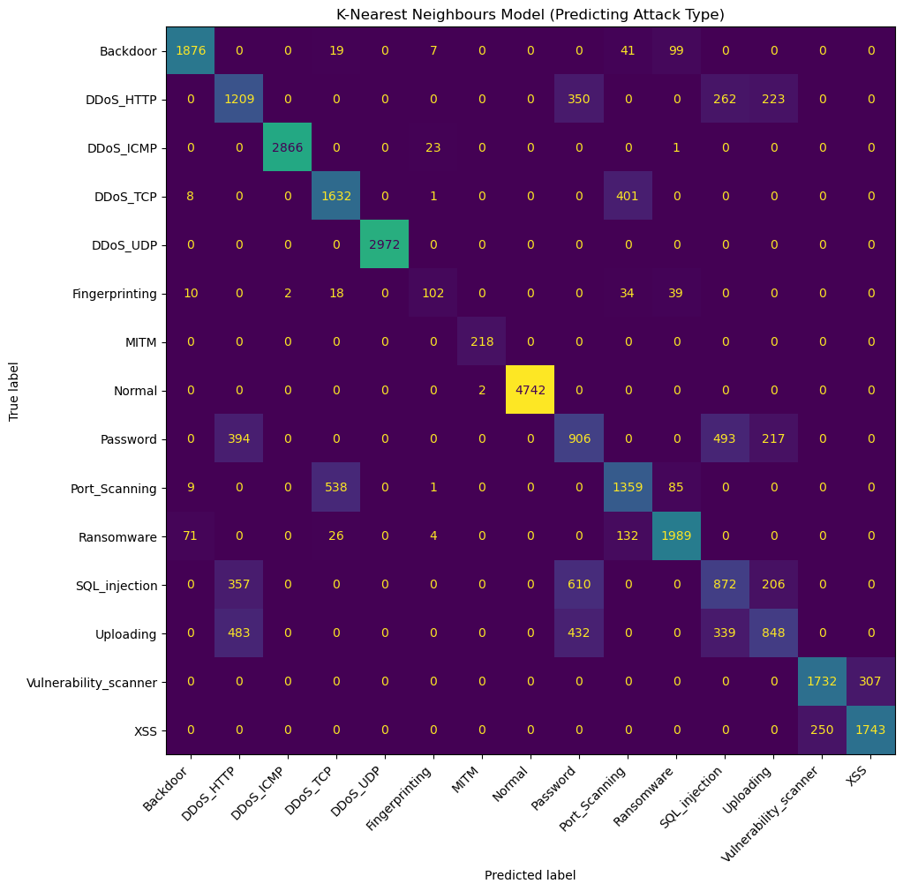
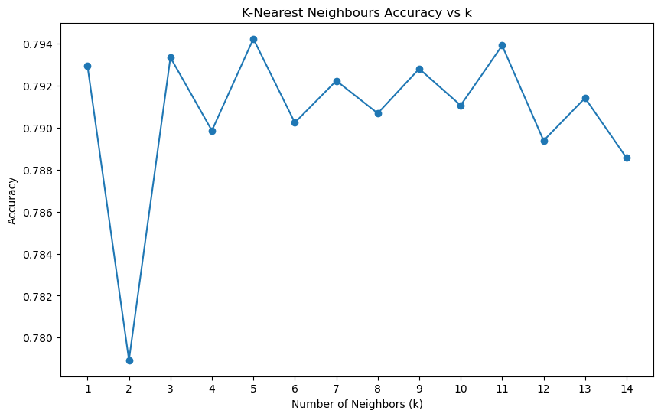
K-Nearest Neighbours (With Scaling)
---- KNN MODEL (WITH SCALING) ---- Accuracy: 0.7942

Slide 12

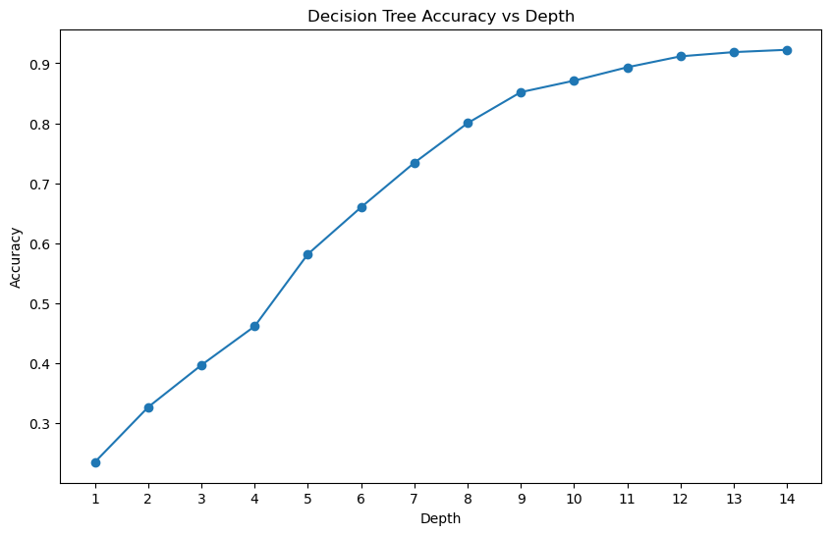
Decision Trees
---- DT MODEL (NO SCALING) ---- Accuracy: 0.9163
Notes:
Performed very well, as backed by the literature
Depth was able to be changed (tapered off at around 12)

Slide 13


Bagging and Boosting Decision Trees
Recall in the literature ([5]) it was reported that bagging and boosting was able to improve performance
---- Bagged DT (NO SCALING) ---- Accuracy: 0.9112
---- Boosted DT (NO SCALING) ---- Accuracy: 0.9212
Notes:
- Was slightly better although nothing really to note that much

Slide 14
Unsupervised Models (not as commonly explored)
Notes:
- For this we change the problem to classify attack or benign, using the ‘attack_label’ feature

Slide 15
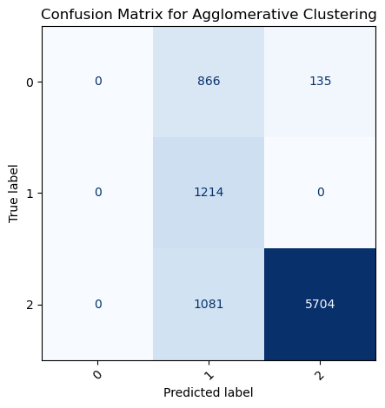
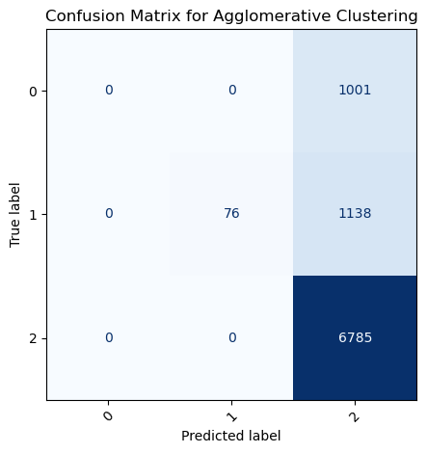
Agglomerative Clustering
--- Agglomerative --- Accuracy: 0.7623
ARI: 0.0390
Notes:
- No idea why there are 3 labels

Slide 16
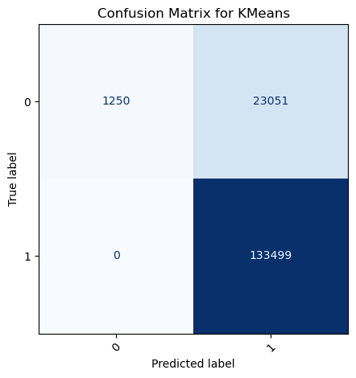
K-Means Clustering
--- K-Means --- Accuracy: 0.8539 ARI: 0.0694
Notes:
- trash

Slide 17
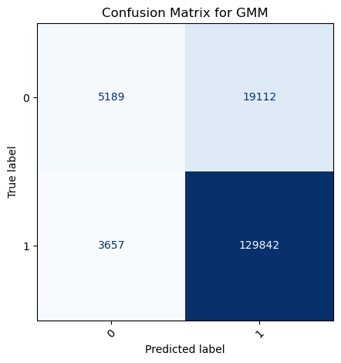
Gaussian Mixture Model
--- GMM --- Accuracy: 0.8557
ARI: 0.2066
Notes:
- trash

Slide 18
Dimensionality Reduction (to try and save the unsupervised dream)
Notes:
- For this we change the problem to classify attack or benign, using the ‘attack_label’ feature

Slide 19
Principal Component Analysis (PCA)
PCA has been known to sometimes improve accuracy of models, especially unsupervised models which can suffer from high dimensionality datasets
Studies [7] and [8] have demonstrated significant improvements to unsupervised models (especially GMM) after using PCA
PCA was conducted on the dataset to try and reduce dimensionality in order to potentially help the unsupervised models perform a bit better
Initially was set up to retain 95% variance (resulted in 23 principal components)
Trial and error with 90% variance, 10 PCs, 5PCs, 4PCs, 3PCs, 2PCs
Found 4 to be the sweet spot (specifically for one of the unsupervised models)

Slide 20
Agglomerative Clustering (slight improvement)
--- Agglomerative --- Accuracy: 0.7687
ARI: 0.4796
Notes:
- ARI went up which means it was labelling things better

Slide 21
K-Means Clustering (No Change)
--- K-Means --- Accuracy: 0.8539 ARI: 0.0694
Notes:
- No change at all

Slide 22
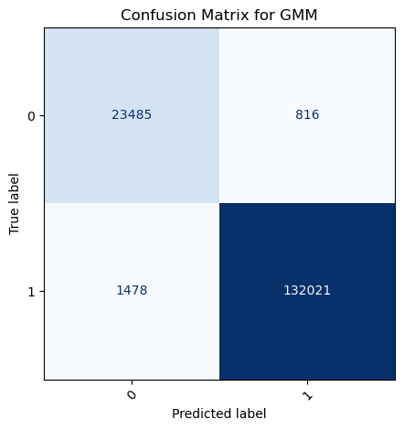
Gaussian Mixture Model (Massive Improvement)
--- GMM --- Accuracy: 0.9855
ARI: 0.9262
NMI: 0.8370
Notes:
- Finally got it to work!
Was quite sus of it since the accuracy seemed too good
Investigation showed that two features that caused it ‘mqtt.topic and mqtt.protoname’
Unsure why this occurred, those values weren’t anything hyper specific to the labelling
Paper also did not say anything about those values in particular
There is a higher correlation with those values with the target
Those values are strings like ‘temperature’ and ‘mqtt’
Have to conclude that im just GOATED

Slide 23
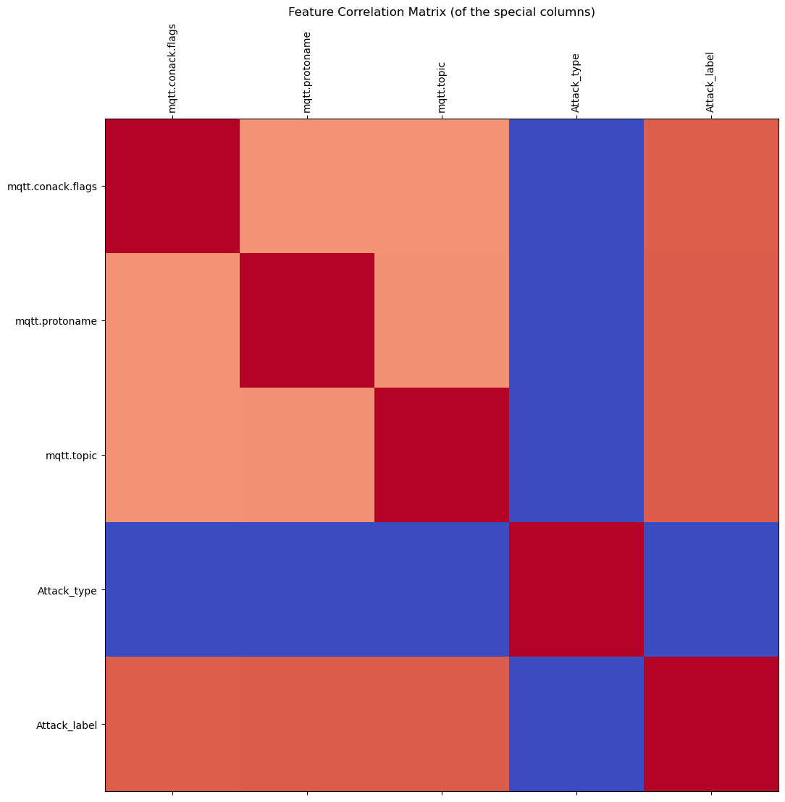
The Two Fields Responsible
0.878002
Two fields namely mqtt.prtoname and mqtt.topic were responsible for the change in GMM
When removing these the model performed much worse again (just as before PCA)
These fields are not completely mapped to the attack label so its strange
0.881600
0.881969
Unique in 'mqtt.conack.flags’: [0.0 '0.0' '0' '0x00000000’]
Unique values in 'mqtt.protoname’: [0.0 '0.0' '0' 'MQTT’]
Unique values in 'mqtt.topic’: [0.0 '0.0' '0' 'Temperature_and_Humidity']
0.878002
0.881600
0.881969
Notes:
There is another feature with similar correlation that didn't have the same effect
Finally got it to work!
Was quite sus of it since the accuracy seemed too good
Investigation showed that two features that caused it ‘mqtt.topic and mqtt.protoname’
Unsure why this occurred, those values weren’t anything hyper specific to the labelling
Paper also did not say anything about those values in particular
There is a higher correlation with those values with the target
Those values are strings like ‘temperature’ and ‘mqtt’
Have to conclude that im just GOATED

Slide 24
Neural Network (because why not)

Slide 25
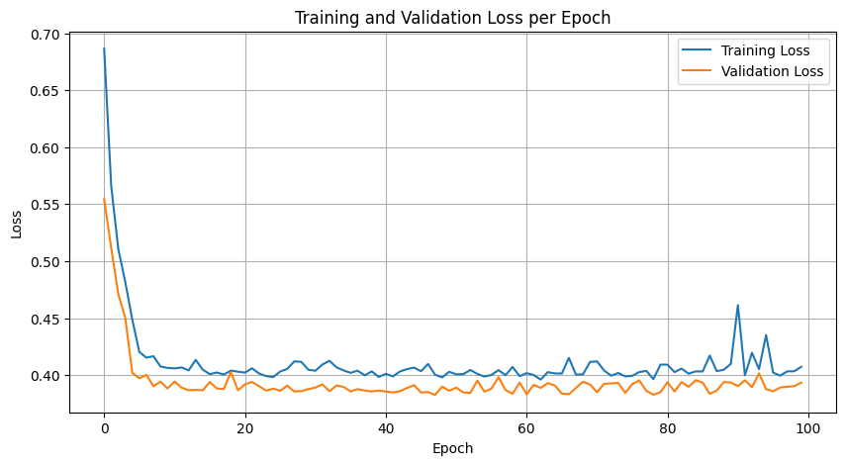
Multi-Layer Perceptron
Set up a simple MLP with initial parameters as follows:
2 hidden layers
Batch size 64
ReLU activation function
Cross entropy loss function
Adam optimiser
Learning rate 0.001
Achieved decent accuracy
Accuracy: 0.8117
Notes:
Seems to converge very quickly, lowered learning rate
Thought I could do better for accuracy by tuning hyperparameters a bit (didn’t have a LOT of time)

Slide 26
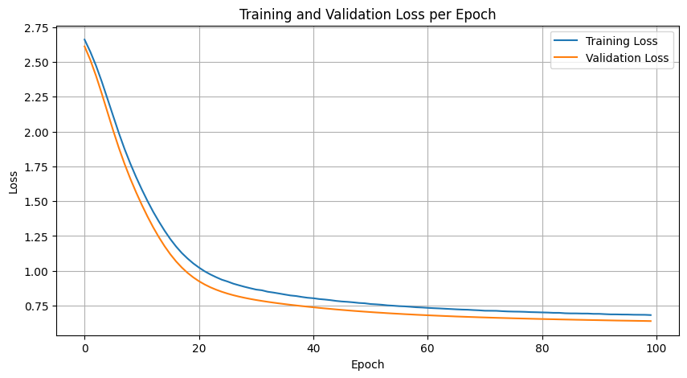
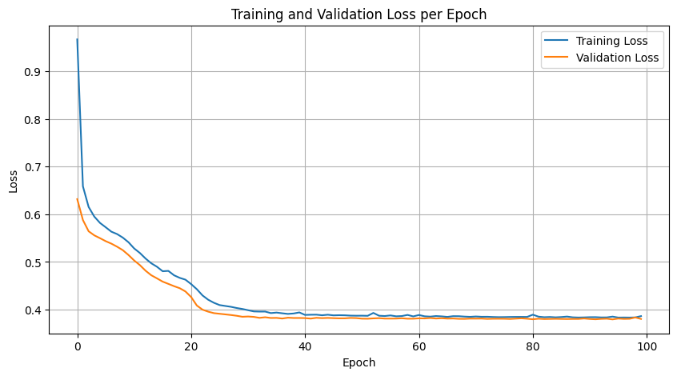
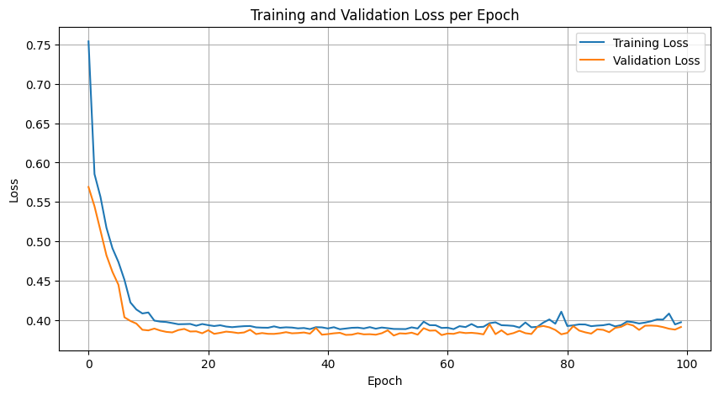
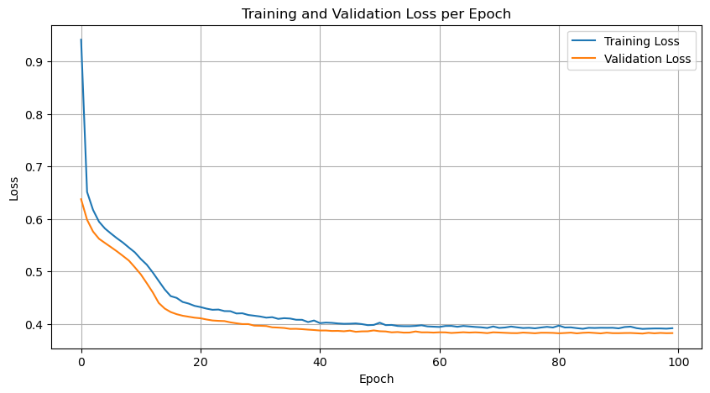
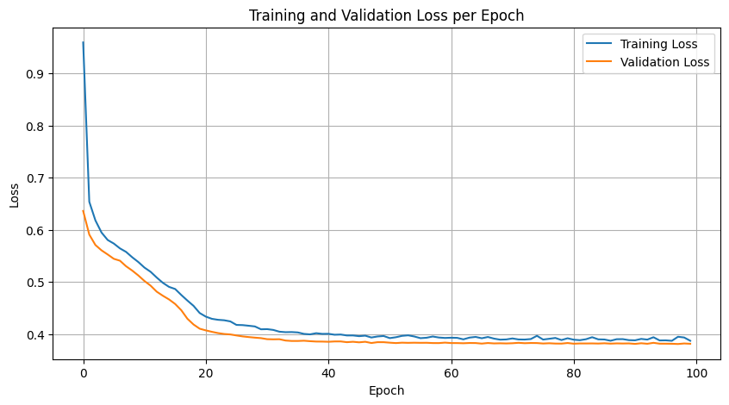
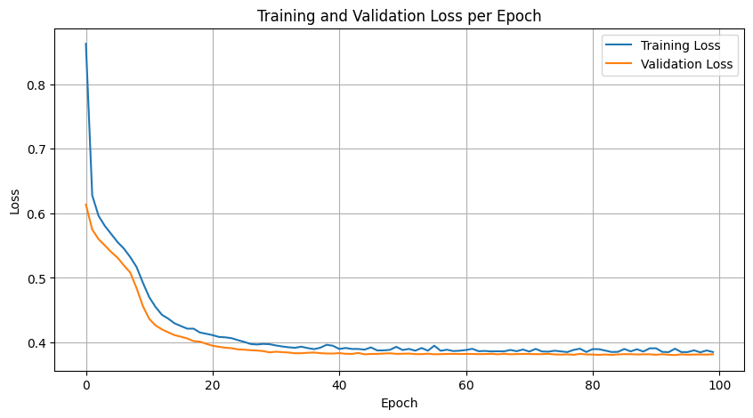
Testing Different Hyperparameters
LR: 0.0001
SGD Optimiser
LR: 0.0005
LR: 0.0005
One layer
Batch Size: 16
AdamW Optimiser
Notes:
- Didn’t get anything better than initial setup

Slide 27
Further Studies
Given more time I would have liked to investigate some things further
Attempt to improve the other unsupervised models, and attempt to investigate the GMM improvement further
Corroborate results with another similar dataset to make sure that the models trained are actually effective and generalisable
Conduct better hyperparameter tuning on the MLP, or perhaps attempt a different neural net configurations like AE-MLP which was conducted in study [10] for DDoS detection and yielded good results

Slide 28
[1] N. Moustafa, Marwa Keshky, Essam Debiez, and H. Janicke, “Federated TON_IoT Windows Datasets for Evaluating AI-Based Security Applications,” Dec. 2020, doi: https://doi.org/10.1109/trustcom50675.2020.00114.
[2] P. Newman, “THE INTERNET OF THINGS 2020: Here’s what over 400 IoT decision-makers say about the future of enterprise connectivity and how IoT companies can use it to grow revenue,” Business Insider, Mar. 06, 2020. https://www.businessinsider.com/internet-of-things-report
[3] M. A. Ferrag, O. Friha, D. Hamouda, L. Maglaras, and H. Janicke, “Edge-IIoTset: A New Comprehensive Realistic Cyber Security Dataset of IoT and IIoT Applications for Centralized and Federated Learning,” IEEE Access, vol. 10, pp. 1–1, 2022, doi: https://doi.org/10.1109/access.2022.3165809.
[4] Márton Bendegúz Bankó et al., “Advancements in Machine Learning-Based Intrusion Detection in IoT: Research Trends and Challenges,” Algorithms, vol. 18, no. 4, pp. 209–209, Apr. 2025, doi: https://doi.org/10.3390/a18040209.
[5] Y. Alotaibi and M. Ilyas, “Ensemble-Learning Framework for Intrusion Detection to Enhance Internet of Things’ Devices Security,” Sensors, vol. 23, no. 12, pp. 5568–5568, Jun. 2023, doi: https://doi.org/10.3390/s23125568.
[6] A. Alsaedi, N. Moustafa, Z. Tari, A. Mahmood, and A. Anwar, “TON_IoT Telemetry Dataset: A New Generation Dataset of IoT and IIoT for Data-driven Intrusion Detection Systems,” IEEE Access, vol. 8, pp. 1–1, 2020, doi: https://doi.org/10.1109/access.2020.3022862.
[7] D. Wang and Z. Ma, “Carbon meets credit: enhancing corporate ratings using principal component analysis and Gaussian mixture models,” Digital Economy and Sustainable Development, vol. 2, no. 1, Dec. 2024, doi: https://doi.org/10.1007/s44265-024-00048-z.
[8] W. Chen et al., “Geological identification using shield tunneling parameters based on four unsupervised clustering methods,” Tunnelling and Underground Space Technology, vol. 163, p. 106732, Sep. 2025, doi: https://doi.org/10.1016/j.tust.2025.106732.
[9] G. Shtar and S. Margel, “Clustering and Dimensionality Reduction: Understanding the ‘Magic’ Behind Machine Learning | Imperva,” Blog, Jul. 31, 2017. https://www.imperva.com/blog/clustering-and-dimensionality-reduction-understanding-the-magic-behind-machine-learning/
[10] Y. Wei, J. Jang-Jaccard, F. Sabrina, A. Singh, W. Xu, and S. Camtepe, “AE-MLP: A Hybrid Deep Learning Approach for DDoS Detection and Classification,” IEEE Access, vol. 9, pp. 146810–146821, 2021, doi: https://doi.org/10.1109/access.2021.3123791.

