Slide 1

United Kingdom – Fatal Accidents Prediction
Using Logical Regression
Springboard Data Science Project - By Murali Sankaran

Slide 2
Background and Motivation
In Great Britain, the Road Accident Data are collected by the Department for Transport and comprise road accident statistics collected from information about personal injury road accidents and their consequent casualties, to a common national standard.
The aim of collecting and publishing national road accident statistics is to inform public debate and to provide the basis for determining and monitoring effective road safety policies to reduce the road accident casualty toll. The UK Data Archive holds annual Road Accident Data from 1985 onwards. A similar series, the Northern Ireland Police Recorded Injury Road Traffic Collision Data, are available from 2004 onwards.

Slide 3
Background and Motivation
Most of the statistics are based on road accidents reported to the police (STATS19 system). These provide detailed statistics about the circumstances of personal injury road accidents, including the types of vehicles involved and the consequent casualties.
Other sources directly related to road safety are also used, including hospital admissions, death registrations, coroner’s reports, national travel survey, crime survey from England and Wales and statistics on breath tests and motoring offences from the Home Office and Ministry of Justice.

Slide 4
Data Collection
The data set files provide detailed data about the circumstances of personal injury road accidents in Great Britain from 2005 onwards, the types of vehicles involved and the consequential casualties. The statistics relate only to personal injury accidents on public roads that are reported to the police, and subsequently recorded, using the STATS19 accident reporting form. Information on damage-only accidents, with no human casualties or accidents on private roads or car parks are not included in this data.
The data for analysis (2005 to 2014) will be used from https://data.gov.uk/dataset/road-accidents-safety-data.

Slide 5

Data Set Features
Number of Rows available for Analysis : 1,640,597
Number of Variables in the data set: 16
Column Description | Data Type | Number of NAN values
Accident_Index | object
Location_Easting_OSGR | float64
Location_Northing_OSGR | float64
Longitude | float64
Latitude | float64
Accident_Severity | int64 | No NAN values
Number_of_Vehicles | int64 | No NAN Values
Number_of_Casualties | int64 | No NAN Values
Date | object | No NAN Values
Day_of_Week | int64 | No NAN Values
Time | object | No NAN Values
Speed_limit | int64 | No NAN Values
Light_Conditions | int64 | No NAN Values
Weather_Conditions | int64 | 161 out of 1.64M has NAN Values
Urban_or_Rural_Area | int64 | No NAN Values
LSOA_of_Accident_Location | object

Slide 6
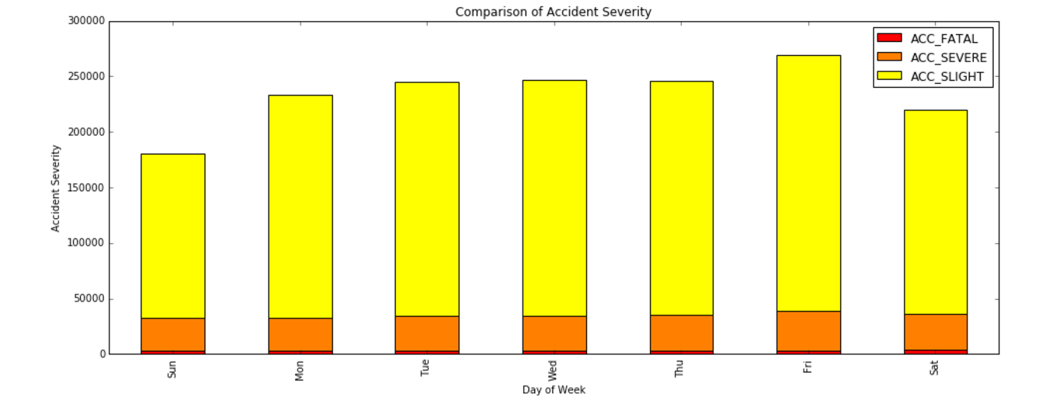
Exploratory Data Analysis
Number of accidents by Day of Week
Based on the above chart, we observe that
Most accidents are slight injuries and fatal accidents are at the minimum.
Friday seems to have more accidents and accidents are progressive starting Sunday.

Slide 7
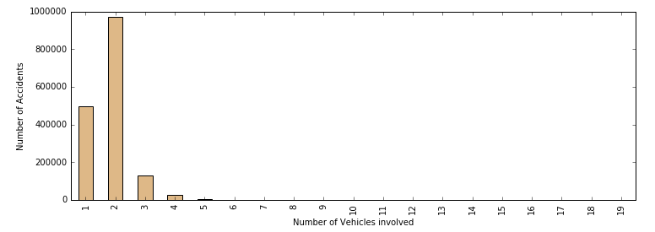
Exploratory Data Analysis
Number of accidents by Number of Vehicles Involved
Here we find that most accidents involve less than 4 vehicles.

Slide 8
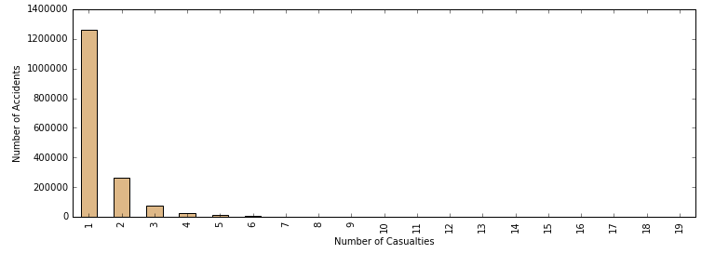
Exploratory Data Analysis
Number of accidents by Number of Casualties
Casualties are mostly one every accident.

Slide 9
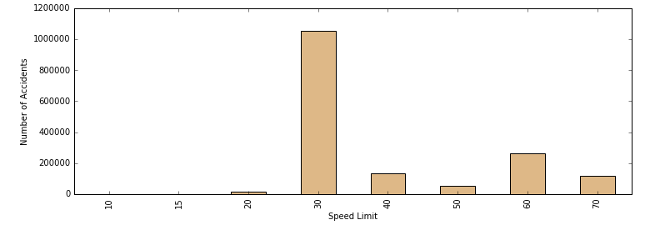
Exploratory Data Analysis
Number of accidents by Speed Limit
Accidents have mostly happened in 30 mile speed limit.

Slide 10
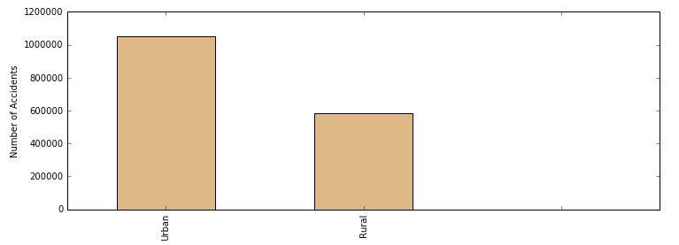
Exploratory Data Analysis
Number of accidents by Urban/Rural Area
Urban area seems to have more accidents compared to rural areas.

Slide 11
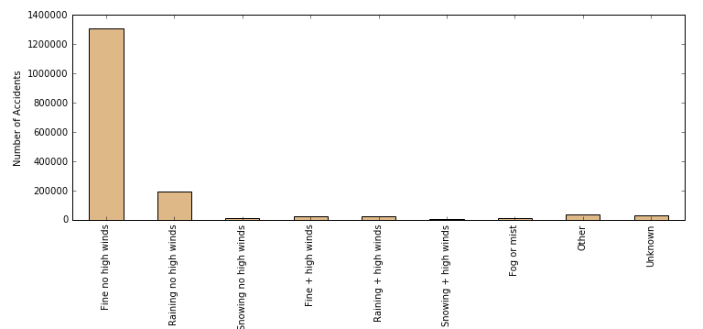
Exploratory Data Analysis
Number of accidents by Weather Conditions
Extreme weather conditions don’t seem to influence high number of accidents.

Slide 12
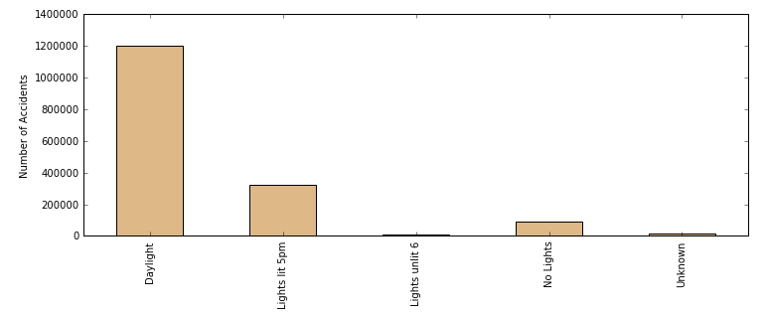
Exploratory Data Analysis
Number of accidents by Light Conditions
Daylight seems to be the culprit in most number of accidents.

Slide 13
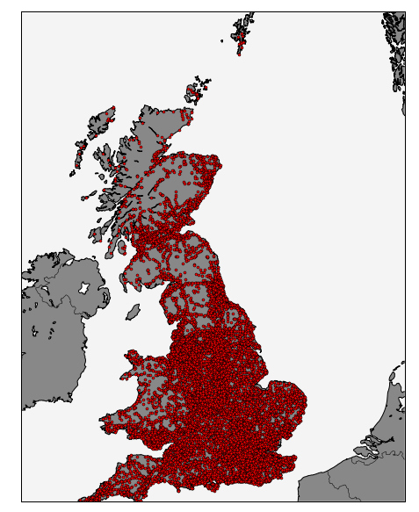
Distribution of Fatal Accidents
Year 2005 to 2014

Slide 14
Logistic Regression using StatsModels
Building a Prediction Model
It's time to go beyond the exploratory analysis and build a model for prediction. We need to look at all the available attributes in the data set and pick the variables that are potential candidates for the model.
After carefully checking the attributes, we pick the following:-
Day_of_Week
Number_of_Vehicles
Number_of_Casualties
Light_Conditions
Weather_Conditions
Urban_or_Rural_Area
Speed_Limit (will be utilised as a Dummy Variable)

Slide 15
Logistic Regression using StatsModels
Logit Regression Results
Dependent Variable | Observations | DF | Pseudo R-square
ACC_FATAL | 1,640,597 | 12 | 0.07134
Area under the ROC Curve: 0.740256
coef std.err z p>z [95.0% Conf. Int]
Intercept -3.1182 0.612 -5.094 0.000 -4.318 -1.918
Number of Vehicles -0.2187 0.010 -22.111 0.000 -0.238 -0.199 Number of Casualties 0.3193 0.005 60.426 0.000 0.309 0.330
Day of Week -0.0013 0.004 -0.380 0.704 -0.008 0.006 Light Conditions 0.1458 0.003 42.727 0.000 0.139 0.152 Weather Conditions -0.0808 0.005 -16.329 0.000 -0.090 -0.071 Urban or Rural Area 0.3778 0.021 17.655 0.000 0.336 0.420 Speed limit (20 kmph) -2.6164 0.619 -4.228 0.000 3.829 -1.404 Speed limit (30 kmph) -2.5370 0.611 -4.150 0.000 -3.735 -1.339 Speed limit (40 kmph) -1.9265 0.612 -3.150 0.002 -3.125 -0.728
Speed limit (50 kmph) -1.6528 0.612 -2.701 0.007 -2.852 -0.453
Speed limit (60 kmph) -1.4479 0.611 -2.368 0.018 -2.646 -0.250
Speed limit (70 kmph) -1.6748 0.612 -2.738 0.006 -2.874 -0.476

Slide 16
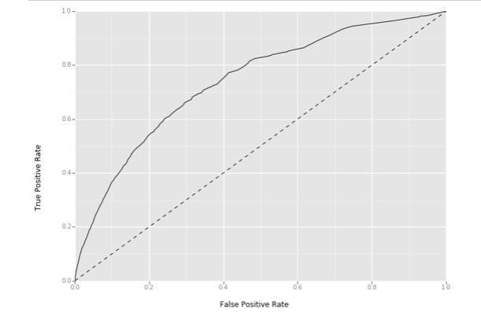
Logistic Regression using StatsModels
ROC Curve

Slide 17
Logistic Regression using StatsModels
Conclusion
We get a great overview of the coefficients of the model, how well those coefficients fit, the overall fit quality, and several other statistical measures.
We're very confident that there is an inverse relationship between the probability of a fatal accident and number of vehicles, weather conditions and speed limit.
However, number of casualties, light conditions and urban/rural area are directly affecting the fatality rate.

