Slide 1
Mikhail Kalmykov
DevOps School Diploma
https://github.com/mskalmykov/nhltop
© 2021 EPAM Systems, Inc.

Slide 2
Application architecture
Task
Use NHL API
Analyze last 3 seasons
Select All-Stars & Final game players
Show player info
Show final game statistics

Slide 3
Database schema

Slide 4
Infrastructure

Slide 5
GIT branching, CI/CD pipeline

Slide 6
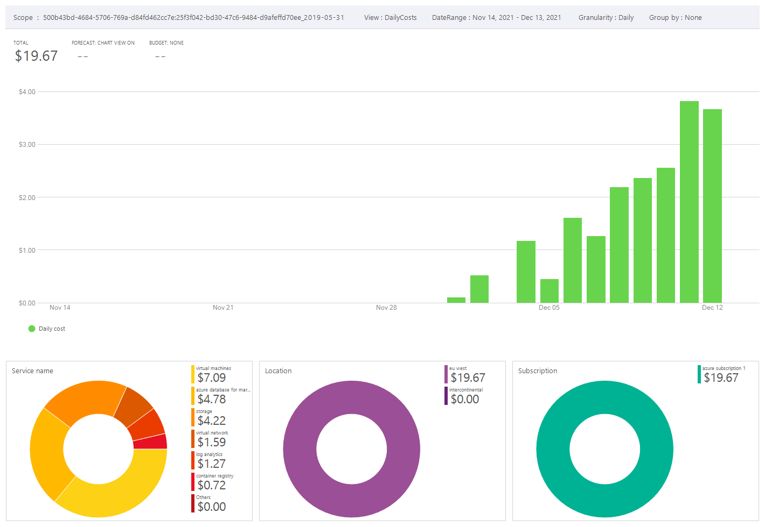
COSTS – AZURE

Slide 7
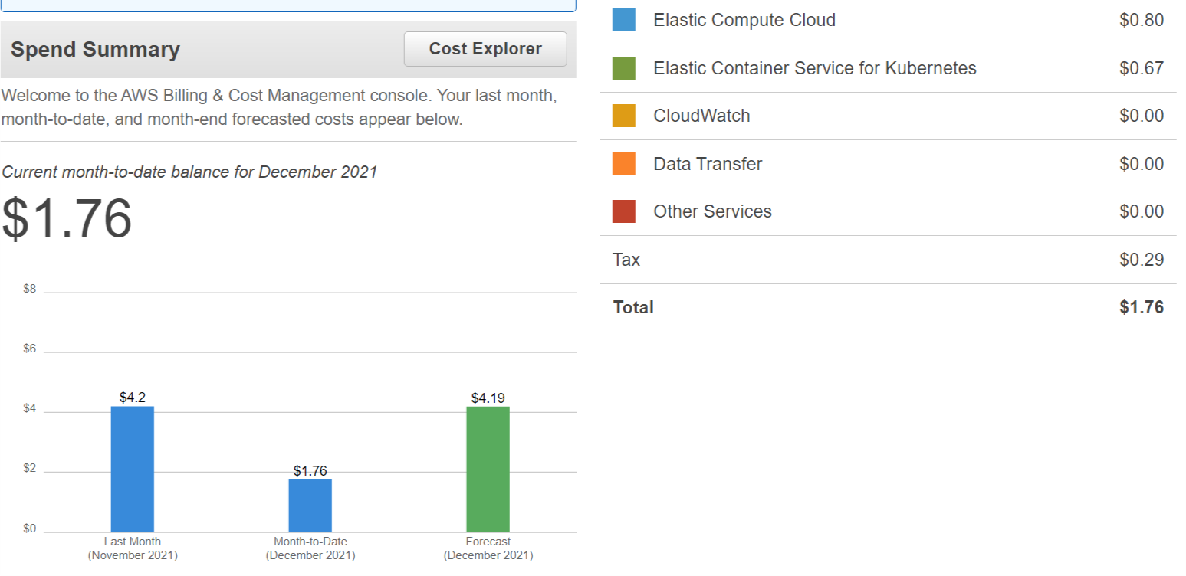
COSTS – AWS

Slide 8
LINKS
https://github.com/mskalmykov/nhltop - code repository
http://msk-epam-diploma-dev.westeurope.cloudapp.azure.com – dev. environment (Azure)
http://msk-epam-diploma-prod.westeurope.cloudapp.azure.com – prod. environment (Azure)
http://a2295b61bc0d64ed08f3058b4a60d4f0-527504591.eu-central-1.elb.amazonaws.com – dev (AWS)
http://a492d30ddcd5e4c37ab112d1383585bd-1162393560.eu-central-1.elb.amazonaws.com – prod (AWS)

