Slide 1
FHE TUTORIAL
Minsik Kang, KIAS CAINS
2026.06.29
PACOH Workshop

Slide 2
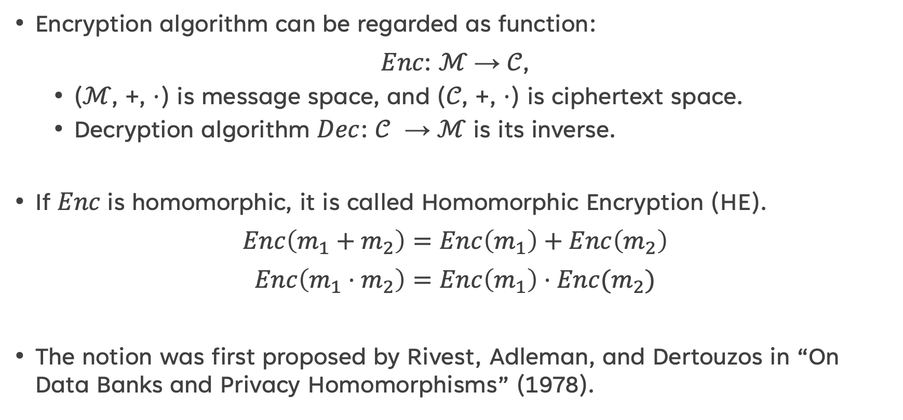
What is homomorphic encryption?
Encryption algorithm can be regarded as function:
𝐸𝑛𝑐: ℳ → 𝒞,
(ℳ, +, ⋅) is message space, and (𝒞, +, ⋅) is ciphertext space.
Decryption algorithm $Dec$: 𝒞 → ℳ is its inverse.
If 𝐸𝑛𝑐 is homomorphic, it is called Homomorphic Encryption (HE).
$Enc\left(m_{1}+m_{2}\right)=Enc\left(m_{1}\right)+Enc\left(m_{2}\right)$
$Enc\left(m_{1}⋅m_{2}\right)=Enc\left(m_{1}\right)⋅Enc(m_{2})$
The notion was first proposed by Rivest, Adleman, and Dertouzos in “On Data Banks and Privacy Homomorphisms” (1978).
[RAD78] Ronald L. Rivest, et al., On data banks and privacy homomorphisms, Foundations of Secure Computation, pages 165–179. Academic Press, 1978

Slide 3
History of FHE
Fully Homomorphic Encryption (FHE) supports arbitrary computations on encrypted data through bootstrapping.
FHE schemes are often grouped into generations as:
Gentry: first plausible FHE construction based on ideal lattices, 2009
BGV/BFV: exact modulo arithmetic over integers, 2011-2012
DM/CGGI: bitwise operation, Boolean circuits, 2016
CKKS: approximate arithmetic over real/complex numbers, 2017
Modern FHE schemes rely on hardness assumption of lattice problems, which are considered post-quantum secure.

Slide 4
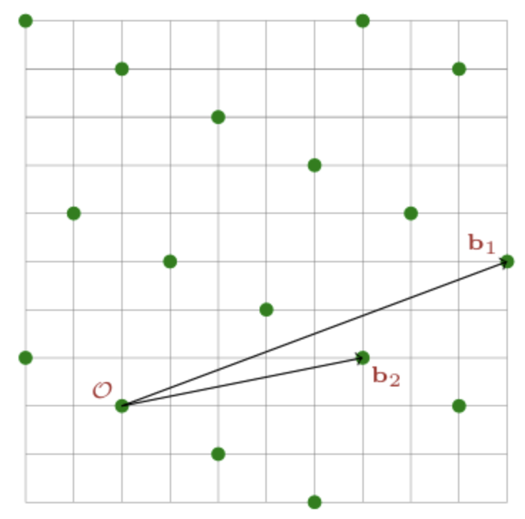
Lattice hard problem
A lattice $Λ$ is a discrete additive subgroup of $ℝ^{n}$.
Basis $B=\{b_{1},…,b_{n}\}$:
$Λ=ℤ⋅b_{1}+⋯+ℤ⋅b_{n}$
$λ_{1}(Λ)$: the length of the shortest nonzero vector in $Λ$.
Shortest Vector Problem (SVP):
Find a nonzero $v∈Λ$ such that $\left\|v\right\|=λ_{1}(Λ)$.
$SIVP_{γ}$: Find independent vectors $v_{i}∈Λ$ with $\left\|v_{i}\right\|≤γ⋅λ_{1}(Λ)$.
For $γ=poly(n)$, solving appears to require $2^{Ω(n)}$ time (and space).

Slide 5
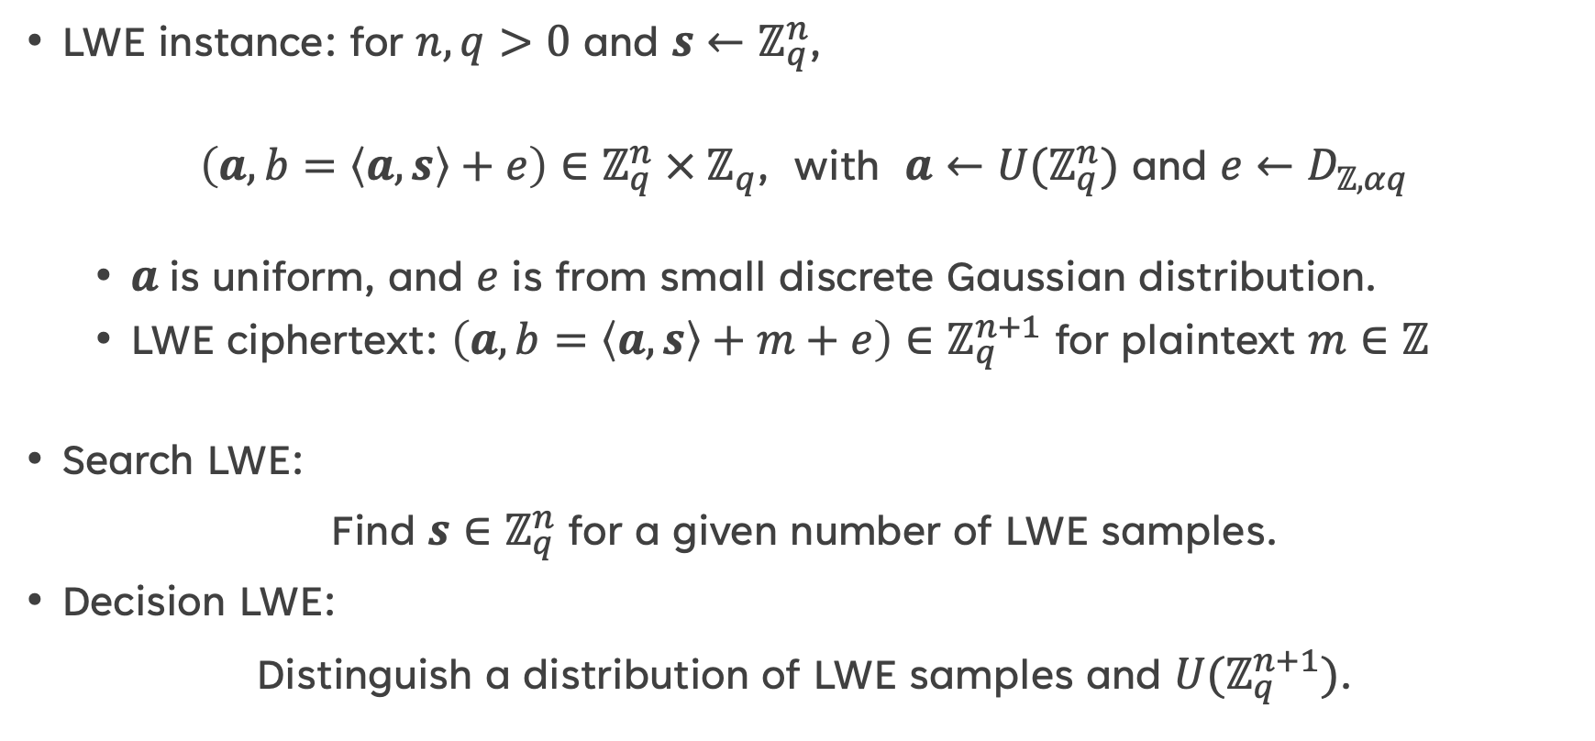
Learning with error (LWE)
LWE instance: for $n,q>0$ and $s←ℤ_{q}^{n}$,
$\left(a, b=\left\langle a,s\right\rangle +e\right)∈ℤ_{q}^{n} × ℤ_{q}$, with $a←{U(ℤ}_{q}^{n})$ and $e←D_{ℤ,αq}$
$a$is uniform, and $e$ is from small discrete Gaussian distribution.
LWE ciphertext: $\left(a, b=\left\langle a,s\right\rangle +m+e\right)∈ℤ_{q}^{n+1}$ for plaintext $m∈ℤ$
Search LWE:
Find $s∈ℤ_{q}^{n}$ for a given number of LWE samples.
Decision LWE:
Distinguish a distribution of LWE samples and $U(ℤ_{q}^{n+1})$.

Slide 6
Hardness of LWE problem
LWE is NP-hard problem with no efficient quantum algorithms.
Two main reductions for LWE:
Worst-case $(n/α$)-$SIVP$ ≤ Search LWE ≤ decision LWE
If you can distinguish LWE samples, then you can find the secret $s$.
If you can find $s$, then you can solve SVP for any $Λ$.
LWE-based crypto is IND-CPA secure:
Given ${\{m}_{0}, m_{1}\}$ and LWE ciphertext $\left(a, b=\left\langle a,s\right\rangle +m_{b}+e\right)$,
it is hard to determine whether $b=0$ or $1$.

Slide 7
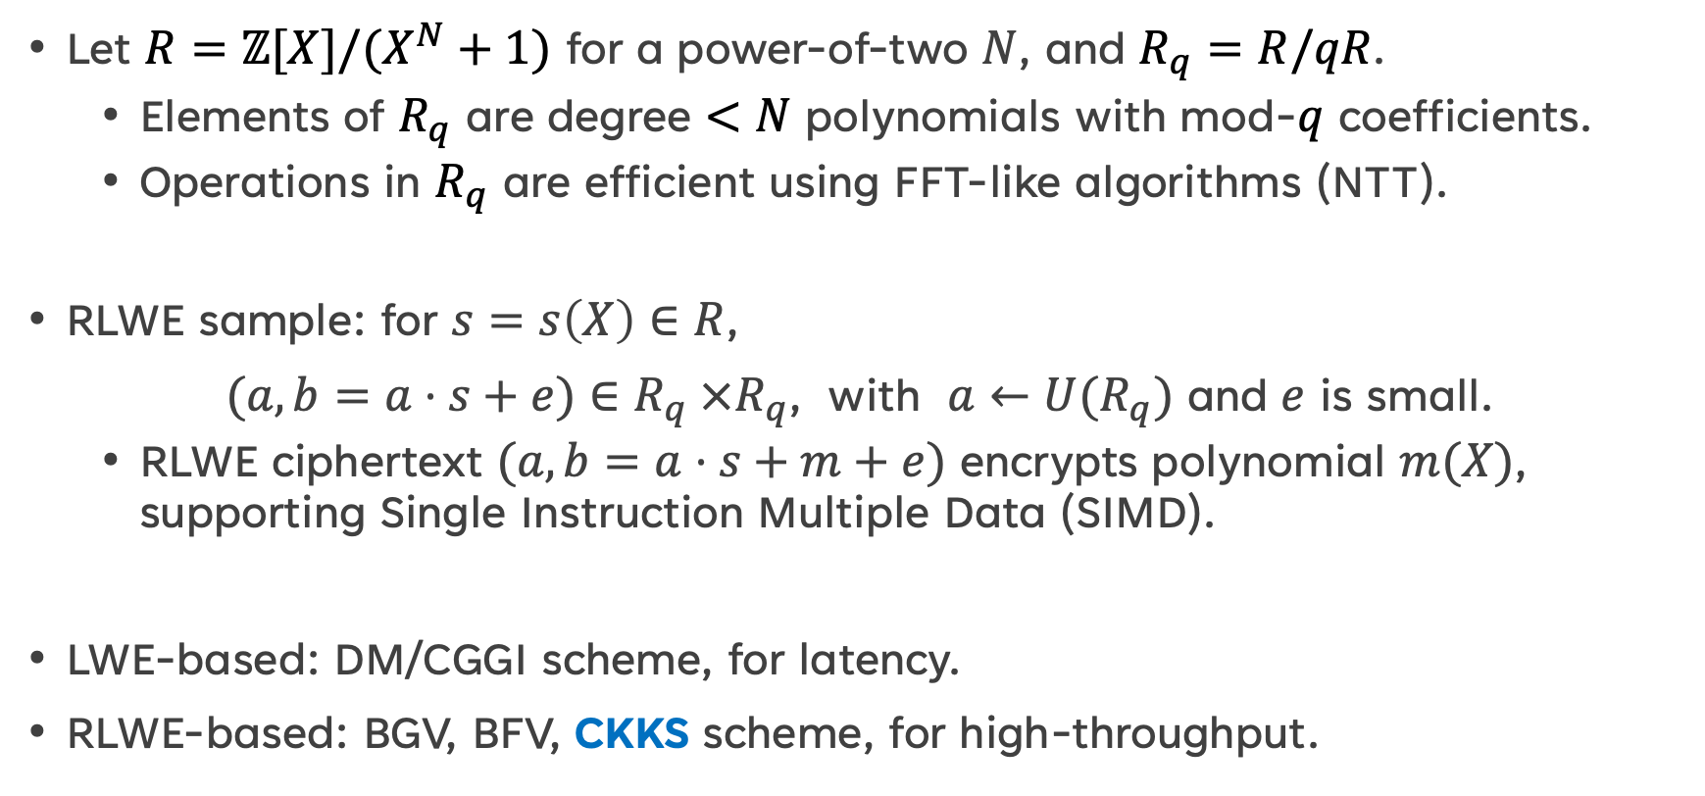
Ring learning with error (RLWE)
Let $R=ℤ[X]/(X^{N}+1)$ for a power-of-two $N$, and $R_{q}=R/qR$.
Elements of $R_{q}$ are degree $<N$ polynomials with mod-$q$ coefficients.
Operations in $R_{q}$ are efficient using FFT-like algorithms (NTT).
RLWE sample: for $s=s\left(X\right)∈R$,
$(a, b=a⋅s+e)∈R_{q} ×R_{q}$, with $a←U(R_{q})$ and $e$ is small.
RLWE ciphertext $(a, b=a⋅s+m+e)$ encrypts polynomial $m(X)$, supporting Single Instruction Multiple Data (SIMD).
LWE-based: DM/CGGI scheme, for latency.
RLWE-based: BGV, BFV, CKKS scheme, for high-throughput.

Slide 8
The CKKS FHE scheme
CKKS scheme is 4th generation FHE scheme proposed by Cheon-Kim-Kim-Song [CKKS17].
CKKS supports approximate computations on real/complex numbers.
CKKS is appropriate for machine learning and AI while preserving data confidentiality.
Message
Encode
Plaintext
Encrypt
Ciphertext
Decode
Decrypt

Slide 9
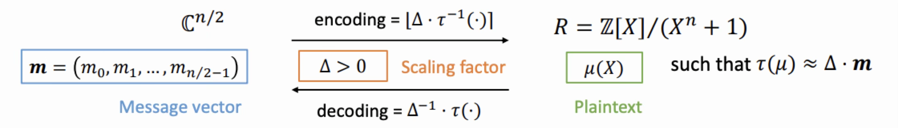
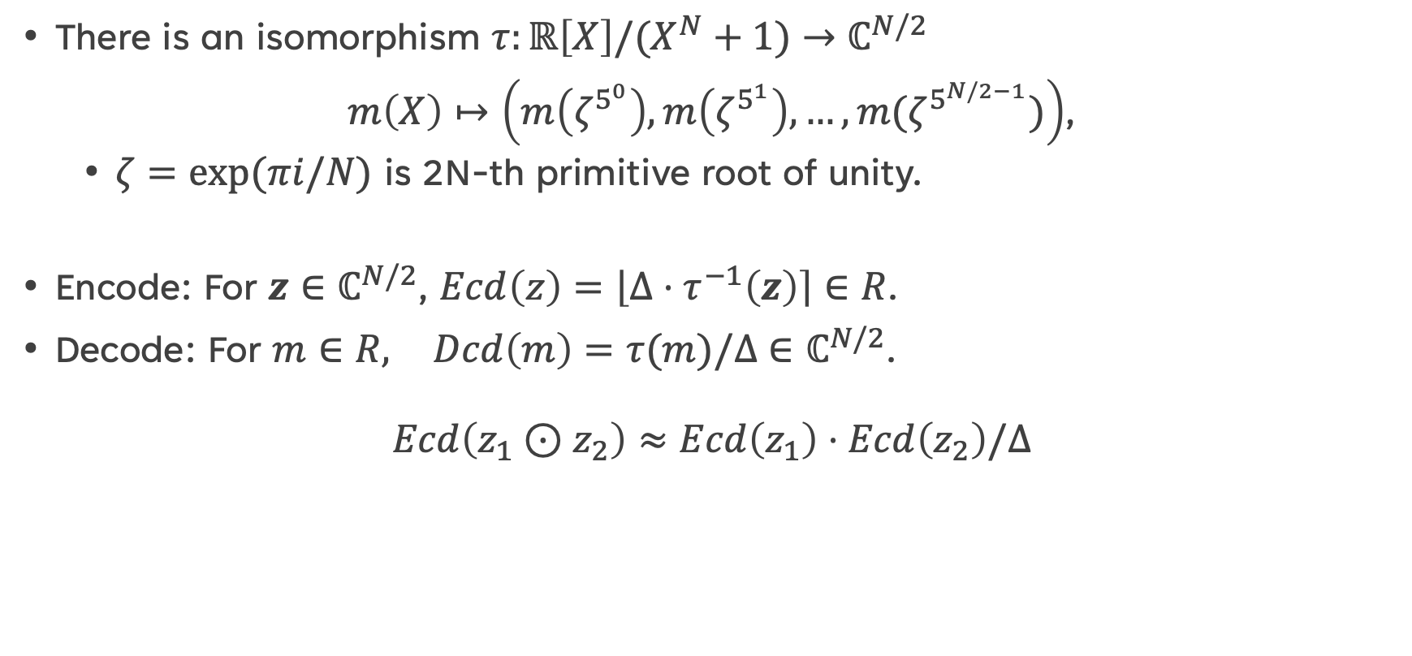
Encoding/Decoding
There is an isomorphism $τ:ℝ\left[X\right]/(X^{N}+1)$ $→$ $ℂ^{N/2}$
$m\left(X\right)↦\left(m\left(ζ^{5^{0}}\right),m\left(ζ^{5^{1}}\right),…,m(ζ^{5^{N/2−1}})\right)$,
$ζ=exp⁡(πi/N)$ is 2N-th primitive root of unity.
Encode: For $z∈ℂ^{N/2}$, $Ecd\left(z\right)=\left\lfloor Δ⋅τ^{−1}\left(z\right)\right\rceil ∈R$.
Decode: For $m∈R,$ $Dcd\left(m\right)=τ(m)/Δ$ $∈ℂ^{N/2}$.
$$Ecd\left(z_{1}⊙z_{2}\right)≈Ecd\left(z_{1}\right)⋅Ecd\left(z_{2}\right)/Δ$$

Slide 10
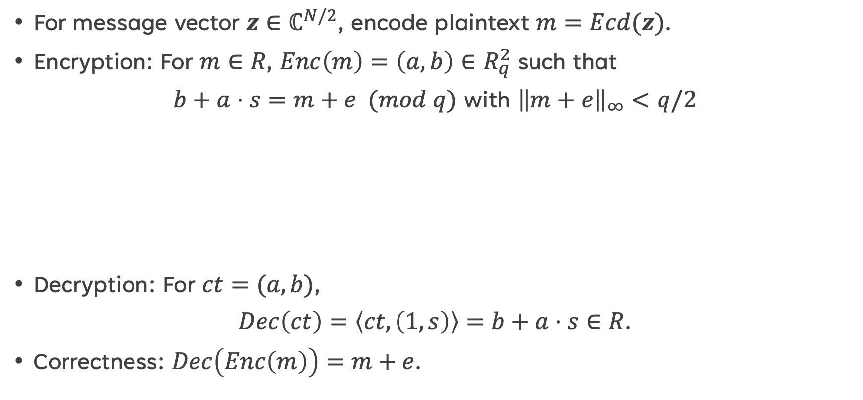
Encryption/Decryption
For message vector $z∈ℂ^{N/2}$, encode plaintext $m=Ecd(z)$.
Encryption: For $m∈R$, $Enc\left(m\right)=\left(a, b\right)∈R_{q}^{2}$ such that
$b+a⋅s=m+e (mod q)$ with ${\left\|m+e\right\|}_{∞}<q/2$
Decryption: For $ct=(a, b)$,
$Dec\left(ct\right)=\left\langle ct,\left(1,s\right)\right\rangle =b+a⋅s∈R$.
Correctness: $Dec\left(Enc\left(m\right)\right)=m+e$.
m
e
BFV/CKKS
e
m
BGV

Slide 11
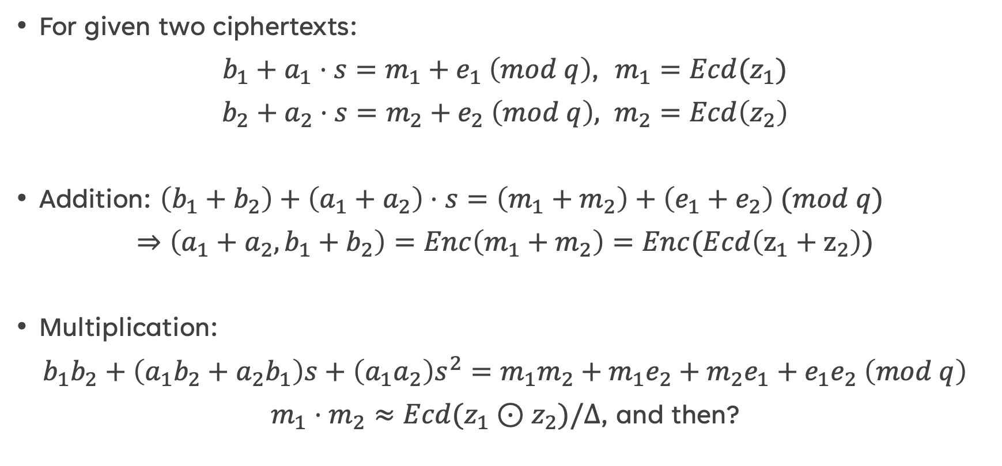
Homomorphic addition & Multiplication
For given two ciphertexts:
$b_{1}+a_{1}⋅s=m_{1}+e_{1} \left(mod q\right)$, $m_{1}=Ecd(z_{1})$
$b_{2}+a_{2}⋅s=m_{2}+e_{2} \left(mod q\right),$ $m_{2}=Ecd\left(z_{2}\right)$
Addition: $\left(b_{1}+b_{2}\right)+\left(a_{1}+a_{2}\right)⋅s=\left(m_{1}+m_{2}\right)+\left(e_{1}+e_{2}\right) (mod q)$
$⇒\left(a_{1}+a_{2},b_{1}+b_{2}\right)=Enc\left(m_{1}+m_{2}\right)=Enc(Ecd\left(z_{1}+z_{2}\right))$
Multiplication:
$b_{1}b_{2}+\left(a_{1}b_{2}+a_{2}b_{1}\right)s+\left(a_{1}a_{2}\right)s^{2}=m_{1}m_{2}+m_{1}e_{2}+m_{2}e_{1}+e_{1}e_{2} \left(mod q\right)$
$m_{1}⋅m_{2}≈Ecd(z_{1}⊙z_{2})/Δ$, and then?

Slide 12

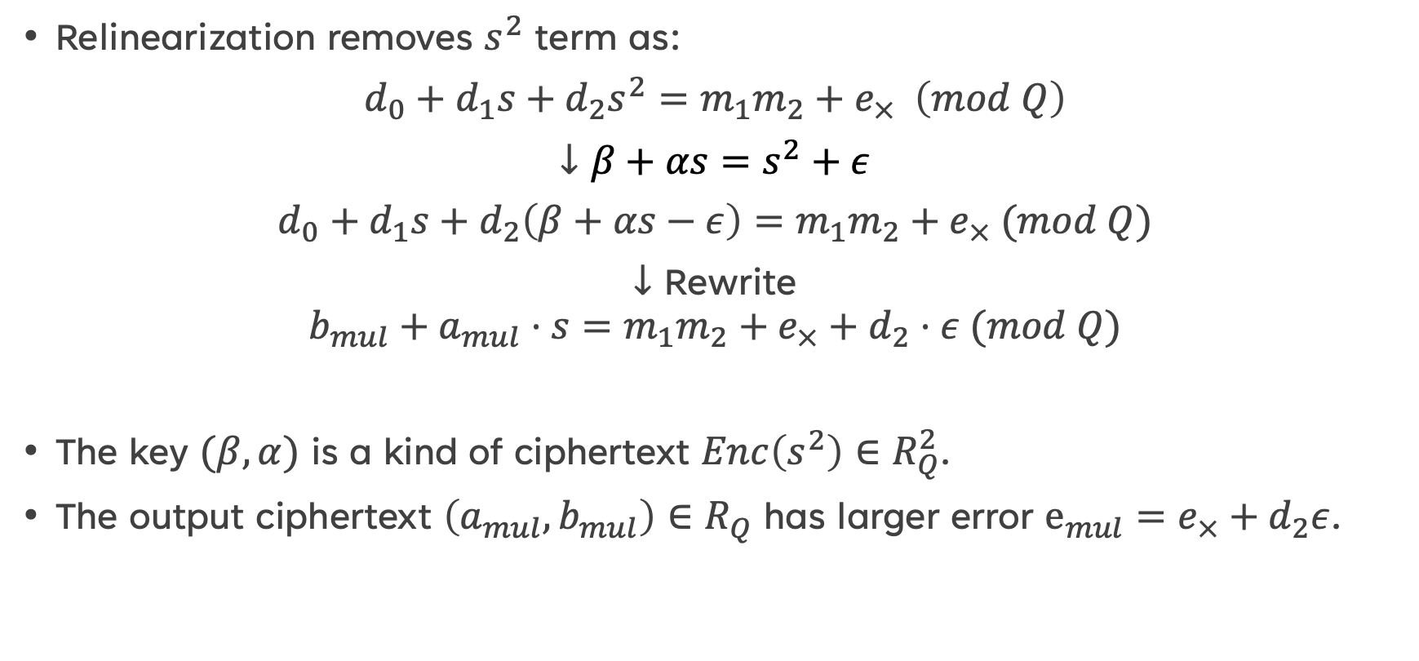

RElinearization
Relinearization removes $s^{2}$ term as:
$d_{0}+d_{1}s+d_{2}s^{2}=m_{1}m_{2}+e_{×} \left(mod Q\right)$
$↓β+αs=s^{2}+ε$
$d_{0}+d_{1}s+d_{2}\left(β+αs−ε\right)=m_{1}m_{2}+e_{×} (mod Q)$
$↓$ Rewrite
$$b_{mul}+a_{mul}⋅s=m_{1}m_{2}+e_{×}+d_{2}⋅ε (mod Q)$$
The key $(β, α)$ is a kind of ciphertext $Enc\left(s^{2}\right)∈R_{Q}^{2}$.
The output ciphertext $\left(a_{mul}, b_{mul}\right)∈R_{Q}$ has larger error $e_{mul}=e_{×}+d_{2}ε$.
$m_{1}m_{2}$
$$e_{mul}$$

Slide 13



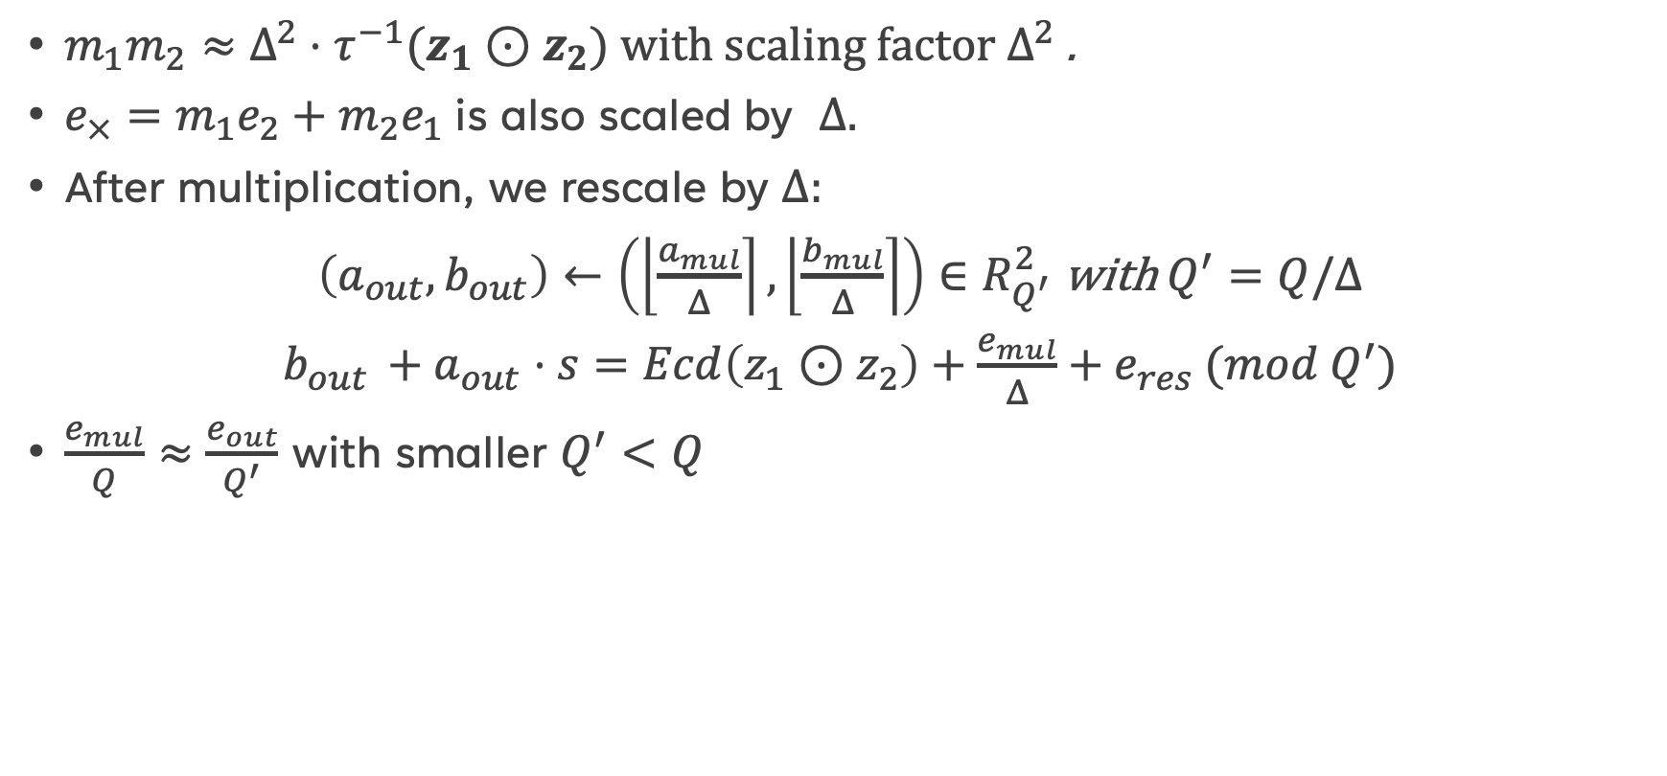



Rescale (modulus switching)
$m_{1}m_{2}≈Δ^{2}⋅τ^{−1}(z_{1}⊙z_{2})$ with scaling factor $Δ^{2}$ .
$e_{×}=m_{1}e_{2}+m_{2}e_{1}$ is also scaled by $Δ.$
After multiplication, we rescale by $Δ$:
$\left(a_{out}, b_{out}\right)←\left(\left\lfloor \frac{a_{mul}}{Δ}\right\rceil , \left\lfloor \frac{b_{mul}}{Δ}\right\rceil \right)∈R_{Q^{′}}^{2}$ with $Q^{′}=Q/Δ$
$b_{out }+a_{out}⋅s=Ecd\left(z_{1}⊙z_{2}\right)+\frac{e_{mul}}{Δ}+e_{res} (mod Q^{′})$
$\frac{e_{mul}}{Q}≈\frac{e_{out}}{Q^{′}}$ with smaller $Q^{′}<Q$
$Δ^{2}⋅z_{1}⊙z_{2}$
$$e_{mul}$$
$$Q$$
$${Δ⋅z}_{1}{⊙z}_{2}$$
$$e_{out}$$
$$Q^{′}≈Q/Δ$$

Slide 14
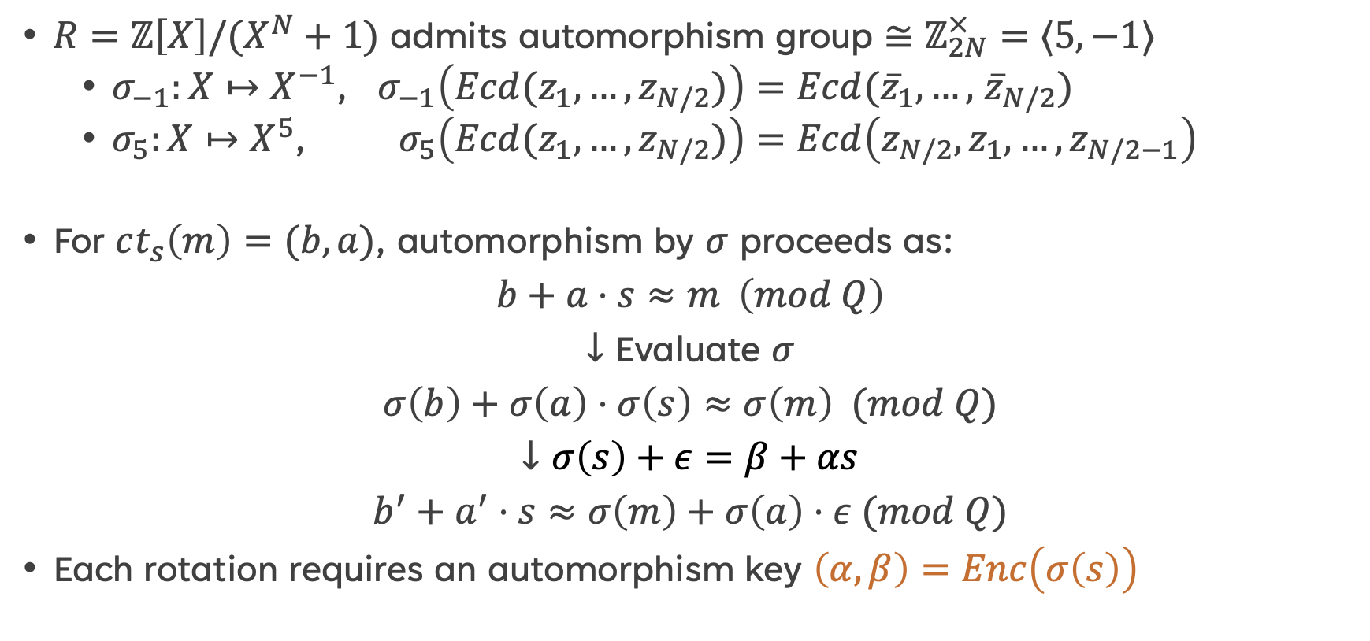
Homomorphic Automorphism
$R=ℤ\left[X\right]/(X^{N}+1)$ admits automorphism group $≅ℤ_{2N}^{×}=⟨5, −1⟩$
$σ_{−1}:X↦X^{−1}$, $σ_{−1}\left({Ecd(z}_{1},…,z_{N/2})\right)=Ecd({\overline{z}}_{1},…,$ ${\overline{z}}_{N/2})$
$σ_{5}:X↦X^{5}\text{,}$ $σ_{5}\left({Ecd(z}_{1},…,z_{N/2})\right)=Ecd\left(z_{N/2},z_{1},…,z_{N/2−1}\right)$
For $ct_{s}\left(m\right)=(b, a)$, automorphism by $σ$ proceeds as:
$b+a⋅s≈m \left(mod Q\right)$
$↓$ Evaluate $σ$
$σ\left(b\right)+σ\left(a\right)⋅σ\left(s\right)≈σ\left(m\right) (mod Q)$
$↓σ\left(s\right)+ε=β+αs$
$b^{′}+a^{′}⋅s≈σ\left(m\right)+σ\left(a\right)⋅ε (mod Q)$
Each rotation requires an automorphism key $\left(α,β\right)=Enc\left(σ\left(s\right)\right)$

Slide 15
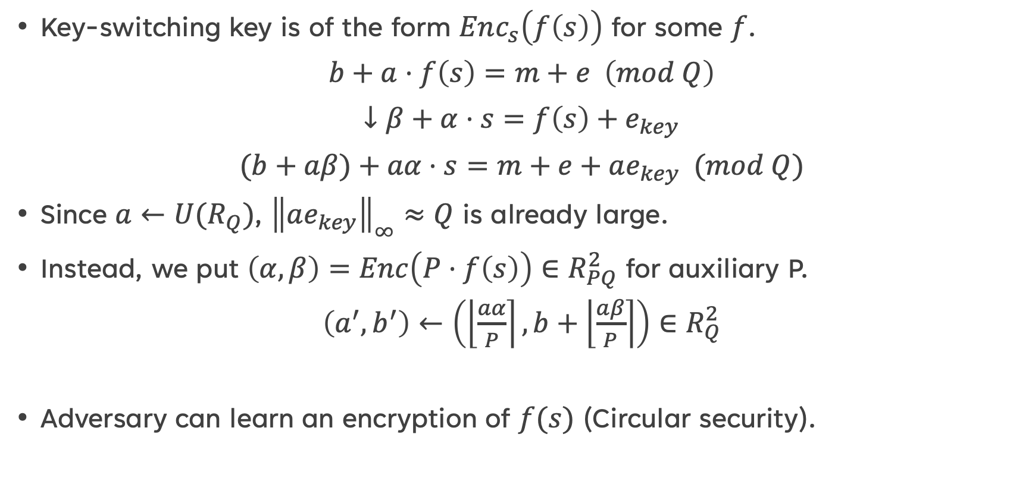
Key-switching operation
Key-switching key is of the form $Enc_{s}\left(f\left(s\right)\right)$ for some $f$.
$b+a⋅f\left(s\right)=m+e \left(mod Q\right)$
$↓$ $β+α⋅s=f\left(s\right)+e_{key}$
$(b+aβ)+aα⋅s=m+e+ae_{key} (mod Q)$
Since $a←U(R_{Q})$, ${\left\|ae_{key}\right\|}_{∞}≈Q$ is already large.
Instead, we put $\left(α,β\right)=Enc\left(P⋅f\left(s\right)\right)∈R_{PQ}^{2}$ for auxiliary P.
$\left(a^{′}, b^{′}\right)←\left(\left\lfloor \frac{aα}{P}\right\rceil ,b+\left\lfloor \frac{aβ}{P}\right\rceil \right)∈R_{Q}^{2}$
Adversary can learn an encryption of $f(s)$ (Circular security).

Slide 16

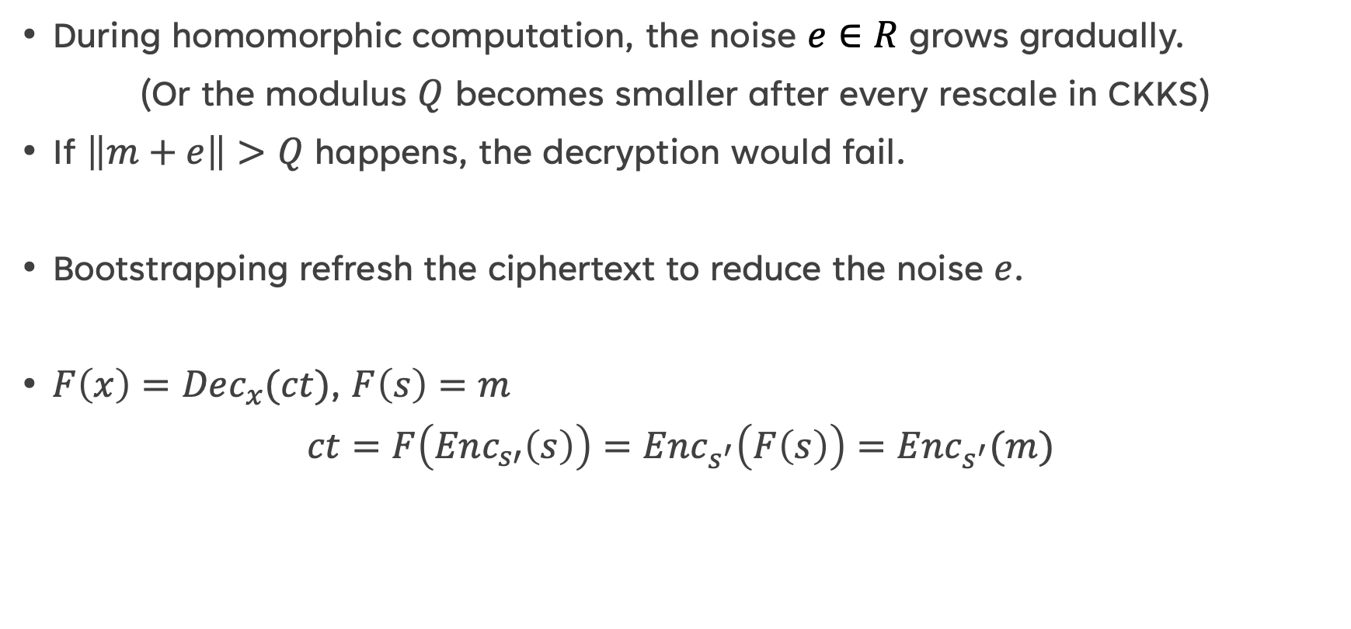


bootstrapping
During homomorphic computation, the noise $e∈R$ grows gradually.
(Or the modulus $Q$ becomes smaller after every rescale in CKKS)
If $\left\|m+e\right\|>Q$ happens, the decryption would fail.
Bootstrapping refresh the ciphertext to reduce the noise $e$.
$F\left(x\right)=Dec_{x}(ct)$, $F\left(s\right)=m$
$ct=F\left(Enc_{s′}\left(s\right)\right)=Enc_{s^{′}}\left(F\left(s\right)\right)=Enc_{s^{′}}(m)$
$$ct=Enc_{s}(m)$$
Hom.Enc
$$Enc_{s^{′}}(ct)$$
Hom.Dec
$$Enc_{s^{′}}(Dec_{s}\left(ct\right)=m)$$

Slide 17
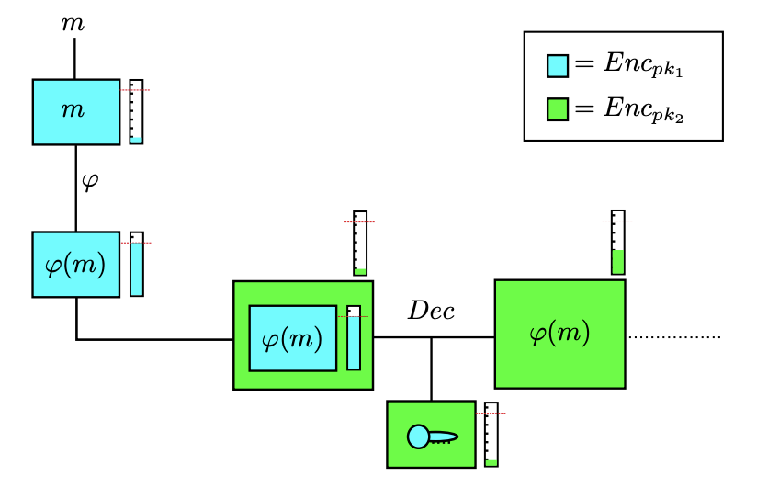
Outline for Bootstrapping
Recrypt

Slide 18
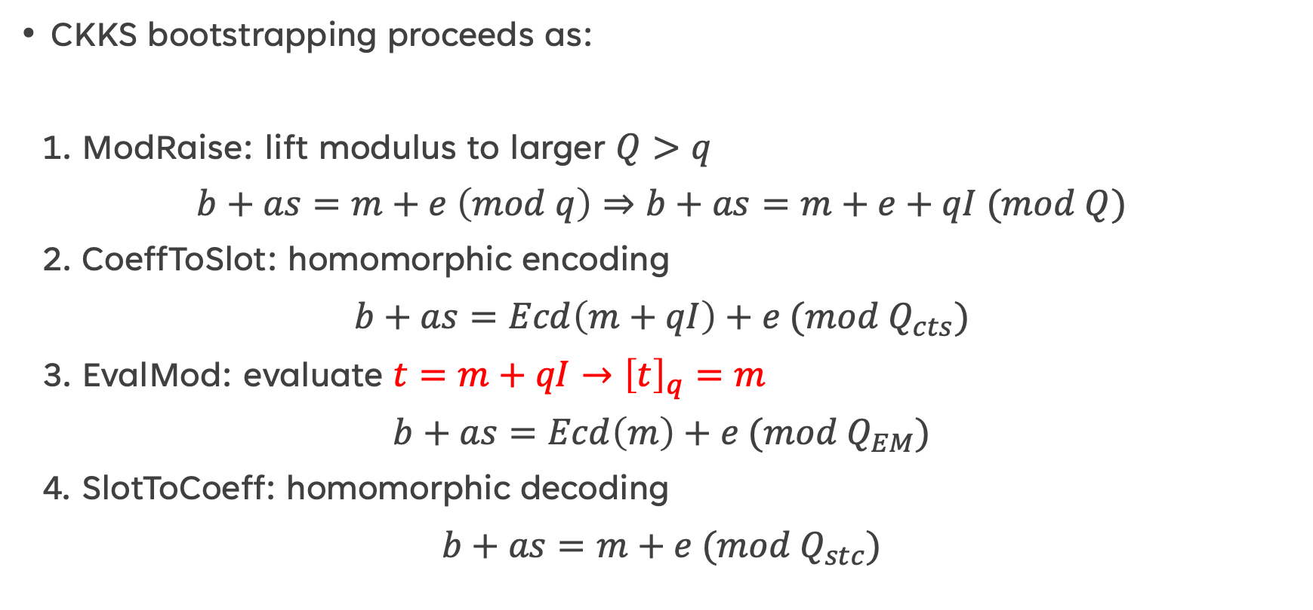
CKKS bootstrapping
CKKS bootstrapping proceeds as:
1. ModRaise: lift modulus to larger $Q>q$
$b+as=m+e \left(mod q\right)⇒b+as=m+e+qI (mod Q)$
2. CoeffToSlot: homomorphic encoding
$b+as=Ecd\left(m+qI\right)+e (mod Q_{cts})$
3. EvalMod: evaluate $t=m+qI→{\left[t\right]}_{q}=m$
$b+as=Ecd\left(m\right)+e (mod Q_{EM})$
4. SlotToCoeff: homomorphic decoding
$b+as=m+e (mod Q_{stc})$

Slide 19
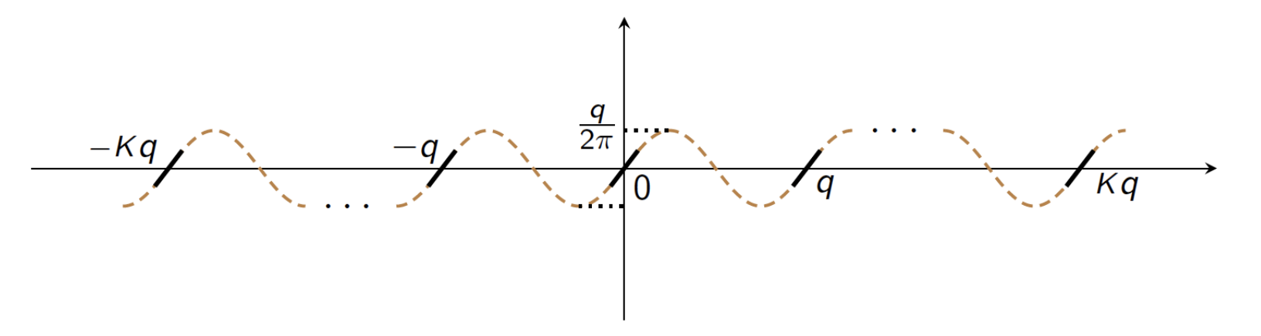
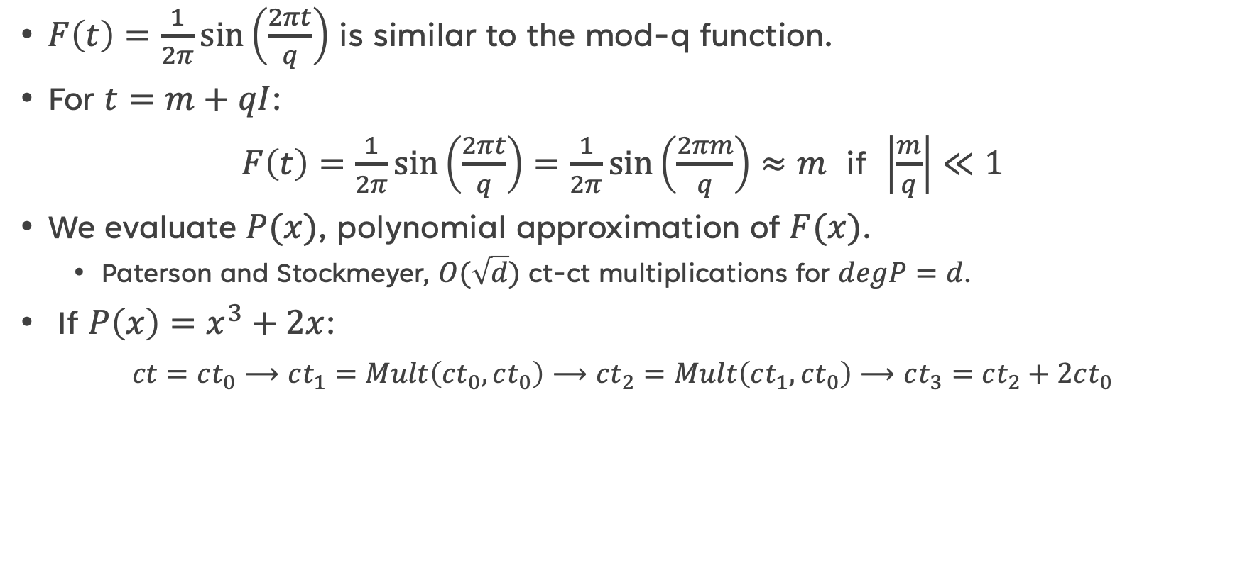
EvalMod: homomorphic sine function
$F\left(t\right)=\frac{1}{2π}\sin\left(\frac{2πt}{q}\right)$ is similar to the mod-q function.
For $t=m+qI$:
$F\left(t\right)=\frac{1}{2π}\sin\left(\frac{2πt}{q}\right)=\frac{1}{2π}\sin\left(\frac{2πm}{q}\right)≈m$ if $\left|\frac{m}{q}\right|≪1$
We evaluate $P(x)$, polynomial approximation of $F(x)$.
Paterson and Stockmeyer, $O(\sqrt{d})$ ct-ct multiplications for $degP=d$.
If $P\left(x\right)=x^{3}+2x$:
$ct=ct_{0}⟶ct_{1}=Mult\left(ct_{0},ct_{0}\right)⟶ct_{2}=Mult\left(ct_{1},ct_{0}\right)⟶ct_{3}=ct_{2}+2ct_{0}$

Slide 20
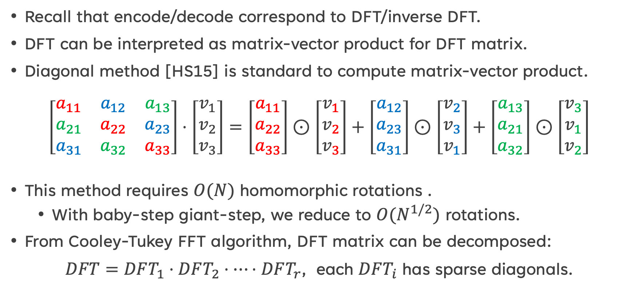
Homomorphic matrix-vector product
Recall that encode/decode correspond to DFT/inverse DFT.
DFT can be interpreted as matrix-vector product for DFT matrix.
Diagonal method [HS15] is standard to compute matrix-vector product.
$$\left[\begin{matrix}a_{11} & a_{12} & a_{13} \\ a_{21} & a_{22} & a_{23} \\ a_{31} & a_{32} & a_{33}\end{matrix}\right]⋅\left[\begin{matrix}v_{1} \\ v_{2} \\ v_{3}\end{matrix}\right]=\left[\begin{matrix}a_{11} \\ a_{22} \\ a_{33}\end{matrix}\right]⊙\left[\begin{matrix}v_{1} \\ v_{2} \\ v_{3}\end{matrix}\right]+\left[\begin{matrix}a_{12} \\ a_{23} \\ a_{31}\end{matrix}\right]⊙\left[\begin{matrix}v_{2} \\ v_{3} \\ v_{1}\end{matrix}\right]+\left[\begin{matrix}a_{13} \\ a_{21} \\ a_{32}\end{matrix}\right]⊙\left[\begin{matrix}v_{3} \\ v_{1} \\ v_{2}\end{matrix}\right]$$
This method requires $O(N)$ homomorphic rotations .
With baby-step giant-step, we reduce to $O(N^{1/2})$ rotations.
From Cooley-Tukey FFT algorithm, DFT matrix can be decomposed:
$DFT=DFT_{1}⋅DFT_{2}⋅⋯⋅DFT_{r}$, each $DFT_{i}$ has sparse diagonals.
[HS15] S. Halevi and V. Shoup, Bootstrapping for HElib, Eurocrypt 2015.

Slide 21
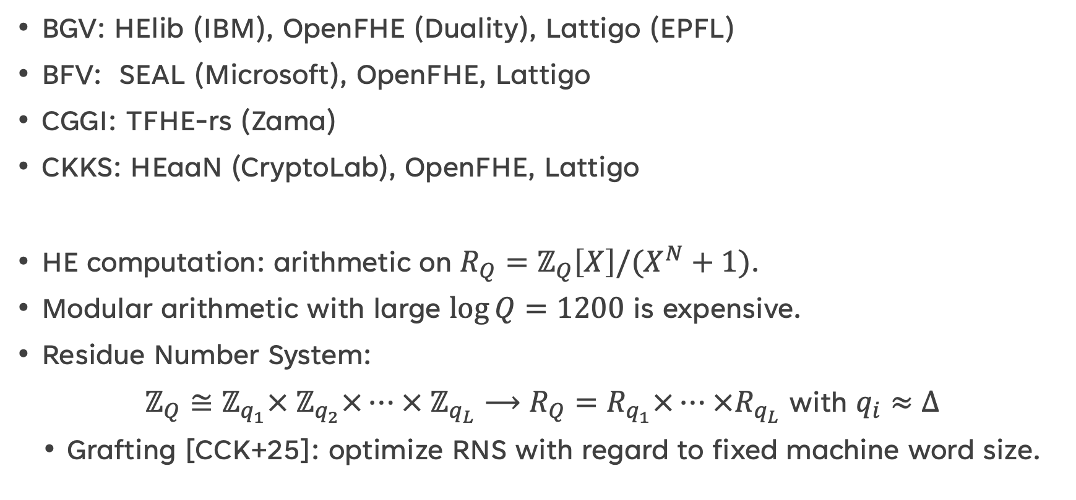
Implementation of FHE
BGV: HElib (IBM), OpenFHE (Duality), Lattigo (EPFL)
BFV: SEAL (Microsoft), OpenFHE, Lattigo
CGGI: TFHE-rs (Zama)
CKKS: HEaaN (CryptoLab), OpenFHE, Lattigo
HE computation: arithmetic on $R_{Q}=ℤ_{Q}\left[X\right]/(X^{N}+1)$.
Modular arithmetic with large $\log{Q}=1200$ is expensive.
Residue Number System:
$ℤ_{Q}≅ℤ_{q_{1}}×{ ℤ}_{q_{2}}×⋯ × ℤ_{q_{L}}⟶R_{Q}=R_{q_{1}}×⋯ ×R_{q_{L}}$ with $q_{i}≈Δ$
Grafting [CCK+25]: optimize RNS with regard to fixed machine word size.
[CCK+25] J.H. Cheon, et al., Grafting: Decoupled Scale Factor and Modulus, ACM CCS 2025.

Slide 22
SUMMARY
FHE is secure under (R)LWE assumption (and circular security assumption).
CKKS scheme supports approximate arithmetic on real/complex numbers with SIMD operation.
CKKS supports addition, multiplication, and automorphism (rotation/conjugation) which are based on key-switching operation.
Bootstrapping refresh the ciphertext by “recrypt and then decrypt homomorphically”.

Slide 23
Future work
HE for Private AI
Linear algebra: matrix-vector or matrix-matrix multiplication
Non-linear function: activation function (ReLU), Softmax (Transformer)
Application to Face Recognition, LLM inference, etc.
Pri
Multi-party homomorphic encryption:
Threshold HE: share the secret key & joint decryption
Multi-key HE: joint evaluation for ciphertexts under different secret keys
Hardware acceleration for NTT/key-switching/bootstrapping.

Slide 24
Thank you!

