Slide 1



Slide 2
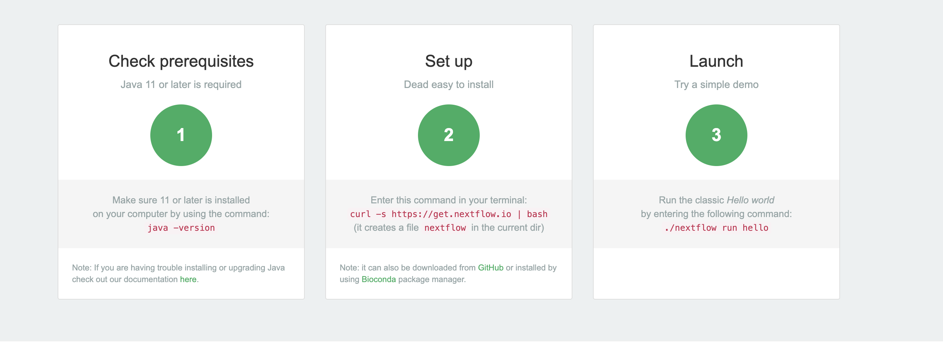
Quick Start

