Slide 1
Lisa
Sashank Gondala, 120050050 Krishna Deepak, 120050057
Bharath Kumar, 120050058
Bharadwaj, 120050056

Slide 2
Lisa
Lisa is a bot which tries to solve a variant of the Wumpus world problem
Description
The bot needs to find its way to a pre-set destination point in a given maze. We can place many barriers in its way and the bot needs to reach the destination in spite of these obstacles.

Slide 3
Task specifications
Working with various modules of Firebird
Modules include
Motion
Long distance sensor and proximity sensor
LCD
Using color sensor
We used obstacles of different colors
Interfacing color sensor with Firebird

Slide 4
Project Plan
Connecting the color sensor to Firebird
Completed within a couple of weeks
Understanding various modules of firebird
Since we used many modules in firebird, it was critical to understand the code before using them
Testing the code by placing on actual maze
Finetuning various parameters

Slide 5
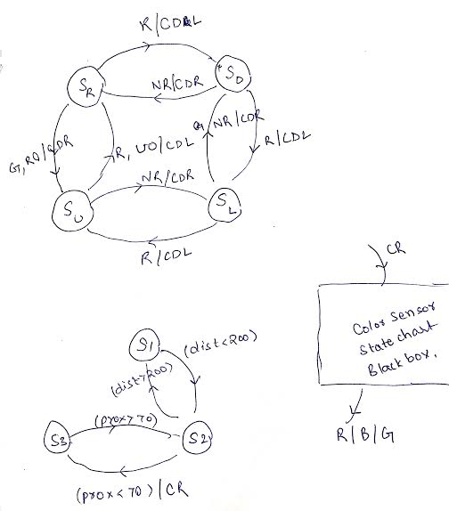
State chart
State Description
s_{R} - Firebird is moving in right direction
s_{D} - Firebird is moving in down dir.
s_{U} - Firebird is moving in up direction
s_{L} - Firebird is moving in left direction
s1 - Distance to obstacle > 200
s2 - Distance to obstacle > 70 & < 200
s3 - Distance to obstacle < 70

Slide 6
Description of State chart
The color sensor’s state chart is assumed to be a black box and further the input it takes is the signal CR, to which it gives outputs as R(red), G(green), B(blue)
For our project, we only need two colors - R(red), NR(Not red) = B || G
Signals
dist - distance value of the long distance sensor
prox - distance value returned by the proximity sensor
When the obstacle is near (prox < 70), signal CR is emitted triggering the color sensor
Color sensor emits R/NR which would trigger the other state diagram
CDL - change direction of firebird by turning left
CDR - change direction of firebird by turning right
RO - signal indicating that the right distance to be covered is over
UO - signal indicating that the up distance to be covered is over

Slide 7
Challenges
Speed with which the bot moves
Problem: It takes a lot of time for color sensor to collect data
In a static setup(one where we do not move the obstacles), the bot can be made to move without any stops in the middle
We have also introduced various speed levels i.e., bot gradually reduces its speed as it reaches the obstacle before stopping in order to notice the color levels

Slide 8
Tasks completed
Color sensor - tcs3200
We faced problems interfacing color sensor with firebird as the existing documentation had some bugs in it
Output of color sensor - Calibration
The output seemed to be biased towards the red color especially when there is more light in the environment (In such cases, even when we show blue/green color the sensor identifies it as red)
Because of this, we had to only use 2 colors - red and not red(green, blue)

Slide 9
Tasks completed
Firebird related
Adjusting speed of firebird
Using the values of long distance sensor and the proximity sensor, we identify the exact location of obstacle and reach it as quickly as possible
Moving firebird
Faced problems as firebird doesn’t move the distance/angle as mentioned
Had to manually calibrate these distances/angles

Slide 10
Test cases
Working on a 2x4 maze with a lot of obstacles
Setup
Start point - (0, 0); Destination - (1, 3)
Lot of obstacles placed => many turns => distance measurements inaccurate
Result
Leads to the bot stopping somewhere in the final destination block (exact position changes each time and depends on number of obstacles it faces)
Happens because at times firebird turns more than 90 deg and at times less adding to the inaccuracy of distance measurements

Slide 11
Performance review
Main observable delay: color sensor collecting intensity values
Color sensor first collects red intensity using red filter, then does the same for other two colors
Takes almost 3-4 seconds to collect intensity values
Other sensor measurements such as proximity sensor and long distance sensor do not induce any computation/communication delay

Slide 12
Re-usability features
We have written the code in a modular fashion
For example, we have written separate functions for tasks such as color sensor calibration, sensor measurements making this part of the code re-usable
We used functions effectively to reduce the clutter in main code making it easy to understand

Slide 13
Enhancements
Accurate distance measurements
Most of the problems we faced arose because we do not have an accurate distance measurement and the firebird doesn’t turn the amount we want it to
Would be nice to find out a way of having this data
At times the firebird goes out of the arena if the wrong color is shown to it
Could be avoided if we have had an exact distance measurement

