Slide 1

Mystery Match!
ICT 8 Lesson 1.3

Slide 2

Instructions
Match the computer part with its picture or definition
1
Drag the text boxes to the correct blank spaces
2
Save your PPTX and upload to Teams
3

Slide 3



Input Devices
Notes:
Label each device with
Mouse
Microphone
Keyboard

Slide 4



Output devices
Notes:
Label each image with - Monitor - Printer - Speakers

Slide 5
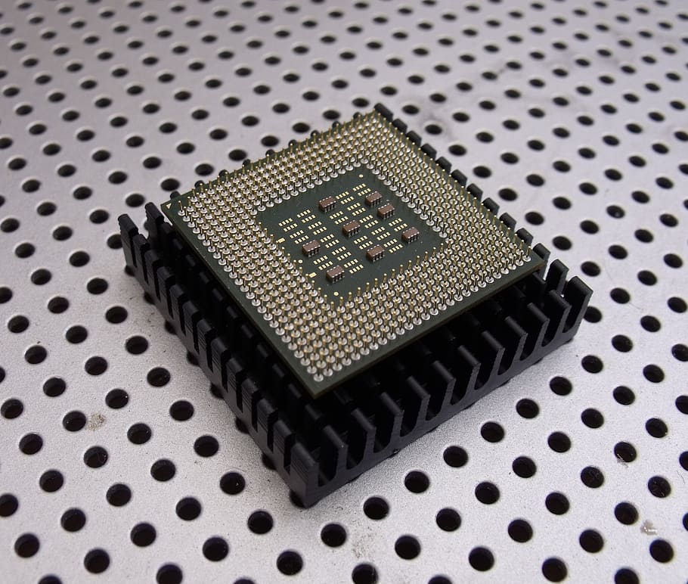
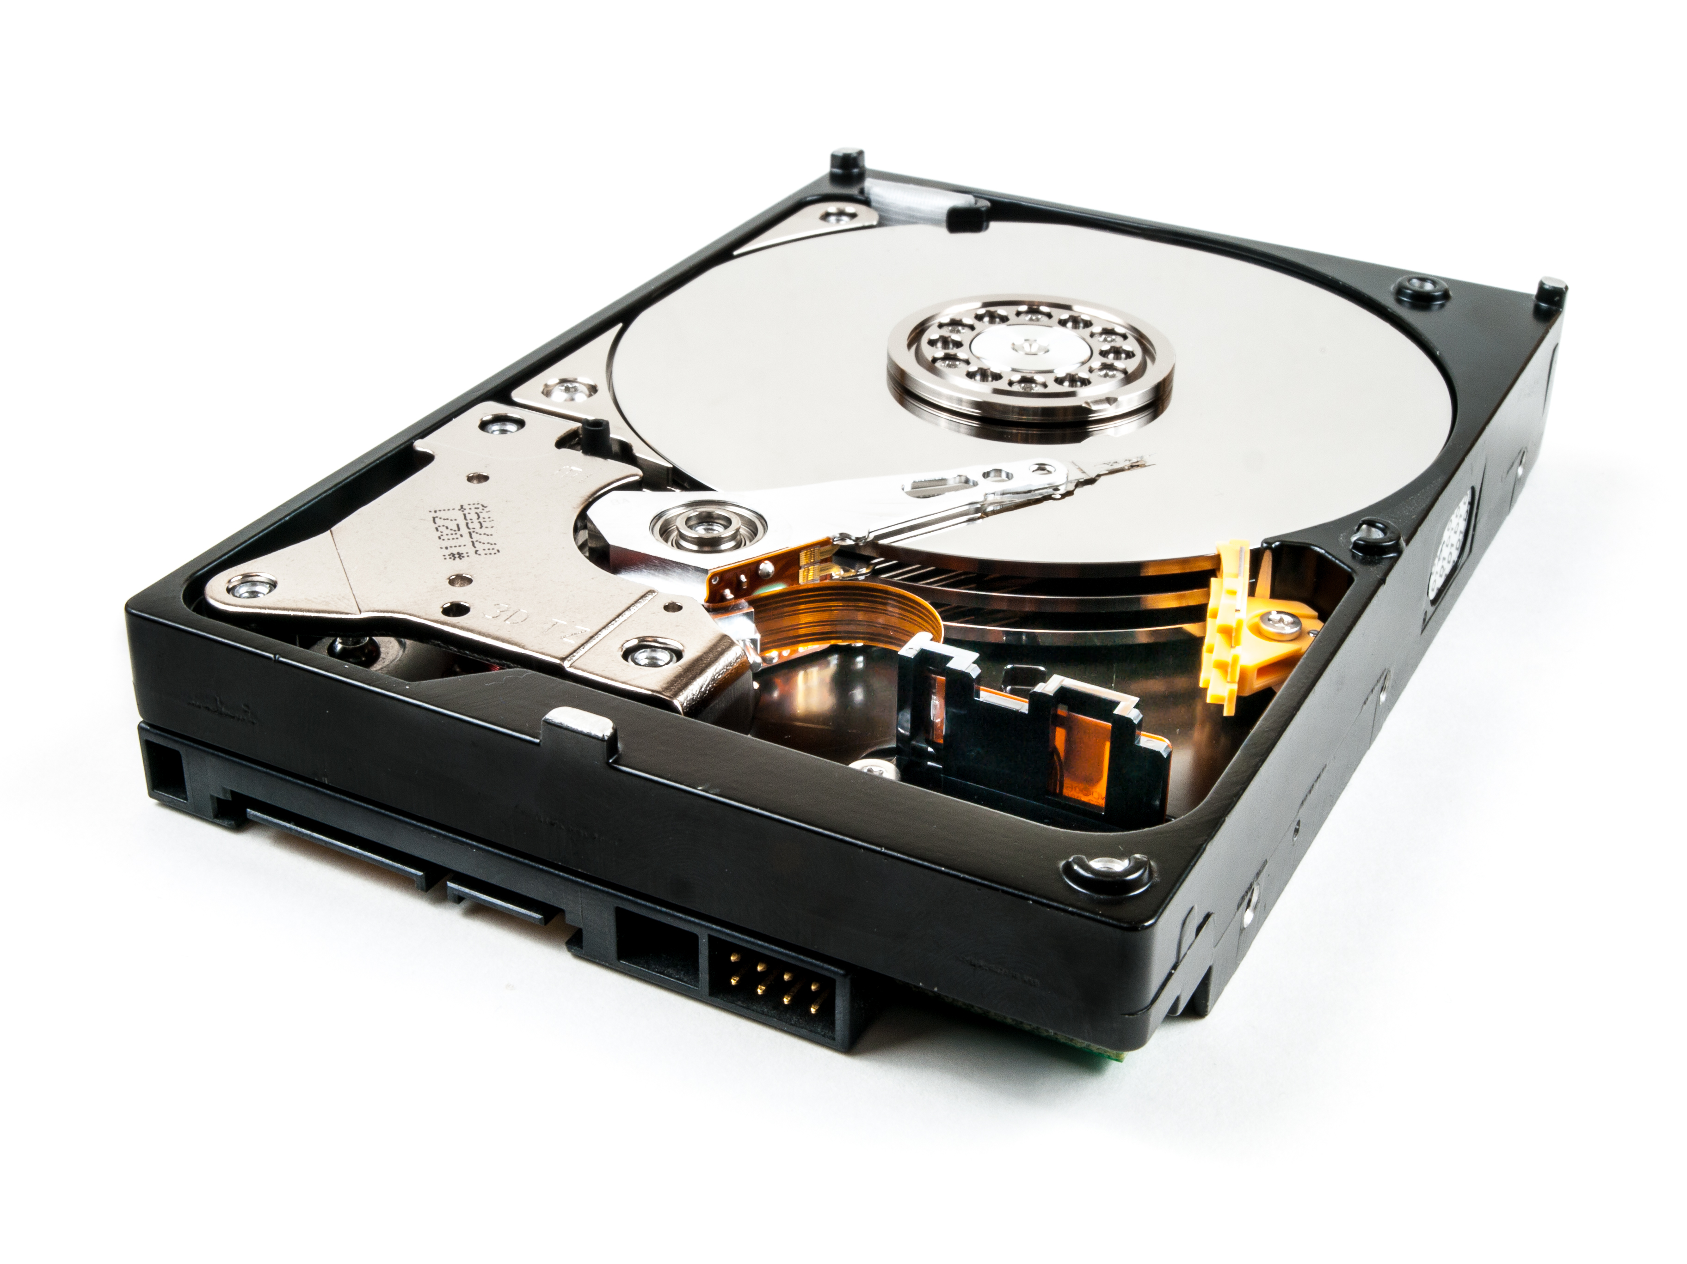
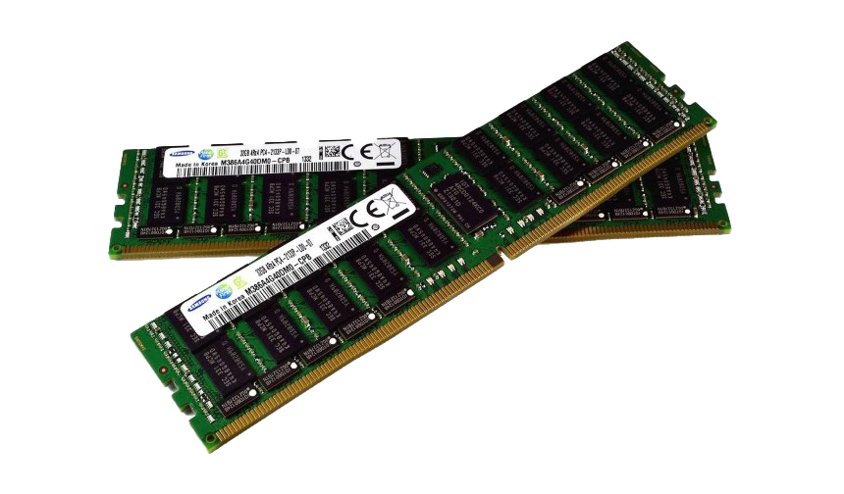
Inside the Computer
Notes:
Label the following
CPU (Processor)
RAM (Memory)
Hard Drive / Storage

Slide 6
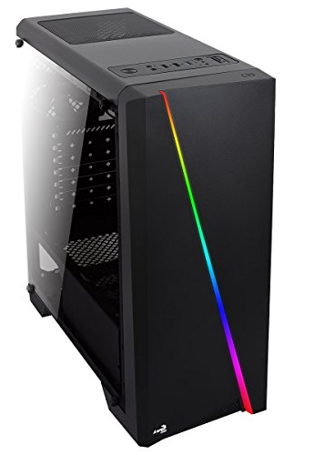

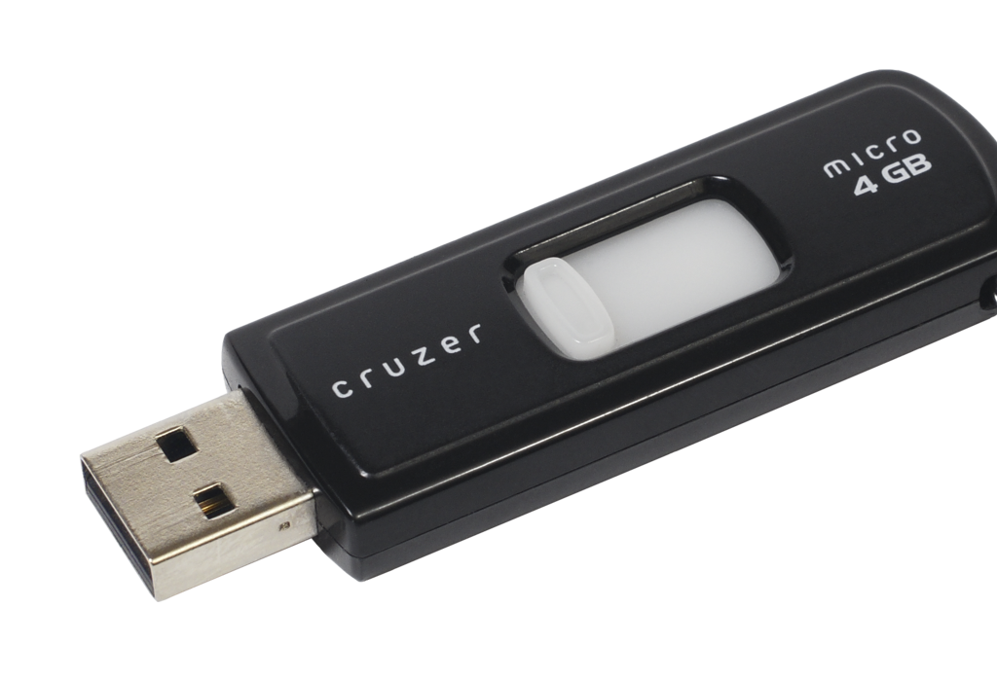
The Tower & Connections
Notes:
Label the following - Tower (Systems Unit)
USB
Ethernet/network cable

Slide 7
All Done!
Save and upload to Teams

