Slide 1
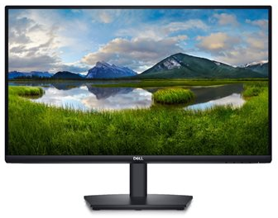




Parts of a Computer
Power Button
Audio Output
USB Port
USB-C Port

