Slide 1

Comilla University
Course No: ICT - 405
Course Title: Database Management System
HTML
Presented By :
Maksuda Sultana
Department of ICT
Roll : 12109040

Slide 2
HTML Form
Used to collect user input
Enabling users to send data to a web server
Tag : <form>......</form>
Form Element :
action : Fix server endpoint where the form data is sent
method : Defines the HTTP method

Slide 3
HTML Form (Cont…)
Input Fields
<input>: Used for text, email, passwords, etc.
<textarea>: Multiline text input.
<select>: Dropdown menu.
Buttons
<button> or <input type="submit">: Triggers the form submission.
Labels
Provide a description for the form controls and improve accessibility.

Slide 4
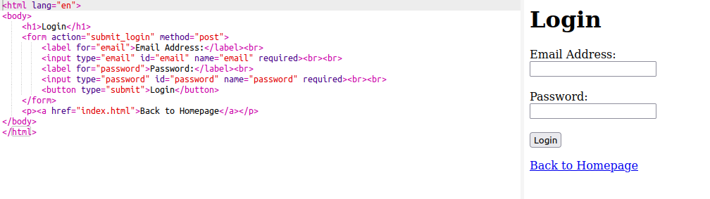
HTML Form (Cont…)
Fig 1 : HTML Form Example Code & Output for Log In Page

Slide 5
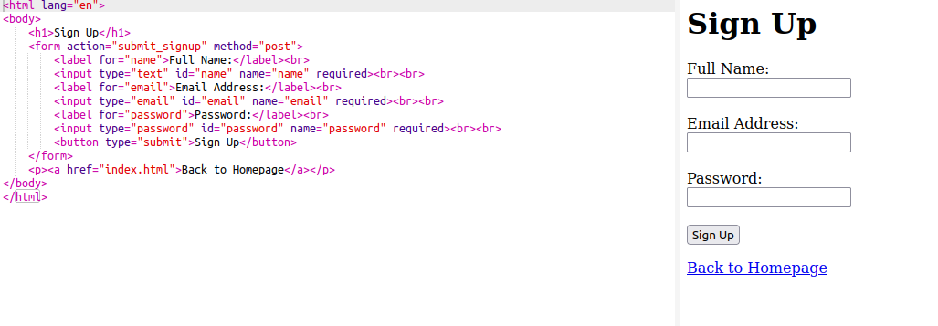
HTML Form (Cont…)
Fig 2 : HTML Form Example Code & Output for Sign Up Page

Slide 6
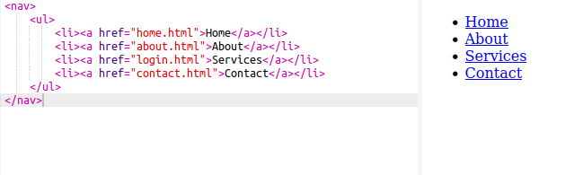
HTML Navigation
Involves creating menus or navigation bars
Tag : <nav>
Fig 3 : Example of HTML Navigation

Slide 7
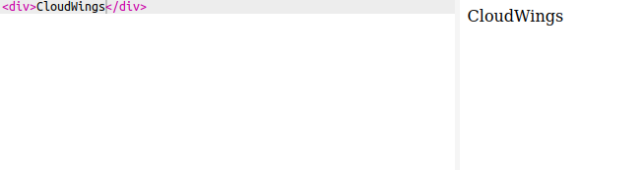
HTML Div
A versatile container
Tag : <div>
Fig 4 : Example of HTML Div

Slide 8
References
https://www.w3schools.com/html/
https://www.javatpoint.com/html-tutorial

Slide 9
Thank You
Any Questions ?

