Slide 1
Ch. 32 String Matching
국민대학교 컴퓨터공학부 최준수
Modified by 임은진

Slide 2
String Matching
Substring search
Find a pattern of length M in a text of length N.
(typically N ≫M)
text
R
E
C
U
R
S
I
V
E
A
L
G
S
T
A
C
K
Q
U
pattern
match
S
T
A
C
K

Slide 3
Brute-Force Substring Search
Naïve Algorithm 1
Check for pattern starting at each text position
R
E
C
U
R
S
I
V
E
A
L
G
S
T
A
C
K
Q
U
S
T
A
C
K
Order: O(MN)
Any improvement?
S
T
A
C
K
S
T
A
C
K
S
T
A
C
K
S
T
A
C
K

Slide 4
Brute-Force Substring Search
Naïve Algorithm 2
Check for pattern starting at each text position
int naiveStringMatch(char text[], char pattern[])
{
int patLength, txtLength;
patLength = strlen(pattern);
txtLength = strlen(text);
for(int i=0; i <= txtLength – patLength; i++)
{
for(int j=0; j < patLength; j++)
if(text[i+j] != pattern[j])
break;
if(j == patLength)
return i;
}
return -1;
}
Find just only one sample of pattern.
Modify the code to find all samples of the pattern.

Slide 5
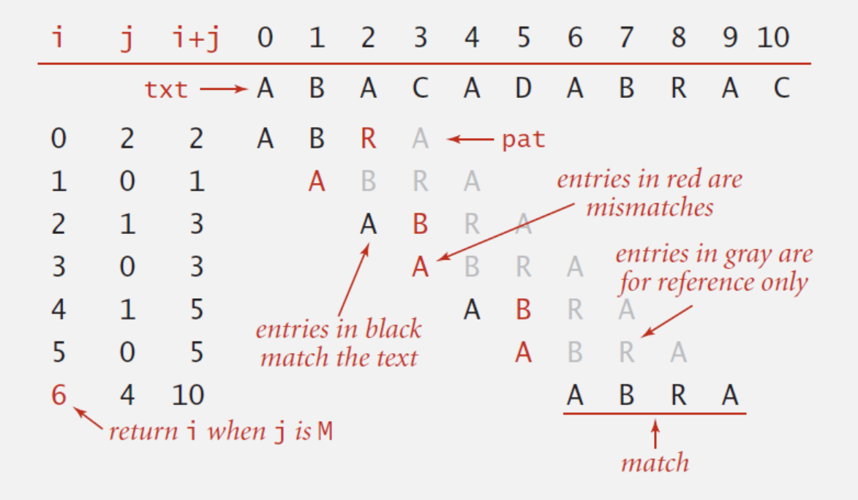
Brute-Force Substring Search
Naïve Algorithm 2
Check for pattern starting at each text position

Slide 6
Brute-Force Substring Search
Naïve Algorithm 2
Naïve algorithm can be slow if text and pattern are repetitive
A
A
A
A
A
A
A
A
A
A
A
A
A
A
A
A
B
A
A
A
A
B
Still order: O(MN)
Any improvement?
A
A
A
A
B
A
A
A
A
B
A
A
A
A
B
A
A
A
A
B

Slide 7
Brute-Force Substring Search
Improvement
Develop a linear time algorithm
Avoid backup
Naïve algorithm needs backup for every mismatch
Thus naïve algorithm cannot be used when input text is a stream.
text stream
A
A
A
A
A
A
A
A
A
A
A
A
A
A
A
A
B
A
A
A
A
B
roll-back
While trying next match, the matched chars in a text must be stored in a buffer.
A
A
A
A
A
A
A
A
A
A
A
A
A
A
A
A
B
A
A
A
A
B

Slide 8
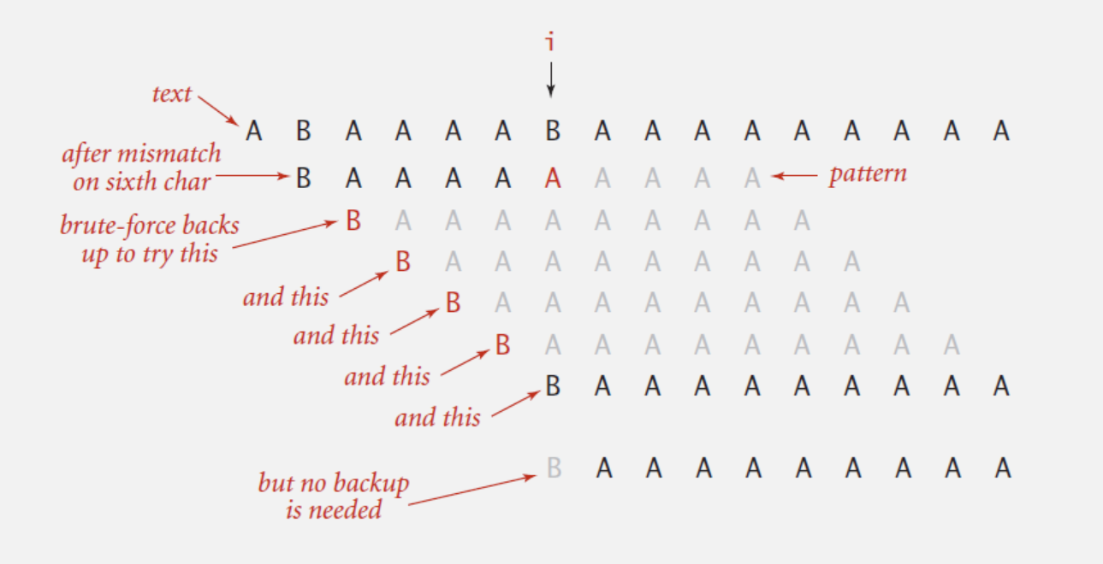
Knuth-Morris-Pratt(KMP) Algorithm
KMP algorithm
Clever method to always avoid backup problem.
avoid these backup steps
directly do this step

Slide 9
Deterministic Finite Automaton
DFA(Deterministic Finite State Automaton)
Finite number of states (including start and accept states)
Exactly one transition for each char
Accept if sequence of transitions leads to accept state
DFA for pattern ABABACA
B,C
A
A
A
A?
Start
state
A
B
A
B
A
C
A
Accept
state
0
1
2
3
4
5
6
7
C
B
B
B,C
C
B,C
B,C

Slide 10
DFA
DFA for pattern ABABACA
B,C
A
A
A
A
Start
state
A
B
A
B
A
C
A
Accept
state
0
1
2
3
4
5
6
7
C
B
B
B,C
C
B,C
B,C
DFA[][]
state
char
 | 0 | 1 | 2 | 3 | 4 | 5 | 6 | 7
A | 1 | 1 | 3 | 1 | 5 | 1 | 7 | 1
B | 0 | 2 | 0 | 4 | 0 | 4 | 0 | 2
C | 0 | 0 | 0 | 0 | 0 | 6 | 0 | 0
 | 0 | 0 | 0 | 0 | 0 | 0 | 0 | 0
if in state j reading char c:
if j is 7, halt and accept
else move to state DFA[c][j]
Example:
text: ABCABAABABABACACA
state:0120123123454567
others

Slide 11
DFA
DFA for pattern ABABACA
B,C
A
A
A
A
Start
state
A
B
A
B
A
C
A
Accept
state
0
1
2
3
4
5
6
7
C
B
B
B,C
C
Simplified Diagram: remove transitions to state 0
A
A
A
A
Start
state
A
B
A
B
A
C
A
Accept
state
0
1
2
3
4
5
6
7
B
B

Slide 12
Algorithm with DFA
Difference from naïve algorithm
Precomputation of DFA[][] from pattern
Text pointer i never decrements (no backup)
// patLength = strlen(pattern);
int DFAmatching(char text[])
{
int i, j, txtLength;
txtLength = strlen(text);
for(i=0, j=0; i <= txtLength && j < patLength; i++)
j = DFA[text[i]][j]; // text[i] to be modified
if(j == patLength)
return i - patLength;
else
return -1;
}
Order: O(N)
simulation of DFA on text with no backup
How to build DFA efficiently?

Slide 13
Algorithm with DFA
DFA for pattern ABABACA
A
A
A
A
Start
state
A
B
A
B
A
C
A
Accept
state
0
1
2
3
4
5
6
7
B
B
Start
state
Accept
state
state
0
1
2
0
1
2
3
1
2
3
4
5
4
5
6
7
text
A
B
C
A
B
A
A
B
A
A
B
B
A
A
B
B
A
A
C
C
A
A
C
A
return 8

Slide 14
Interpretation of DFA
The state of DFA represents
the number of characters in pattern that have been matched
State 5
A
A
A
A
A
B
A
B
A
C
A
0
1
2
3
4
5
6
7
B
B
text
B
C
B
A
A
B
A
B
A
A
B
A
Suffix of text[8]
pattern
A
B
A
B
A
C
A
Prefix of pattern[]

Slide 15
Prefix/Suffix
Prefix / Suffix of a Text
bananada
Prefix | Suffix
bananada | bananada
bananada | bananada
bananada | bananada
bananada | bananada
bananada | bananada
bananada | bananada
bananada | bananada
bananada | bananada
bananada | bananada
NULL string

Slide 16
DFA Construction
DFA Construction:
Suppose that all transitions from state 0 to state j-1 are already computed
Match transition:
If in state j and next char c == pattern[j], then transit to state j+1.
Pattern: ABABACA
State 5
A
A
A
A
B
A
B
A
C
0
1
2
3
4
5
6
7
B

Slide 17
DFA Construction
DFA Construction:
Mismatch transition:
If in state j and next char c != pattern[j], then which state to transit?
Pattern: ABABACA
State 5
A
?
A
A
A
B
A
B
A
C
0
1
2
3
4
5
6
7
B
?

Slide 18
DFA Construction
Matching start here
mismatch
text
B
C
B
A
A
B
A
B
A
A
B
A
pattern
A
B
A
B
A
C
A
roll-back
Roll back: Next matching start here from state 0
text
B
C
B
A
A
B
A
B
A
A
B
A
The same as pattern[1] ~ pattern[j-1]
Roll-back and transit to some state X by matching
pattern[1] ~ pattern[j-1] from state 0 on DFA.
Transit to the next state DFA[′A′][X] for the mismatched char ′A′.

Slide 19
DFA Construction
DFA Construction:
Mismatch transition:
If in state j and next char c != pattern[j], then the last j-1 characters of input text are pattern[1] ~ pattern[j-1], followed by c.
Compute DFA[c][j]:
Simulate pattern[1] ~ pattern[j-1] on DFA from state 0 and let X be the current state
Then DFA[c][j] = DFA[c][X]

Slide 20
DFA Construction
DFA Construction:
Mismatch transition:
DFA[c][j] = DFA[c][X]
DFA[′A′][5] =
DFA[′B′][5] =
DFA[′A′][3] =
1
DFA[′B′][3] =
4
Pattern: ABABACA
State 5
j
A
?
A
A
A
B
A
B
A
C
1
2
3
4
5
6
7
0
3
X=3
B
Simulation of “BABA” in ABABACA
?

Slide 21
DFA Construction
DFA Construction:
Mismatch transition:
If in state j and next char c != pattern[j], then the last j-1 characters of input text are pattern[1] ~ pattern[j-1], followed by c.
To compute DFA[c][j]:
Simulate pattern[1] ~ pattern[j-1] on DFA (still under construction) and let the current state X.
take a transition c from state X.
Running time : require j steps.
But, if we maintain state X, it takes only constant time!

Slide 22
DFA Construction
DFA Construction:
Maintaining state X:
Finished computing transitions from state j.
Now, move to the next state j+1.
Then what the new state(X′) of X be?
State 6
Pattern: ABABACA
j+1
A
A
A
A
B
A
B
A
C
A
1
2
3
4
5
6
7
0
3
B
X=3
Simulation of “BABA” in ABABACA
Simulation requires j+1 steps
But, X′ = DFA[′C′][X]
X′ = ?
Simulation of “BABAC” in ABABACA
X′ = DFA[′C′][3] = 0

Slide 23
DFA Construction
DFA Construction: A Linear Time Algorithm
For each state j:
Match case: set DFA[pattern[j]][j]=j+1
Mismatch case: Copy DFA[][X] to DFA[][j]
Update X
int DFA[MAX_SIZE][MAX_SIZE]; /* initially all elements are 0 */
// int R; /* text character set size */
void constructDFA(char pattern[])
{
int patLength = strlen(pattern);
DFA[pattern[0]][0] = 1;
for(int X=0, j=1; j<patLength; j++)
{
for(int c=0; c<R; c++) // copy mismatch cases
DFA[c][j] = DFA[c][X];
DFA[pattern[j]][j] = j+1; // copy match case
X = DFA[pattern[j]][X]; // update X
}
}

Slide 24
DFA Construction
DFA Construction: Example
DFA[][]
state
char
 | 0 | 1 | 2 | 3 | 4 | 5 | 6 | 7
A
B
C
0123456
Pattern: ABABACA
others
0
1
2
3
4
5
6
7

Slide 25
DFA Construction
DFA Construction: Example
DFA[][]
j start from 1
state
char
 | 0 | 1 | 2 | 3 | 4 | 5 | 6 | 7
A | 0
B | 0
C | 0
 | 0
0123456
Pattern: ABABACA
1
1
1
3
1
3
5
1
7
1
1
0
2
2
0
4
0
4
0
2
0
0
0
0
0
0
0
6
int patLength = strlen(pattern);
DFA[pattern[0]][0] = 1;
for(int X=0, j=1; j<patLength; j++)
{
for(int c=0; c<R; c++)
DFA[c][j] = DFA[c][X];
DFA[pattern[j]][j] = j+1;
X = DFA[pattern[j]][X];
}
others
0
0
0
0
0
0
0
X
0
0
1
2
3
0
1
1
DFA[B][0]
DFA[B][1]
DFA[C][3]
DFA[A][1]
DFA[A][0]
DFA[A][2]
DFA[A][0]

Slide 26
String Matching with DFA
String matching algorithm with DFA accesses no more than M+N chars to search for a pattern of length M in a text of length N.
DFA[][] can be constructed in time and space of order O(RM), where R is the number of characters used in a text.

Slide 27
String Matching with DFA
Questions:
Text에 나타나는 모든 pattern 을 찾을 수 있는가?
Text: AAAAAAAAA
Pattern: AAAAA
해답: 0, 1, 2, 3, 4, 5

