Slide 1
24. Single-Source Shortest Paths

Slide 2
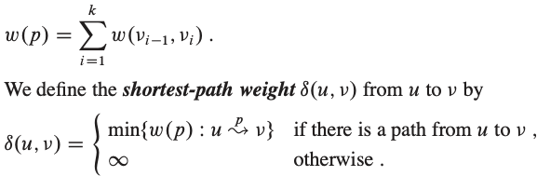
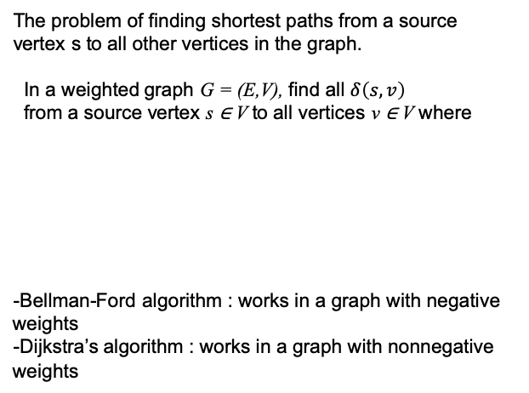
Single-Source Shortest Path Problem
The problem of finding shortest paths from a source
vertex s to all other vertices in the graph.
In a weighted graph G = (E,V), find all $δ\left(s,v\right)$
from a source vertex s ∈ V to all vertices v ∈ V where
-Bellman-Ford algorithm : works in a graph with negative weights
-Dijkstra’s algorithm : works in a graph with nonnegative weights

Slide 3
Variants of single-source shortest paths problem
- Single-destination shortest-paths problem : edge 방향을 반대로 하고 single-source shortest-paths problem을 푼다.
- Single-pair shortest-path problem : single-source shortest-paths problem을 풀면 그 안에 해가 포함되어 있다. Single-pair shortest-path problem 만 푸는 알고리즘의 worst-case running time 은 가장 좋은 single-source shortest-paths problem 의 worst-case running time 과 점근적으로 같다.
- All-pairs shortest-paths problem : 모든 vetices 에 대해 single-source shortest-paths problem을 푼다. 그러나 25장의 알고리즘들 (e.g. Floyd-Warshall algorithm) 과 같이 더 효율적인 방법도 있다.

Slide 4
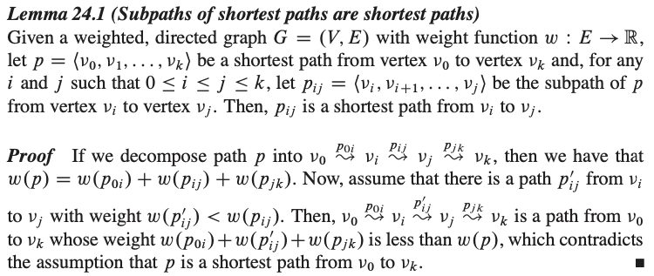
Optimal substructure of a shortest path
Thus,
Dijkstra’s algorithm : greedy algorithm
Floyd-Warshall algorithm : dynamic programming

Slide 5
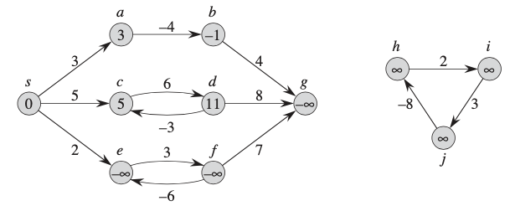
Negative-weight edges
not reachable from s
source
Graph G 에 negative-weight cycle 이 있으면 shortest-path problem 은 well-defined 가 아니다. s->e, s->f, s->g 때문
Bellman-Ford algorithm : works in a graph with negative weights, unless there is a negative cycle. (and detects it.)
Dijkstra’s algorithm : works in a graph with nonnegative weights

Slide 6
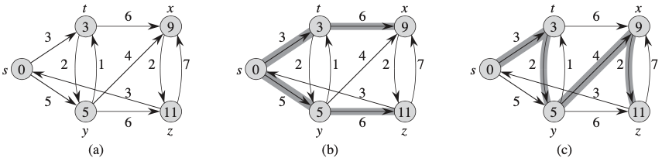
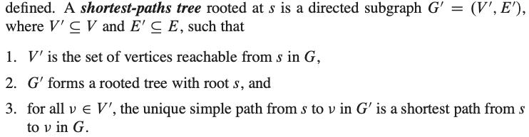






Shortest-paths tree
$$t.π=s$$
$$x.π=t$$
s$.π=nil$
$$y.π=s$$
$$z.π=y$$
predecessor subgraph defined by “$v.π$ : v 의 predecessor in shortest-paths tree” 와 같다.

Slide 7
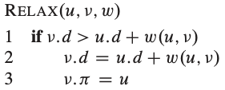
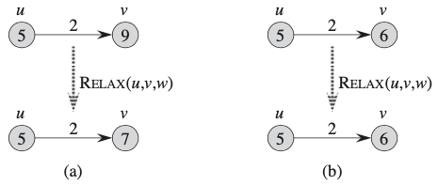
Relaxation
Update operation of v.d (shortest-path estimate)

Slide 8
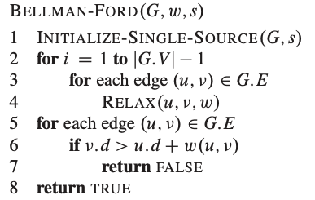
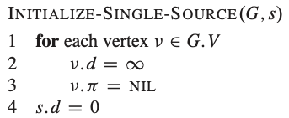
24.1 Bellman-Ford Algorithm
Single source shortest path algorithm
Unlike Dijkstra’s algorithm, edges can have negative weight.
The algorithm returns false when there is a negative cycle.
main
check for negative cycle

Slide 9
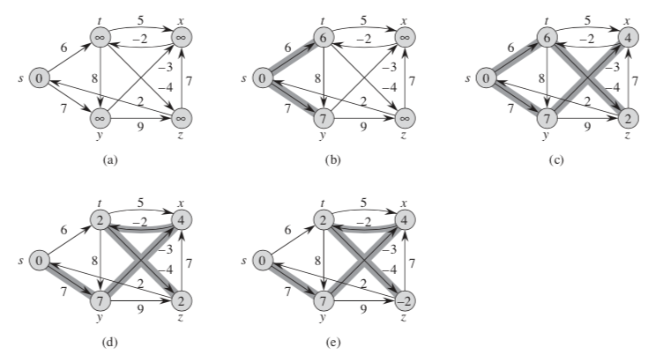
source : s
edge order :
1
i=1
i=2
9
11
4
2
5
3
7
8
10
6
i=3
i=4
= O(VE)

Slide 10
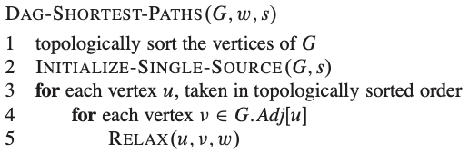
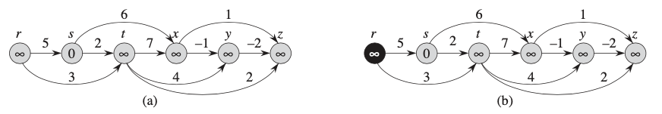
24.2 Topological sort 를 이용한 single-source shortest path
- G 가 directed acyclic graph 일 때 (cycle 이 없으므로 negative-weight cycle 도 없음) 사용 가능

Slide 11
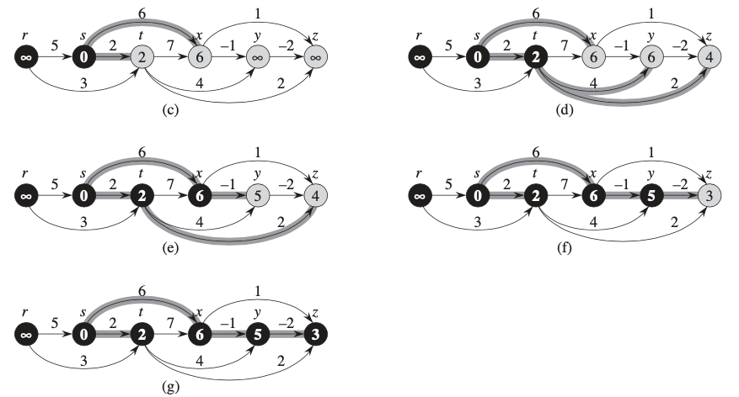




$$=Θ(E+V)$$
$$=Θ(E+V)$$
$$=Θ(V)$$
$$=Θ(E)$$

Slide 12
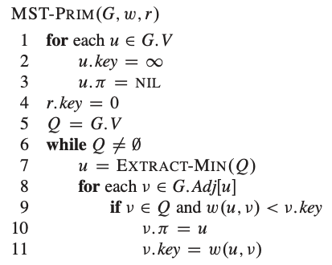
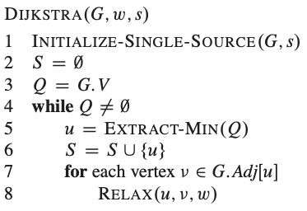
24.3 Dijkstra’s Algorithm
- used when G has no negative edges.
- Greedy algorithm
: BUILD_MIN_HEAP( ) : O(V)
← greedy choice
: V x O(lg V)
: DECREASE_KEY( ) : E x O(lg V)
priority queue 가 binary min heap 으로 구현된 경우 running time (refer to chapter 5) = O( (V+E)lg V)

Slide 13
