Slide 1
27. Multithreaded Algorithms

Slide 2
Multiprocessors
Shared Memory multiprocessor model
Distributed Memory multiprocessor model

Slide 3
Thread : Serial process
Static threading
Dynamic threading

Slide 4
Dynamic multithreaded programming
Parallel loops
Nested parallelism

Slide 5

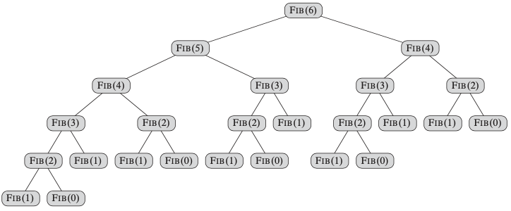
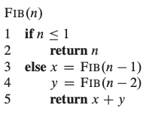
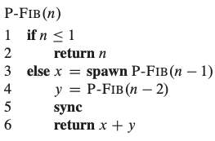
27.1 The Basics of dynamic multithreading
Computing Fibonacci numbers

Slide 6
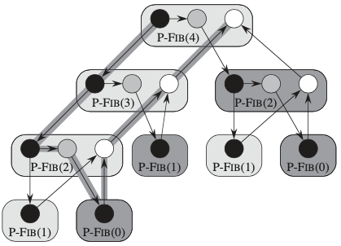
computation dag
call spawn
edges represent dependency
- down : spawn/call
- up : return
- horizontal : continuation

Slide 7
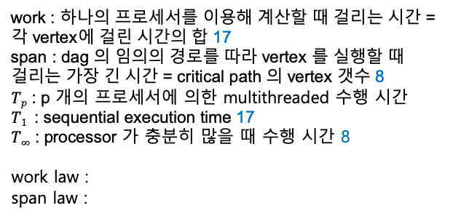
Performance
work : 하나의 프로세서를 이용해 계산할 때 걸리는 시간 = 각 vertex에 걸린 시간의 합 17
span : dag 의 임의의 경로를 따라 vertex 를 실행할 때 걸리는 가장 긴 시간 = critical path 의 vertex 갯수 8
$Tp$ : p 개의 프로세서에 의한 multithreaded 수행 시간
$T1$ : sequential execution time 17
$T∞$ : processor 가 충분히 많을 때 수행 시간 8
work law :
span law :

Slide 8
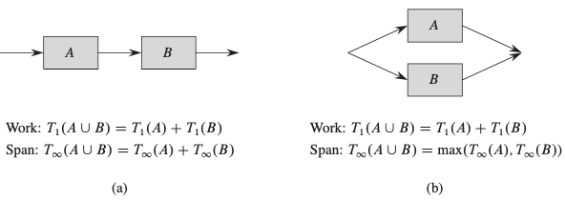
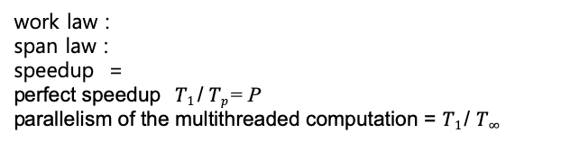
Speedup
work law :
span law :
speedup =
perfect speedup $T1$/ $Tp$= P
parallelism of the multithreaded computation = $T1$/ $T∞$

Slide 9

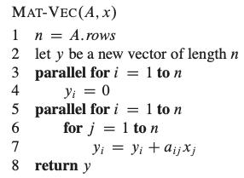
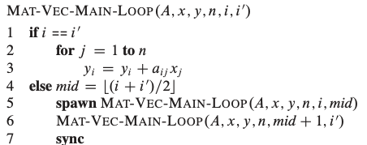
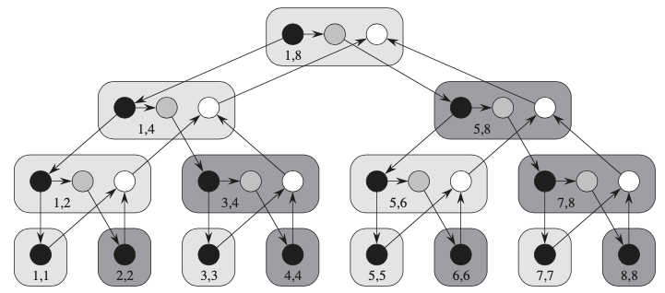


Parallel for loop
$$=Θ(n)$$
parallelism =

Slide 10
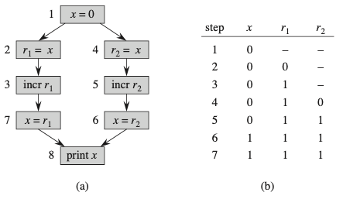
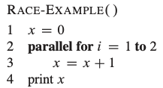
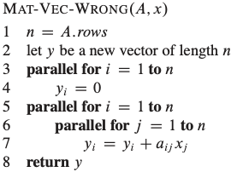
Race conditions

Slide 11
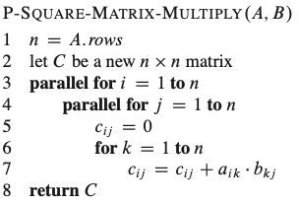

27.2 Multithreaded matrix multiplication
parallelism :
$$T1(n)= Θ(n3)$$

Slide 12
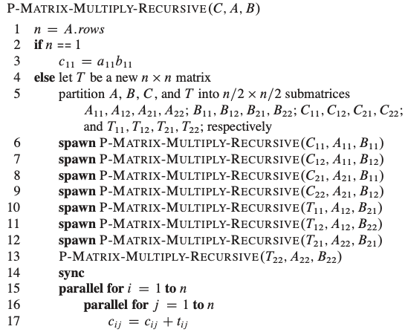
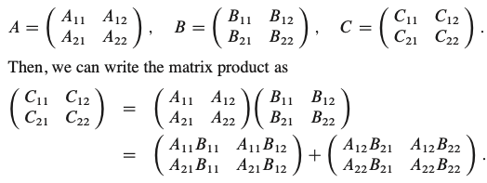

Slide 13


Slide 14
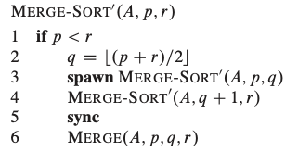


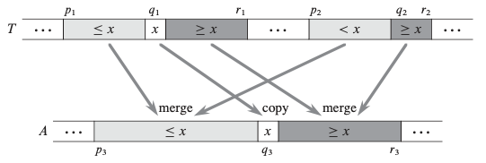
27.3 Multithreaded mergesort

Slide 15
