Slide 1
Asymptotic Notation (점근적 표기)
to describe growth of functions
and to compare functions

Slide 2
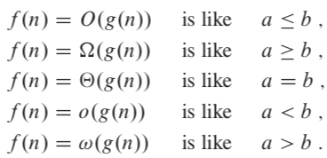
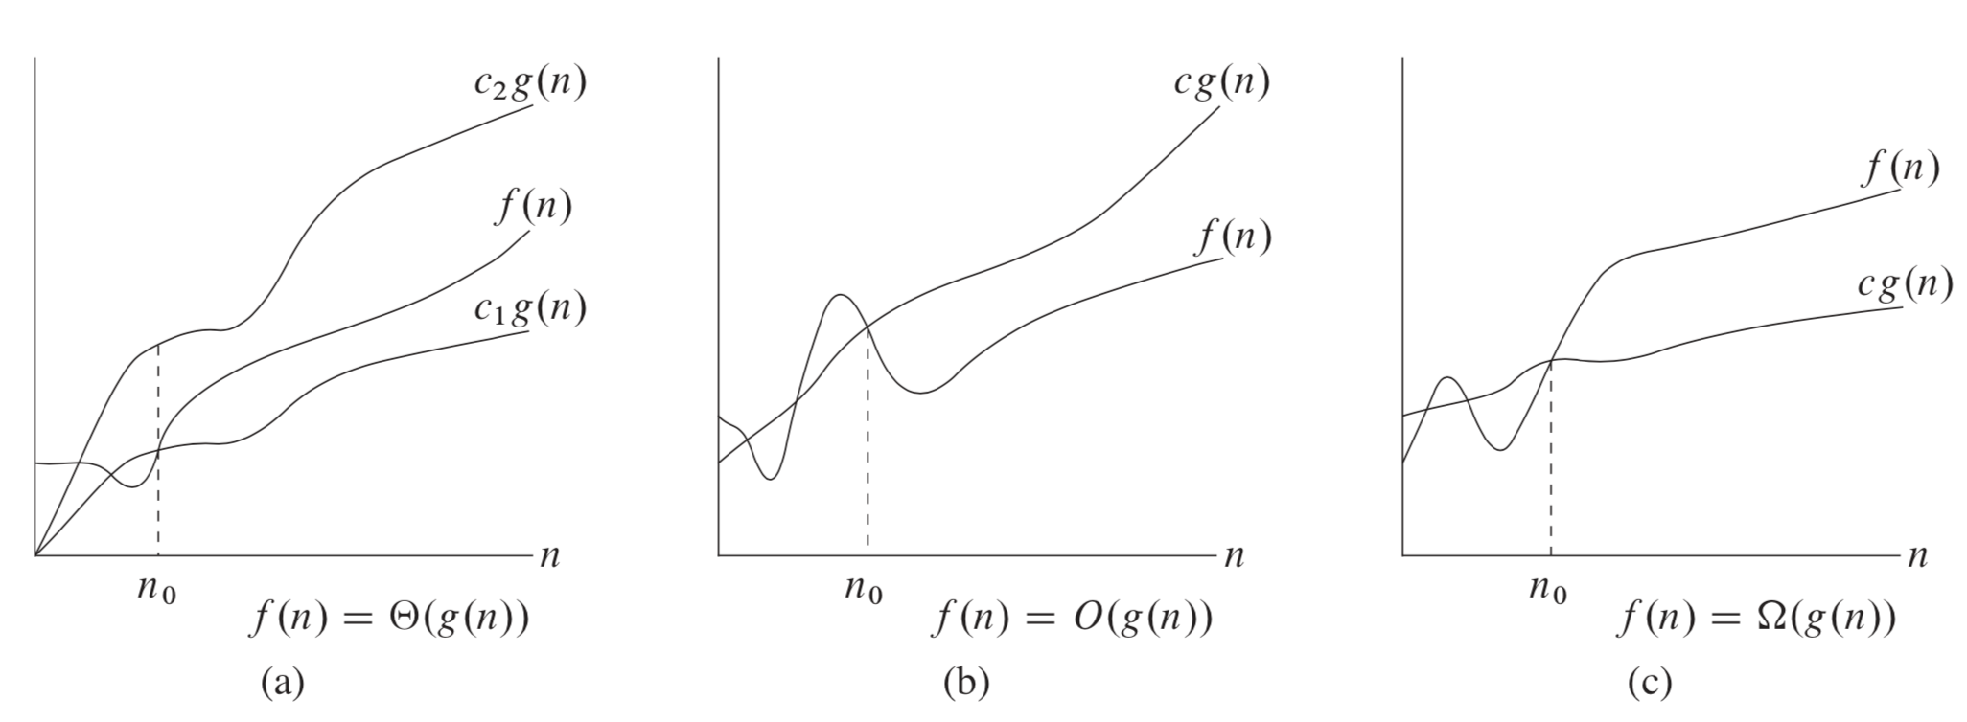
Asymptotic notations
함수들의 독립변수가 아주 커졌을 때
함수값의 크기를 비교하는데 사용

Slide 3
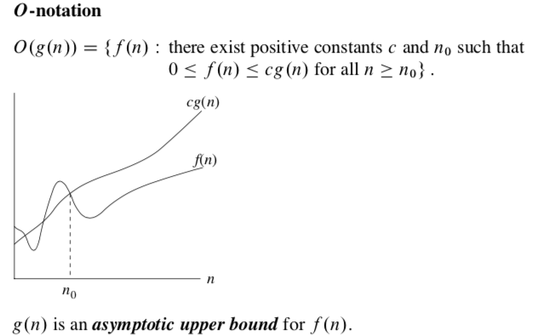

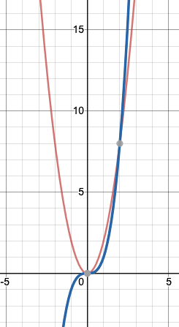
f(n) = 2n²
g(n)= n³

Slide 4
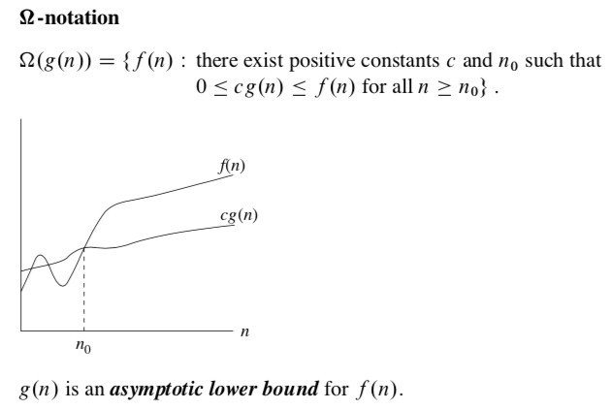

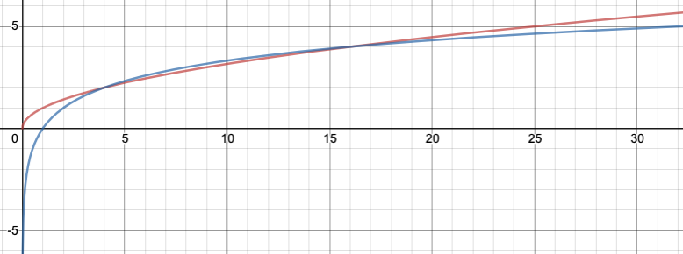

f(n) =$√n$
g(n)= lg n

Slide 5
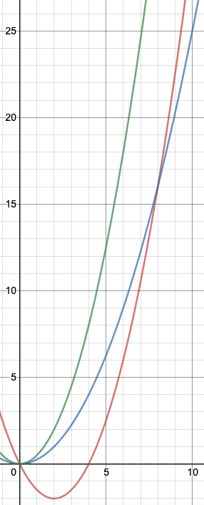
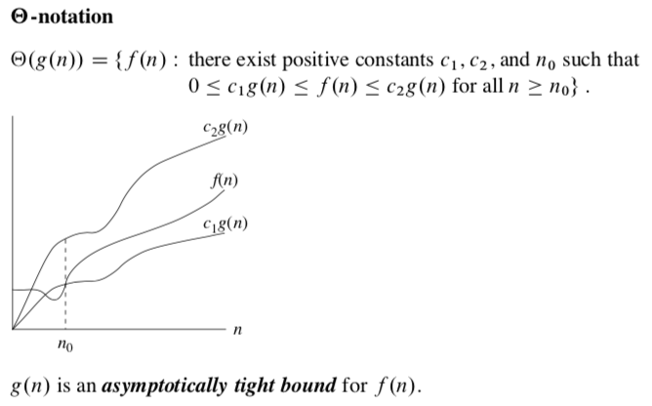

c₁ g(n)= ¼ n²
c₂ g(n)= ½ n²
f(n) = n² /2 -2n

Slide 6


Slide 7
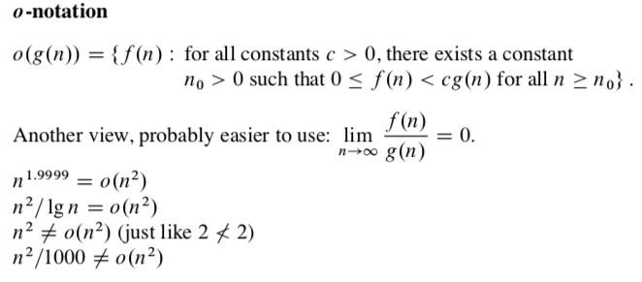

Slide 8
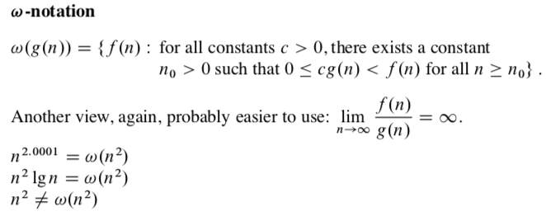

Slide 9
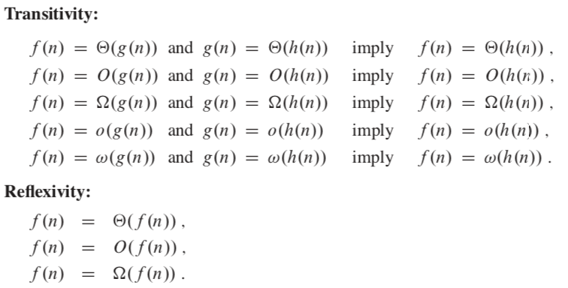
Comparing functions

Slide 10
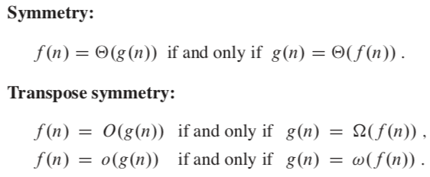

Slide 11
Unlike real numbers, not all functions are asymptotically comparable.

Slide 12





Standard Notations and Common Functions
Floor function (내림) and Ceiling function (올림)
modulo 연산
d차 다항식
for all real constants a and b such that a> 1 →

Slide 13





for all real x,
when
for all x

Slide 14
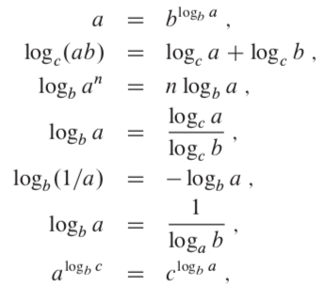
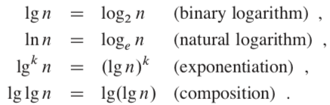




Logarithms
when |x| < 1
for x > -1
→ →

Slide 15

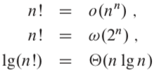
Factorials
Stirling’s approximation :
→

Slide 16

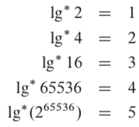
The iterated logarithm function
lg^{(i)} n = lg ( lg ( lg … n … ))) vs. lg^{i} n = lg n x lg n x … x lg n
VERY slooooooowly growing function

Slide 17
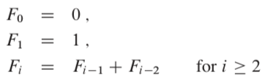
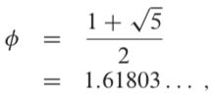
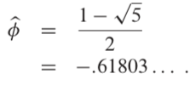



Fibonacci numbers 는 지수함수적으로 증가한다.
의 해
→

