Slide 1
25. All-Pairs Shortest Paths

Slide 2
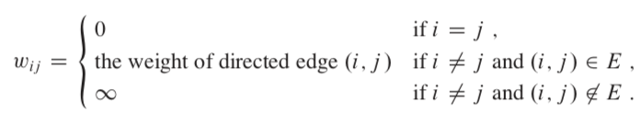
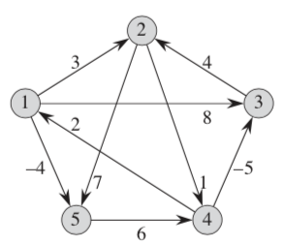
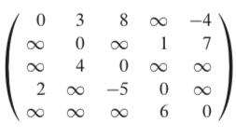
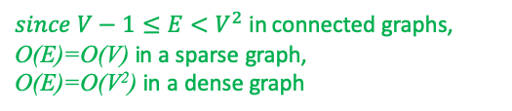
Weight Matrix representation
Representation of weight matrix W in G = (V, E)
W=
$since V−1≤E<V^{2}$ in connected graphs,
O(E)=O(V) in a sparse graph,
O(E)=O(V²) in a dense graph

Slide 3
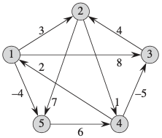
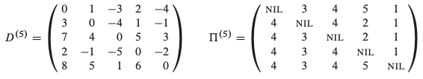
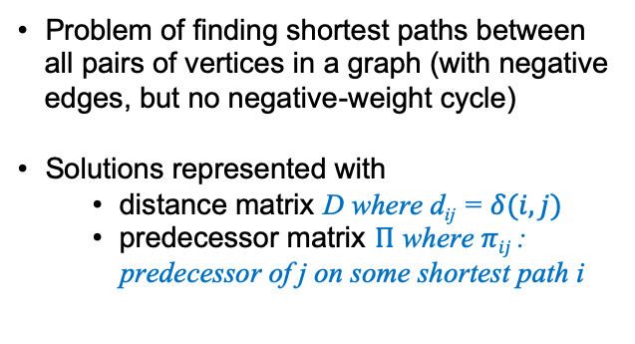
All-Pairs Shortest Paths
Problem of finding shortest paths between all pairs of vertices in a graph (with negative edges, but no negative-weight cycle)
Solutions represented with
distance matrix D where d_{ij} = $δ(i,j)$
predecessor matrix $Π$ where $πij$ : predecessor of j on some shortest path i
iteration

Slide 4
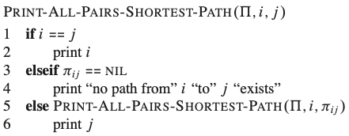
5,2
5,4,3,2

Slide 5
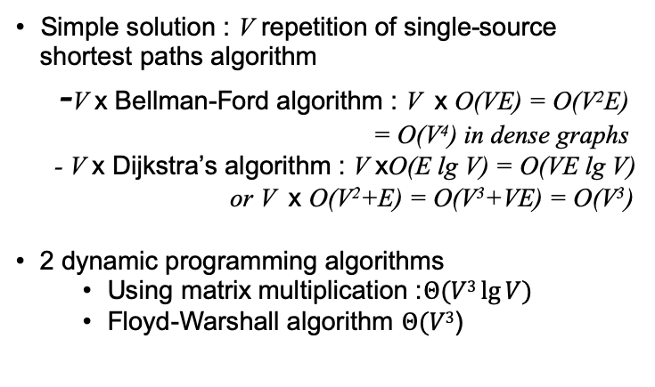
All-Pairs Shortest Paths
Simple solution : V repetition of single-source shortest paths algorithm
-V x Bellman-Ford algorithm : V x O(VE) = O(V²E)
= O(V⁴) in dense graphs
- V x Dijkstra’s algorithm : V xO(E lg V) = O(VE lg V)
or V x O(V²+E) = O(V³+VE) = O(V³)
2 dynamic programming algorithms
Using matrix multiplication :$Θ(V3\lg{V)}$
Floyd-Warshall algorithm $Θ(V3$)

Slide 6
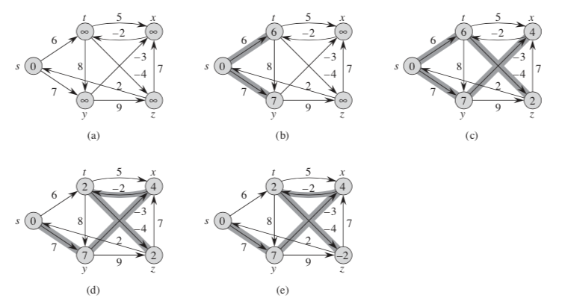
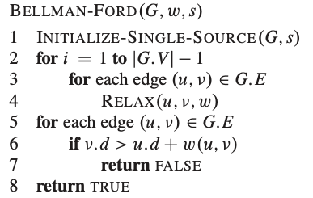
source : s
edge order :
1
i=1
i=2
9
11
4
2
5
3
7
8
10
6
i=3
i=4
= O(VE)

Slide 7
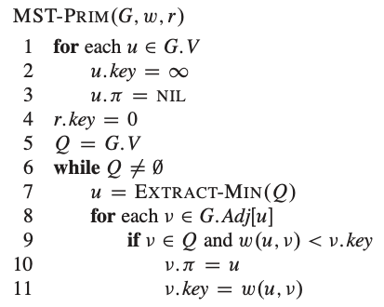
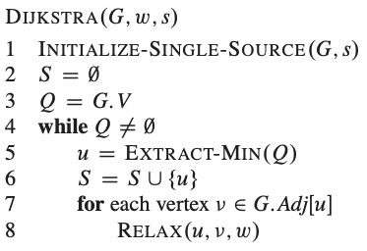
24.3 Dijkstra’s Algorithm
- used when G has no negative edges.
- Greedy algorithm
: BUILD_MIN_HEAP( ) : O(V) : O(V)
← greedy choice
: V x O(lg V) : V x O(V)
: DECREASE_KEY( ) : E x O(lg V) : E x O(1)
priority queue 가 binary min heap 으로 구현된 경우 running time (refer to chapter 5) = O( (V+E)lg V)
Q가 linear array 로 구현된 경우 running time = O( V²+E )

Slide 8

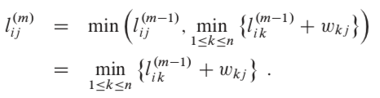
25.1 All-Pairs Shortest Paths with Matrix Multiplication
Let l_{ij}^{(m)} be the minimum weight of any path from vertex i to j that contains at most m edges.
shortest path 는$최대 n−1 edges 를 가지므로 δ(i,j)$ = l_{ij}^{(n-1)}

Slide 9
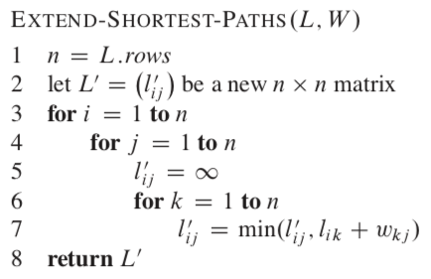
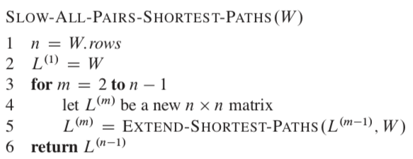
All-Pairs Shortest Paths with Matrix Multiplication : O(n⁴)

Slide 10
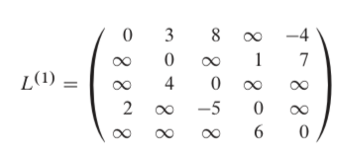
All-Pairs Shortest Paths with Matrix Multiplication : O(n⁴)

Slide 11
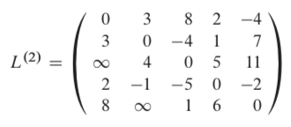
All-Pairs Shortest Paths with Matrix Multiplication : O(n⁴)
L⁽¹⁾
W

Slide 12
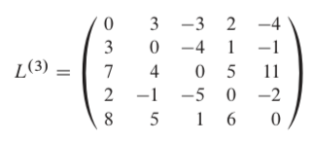
All-Pairs Shortest Paths with Matrix Multiplication : O(n⁴)
L⁽²⁾
W

Slide 13
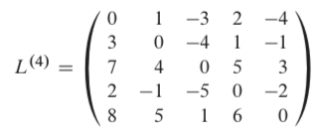
All-Pairs Shortest Paths with Matrix Multiplication : O(n⁴)
L⁽³⁾
W

Slide 14
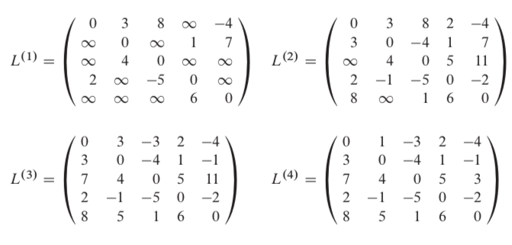
All-Pairs Shortest Paths with Matrix Multiplication : O(n⁴)
Observation : the matrix multiplication is associative.

Slide 15
All-Pairs Shortest Paths with Matrix Multiplication : O(n⁴)
L⁽⁴⁾ =L⁽²⁾ L⁽²⁾

Slide 16
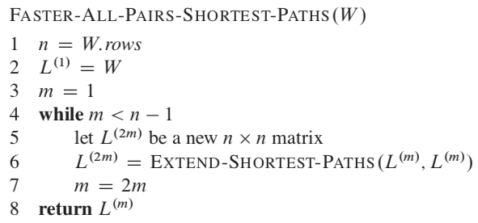
All-Pairs Shortest Paths with Matrix Multiplication : O(n³log n)

Slide 17
25.2 Floyd-Warshall algorithm
an intermediate vertex of a simple path p = {v₁, v₂, …v_{l} } is any vertex of p other than v₁ or v_{l} , that is, any vertex in the set = {v₂, …v_{l-1} }.
For any pair of vertices i,j in V, consider all paths from i to j whose intermediate vertices are all drawn from {1, 2, . . . k} and let p be a minimum-weight path from among them.

Slide 18
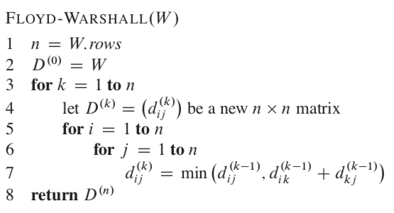


Floyd-Warshall algorithm :O(n³)

Slide 19
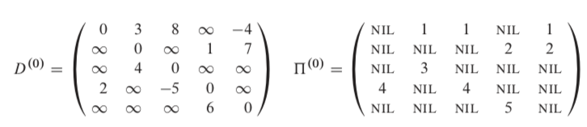
Floyd-Warshall algorithm k=0
predecessor matrix for reconstruction

Slide 20
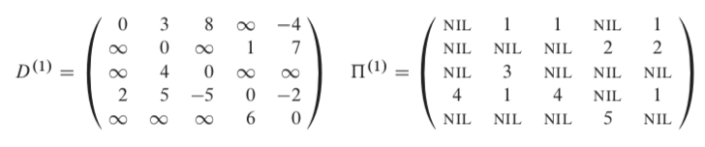
Floyd-Warshall algorithm k=1
i=4, j=2

Slide 21
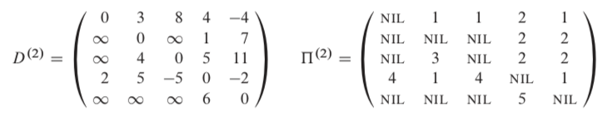
Floyd-Warshall algorithm k=2
i=3, j=4

Slide 22
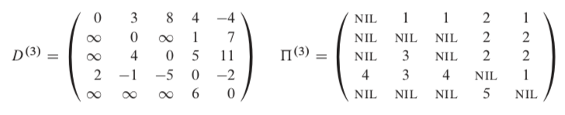
Floyd-Warshall algorithm k=3
i=4, j=2

Slide 23
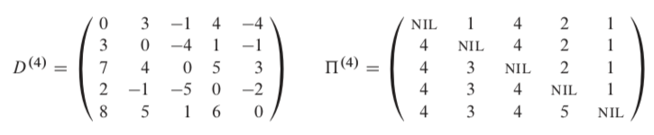
Floyd-Warshall algorithm k=4
i=5, j=2

Slide 24
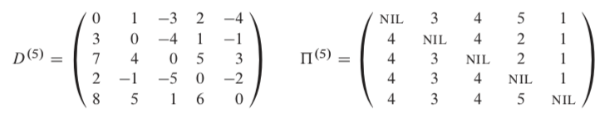
Floyd-Warshall algorithm k=5
i=1, j=3

