Slide 1
22. Graph Algorithms

Slide 2










Graphs
5
e
4
6
5
3
6
3
4
f
2
2
1
1
(a)
(b)
(a) An undirected graph (b) a directed graph.
◮ An abstract way of representing connectivity using nodes (also called vertices) and edges
◮ m edges connect some pairs of nodes
– Edges can be either directed or undirected
◮ Nodes and edges can have some auxiliary information
Graphs

Slide 3



Definitions (Appendix B.4)
An undirected graph G is a pair (V, E), where V is a finite set of points called vertices and E is a finite set of edges.
An edge e ∈ E is an unordered pair (u, v), where u, v ∈ V .
In a directed graph, the edge e is an ordered pair (u, v). An edge (u, v) is incident from vertex u and is incident to vertex v.
An undirected graph can be thought of as a directed graph.
e
u
v
$$V=\left\{u,v\right\}, E=\{\left(u,v\right)\}$$
e
u
v
$$V=\left\{u,v\right\}, E=\{\left(u,v\right)\}$$
u
v
$$V=\left\{u,v\right\}, E=\{\left(u,v\right),(v,u)\}$$

Slide 4
A path from a vertex v to a vertex u is a sequence (v₀, v₁, v₂, . . . , v_{k}) of vertices where v₀ = v, v_{k} = u, and (v_{i}, v_{i+1}) ∈ E for i = 0, 1, . . . , k − 1.
A vertex u’ is reachable from a vertex u if there is a path p from u to u’ in G.
The length of a path is defined as the number of edges in the path.
A cycle is a path where v₀ = v_{k}
An undirected graph is connected if every pair of vertices is connected by a path.
A forest is an acyclic (cycle 이 없는) graph, and a tree is a connected acyclic graph.
A graph that has weights associated with each edge is called a weighted graph.

Slide 5
Tree
s
w
r
t
x
v
u
y
◮ A connected acyclic graph
◮ Most important type of special graphs
Many problems are easier to solve on trees
◮ Alternate equivalent definitions:
A connected graph with n − 1 edges ( where n is a number of vertices)
An acyclic graph with n − 1 edges
There is exactly one path between every pair of nodes
An acyclic graph but adding any edge results in a cycle
A connected graph but removing any edge disconnects it

Slide 6
Representation of a Graph
Graphs can be represented by their adjacency matrix or adjacency list.
Adjacency matrices have a value a_{i,j} = 1 if nodes i and j share an edge; 0 otherwise. In case of a weighted graph, a_{i,j} = w_{i,j}, the weight of the edge.
The adjacency list representation of a graph G = (V, E) consists of an array Adj[1..|V|] of lists. Each list Adj[v] is a list of all vertices adjacent to v.
For a graph with n nodes, adjacency matrices take Θ(n²)
space and adjacency list takes Θ(|E|+|V|) space.

Slide 7
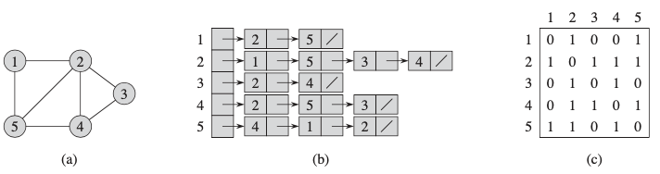
Undirected Graph
교과서에는 대부분 adjacency list 표현을 가정할 것이다.

Slide 8
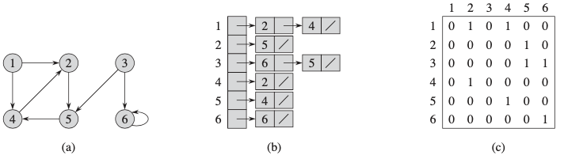
Directed Graph

Slide 9
Graph Traversal
◮ The most basic graph algorithm that visits nodes of a graph in certain order
◮ Used as a subroutine in many other algorithms
◮ 교과서 예에서 특별한 언급이 없으면 vertex 는 알파벳 순으로 처리한다.
◮ We will cover two algorithms
Breadth-First Search (BFS): uses queue
Depth-First Search (DFS): uses recursion (stack)

Slide 10
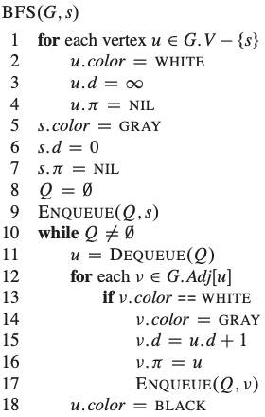
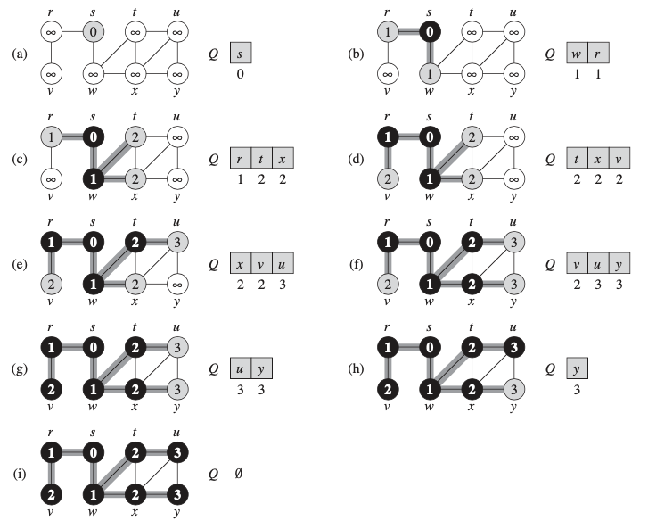

22.2 Breadth-First Search
initialization
not discovered
discovered
starting point
Finished
$$O(V+E)$$
predecessor
depth in the BFS tree

Slide 11

Breadth-first tree (BFS tree)
BFS 는 vertex s 로부터 reachable vertex v 에 대한 shortest path distance $δ\left(s,v\right)$ 를 모두 계산한다. 그 값은 v.d 이다.
s
w
r
t
x
v
u
y

Slide 12
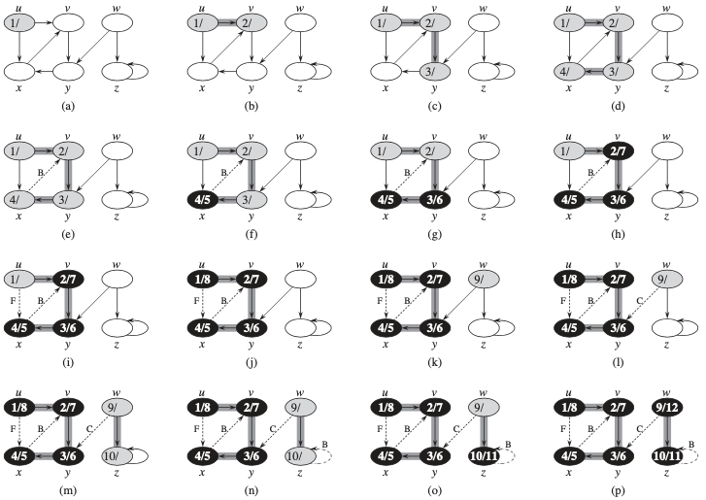
22.3 Depth-First Search

Slide 13
Depth-first forest (DFS forest)
u
w
v
y
z
x

Slide 14
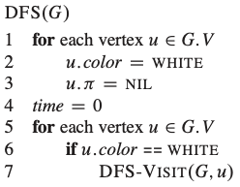
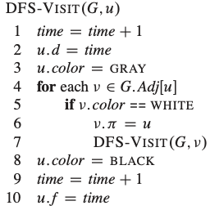
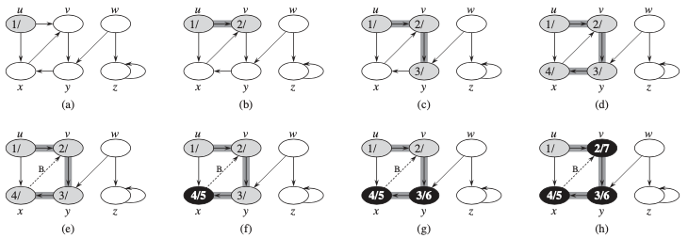

DFS algorithm
not discovered
discovered
finished(=visited)
$$O(V+E)$$

Slide 16
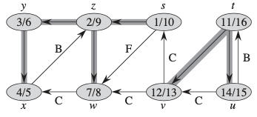
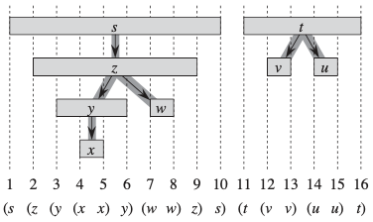
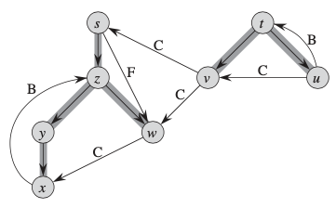
Properties of DFS
다음과 같은 timestamped directed graph 가 만들어진다.
tree edge
backward edge
forward edge
cross edge

Slide 17
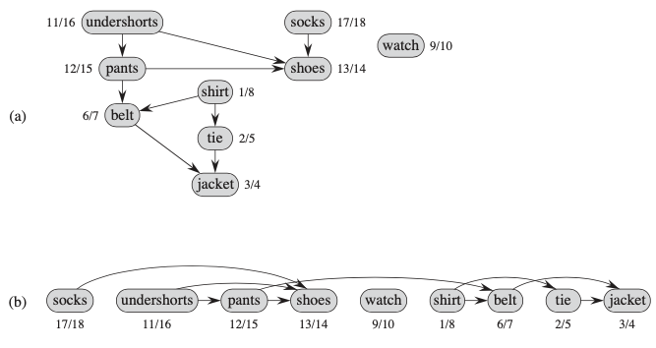
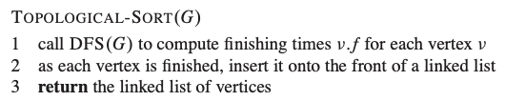
22.4 Topological Sort
dag : directed acyclic graph

Slide 18
Topological Sort : exercise
DFS starting vertices : (1) tie (2) shirt (3) pants (4) 니맘대로...
DFS starting vertices : (1) shirt->belt (2) socks (3) pants (4) 니맘대로...

Slide 19
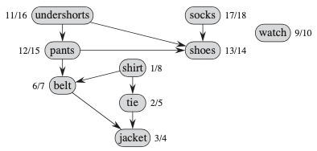
Theorem 22.12
TOPOLOGICAL-SORT algorithm produces a topological sort of the directed acyclic graph provided as its input.
Proof Suppose that DFS is run on a given dag G = {V,E} to determine finishing times for its vertices. It suffices to show that for any pair of distinct vertices u,v in V , if G contains an edge from u to v, then v.f < u.f.

Slide 20
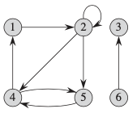
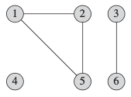
22.5 Strongly connected components
- An undirected graph is connected if every vertex is reachable from all other vertices. The connected components of a graph are the equivalence classes of vertices under the “is reachable from” relation.
{1,2,5},{3,6},{4}
- A directed graph is strongly connected if every two vertices are reachable from each other. The strongly connected components of a directed graph are the equivalence classes of vertices under the “are mutually reachable” relation.
{1,2,4,5}, {3}, {6}

Slide 21
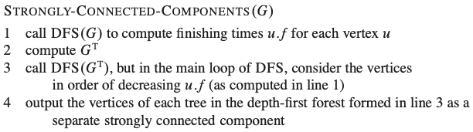
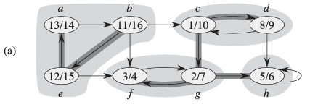
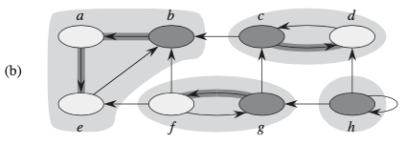
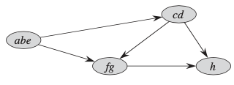
G
G^{T}

Slide 22
1. DFS(G)
b
c
g
d
e
a
f
h

Slide 23
2. compute G^{T}
All edge directions are reversed.
G
G^{T}

Slide 24
3. DFS(G^{T})
Vertices are selected in order of decreasing u.f
G^{T}
Practice) compute u.s/u/f in G^{T}

Slide 25
4. SCC
b
c
g
h
a
d
f
e
G

Slide 26
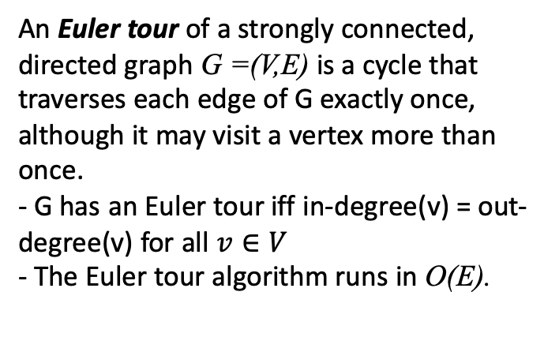
Euler tour
An Euler tour of a strongly connected, directed graph G =(V,E) is a cycle that traverses each edge of G exactly once, although it may visit a vertex more than once.
- G has an Euler tour iff in-degree(v) = out-degree(v) for all $v∈V$
- The Euler tour algorithm runs in O(E).

